Slide 1

Nearly New Nautical
Charting a course to the best boats
Report prepared by Ryan McLean, Data Scientist

Slide 2
Nearly New Nautical strives to create a premium platform for boat selling and buying
Users list their boat, providing a range of information
Boats that get lots of views drive traffic
Boats with few views create website noise that weakens the user experience

Slide 3
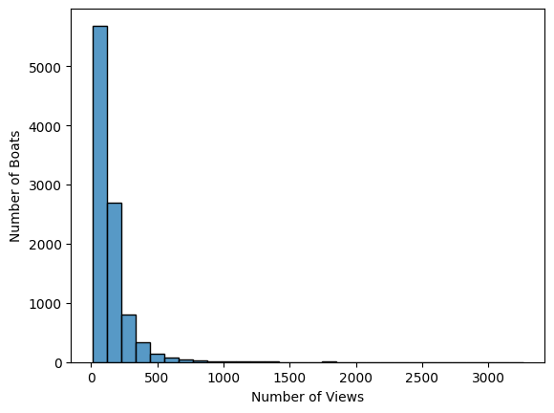
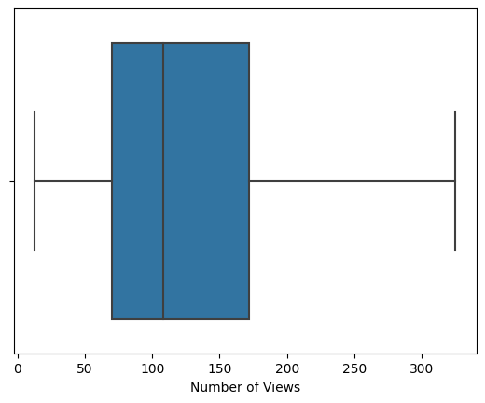
Right now, the boats on our site generate a wide range of views
50% of our boats are viewed between 70 and 172 times, with a median value of 108

Slide 4

Our plan forward
The data and analytics team will use machine learning to predict website traffic, giving us the power to post only boats that will increase traffic

Slide 5
Data Processing Steps
Outliers: Taking out the most extreme boats so we get a model that fits most boats
Missing values: To ensure a clean dataset, boats with insufficient information were removed
Price changes: Since we post across multiple countries, I converted all boat prices to Euros for equal comparison
Boat model: 56% of our boats fall into 3 different models, and 89% of boats are in just 10 models.
Sale type: Categorized boat as used, new, or from a display
Fuel type: Categorized boats into diesel, unleaded, and other energy sources
Machine Learning Preprocessing: I also performed one-hot dummy encoding and variable scaling to ensure that the information was scaled and interpreted correctly by the mathematics

Slide 6
Final list of boat features that predict views Model trained on 8,476 boats posted on our site
Price (in euros)
Year built
Length
Width
Currency (e.g., pound, euro)
Country where the boat is located
Boat model (e.g., Yacht, sport boat)
Sale type (e.g., used, new)
Fuel type (e.g., diesel, unleaded)
Boat material (e.g., Fiberglass, PVC)

Slide 7
After evaluating multiple metrics, the Random Forest algorithm was chosen for best performance

Slide 8
Price is the strongest predictor of views, followed by location, size, and age.
Listings that are more expensive, located in Switzerland, have a larger area, and were built more recently tend to drive website traffic the most
Using this algorithm, we can predict within 46% the number of views a listing will have.
With this information, we can choose to focus our attention on providing the best options for our consumers.

Slide 9
Conclusion
Data Science will help us chart a course to the best boats

