Slide 1
Always use “Barlow Medium” font for the presentation title.
If the title is longer than three lines, font size may be reduced but no less than 36 pt. and needs to fit within the title text container.
DO NOT reposition or alter the text containers.
COVER IMAGE GUIDELINE
This cover image may be replaced with another image either from the Brand Image Library PowerPoint (available on the Brand Hub) OR a brand approved image that meets Analog Devices’ photography guidelines. Alternatively, you may choose to use the cover slide with no image as shown on slide 2.
The image can be replaced in the Slide Master. The image should cover the entire slide, size 33.87 cm (W) × 19.05 cm (H), with the focal point toward the right of the slide and not appearing behind the AMP. See instructions on slide 4 on how to change the image.
For additional guidance, reach out to Brand Creative.

Slide 2
Always use “Barlow Medium” font for the presentation title.
If the title is longer than three lines, font size may be reduced but no less than 36 pt. and needs to fit within the title text container.
DO NOT reposition or alter the text containers.

Slide 3
Guidelines & Best Practice
This template should be used for everyday project and business needs. DO NOT use this template for the creation of presentations for trade shows, events, or town hall meetings including keynote presentations. A separate presentation template is available for such needs.
As a best practice it is recommended to not have more than 10 slides and a presentation that is no longer than 20 minutes. While it may not always be possible, the more succinct a presentation, the more successful it will be.
This template provides a mix of light and dark backgrounds. It is encouraged to predominantly use the light background and reserve the blue/dark blue background for key messages, call outs, large data visualizations, or similar.
Always maintain a high contrast between the background color and content/text color. DO NOT use colors that are low contrast and will not be accessible. Only use colors in the palette and avoid overuse of different colors.
Avoid creating cluttered or text-heavy presentation slides, which will be difficult for audiences to follow. Eliminate unnecessary text and use clear space to improve the readability and help direct to focal points. Opt to visualize data through graphs, charts, infographics, or other appropriate visual elements.
Always use high quality photographs, images, and graphics, and never use clip art. Make sure that you have copyright permission or license for any images used.
Avoid sound effects, distracting backgrounds, or gratuitous animations and effects.

Slide 4
Frequently Asked Questions (PC Users)
  How do I convert old PPT files to the new template?
Method One
  To directly update an existing template, click on Design in the menu bar. Click the arrow on the bottom right-hand side of the template thumbnails.
  Select Browse for Themes … Navigate to and select the new template. Select Open.
  To resolve most formatting issues: select the slides, right-click, and select Reset Slide.
Method Two
  You may also open a new PPT using the current template and import slides by going to Home > Reuse Slides. From the Reuse Slides panel, browse for the PPT file you wish to use and left-click it. If you want the new template applied, un-check the box Use source formatting.
  Select the slides you wish to reuse by left-clicking on the image or Insert Slide button. As noted above, you may need to reset slides.
Note: Either method will take care of most, if not all, of the reformatting for you. However, depending on how your original PPT file was built, you may need to go through slide-by-slide and make corrections to layout or color.
How do I save the template to my personal Microsoft Templates folder?
After opening the template, go to File > Save As. After selecting a save location, scroll down the list labeled PowerPoint Presentation (*.pptx) and choose PowerPoint Template (*.potx). By default, this will choose your personal Microsoft Templates folder as the save destination. Click Save and the template will be available when you go to File > New.
How do I change the image on the cover slide or section slide?
Replace with an image from the Brand Image Library PowerPoint
(available on the Brand Hub):
  From the Brand Image Library PPT, select and copy the image you want to use.
  Click on the View ribbon and select Slide Master. Select either the cover or selection slide master. Delete the old image.
  Paste the new image from the image library. Right-click and select “Send to Back.”
You may also replace the image with a brand approved image that meets ADI’s photography guidance in the ADI Brand Guidelines (available on the Brand Hub) using the instructions above.
The image should cover the entire slide, size 33.87 cm (W) × 19.05 cm (H),
with the focal point toward the right of the slide and not hidden behind the AMP triangle.

Slide 5
Frequently Asked Questions (Mac Users)
  How do I convert old PPT files to the new template?
Method One
  To directly update an existing template, click on Design in the menu bar. Click the arrow on the bottom of the template thumbnails.
  Select Browse for Themes … Navigate to and select the new template. Select Apply.
  To resolve most formatting issues: select the slides, go to Home, and select Reset.
Method Two
  You may also open a new PPT using the current template and import slides by going to Home > New Slide > Reuse Slides. From the Reuse Slides panel, browse for the PPT file you wish to use and select OK.
  Select the slides you wish to reuse, right-click, and select Insert Slides. The new theme will be automatically applied. As noted above, you may need to reset slides.
Note: Either method will take care of most, if not all, of the reformatting for you. However, depending on how your original PPT file was built, you may need to go through slide-by-slide and make corrections to layout or color.
How do I save the template to my personal Microsoft Templates folder?
After opening the template, go to File > Save as Template. By default,
this will choose your personal Microsoft Templates folder as the save destination. Click Save and the template will be available when you go
to File > New from Template.
How do I change the image on the cover slide or section slide?
Replace with an image from the Brand Image Library PowerPoint
(available on the Brand Hub):
  From the Brand Image Library PPT, select and copy the image you want to use.
  Click on the View ribbon and select Slide Master. Select either the cover or selection slide master. Delete the old image.
  Paste the new image from the image library. Right-click and select “Send to Back.”
You may also replace the image with a brand approved image that meets ADI’s photography guidance in the ADI Brand Guidelines (available on the Brand Hub) using the instructions above.
The image should cover the entire slide, size 33.87 cm (W) × 19.05 cm (H),
with the focal point toward the right of the slide and not hidden behind the amp triangle.

Slide 6
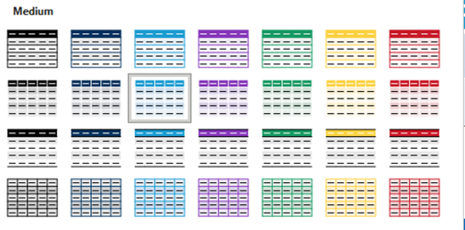
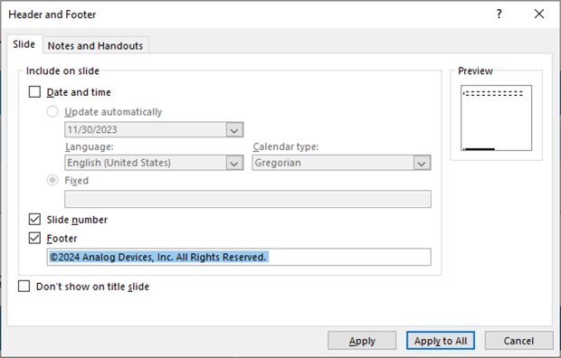
Frequently Asked Questions
  How do I update older tables to the standard ADI style?
  Select the table you’d like to update. From the menu bar, select Table Design.
  From the Table Styles drop-down box, select one of the preformatted table style options. These all use the approved ADI color palette.
  For consistency, it is suggested that you choose the light blue header options from the second row of the Medium table style group.
How do I change all fonts to Barlow?
  From the Home menu, select Replace > Replace Fonts… Choose the font you want to replace from the Replace dropdown and choose Barlow from the With dropdown.
  How do I fix broken footers after converting my PPT to the new template?
  If, after taking the steps outlined previously, your page numbers don’t update to the new style or have restyled unexpectedly, start by deleting your old footers.
  Then go to Insert in the menu bar and select Header & Footer.
  Select the options you’d like to include (Date and Time, Slide Number, and Footer). Check the Don’t show on title slide box.
  Select Apply to All to update all slides.

Slide 7
Guidelines & Best Practice
  How do I change the copyright text in the footer?
  Refer to the table to find the appropriate disclaimer to use in the footer of your presentation.
  Select and copy the appropriate line of footer text in the table below.
  Select the Insert tab and click on Header & Footer. In the text field under Footer, paste the new footer text. Click on Apply to All.
Category | NDA Required? | Footer | Examples*
Public (General public) | No | ©2025 Analog Devices, Inc. All Rights Reserved. | Press releases, product announcements, product data sheets, training materials found on analog.com
Confidential (Business partners, suppliers, customers, contractors) | Yes | Analog Devices Confidential Information. ©2025 Analog Devices, Inc. All Rights Reserved. | Classified technical content, prices and terms of sale, custom development, product roadmaps, training specific to an agreement or project, any pre-released samples or products, any information regarding our manufacturing process
Internal Only (ADI employees only) | No | Analog Devices Confidential Information—Not for External Distribution. ©2025 Analog Devices, Inc. All Rights Reserved. | Profit margins, employee compensation, detailed product roadmaps, legal information, M&A content, corporate structure, and org charts

Slide 8
The first level text is Barlow 18 pt., no bullet, no indent. Insert two returns between lines if additional space is desired. There is 6 pt. of space after each paragraph. Add additional space if needed with extra returns or using the paragraph formatting menu.
  The second level text is set in Barlow 16 pt., bullet and indent.
    The third level text is set in Barlow 14 pt., bullet and indent.
NOTE on Title Case (for slide titles and subtitles): The first letter of each word is capitalized for principal words. Articles, conjunctions, and prepositions such as “a,” “the,” “and,” “to”, etc. do not get capital letters unless they start the title or exceed four characters.
DO NOT alter the title box width. Avoid text crowding or overlapping the logo.
DO NOT alter the text box width. Fit your content within the text box, avoid placing content too close to the slide edges, and do not overlap the title, logo, slide number, or copyright text.

Slide 10
Always use “Barlow Medium” font for the presentation title.
If the title is longer than three lines, font size may be reduced but no less than 36 pt. and needs to fit within the title text container.
DO NOT reposition or alter the text containers.
SECTION IMAGE GUIDELINE
This section/divider slide image is a placeholder ONLY. This cover image may be replaced with another image either from the Brand Image Library PowerPoint (available on the Brand Hub) OR or a key visual specific to the content of this section. Alternatively, you may choose to use the divider slide with no image as shown on slide 14.
The image can be replaced in the Slide Master. The image should cover the entire slide, size 33.87 cm (W) × 19.05 cm (H), with the focal point toward the right of the slide and not appearing behind the AMP. See instructions on slide 4 on how to change the image.
For additional guidance, reach out to Brand Creative.
*This can also be used to add ”Key Message” in place of “Section Title”

Slide 14
Always use “Barlow Medium” font for the presentation title.
If the title is longer than three lines, font size may be reduced but no less than 36 pt. and needs to fit within the title text container.
DO NOT reposition or alter the text containers.

Slide 20
Table Style
Default—18 pt. size (recommended to change to 14 pt. size)
Column 1 | Column 2 | Column 3 | Column 4 | Column 5
Text Left Aligned
Vertical Align: Middle
Alternate Custom Style #1—14 pt. Size, Row Height: 1 cm Minimum, Title and Text Centered
Column 1 | Column 2 | Column 3 | Column 4
Text Center Aligned
Vertical Align: Middle
Alternate Custom Style #2—14 pt. Size, Row Height: 1 cm Minimum, Title Centered, Text Left Aligned
Column 1 | Column 2 | Column 3 | Column 4
Text Left Aligned
Vertical Align: Middle

Slide 21
Chart Style
Default Style
Custom Style
*Chart size should be large for audience accessibility

Slide 22
Chart Style
Custom Style for Dark Blue Background
*Chart size should be large for audience accessibility

