Slide 1


VENDOR CONSULTATION · AI EVALUATION
Where Are Humans Still in the Loop — and How Do We Choose Them?
Ideate, review, polish, and communicate — and what that means for a rating partner
Ryan Foley · Principal Applied Scientist, AI Data Science · August 2026
Notes:
Framing: I am not arguing humans do everything. The question is which parts of an eval degrade without a human, and how you buy that human input efficiently. That is what I want your input on today.

Slide 2
WHO YOU'RE TALKING TO
About Me — A Decade-Plus of Human + Model Evaluation
Ryan Foley
Principal Applied Scientist, AI Data Science — Microsoft (Azure)
Previously Staff Data Scientist, Google — 12 years across Gemini, Assistant & Search
M.S. Statistics, Stanford · B.S. Financial Math & Statistics, UCSB (Highest Honors)
12+
3.5×
years in evaluation & metrics at Google and Microsoft
rater recall lift from a redesigned rating methodology
Led Gemini Factuality evaluation: novel rating methodology, eval sets, and metrics adopted into the core release process; cited contributor to the Gemini technical report
Validated alternative rater vendors, calibrated metrics, and stood up new rating pipelines — deep experience on the buyer side of the human-rating market
Built hybrid auto/human evaluations and rater-quality models (accuracy by locale, systemic issue detection)
Evaluation consulting for 200+ launches, from Duplex to new Assistant surfaces; now building agent eval frameworks, synthetic prompt pipelines, and LLM-judge architectures
2×
200+
lift in fully-accurate response rate within one year
launches supported with eval sets, SxS & analysis
Notes:
Credibility framing: I have been the buyer. At Google I validated alternative rater vendors and rebuilt pipelines around them, which is why I care about measured accuracy rather than headline rates. Mention the Gemini technical report citation only if it comes up naturally.

Slide 3



SHARED VOCABULARY
Components of an Eval
Eval Set
Task + Rubrics
Metrics & Analysis
The data: prompts, context, questions, tasks. A given variable meant to cover your target eval space — representative users today, or aspirational use cases for the future.
The things you want to measure, made operational — task definitions and rubric criteria that annotators (human or LLM) score against.
What you get from all the annotations on the rubrics: aggregate metrics, slices, confidence intervals — and the story they tell.
Humans have a distinct and necessary role in each.
Notes:
Set shared vocabulary before the argument. Three components, and I will walk each one asking the same question: what breaks if no human touches this? Each component has a distinct failure mode when no human is involved.

Slide 4




COMPONENT 1 · EVAL SET
Eval Set: An LLM Might Create It — Humans Steer It
Sampling criteria & use-case definition
Stratification and intent live with humans: “we sampled this question, and I read the user as wanting X.” The model can generate; only a human can decide what should be represented.
Aspirational use cases
Future-facing targets come from UX research with real users — “our aspirational use case is Y” — not from what the model already knows how to produce.
Real customer patterns
Actual human traffic always earns a place in the set — at minimum as a regression set, so quality never silently slips on what users truly do.
Manual review of the eval set
A human pass over the set catches skew, duplicates, and unrealistic prompts before they poison every metric downstream.
Division of labor: the LLM drafts at scale — the human defines the target and reviews the draft.
Notes:
Key point: generation is cheap, targeting is not. An LLM can produce ten thousand prompts, but it cannot tell you whether that distribution matches your users or your roadmap. Regression sets from real traffic are non-negotiable.

Slide 5
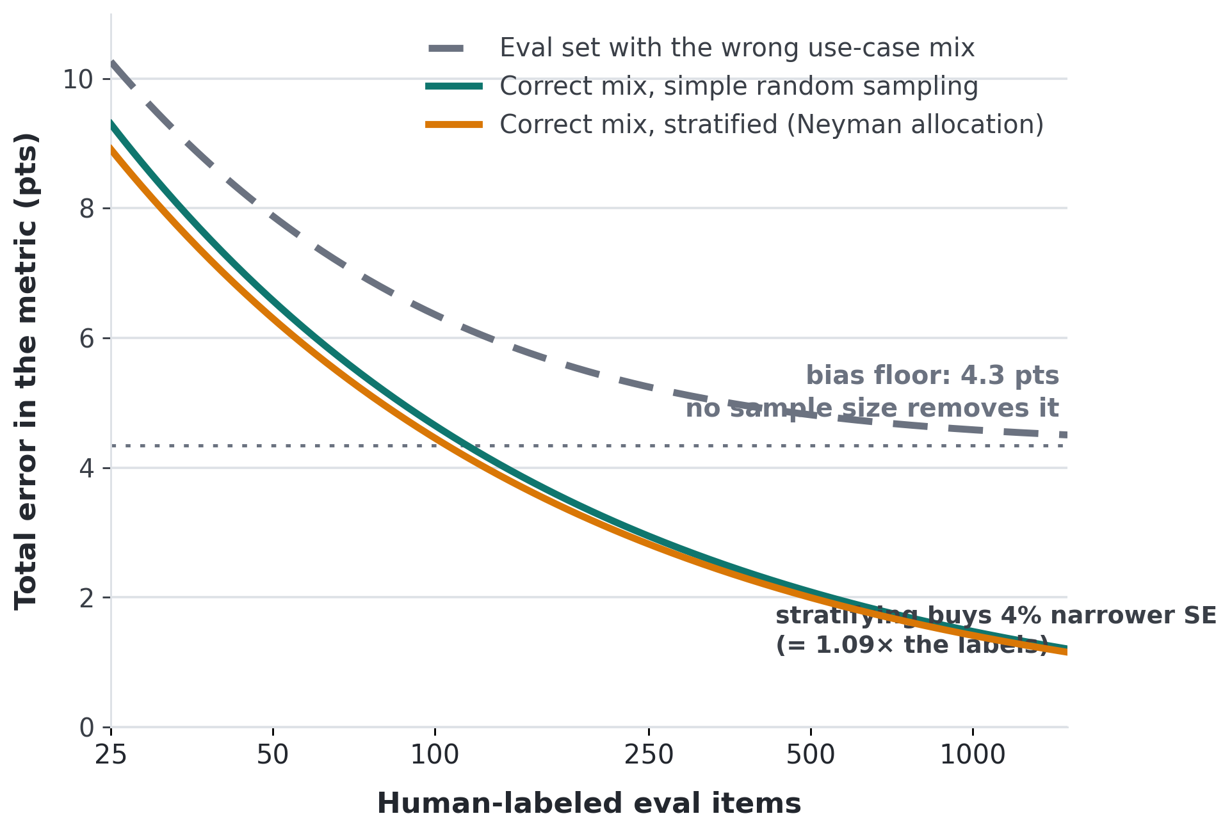
WHY THE MIX MATTERS
Use-Case Stratification Buys Accuracy You Cannot Buy With Volume
The setup
Four use-case strata with different true pass rates. Humans define the strata and their weights; the eval set is drawn against them.
Two separate effects
Wrong mix → bias. Over-weight easy use cases and the metric is off by ~4 pts no matter how many labels you buy.
Right mix → variance. Stratified allocation then trims a further ~4% off the SE.
Past ~115 items the mix error dominates sampling error entirely.
Defining the strata is the human judgment call.
Optimal allocation: Neyman (1934); Cochran, Sampling Techniques (1977). Stratified hybrid estimation: Fisch et al., NeurIPS 2024.
Notes:
This is the quantitative case for the previous slide. The variance benefit from stratification is real but second-order — roughly four percent here. The first-order effect is bias: if the eval set mix does not match the use-case distribution you care about, the metric is simply wrong, and buying more labels drives error toward the wrong number faster. Only a human can specify the strata and their weights, because that comes from traffic analysis and product intent, not from the data itself. Fisch et al. 2024 (StratPPI) shows the same stratification logic also tightens hybrid human/autorater intervals.

Slide 6



COMPONENT 2 · TASK + RUBRICS
LLM Ground Truth, LLM Judge — Where Are the Humans?
Craft (or review) the rubric
Sanity-check labels & scores
Bring domain expertise
The rubric is your objective function. Humans define the goals; abdicate that and the eval optimizes for something nobody chose.
Ground truth without a human is just self-consistency. And rubrics are never perfect — latent patterns get missed and need human-driven tweaking.
Some knowledge simply isn't in the training data — proprietary processes, tacit domain judgment, edge cases only practitioners have seen.
“AI doesn’t know what I know.”
— a chief chemist at Honeywell, on why expert review still matters
On autorater bias relative to human raters: Chaganty, Mussmann & Liang (ACL 2018); Zheng et al. (NeurIPS 2023).
Notes:
Strongest slide in the deck. The self-consistency point usually lands hardest: if the LLM writes ground truth and the LLM grades it, you have measured agreement with yourself, not correctness. The Honeywell quote is the human version of that argument.

Slide 7



STEELMAN
But When Might We Not Need Humans?
Where LLM-only holds up
THE CRUX
First pass & quick sanity checks
“Results not important” is never fully true.
LLMs do okay as a fast, cheap directional read before any human touches the data.
There is always some importance — so treat it as a dial, not a switch:
Spot-check N data points, with N scaled to the stakes of the decision.
On any important experiment, humans review the actual wins and losses — not just the aggregate delta.
Done rigorously, that review corrects your point estimate and sets your CI width — the human effort shows up in the error bars.
Simple, well-specified checks
Format compliance, exact match, refusal detection — narrow criteria a judge scores reliably.
Low-stakes results
When little rides on the number, cheap and instant beats slow and certified…
Human review isn’t on/off — it’s a budget you allocate by risk.
Notes:
Deliberately steelman the LLM-only case so the argument is credible. Then land the crux: stakes are continuous, not binary, so human review is a budget. Emphasize the win/loss review point — on any launch-relevant experiment somebody has to read the actual regressions and gains, because an aggregate delta hides which direction the errors run. Done rigorously that review both corrects the point estimate and determines CI width, which is the quantitative bridge to the vendor conversation.

Slide 8
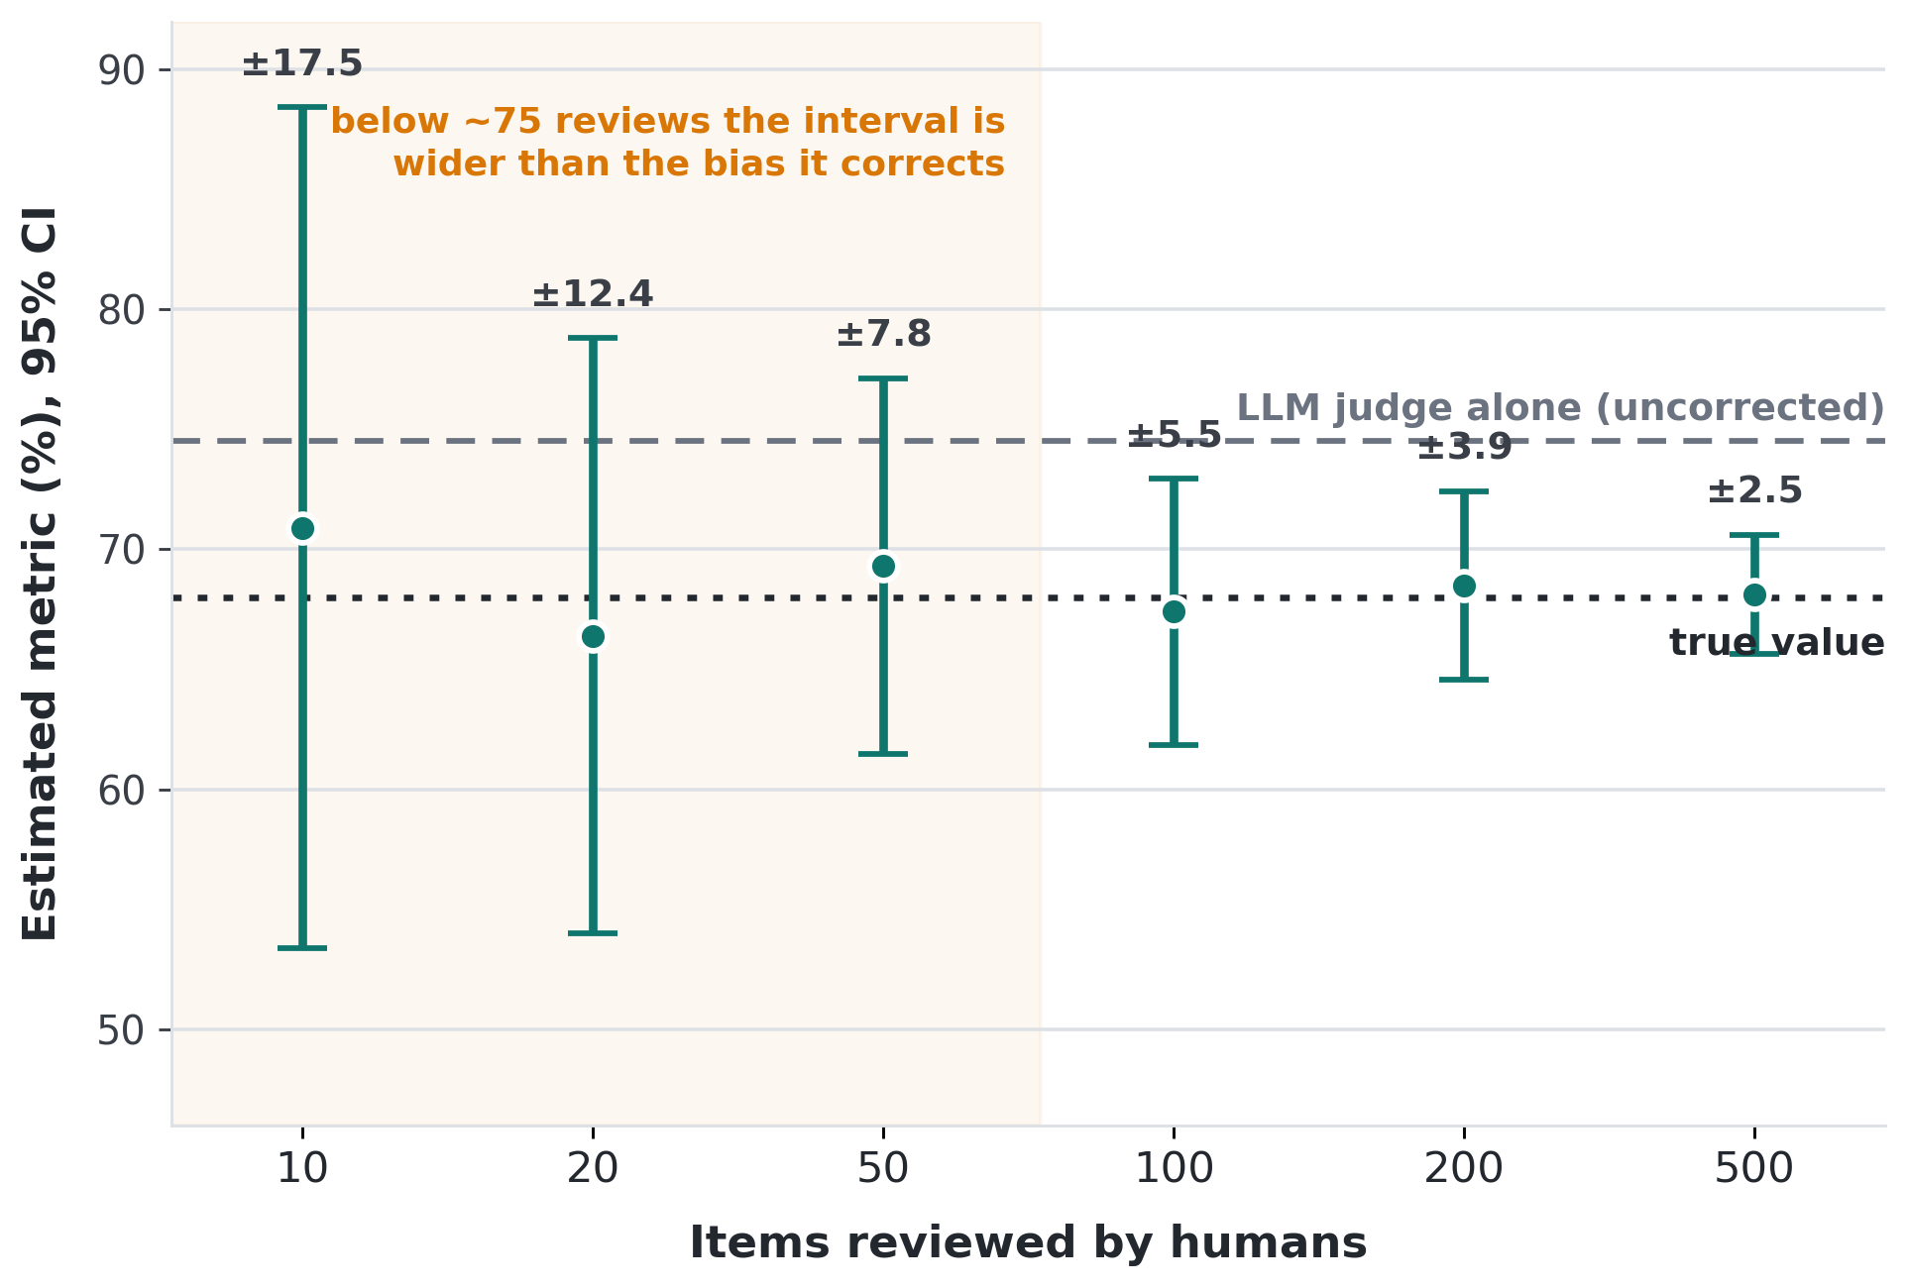
SIZING THE HUMAN BUDGET
How Much Human Review Do You Actually Need?
The setup
An LLM judge scores every item cheaply but carries a systematic bias. Humans review a random subset; the mean human–judge difference de-biases the estimate.
What the curve says
Precision of the correction scales as 1/√n — so 10 → 40 reviews halves the interval.
Under ~75 reviews, the correction is noisier than the bias it removes.
Past ~200, returns flatten — that is where extra spend stops buying confidence.
Human review volume is a dial you can price.
Prediction-powered inference: Angelopoulos et al., Science (2023); PPI++: Angelopoulos, Duchi & Zrnic (2023); StratPPI: Fisch et al., NeurIPS 2024.
Notes:
This is the quantitative core of the pitch. Illustrative numbers: 8 percent judge-human disagreement, a 6.5 point judge bias. The point is not the specific values but the shape — human review volume maps onto interval width through a known relationship, so 'how many raters do we need' is an answerable question rather than a negotiation. Note the crossover: reviewing too few items produces a correction noisier than the error being corrected, which is worse than not correcting at all. This is also the natural place to ask the vendor how they price tiers of review volume.

Slide 9




COMPONENT 3 · METRICS & ANALYSIS
Metrics & Analysis: Humans at the End of the Pipeline
Metric definition
Calibration to expert ground truth
Every metric traces back to the objective function — and that usually needs a human to define what success even means.
“Is this answer wrong?” → fraction wrong requires N replications from the LLM judge, with agreement above x/n against human expert judgment before you trust the number.
Interpretation of results
Communication
Analysis and takeaways still require human experts reading results against business context, experience, and motivations.
The last mile is always human-to-human: findings land with your customers — internal or external — only if a person can tell the story.
Notes:
Calibration is the concrete ask: N replications from the judge, agreement threshold against human expert labels before the metric is trusted. Close on communication, since even a fully automated pipeline ends with a person explaining results to other people.

Slide 10



PHASE 1 · SELECTION
Choosing the Right Humans
Accuracy at the right cost
Scalability
Integration
Best achievable accuracy per dollar — including ensembles of cheaper raters that outperform single experts. I maintain a small internal benchmark on rater accuracy and would love to see where your pool lands.
Volume when we need it, i18n coverage across locales, and breadth across fast-moving use cases — without recalibrating from scratch each time.
Plug into our internal infra and rating tooling — or bring a genuinely white-glove managed experience. The costly middle ground is neither.
Selection gets you a starting point. What follows is what actually holds quality steady.
Notes:
Three selection criteria. Emphasize that I care about accuracy per dollar, not headline rater credentials — an ensemble of cheaper raters often beats a single expensive one, and I have internal benchmark numbers to compare against. Then transition: picking a vendor is the easy part.

Slide 11
PHASE 2 · ONBOARDING, SCALING & MAINTENANCE
Quality Is a Program, Not a Purchase
1
Onboard before production
2
Monitor continuously
Rater entrance exams gate access to live tasks. Rating guidelines carry worked examples, not just prose definitions — examples are what actually transfer.
Automated monitoring across the pool, with human review reserved for flagged raters. Plus small blind ground-truth sets, authored by our internal experts and seeded into live queues.
3
Fix the task before blaming the rater
4
Align the incentives
Task and experiment fixes plus rater education beat firing. A confused rater usually means an ambiguous rubric — that is a signal about our instrument, not their competence.
Quarterly vendor targets, bonuses, and structured feedback tied to automated quality metrics and exam scores — so the program improves without renegotiating every quarter.
Discussion: where does your pool land on accuracy × cost × scale — and what does a paid pilot look like?
Notes:
The ongoing program is where vendors actually differentiate. Push on specifics: what does your entrance exam look like, can you run blind GT sets we author, how do you surface flagged raters to us, and are you willing to tie quarterly bonuses to measured accuracy? Emphasize remediation over churn — replacing raters resets calibration and usually costs more than fixing the task. Close with the pilot ask.

