Slide 1
ISAACWiper
Also known as LasainWiper (I don’t know why)
The name “ISAACWiper” comes from ESET researchers who discovered the file and initially thought the MW used the ISAAC PRNG
It uses another PRNG that will be discussed later ☺
Discovered the day of the conflict (FEB24, 2022)
Another iteration of ISAACWiper discovered a day later
Has debug strings
This is the sample I am analyzing
Reference: https://www.welivesecurity.com/2022/03/01/isaacwiper-hermeticwizard-wiper-worm-targeting-ukraine/

Slide 2


ISAACWiper Samples
13037b749aa4b1eda538fda26d6ac41c8f7b1d02d83f47b0d187dd645154e033
Sample Collected
7bcd4ec18fc4a56db30e0aaebd44e2988f98f7b5d8c14f6689f650b4f11e16c0
Sample Collected
abf9adf2c2c21c1e8bd69975dfccb5ca53060d8e1e7271a5e9ef3b56a7e54d9f
No Sample
afe1f2768e57573757039a40ac40f3c7471bb084599613b3402b1e9958e0d27a
No Sample

Slide 3
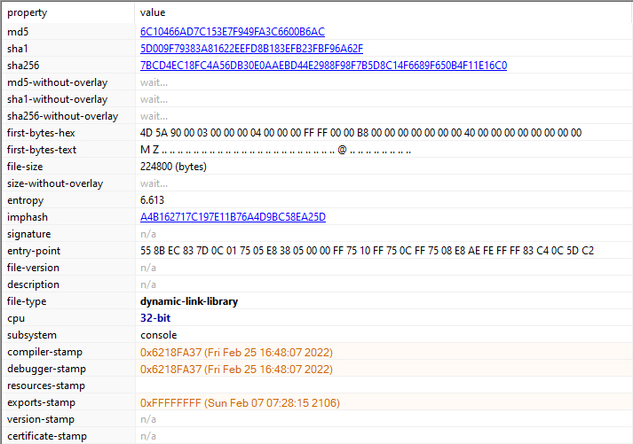
ISAACWiper Static Analysis

Slide 4
ISAACWiper Static Analysis (Tools)
Tools used:
PE Studio
Detect it Easy (DiE)
RDG Packer Detector
Professional PE file Explorer (Puppy)
CAPA
IDA
Hatching Triage (Sandbox)
Many Microsoft documentation lookups ☺

Slide 5
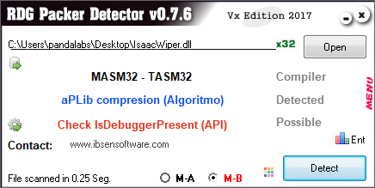
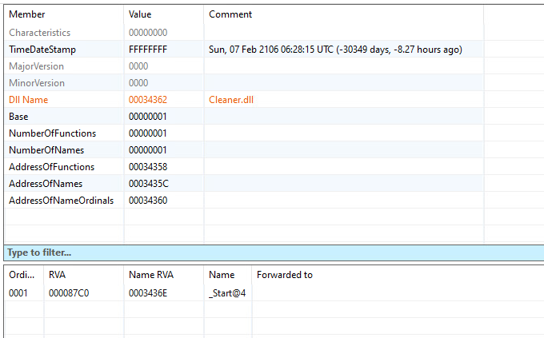
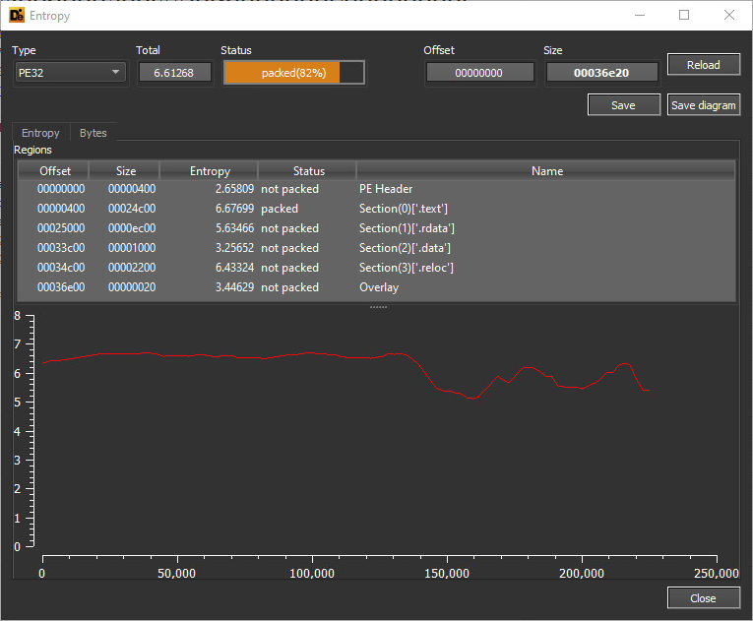
ISAACWiper Static Analysis

Slide 6

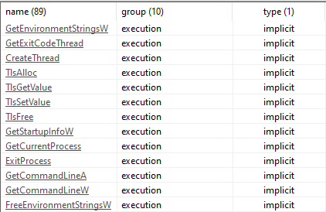
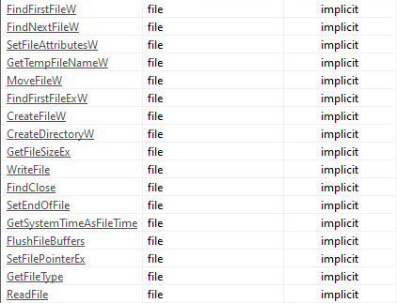
ISAACWiper Static Analysis (Libraries)
Libraries
Execution
File

Slide 7
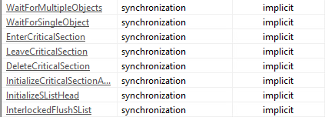
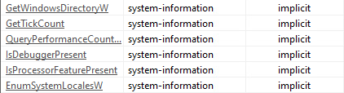
ISAACWiper Static Analysis (Libraries)
Synchronization
System-Information
Storage

Slide 8
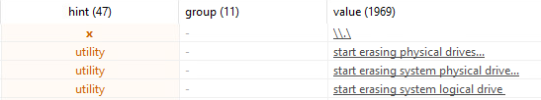
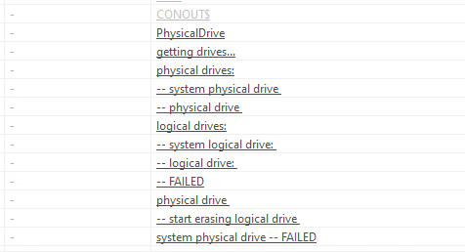
ISAACWiper Static Analysis (Strings)

Slide 9
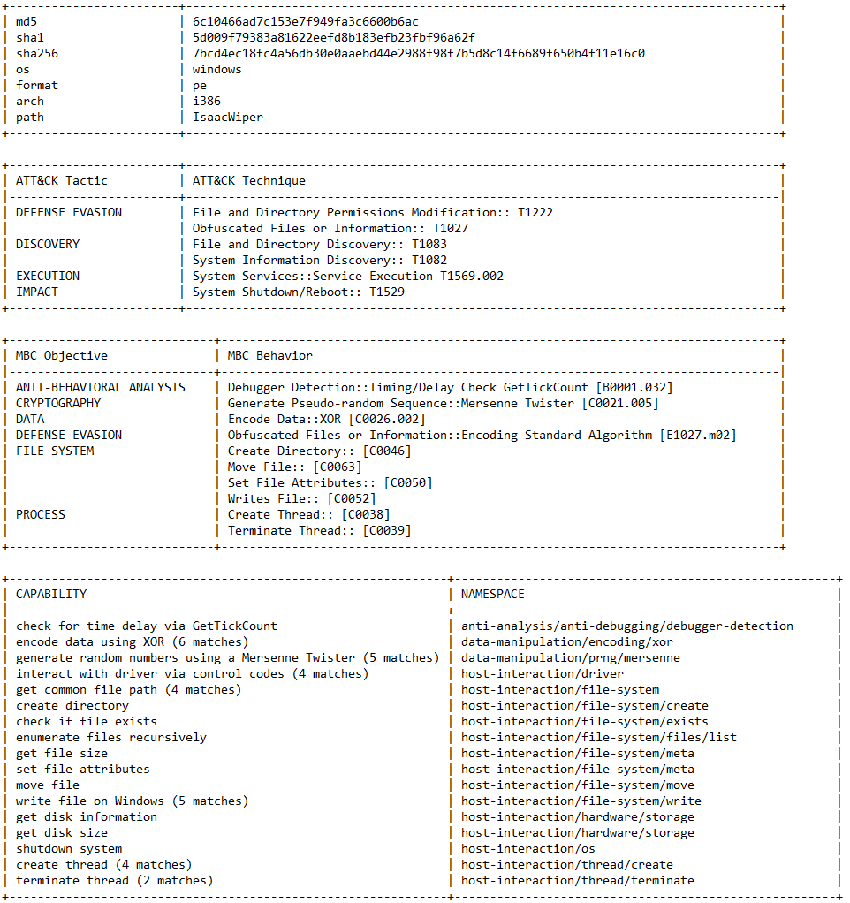
ISAACWiper Static Analysis (CAPA)

Slide 10
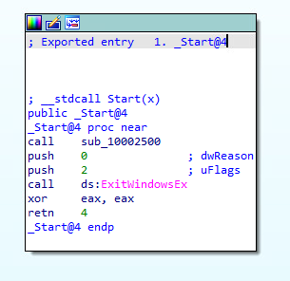
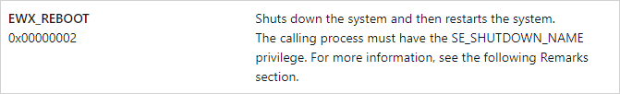
Reversing ISAACWiper (_Start@4)
Call sub_10002500
Reboot
Reference: https://learn.microsoft.com/en-us/windows/win32/api/winuser/nf-winuser-exitwindowsex

Slide 11
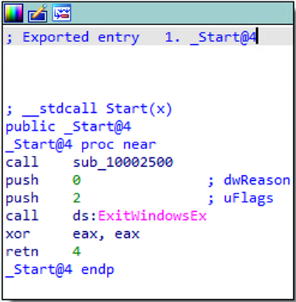
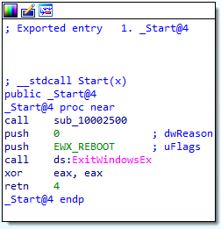
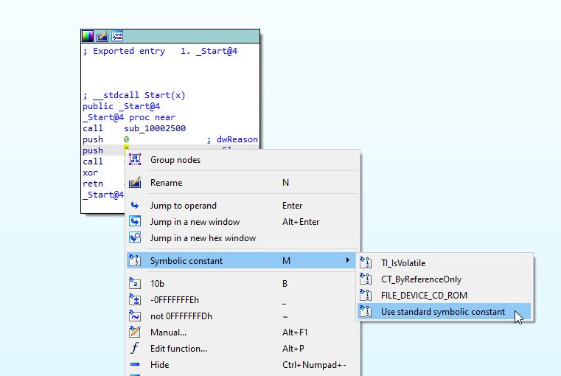
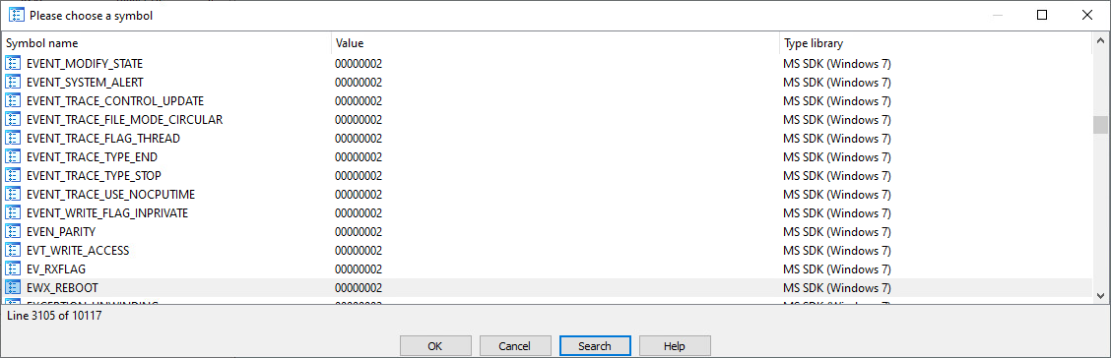
Reversing ISAACWiper (Symbolic Constants)

Slide 12
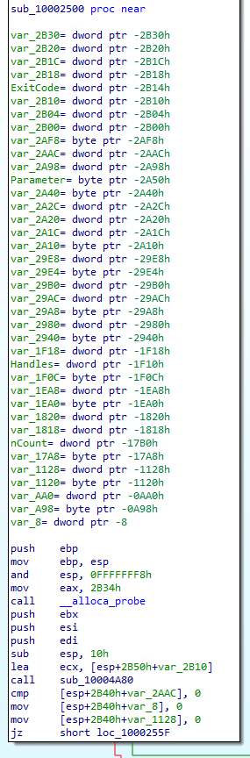
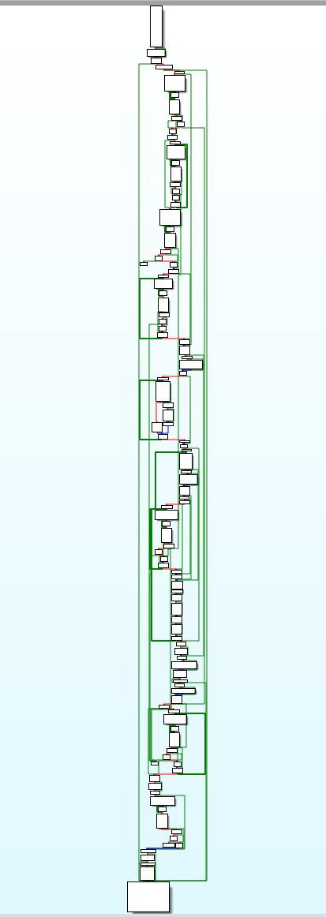
Reversing ISAACWiper (2500)

Slide 13
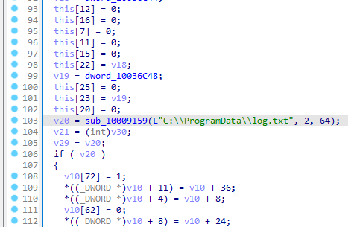
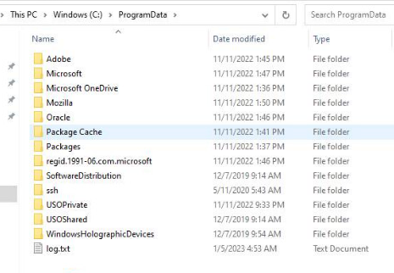
Reversing ISAACWiper (4A80)

Slide 14
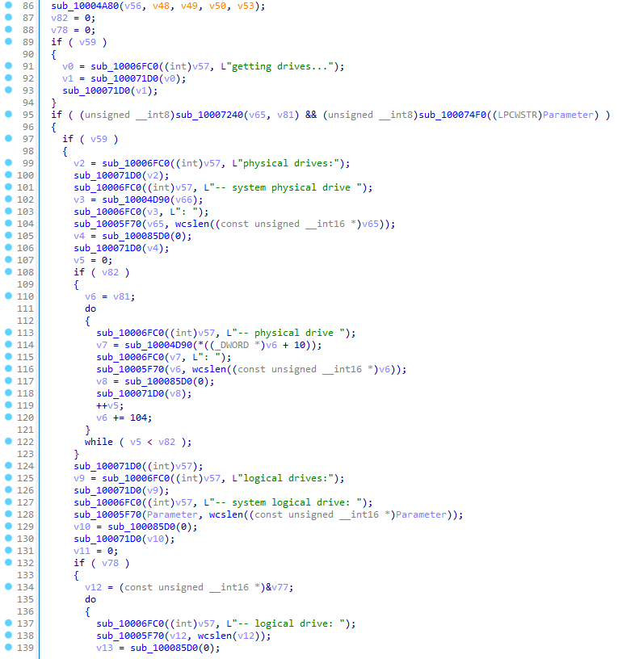
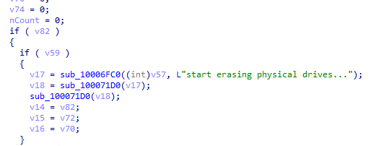
Reversing ISAACWiper (2500 DBG Strings)
Create log.txt

Slide 15
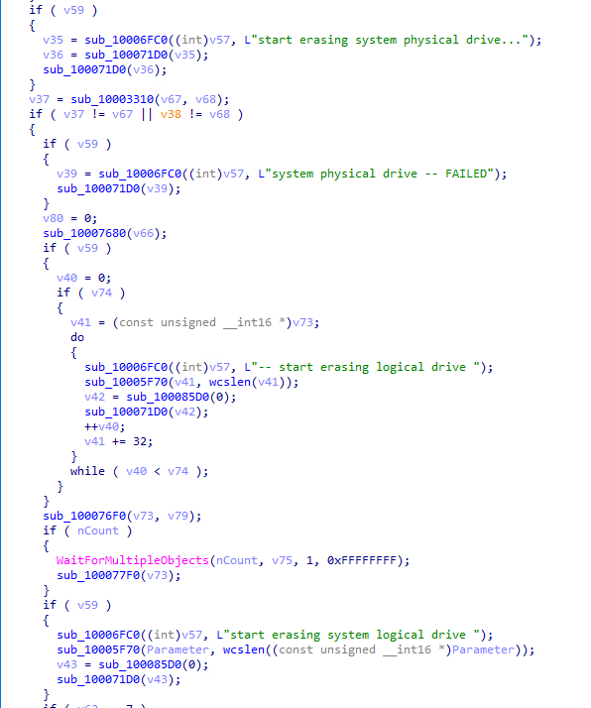
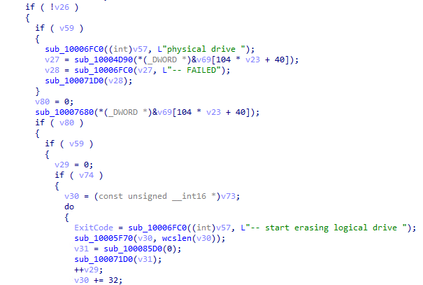
Reversing ISAACWiper (2500 DBG Strings 2)

Slide 16
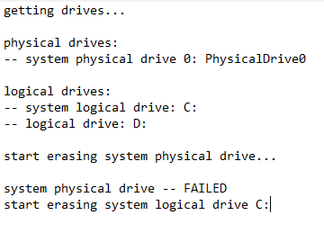
Reversing ISAACWiper (log.txt)

Slide 17
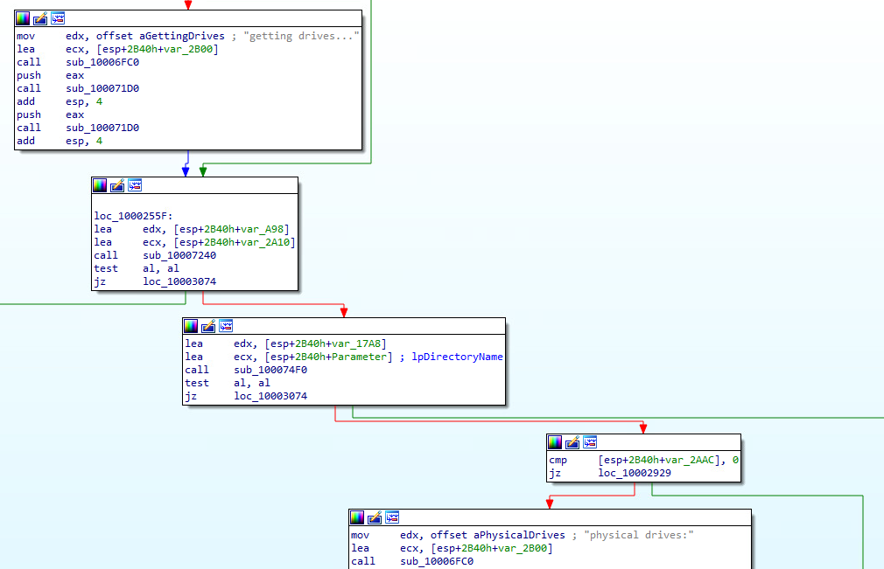
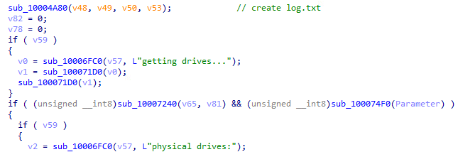
Reversing ISAACWiper (7240-74F0 Conditionals)

Slide 18
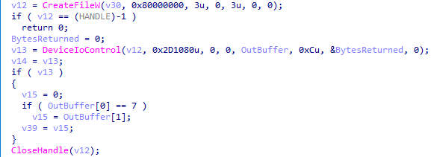
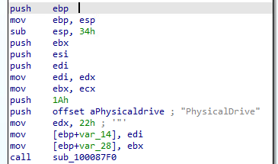
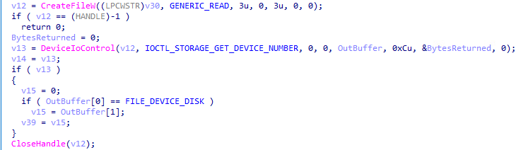

Reversing ISAACWiper (7240)
Get the list of physical drives (0-n)
dwIoControlCode
Reference: https://learn.microsoft.com/en-us/windows-hardware/drivers/kernel/specifying-device-types
Reference: https://learn.microsoft.com/en-us/windows-hardware/drivers/ddi/wdm/ns-wdm-_device_object
Reference: https://learn.microsoft.com/en-us/windows-hardware/drivers/ddi/ntddstor/ni-ntddstor-ioctl_storage_get_device_number

Slide 19
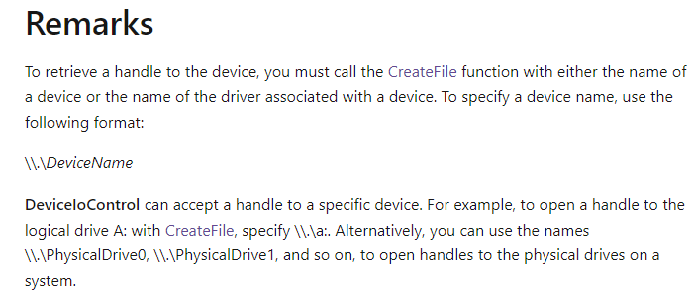
Reversing ISAACWiper (7240 cont.)
Reference: https://learn.microsoft.com/en-us/windows/win32/api/ioapiset/nf-ioapiset-deviceiocontrol

Slide 20
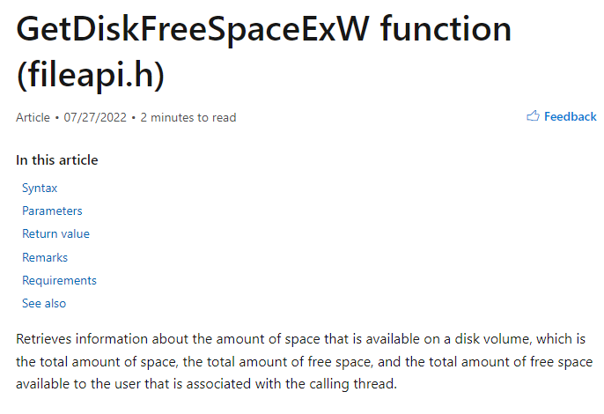
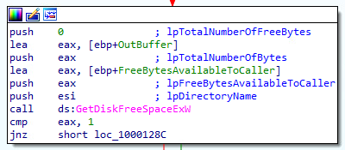
Reversing ISAACWiper (7240 cont.)
Reference: https://learn.microsoft.com/en-us/windows/win32/api/fileapi/nf-fileapi-getdiskfreespaceexw

Slide 21
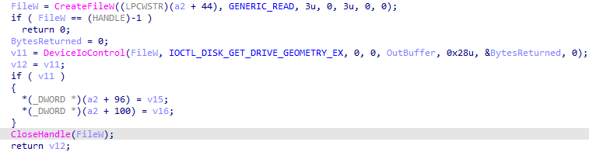
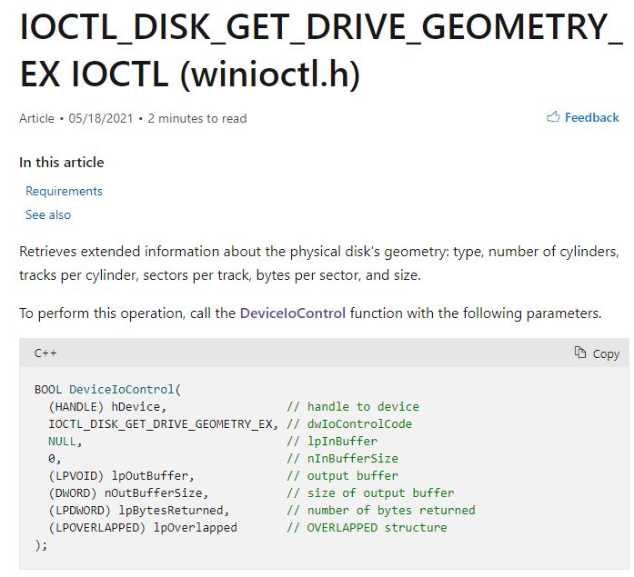
Reversing ISAACWiper (74F0)
Get partition of physical drive (n)
Reference: https://learn.microsoft.com/en-us/windows/win32/api/winioctl/ni-winioctl-ioctl_disk_get_drive_geometry_ex

Slide 22

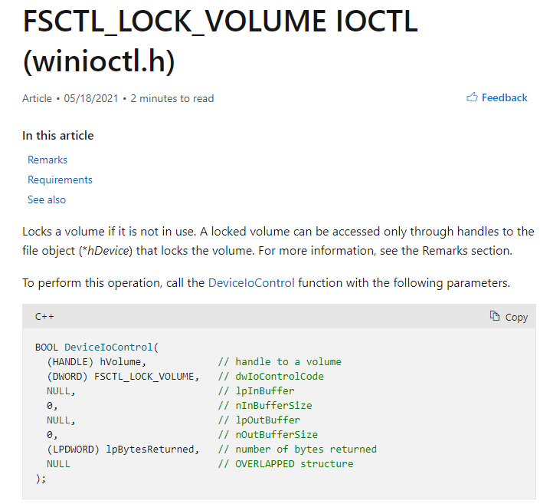
ISAACWiper Wiping Operations (3310)
Reference: https://learn.microsoft.com/en-us/windows/win32/api/winioctl/ni-winioctl-fsctl_lock_volume

Slide 23
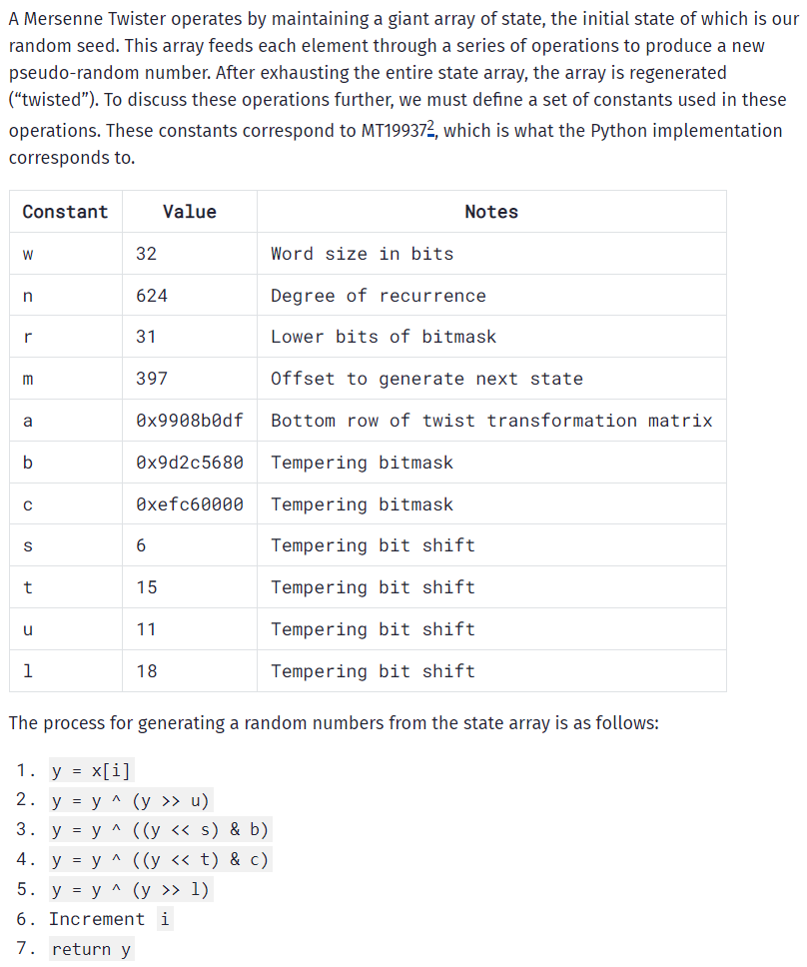
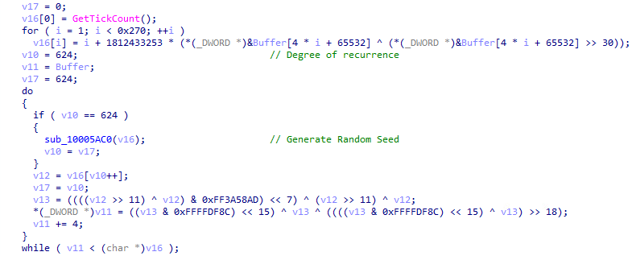
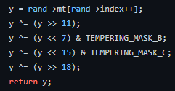
ISAACWiper Wiping Operations (3310 cont.)
Python “twist” implementation
Pseudocode “twist” implementation
Reference: https://blog.ollien.com/posts/reverse-mersenne-twister/
Reference: https://github.com/python/cpython/blob/main/Modules/_randommodule.c#L25

Slide 24
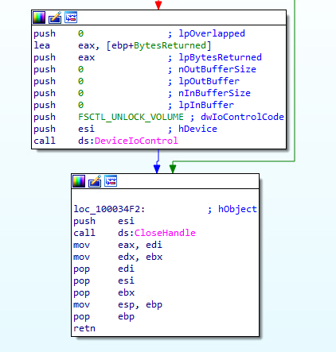
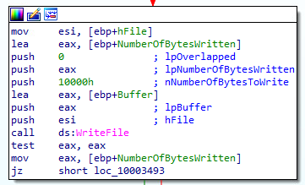
ISAACWiper Wiping Operations (3310 cont.)

Slide 25
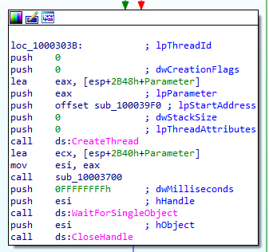
ISAACWiper Wiping Operations (2500 cont.)

Slide 26
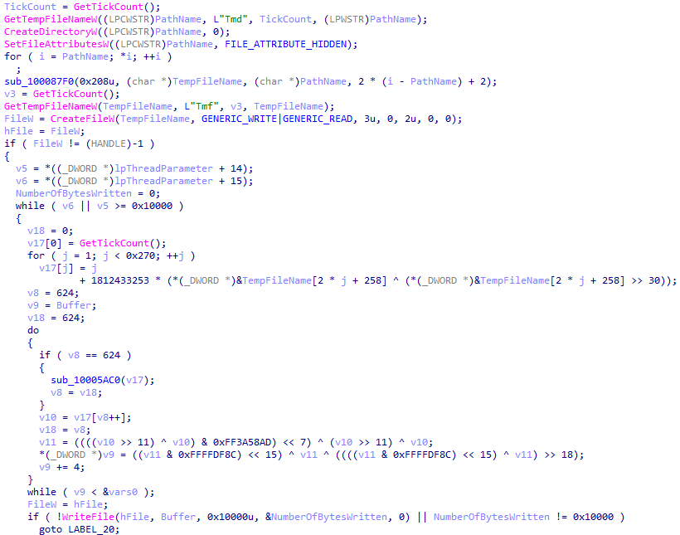
ISAACWiper Wiping Operations (39F0)
Mersenne Twister Algorithm

Slide 27
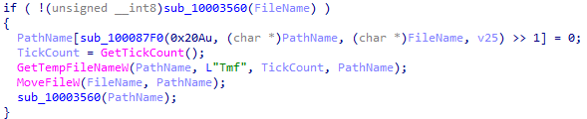
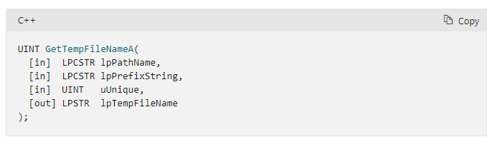
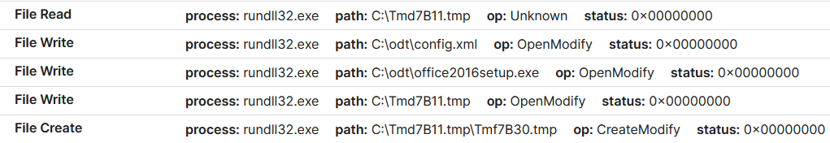
ISAACWiper Wiping Operations (GetTempFileNameW)
GetTempFileNameW(“.”, ”Tmf”, TickCount, “.”)
Reference: https://learn.microsoft.com/en-us/windows/win32/api/fileapi/nf-fileapi-gettempfilenamea

Slide 28
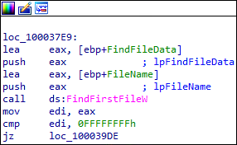
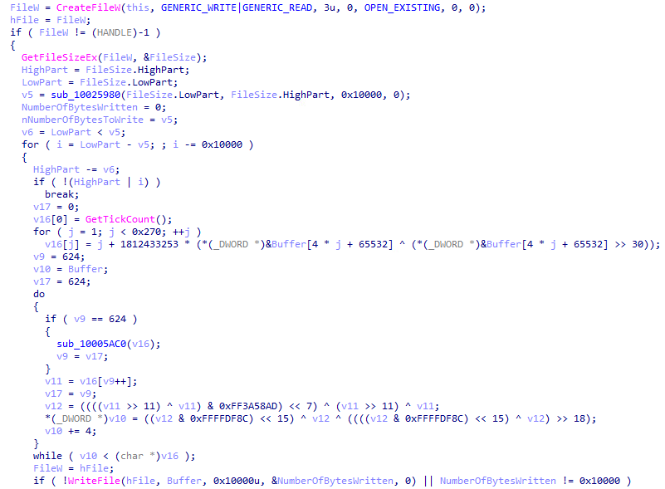
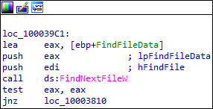
ISAACWiper Wiping Operations (3700)
Sub_10003560

Slide 29

ISAACWiper Execution

Slide 30




ISAACWiper Execution cont.

Slide 31
ISAACWiper Recap
Start
Create log.txt
Get physical drives
Get partitions and drive data
Overwrite physical drives with 10k bytes of PRNG data
Using 1 thread, create a file named “TmdXXXX/TmfXXXX.tmp and write to it using PRNG data until disk is full
End
Recursively wipe first 10k bytes of all files with PRNG data

Slide 32
ISAACWiper?
More like…
MersenneTwisterWiper

