Slide 1
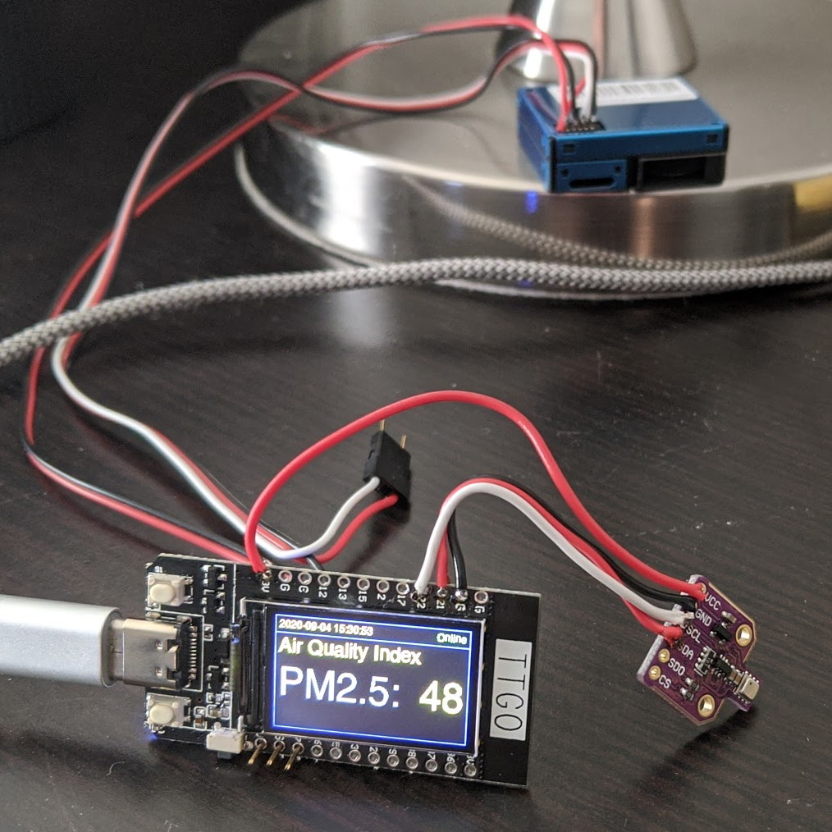
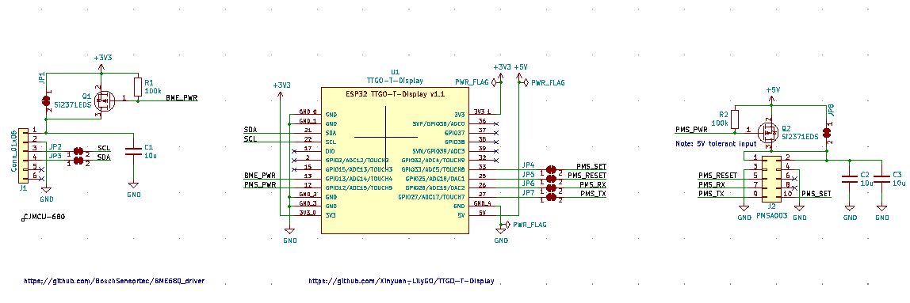
Existing project: https://github.com/kylemanna/sniffer
want to adapt into m5stack module
would also be cool to make TTGO adapter (budget m5stack)

Slide 2
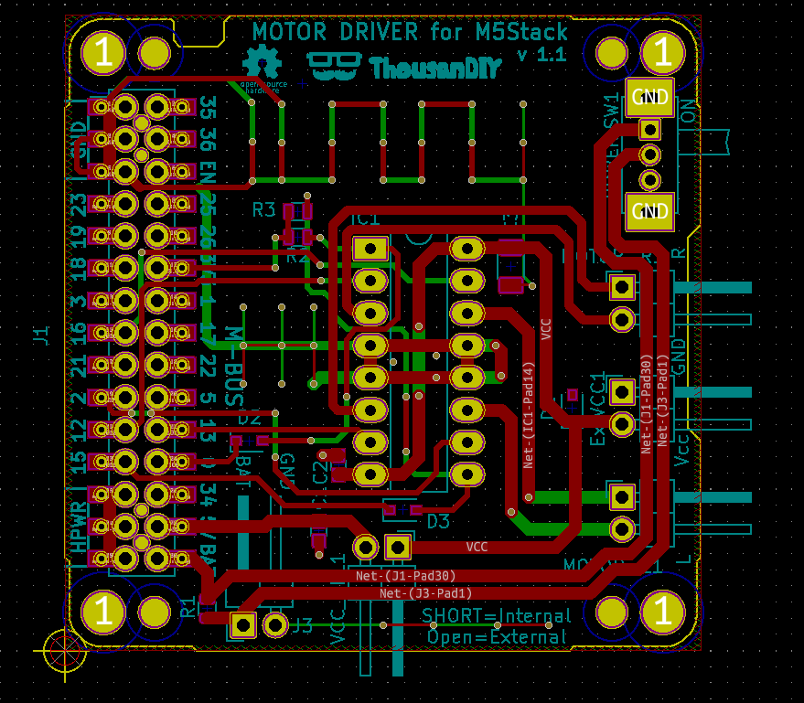

Slide 3
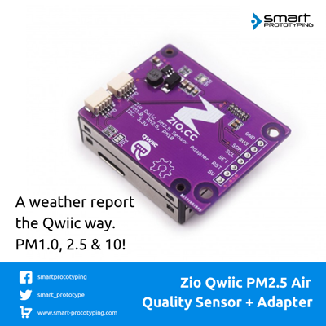
https://github.com/ZIOCC/Zio-Qwiic-PM2.5-Air-Quality-Sensor-Adapter-Board

Slide 4
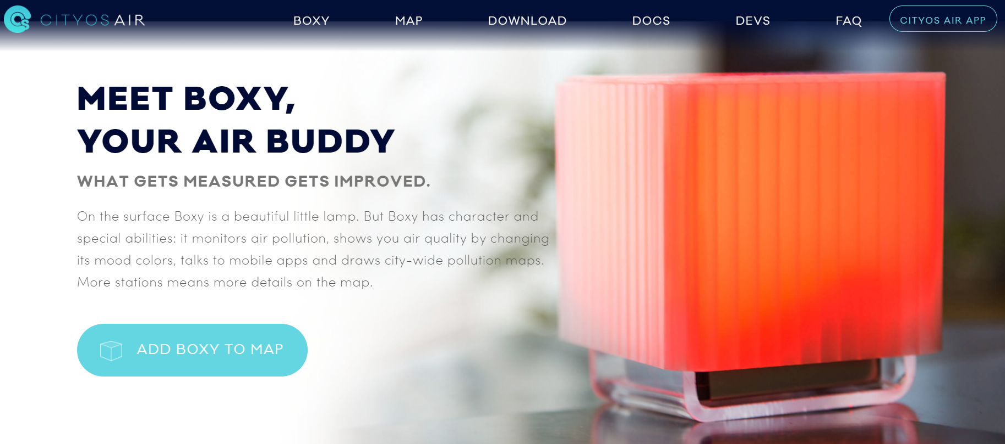
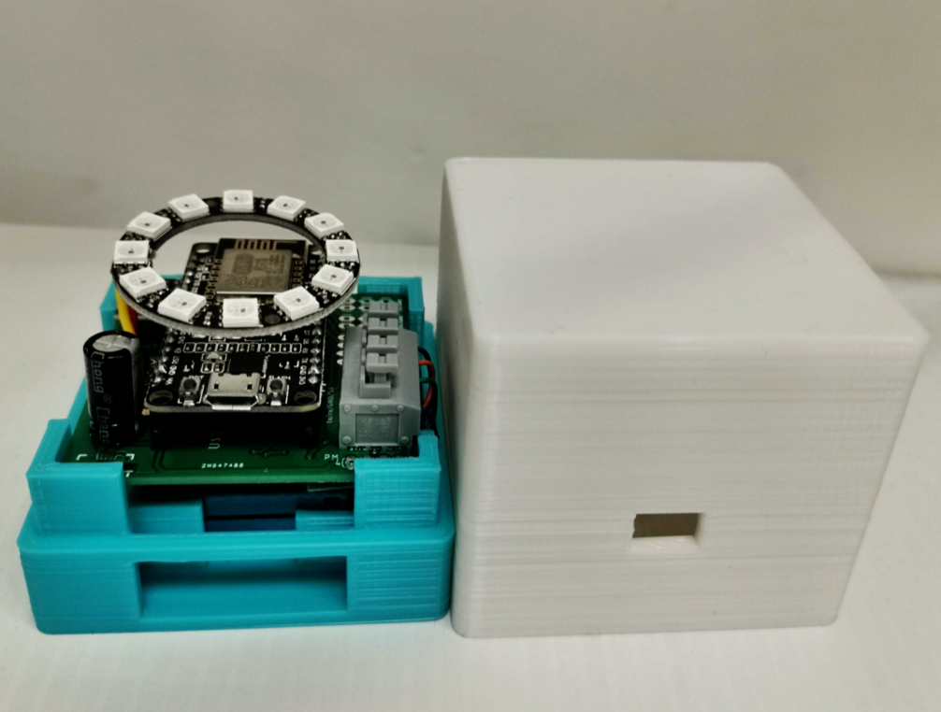
https://cityos.io/air
https://github.com/appsmonkey/air.nodemcu.full

Slide 5

