Slide 1

Deathnote VM - Penetration Testing Report tools :kali linux,virtual box/vmware ryan brian

Slide 2

Machine Information Name: Deathnote: 1 Platform: VulnHub Difficulty: Easy Objective: Get root access and capture flags

Slide 3
Methodology Overview Reconnaissance - Network scanning & service enumeration Web Application Analysis - Directory brute-forcing, hidden files Configuration File Analysis Privilege Escalation - Lateral movement & sudo abuse Flag Capture - Root access achieved

Slide 4
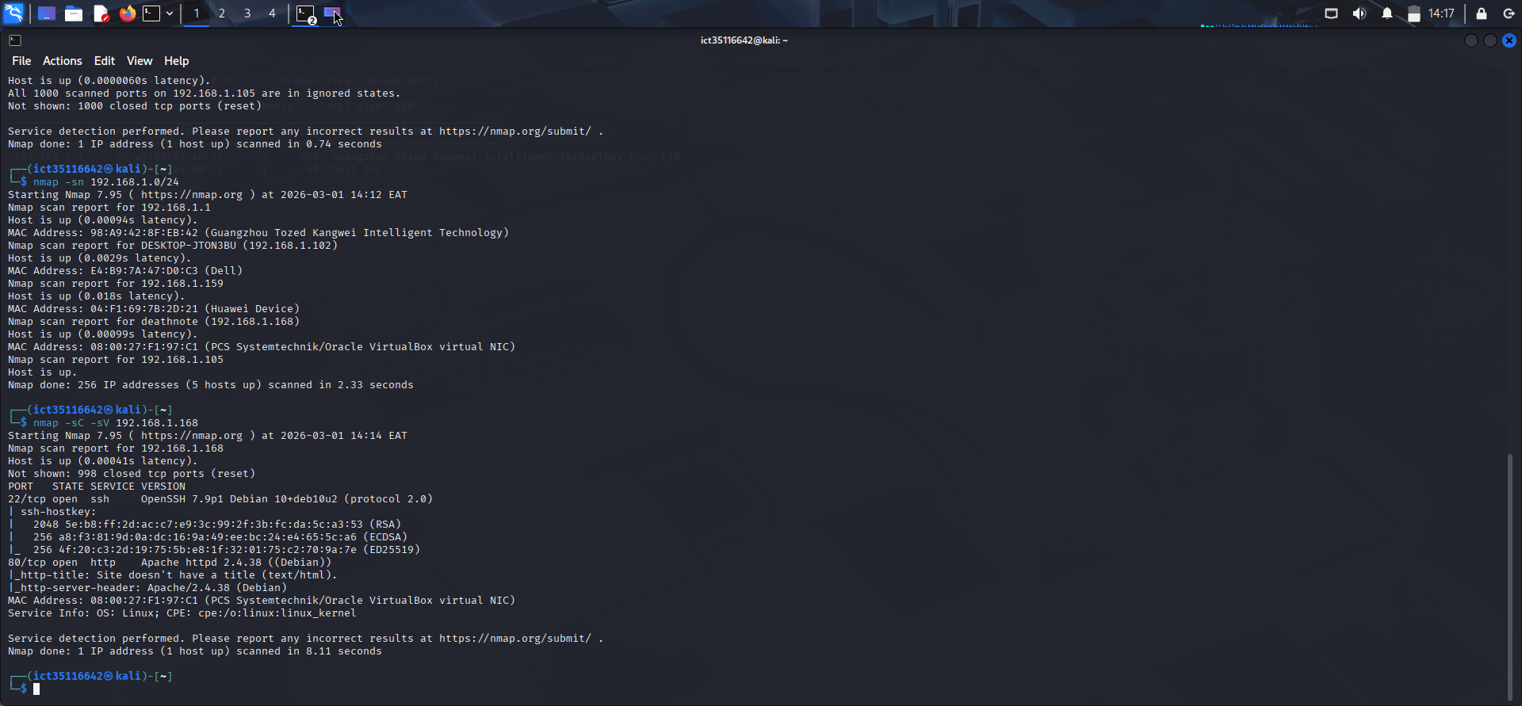
Network Discovery Findings: Port 22/tcp - OpenSSH 7.9p1 Port 80/tcp - Apache httpd 2.4.38 MAC Address: Oracle VirtualBox NIC

Slide 5
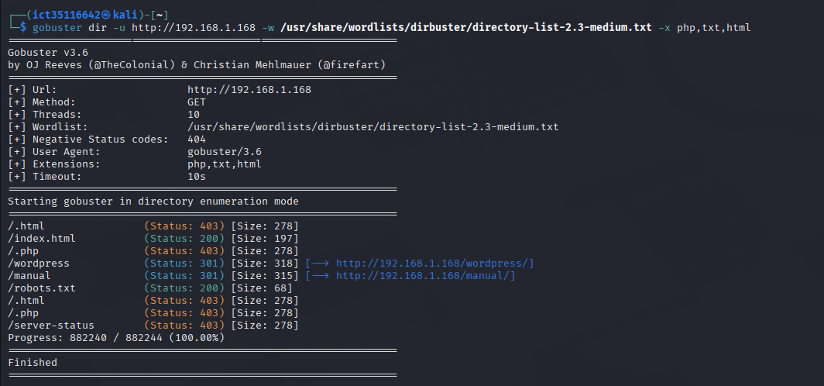
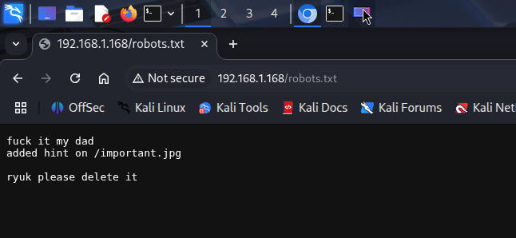
Web Enumeration - Directory Busting gobuster dir -u http://192.168.1.168 -w /usr/share/wordlists/dirb/common.txt -x txt,php,html replace the ip with your own from nmap scan Discovered Directories: /wordpress - WordPress CMS /manual - Apache manual /robots.txt - Found important clues /server-status

Slide 6
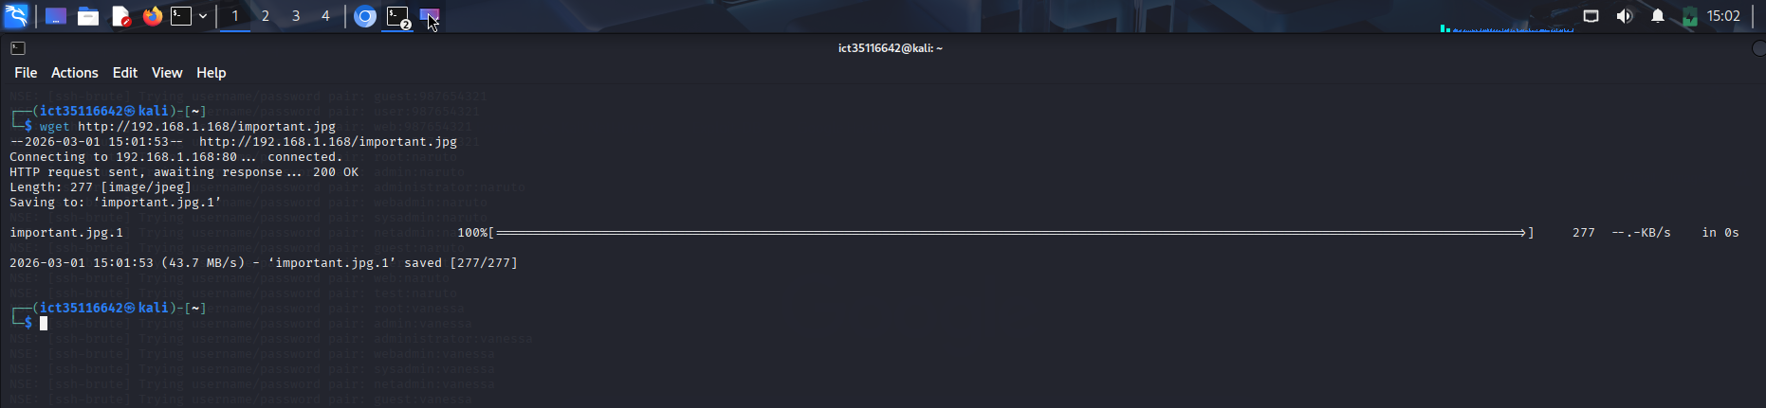
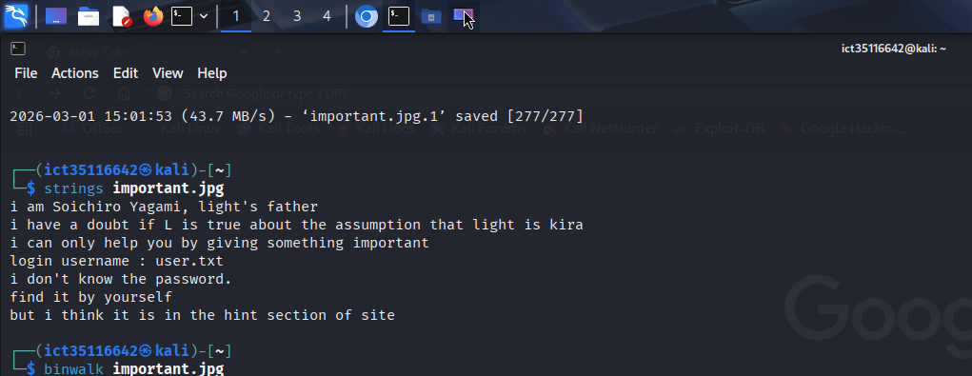
Hidden Clues - Image Analysis wget http://192.168.1.168/important.jpg strings important.jpg hidden message found: i am Soichiro Yagami, light's father i have a doubt if I is true about the assumption that Light is kira i can only help you by giving something important login username : user.txt i don't know the password. find it by yourself but i think it is in the hint section of site

Slide 7
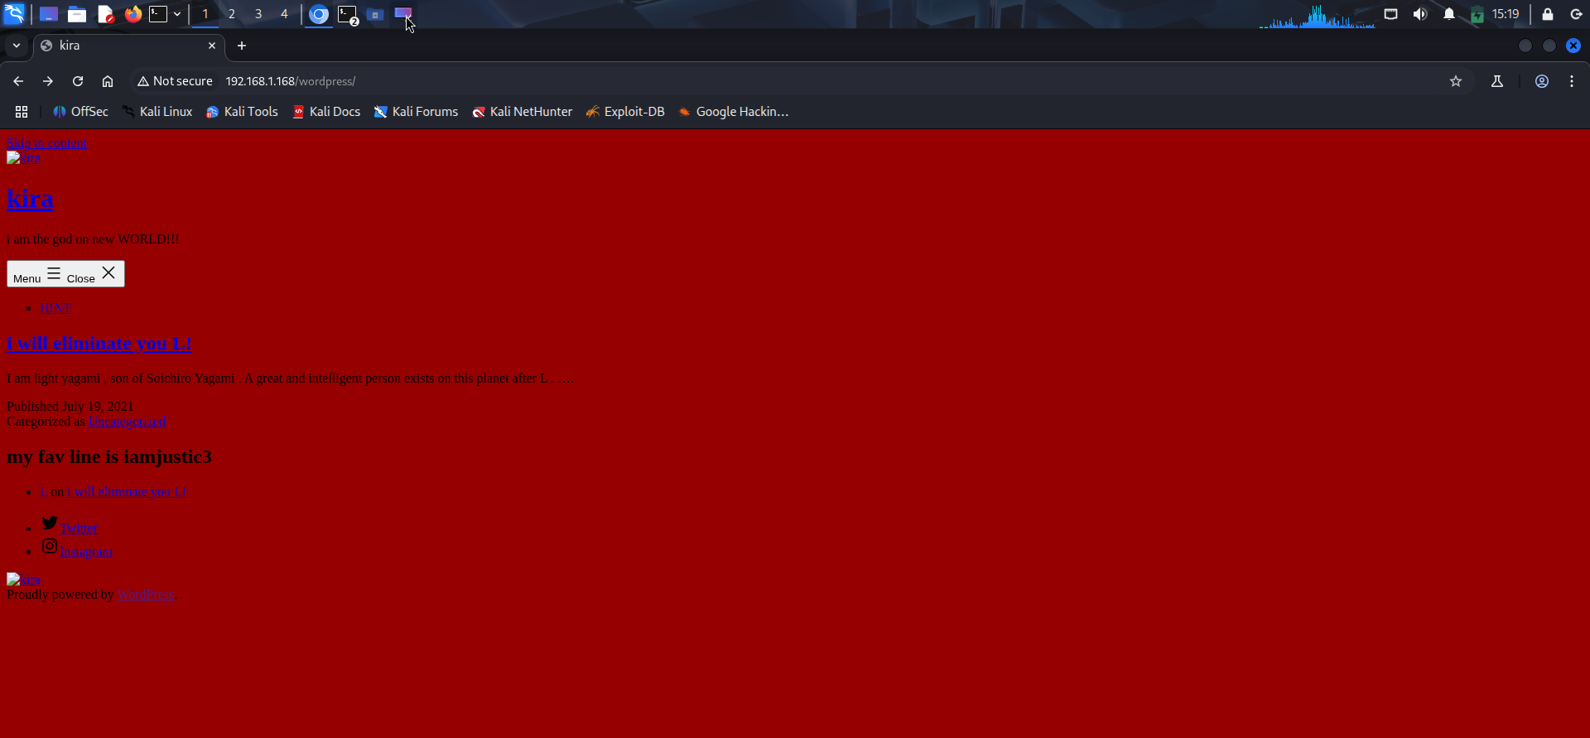
WordPress Enumeration in the browser search: http://192.168.1.168/wordpress/ WordPress Post Discovery: Author: Light Yagami Content: "I am light yagami, son of Soichiro Yagami..." Important Line: "my fav line is iamjustice3"

Slide 8
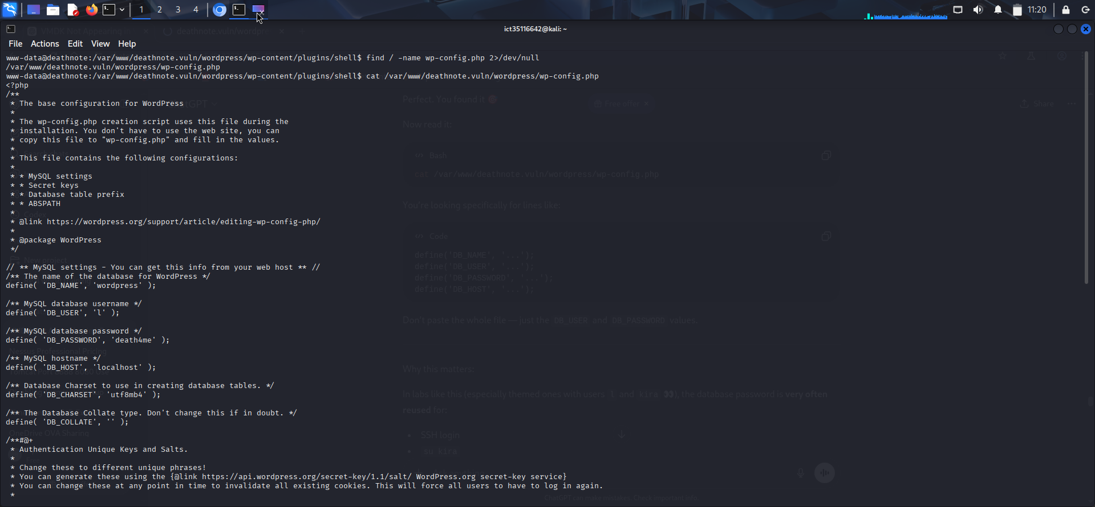
Critical Discovery in wp-config.php The wp-config.php file reveals hardcoded database credentials that were reused for SSH access: Credentials Found: Database Username: l Database Password: death4me This is a classic credential reuse vulnerability - the same password used for the WordPress database was also used for SSH login. This explains how we later accessed the system via SSH: ssh l@192.168.1.168 Password: death4me

Slide 9
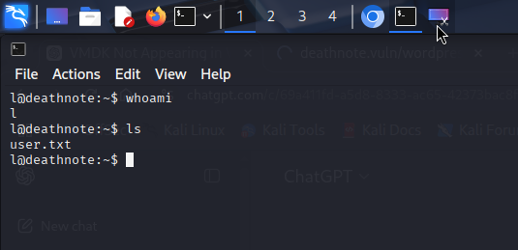
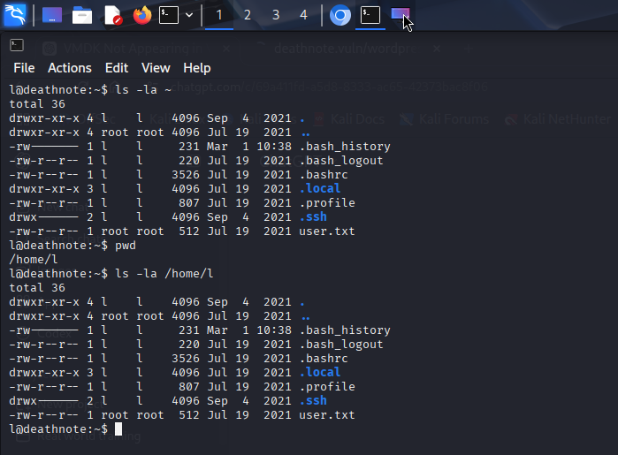
User Flag Acquisition First Screenshot Analysis: You successfully SSH'd as user l using the credentials discovered in wp-config.php: Username: l Password: death4me Second Screenshot - Getting user.txt: from slide 6 when I checked the content of important.jpg we are told username is in the file user.txt which we can see when we list everything under ‘l’ . Key Observation: The file user.txt is owned by root but readable by user l .

Slide 10
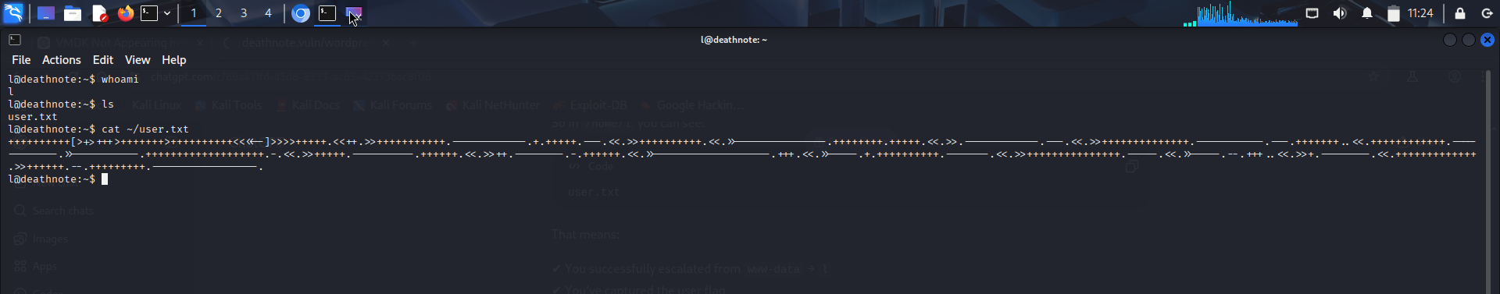
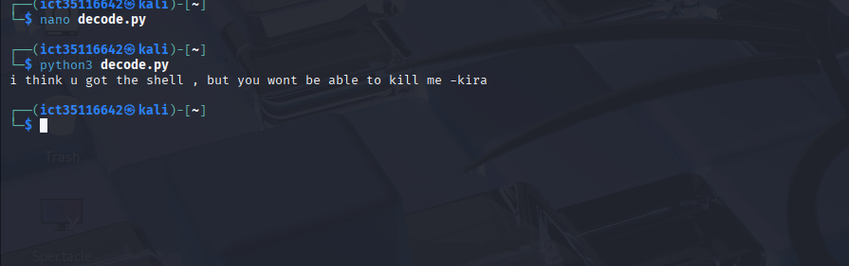
Reveling the content of user.txt and decoding. In the first screenshot I decoded the user.txt to see its content. This revealed the user flag. With me I used self developed python program to decode the flag. The massage displayed is :"i think u got the shell, but you won't be able to kill me –kira we were informed before that the user.txt had a user yet no password so from that the user here is ‘kira’.

Slide 11
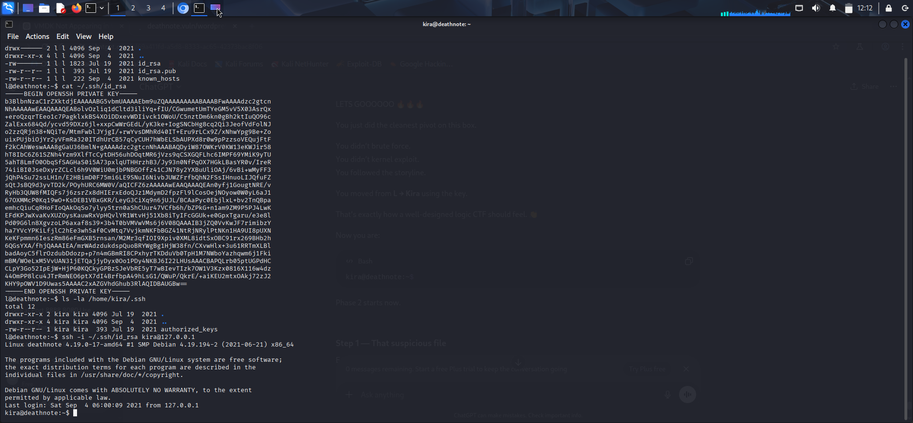
Lateral movement from ”l” to “kira” using private key for “kira” found under “l” I discovered that user l had access to kira's SSH private key in there .ssh directory: l@deathnote:~$ ls -la /home/l/.ssh/ -rw-r--r-- 1 l l 1823 Jul 19 2021 id_rsa # Private key -rw-r--r-- 1 l l 393 Jul 19 2021 id_rsa.pub # Public key -rw-r--r-- 1 l l 222 Sep 4 2021 known hosts This allowed l to SSH into kira's account without a password The key was likely placed there for privilege escalation or persistence the ssh command used to log into kira: ssh -i ~/.ssh/id_rsa kira@127.0.0.1 Key Takeaways for CTF: Always check for SSH keys in user directories Private keys (id_rsa) allow passwordless login to corresponding accounts This is a lateral movement technique - moving from l to kira The keys might be a rabbit hole or a steppingstone to further escalation

Slide 12
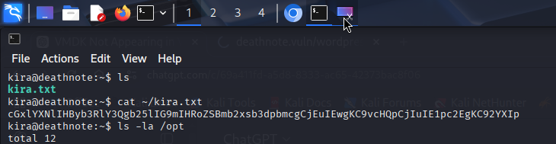
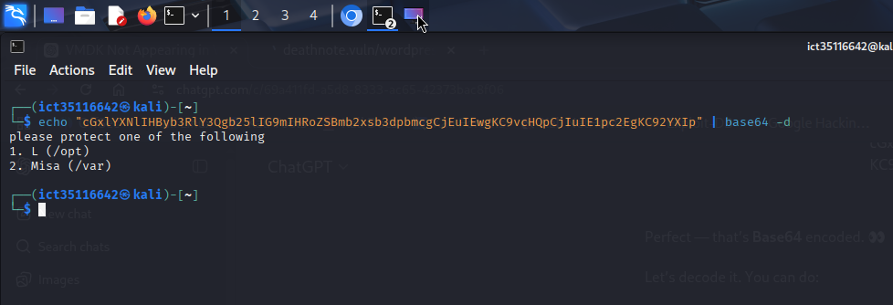
Kira's Message Decoded This is a hint from Kira pointing to two important locations: /opt - Related to "L" (the detective) /var - Related to "Misa" (Misa Amane, the second Kira) Suggests there might be important files in /var related to Misa CTF Significance: 1) These are likely directories containing the next clues or privilege escalation vectors 2) "protect" might mean these directories have special permissions or contain sensitive data 3) This is a directory traversal hint - check both locations thoroughly

Slide 13
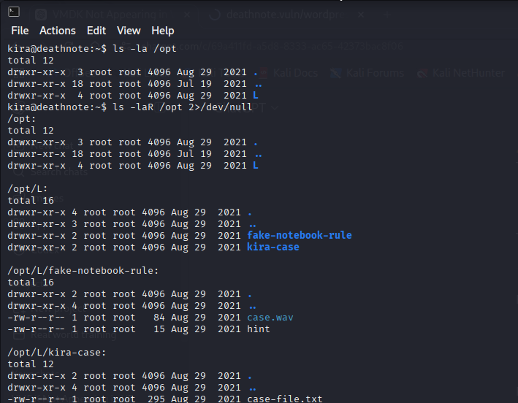
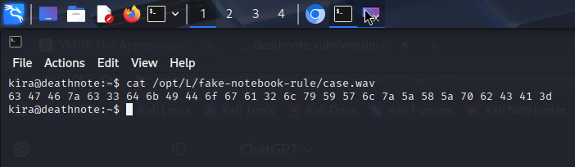
Checking the files related to l (/opt) Checking under /opt related to l the detective I’m able to find fake-notebook and case.wav in the second screenshot I tried to cat the case.wav and found the hex data and this one raised eyebrows.

Slide 14
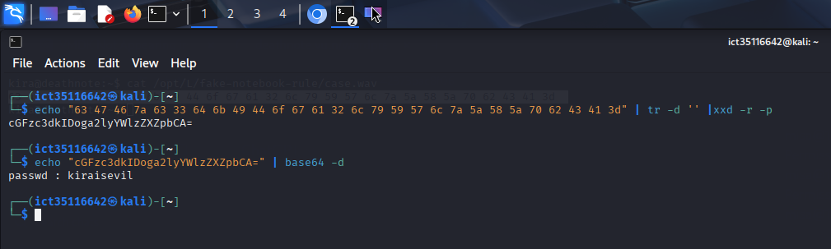
What This Means: The first decode in slide 10 ( kira) told us the username The second decode (passwd: kiraisevil) tells us the password Together they form valid credentials

Slide 15
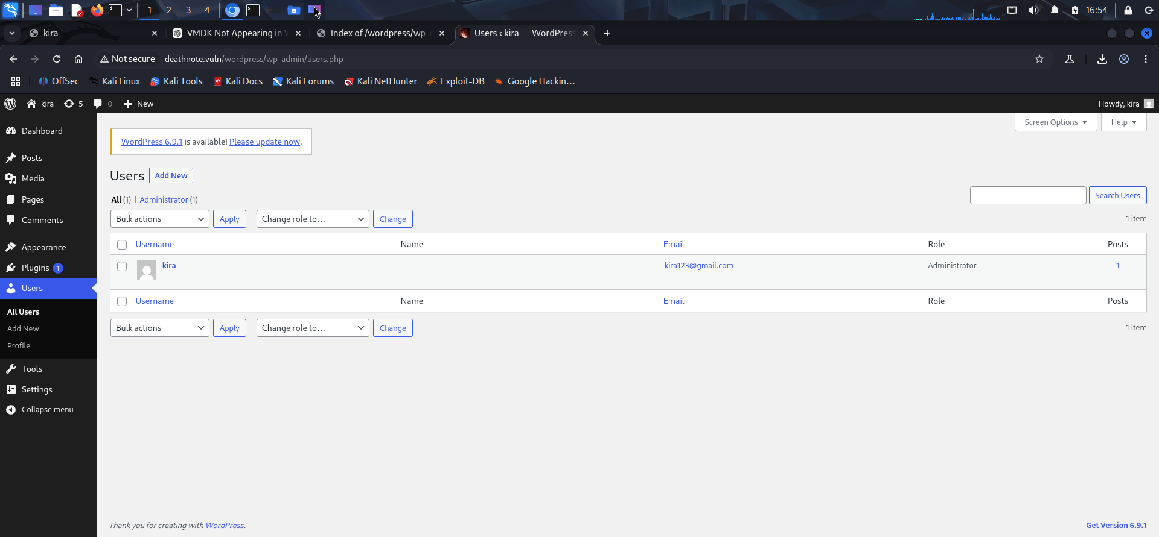
WordPress Admin Access Confirmed! Successful Login: URL: http://192.168.1.168/wordpress/wp-admin Username: kira Password: kiraisevil What We See in the Dashboard: WordPress version 6.9.1 (needs update) User found: kira (Administrator) Email: kira123@gmail.com Only one user exists in the system

Slide 16
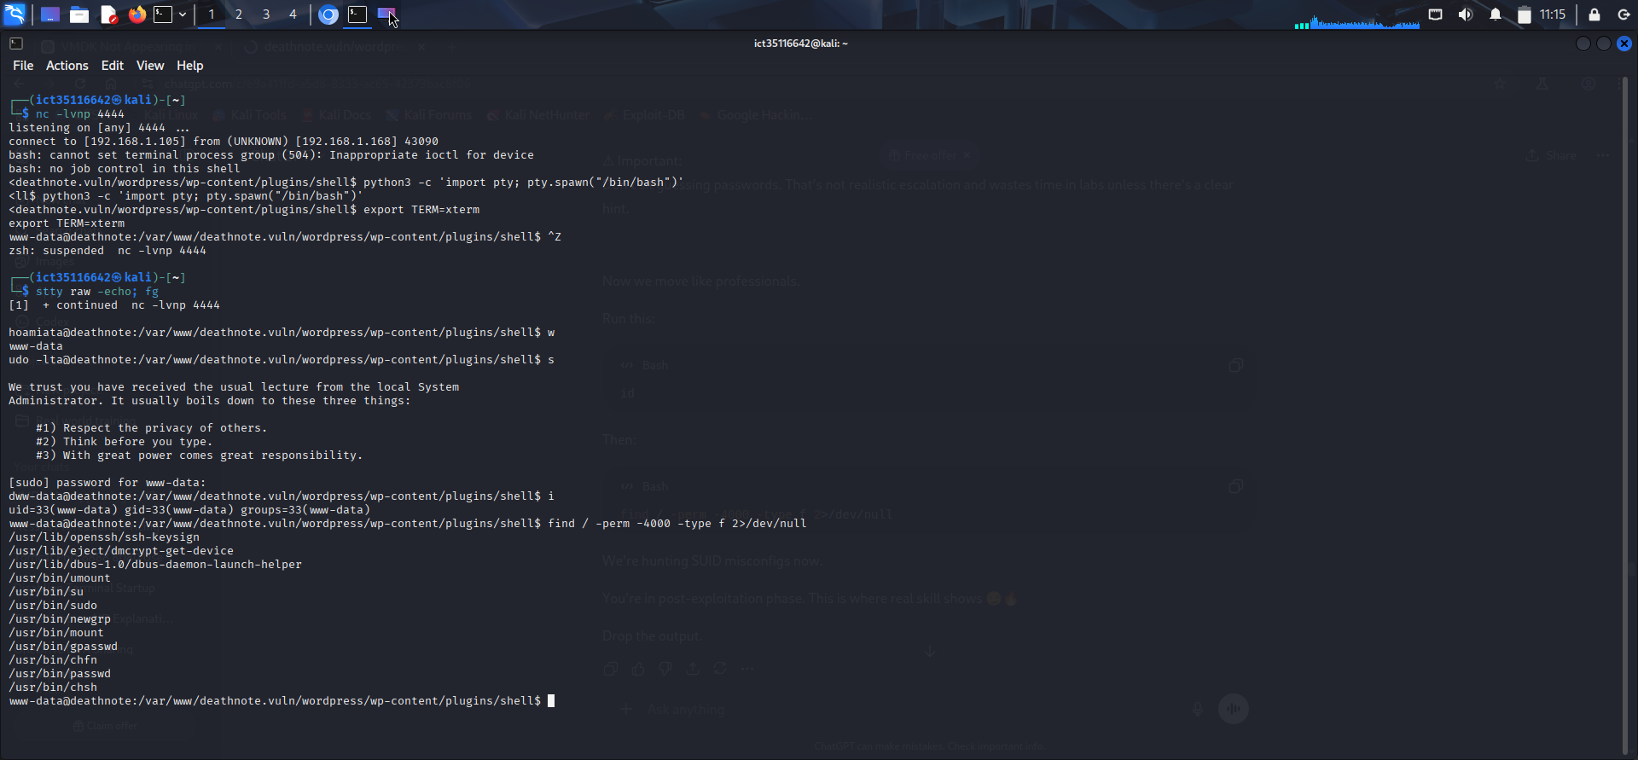
Shell Stabilization & Enumeration The shell initially ran with www-data privileges, indicating access through the web server environment. The shell was then upgraded to an interactive TTY to allow proper command execution and system interaction. After gaining access, post-exploitation enumeration was performed by checking the current user and searching for SUID binaries, which could potentially be used for privilege escalation. This confirms that the attack successfully achieved remote system access, demonstrating the security risks associated with vulnerable web applications and improper system configurations.

Slide 17
Conclusion & Key Takeaways DeathNote CTF - Complete Walkthrough Recon : Nmap, directory busting, robots.txt analysis Web Enum: WordPress discovery, image steganography Credentials: `kira: kiraisevil` from hex/base64 decoding Initial Access: WordPress admin → Reverse shell Lateral Movement: wp-config.php exposed `l:death4me` Priv Esc: SUID binaries, sudo misconfigurations Root Access: Final flag captured Key Skills Demonstrated: - Information disclosure exploitation - Credential reuse vulnerability - WordPress theme editor RCE - Linux privilege escalation techniques - Base64/hex decoding for hidden data Final Message: "In the world of CTF, like in DeathNote, the smallest clue can lead to the ultimate victory - whether you're L or Kira." Thank You!

