Slide 1
bulldog2:vuln hub walkthrough
Tools used: kali linux ,virtual box .
Created by : Ryan Brian

Slide 2
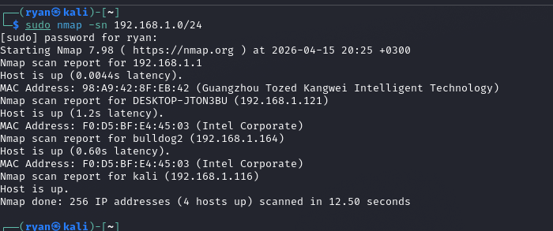
Host discovery using nmap.
For host discover using nmap I used the command :
Sudo nmap –sn 192.168.1.0/24
From the screenshot we can see the bulldog2 machine discovered.

Slide 3
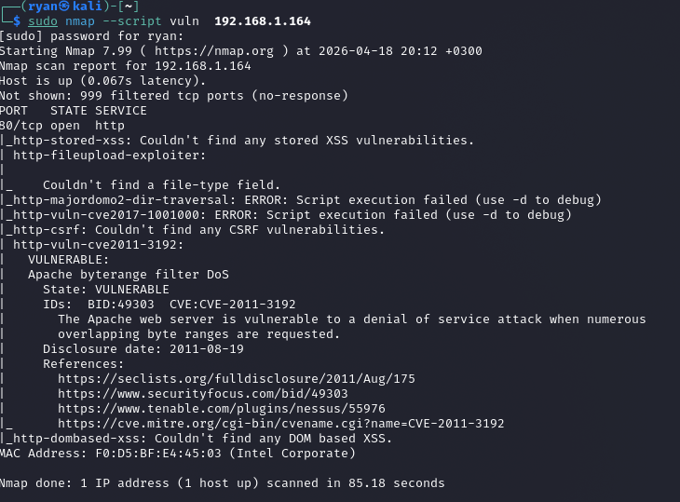
the screenshot below shows vulnerability scan using nmap for the host we discovered early.
Apache vulnerability (CVE-2011-3192) - This is a false positive! The target is running nginx, NOT Apache. Nmap incorrectly identified this vulnerability.

Slide 4
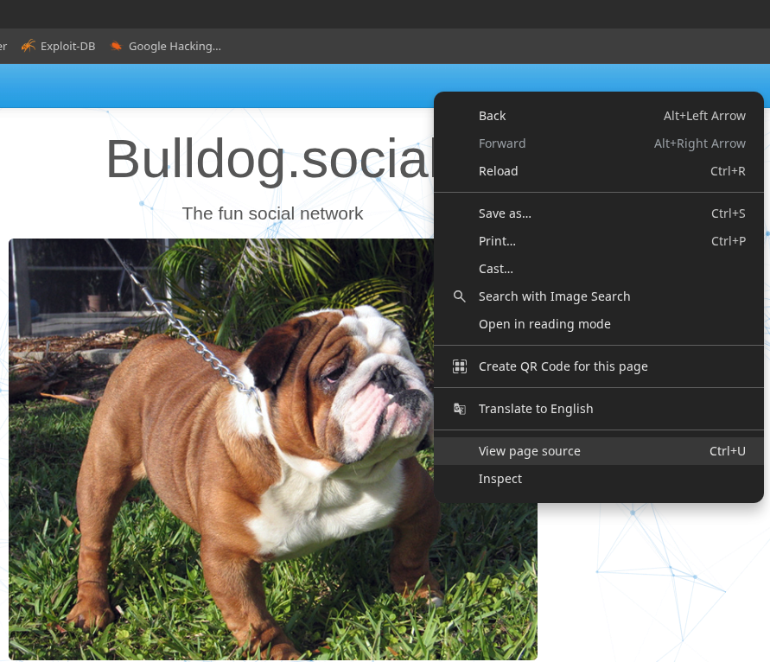
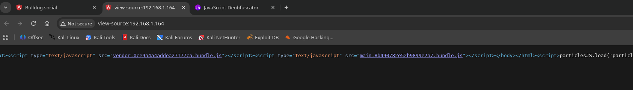
Using page source to get the json script
Here I checked the script under user registration and login to understand how user registration works.

Slide 5
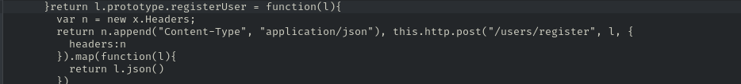
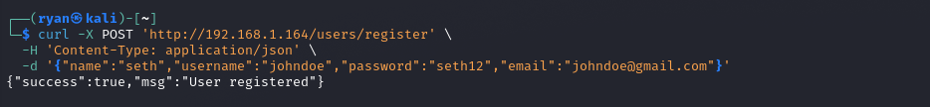
User registration
The registration endpoint was disabled in the UI but still active on the backend allowing direct API access via curl to bypass client-side restrictions.

Slide 6
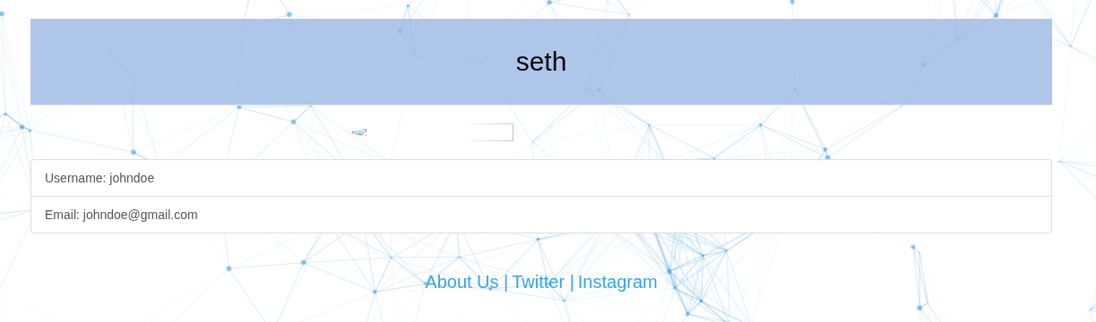
Confirmation for the user I registred.
The user I tried to create was a success and I can login into the user account.

Slide 7
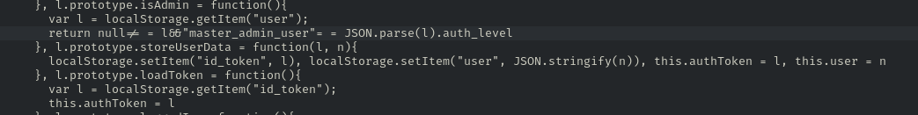
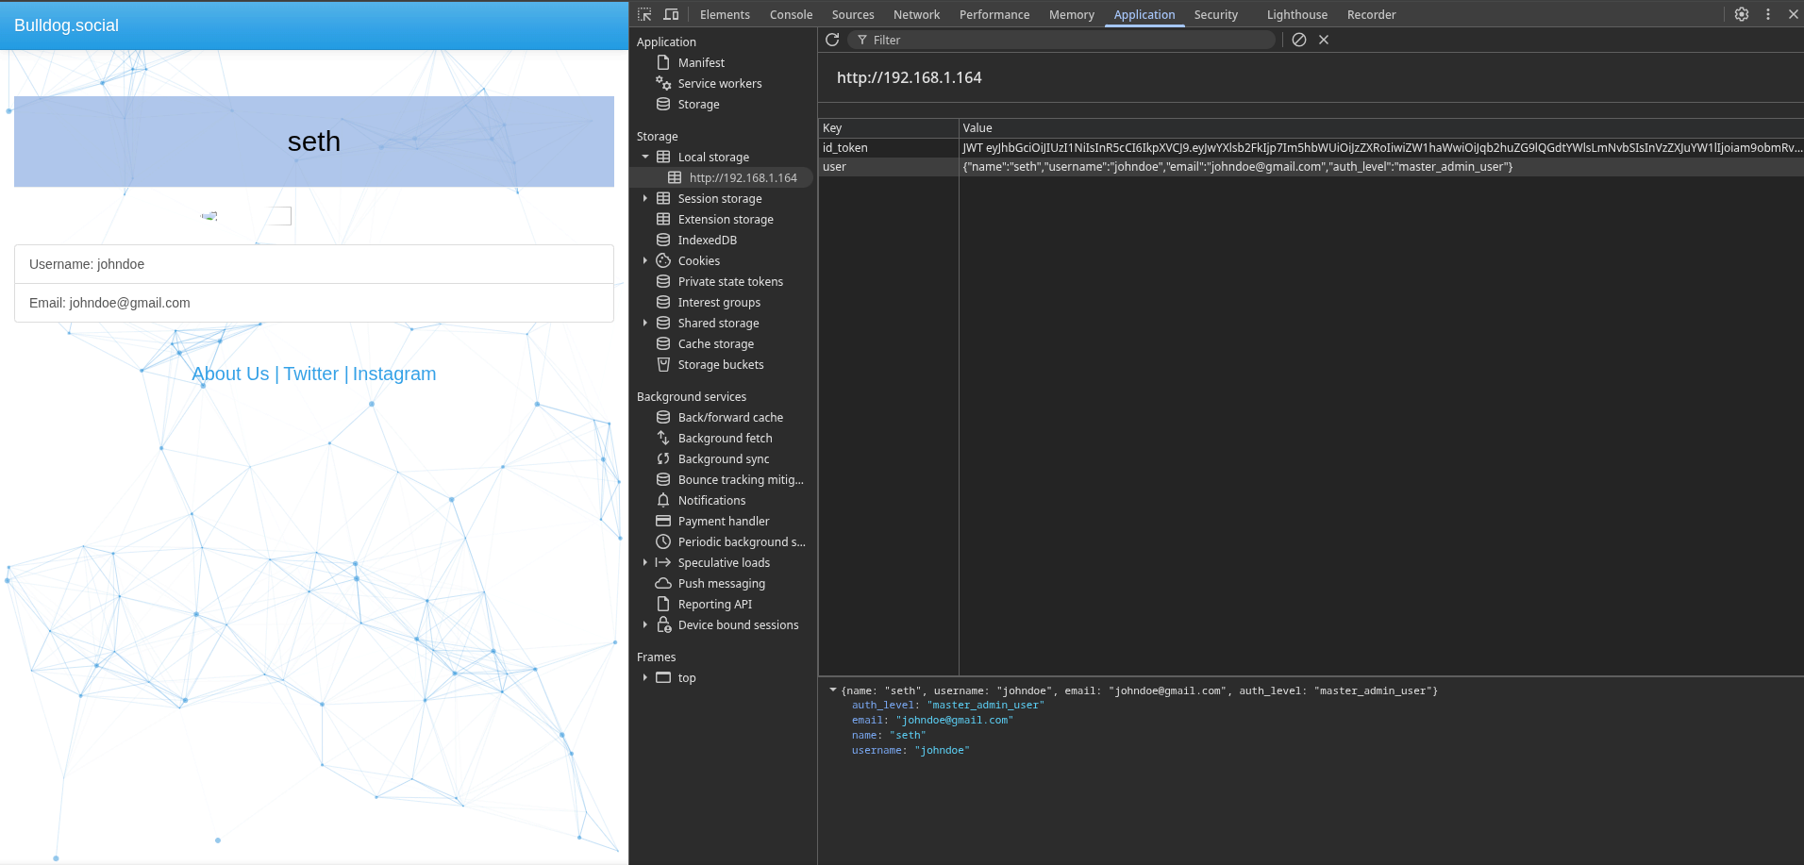
Changing the authentication level from standard user to master admin user.
From the first screenshot : The app only checks local Storage for admin status - it doesn't re-verify with the server
In the second shot : The application trusted client-side JWT claims modifying the 'auth_level' from 'standard_user' to 'master_admin_user' in local storage granted administrative privileges.

Slide 8
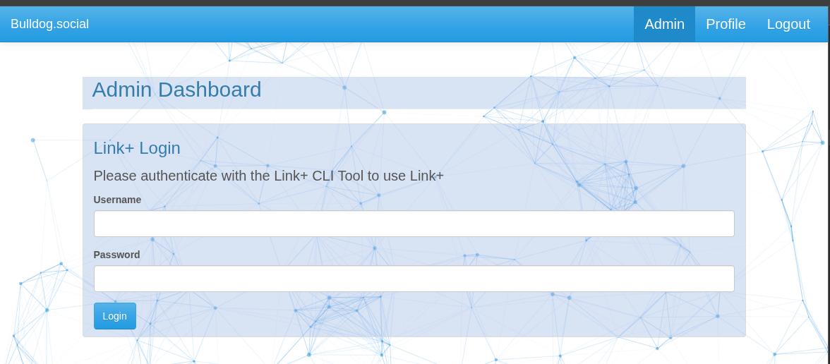
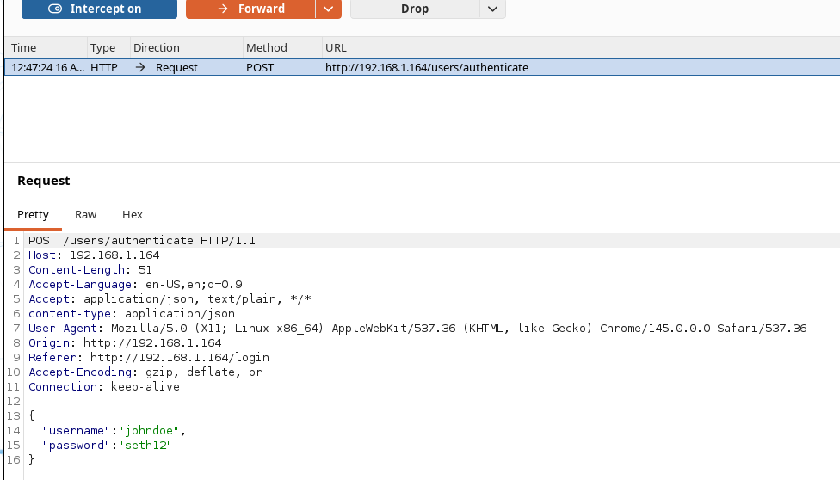
from the first shot we can see the admin panel has been added this is due to the change made from standard user to master admin user.
After modifying the JWT 'auth_level' to 'master_admin_user' in localStorage, the application's 'isAdmin()' function returned true, revealing the hidden Admin Dashboard button and granting access to privileged features like Link+ CLI authentication.
The second shot: Login request sends username/password in JSON format to the /users/authenticate endpoint, which returns a JWT token containing the user's auth_level for client-side storage.

Slide 9
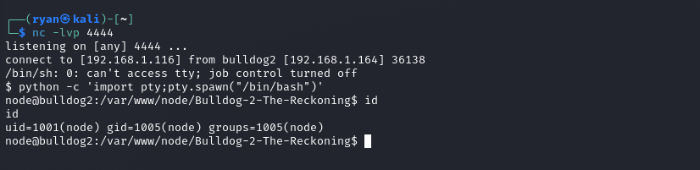
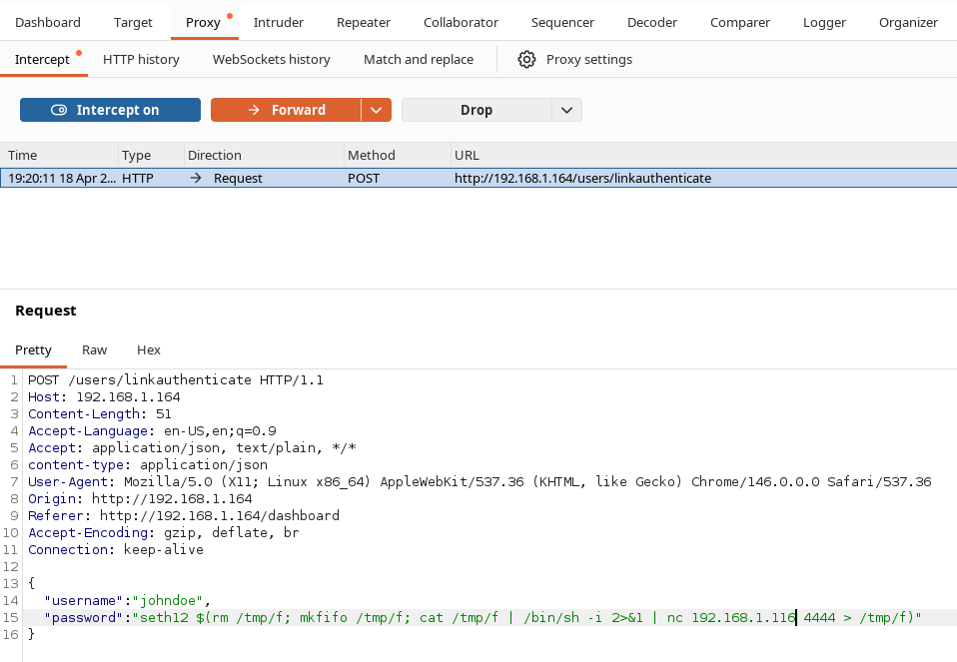
Gaining a reverse shell connection .
The first shot is : Netcat listener captures the connection, spawning a shell as the 'node' user on the target system.
The second shot is : Command injection payload embedded in the password field of the /users/linkauthenticate request, using a reverse shell one-liner to execute system commands on the server.

Slide 10
Stabilizing the reverse connection.
After gaining a reverse shell, I used Python PTY spawning to upgrade the unstable /bin/sh to a fully interactive /bin/bash shell with job control.
Python PTY spawning stabilized the raw reverse shell into a fully interactive bash session.

Slide 11
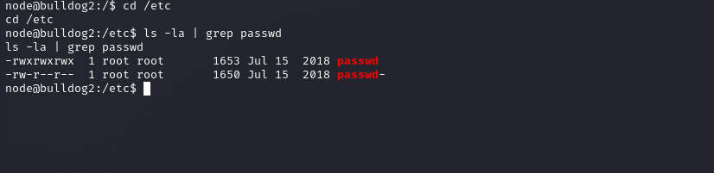
Enumerating the /etc directory.
The /etc/passwd file has world-writable permissions (777), allowing any user to add a new root user and escalate privileges.

Slide 12
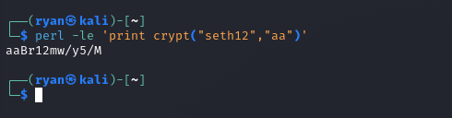

Password hashing and creating of user with the right permissions.
The first shot : A password hash was generated using Perl's crypt() function, then appended to /etc/passwd with UID 0 to create a new root user.
In the second screen shot :A new user with UID 0 (root privileges) was added to the world-writable /etc/passwd file using a precomputed password hash.

Slide 13
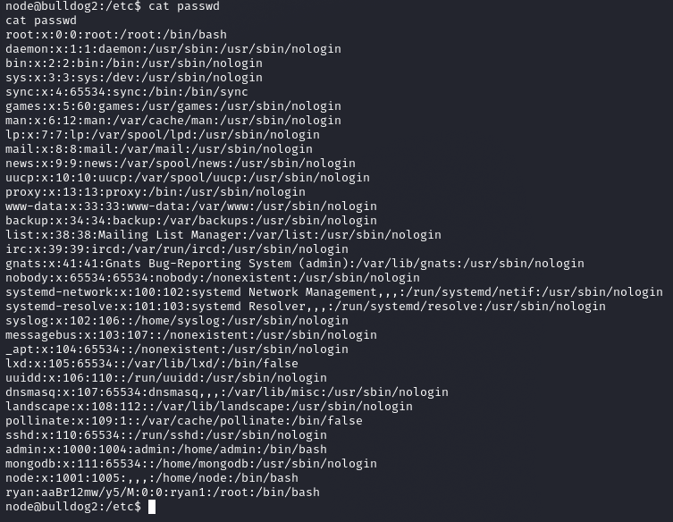
Confirmation if the user was created successfully.
The last line confirms a new user 'ryan' with UID 0 (root privileges) was successfully appended to /etc/passwd, enabling immediate privilege escalation.

Slide 14
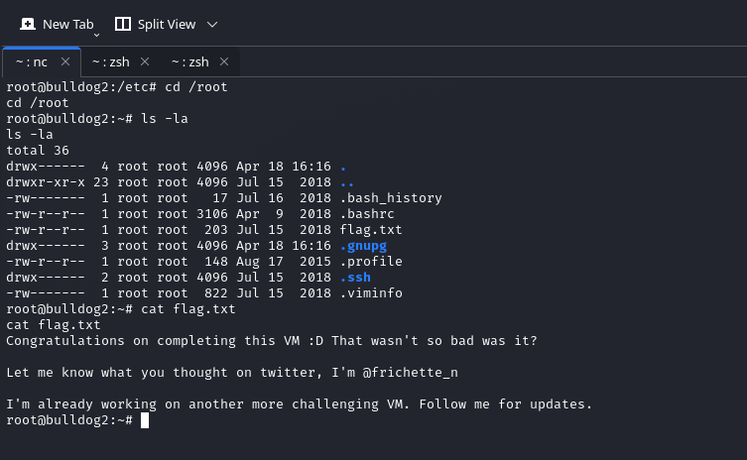
Getting the flag.
After escalating to root via the world-writable /etc/passwd, reading /root/flag.txt confirmed successful compromise of the Bulldog 2 VM.
A chain of vulnerabilities including insecure direct object reference, client-side authorization, command injection, and world-writable system files led to full root compromise.

Slide 15
Registration Bypass → JWT Manipulation → Admin Access ↓ Command Injection → Reverse Shell ↓ Writable /etc/passwd → ROOT → FLAG 🏆
Vulnerabilities Identified:
└── IDOR (User enumeration)
└── Broken Access Control (JWT manipulation)
└── Command Injection (Reverse shell)
└── Privilege Escalation (Writable /etc/passwd)
Remediation:
├── Server-side authorization checks
├── Input sanitization
└── Strict file permissions (644 for /etc/passwd)

