Slide 1
Virtual Barber
Tyler Ambroziak
Ryan Fox
Cs 638-1
5/3/10

Slide 2
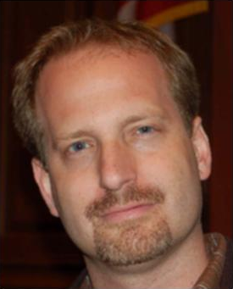
The Goal
Go From This

Slide 3
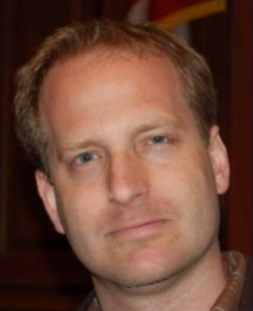
The Goal
Go From This
To This

Slide 4
The Motivation
For people who have had facial hair for a long time, the decision to shave can be difficult
Don’t know if it will look okay or not
If you could “preview” what you’d look like without a beard, the decision of whether or not to shave would be an easier one

Slide 5
The Problem
Given an image of a person with a beard, how do you realistically “remove” the beard while keeping the rest of the face the same?

Slide 6
Main Idea
Use a collection of non-bearded faces to synthesize non-bearded version of a bearded face
Use robust statistics
Define beard layer mask based on differences in input vs. initial output image
Refine image by using beard mask to define region of synthesis
Preserves other layered features such as glasses, moles, etc.

Slide 7
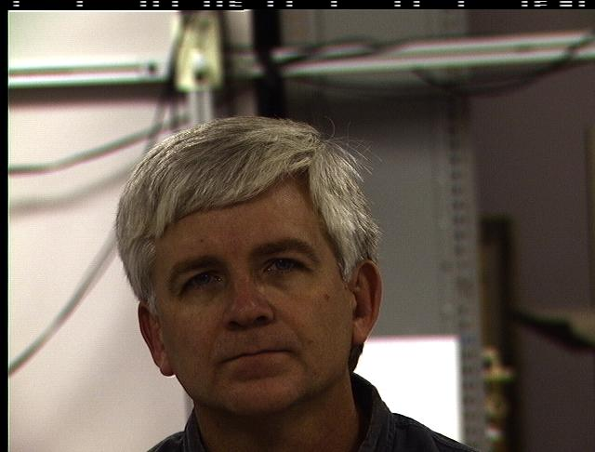
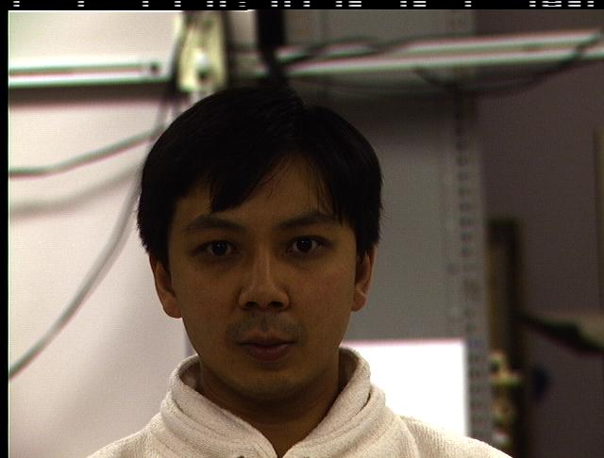
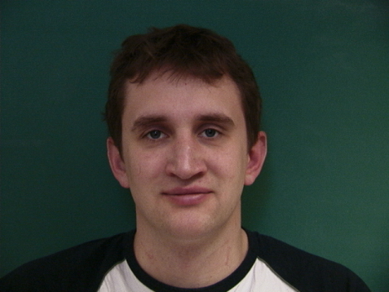
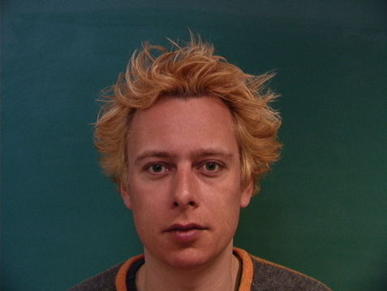
The Method
Construct non-beard subspace
60 non-bearded, neutral faces
Aligned faces using 28 manually-defined feature points
Images cropped to 95x93 pixels
Cropped images vectorized and combined into “mega-matrix”

Slide 8
Constructing Subspace
Used images from two face databases
CMU’s Multi-PIE Database (ri.cmu.edu)
IMM Face Database (www2.imm.dtu.dk/~aam)
60 unique clean shaven males
25 unique females
20 unique bearded males
Used only male faces in non-beard subspace

Slide 9
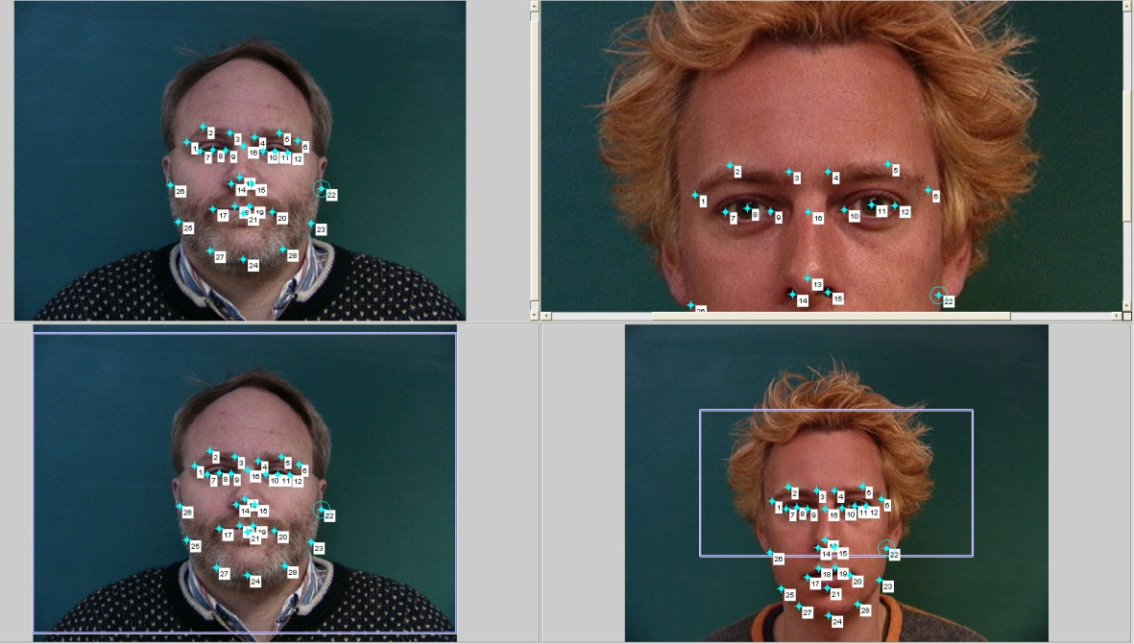
The Method
Construct non-beard subspace
Input bearded image
Manually define the 28 feature points for alignment
Image cropped and vectorized

Slide 10
The Method
Construct non-beard subspace
Input bearded image
Remove the beard layer
Several Approaches

Slide 11
Removing the Beard Layer

Slide 12
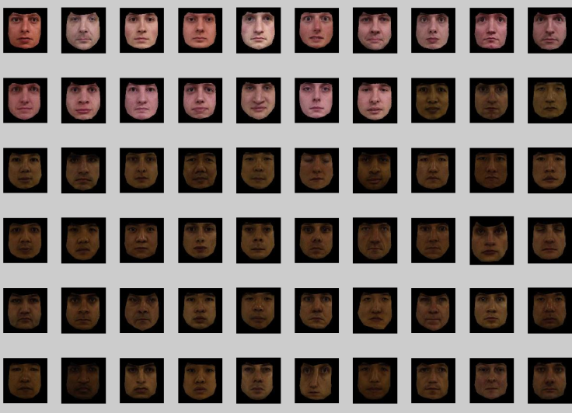


Technique 1: Naïve approach
x* = Vc
x is a face image with a beard, x* is same face without beard
V is the non-beard subspace
c = (V^{T}V)⁻¹ V^{T}x
Easy implementation in Matlab

Slide 13

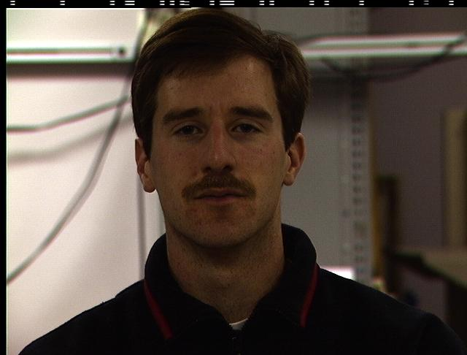

Results: Naïve Approach

Slide 14

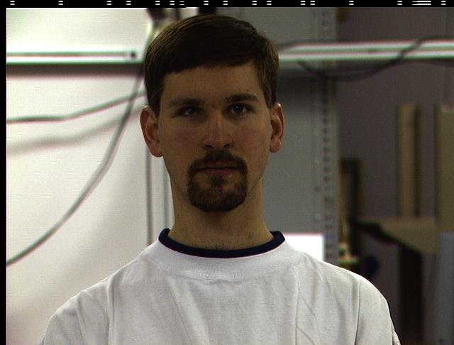

Results: Naïve Approach

Slide 15

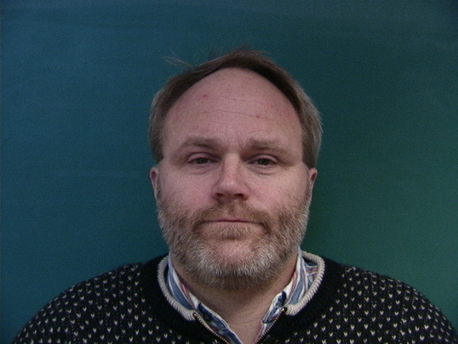

Results: Naïve Approach

Slide 16
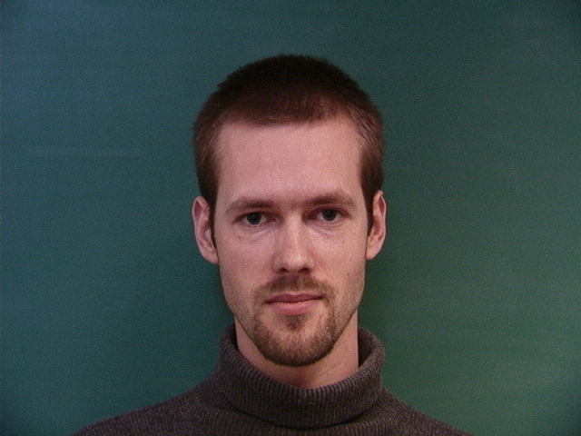
Results: Naïve Approach

Slide 17

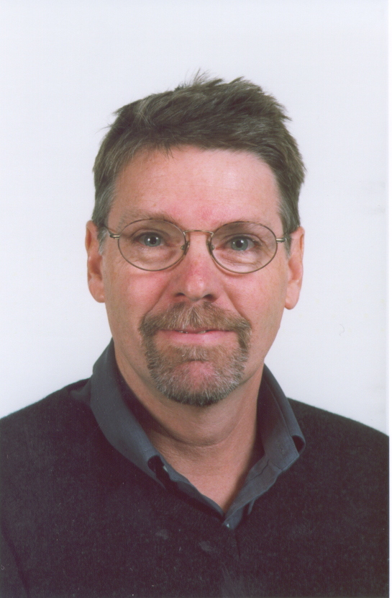

Results: Naïve Approach

Slide 18
Technique 2: Iteratively Reweighted Least Squares
Treat beards as outliers of non-beard subspace V
Use M-estimator to remove influence of the outliers from the projection
Iterating over the previous method, re-weighting pixels based on the beard space
Currently being implemented. Results from Ngyuen paper:
Original
Naive reconstruction
Robust reconstruction

Slide 19
Strengths/Weaknesses
Does a fairly good job of removing beards
Quick processing time
Can be used to remove other “layers”
Non-beard subspace could be larger
Requires user input/manual image registration
Uninformed techniques remove objects that should remain
Glasses, moles, scars, etc.

Slide 20
To Do
Finish implementing IRLS
Factorizing layered spaces using PCA
Beard mask segmentation using graph-cuts
Pre-define masks for region preservation
Trying out different facial hair styles

Slide 21
Future extensions
Law enforcement: identification of wanted persons
Evaluating a look before shaving
Apply to other “layers” (i.e. glasses, scars, moles, etc.)
Beard synthesis

Slide 22
References
Minh Hoai Nguyen, Jean-François Lalonde, Alexi A. Efros, and Fernando de la Torre. Image-based Shaving, Computer Graphics Forum Journal (Eurographics 2008), 27(2), p.627-635, 2008.

Slide 23
Questions?

