Slide 1
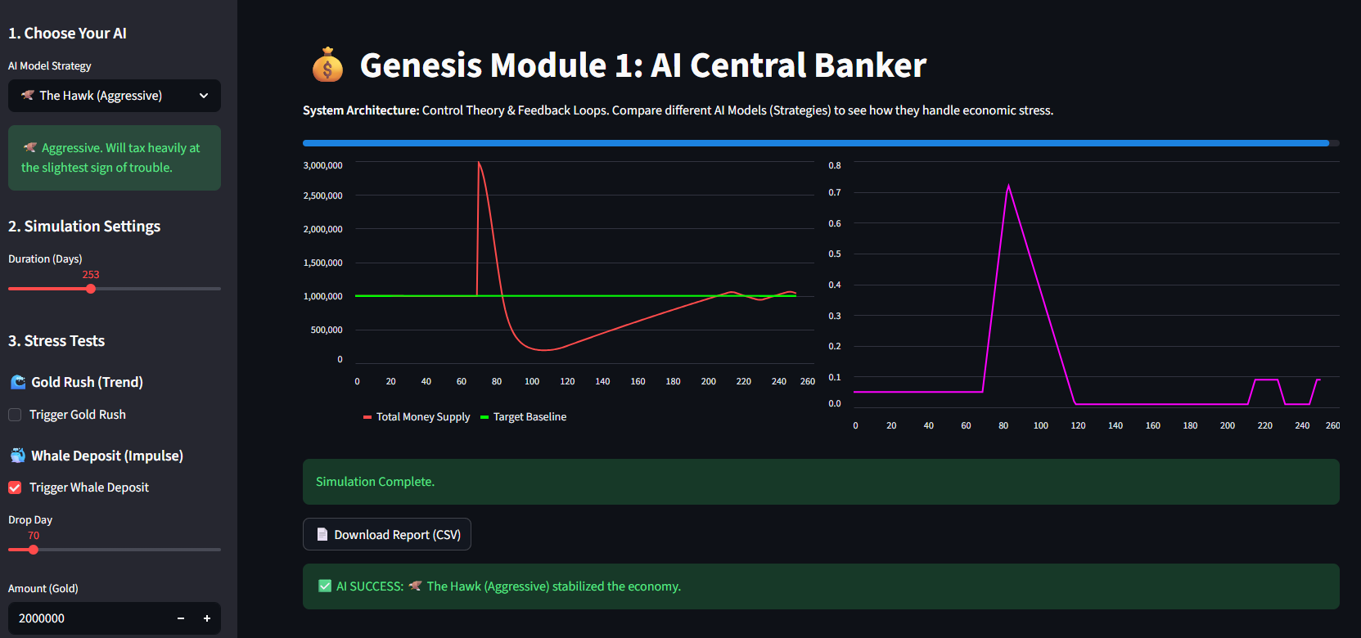
Genesis Module 2: The AI Central Banker
Automated Economic Stabilization using Control Theory
Source: dashboard/app.py
By Ryan Gilbert

Slide 2
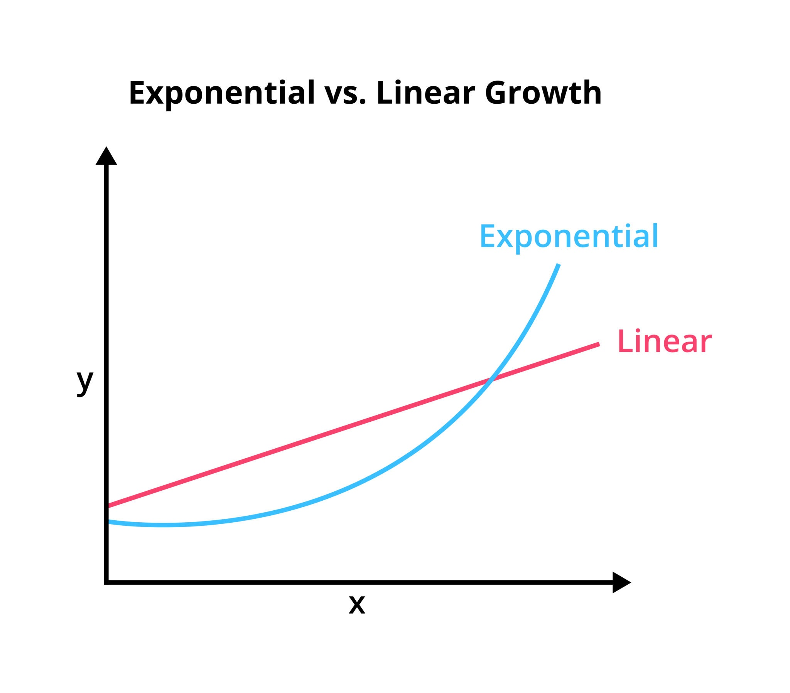
The Silent Killer: Hyperinflation
Infinite Faucets: In MMOs, monsters spawn forever, printing infinite money.
Static Sinks: Vendor prices and repair bills rarely change.
The Result: Money supply grows exponentially → Currency becomes worthless → New players cannot compete.
Source: Getty Images

Slide 3
Dynamic Monetary Policy
Concept A: “Central Bank” AI that monitors the Total Money Supply in real-time.
Mechanism: If inflation > Target, the AI raises the Transaction Tax (Burn Rate).
Logic: Uses a Proportional-Integral-Derivative (PID) loop to apply force against the market trend.
Goal: Keep the economy stable without human intervention.

Slide 4
Python Implementation
Core Logic:
  Economy Class tracks global M1 supply.
  CentralBankAI Class decides policy.
Strategies:
  The Hawk: Aggressive Intervention (High $K_p$)
  The Dove: Passive observation(Low $K_p$)
Simulation: Streamlit Dashboard runs 365-day cycles in milliseconds.

Slide 5
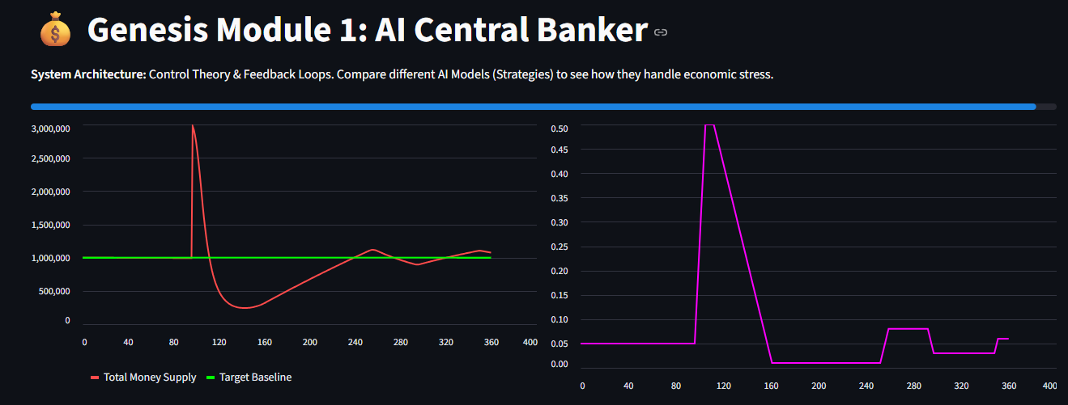
Resilience Testing & Failure Analysis
Scenario: A "Whale Deposit" injected 2M Gold (200% spike) on Day 97.
Observation: The “Balanced” AI reacted too slowly, causing a 40-day inflation spike followed by a deflationary crash.
Key Findings: A simple Proportional Controller is insufficient for impulse events. A Derivative (D) term is required to predict recovery and prevention over-correction.

