Slide 1
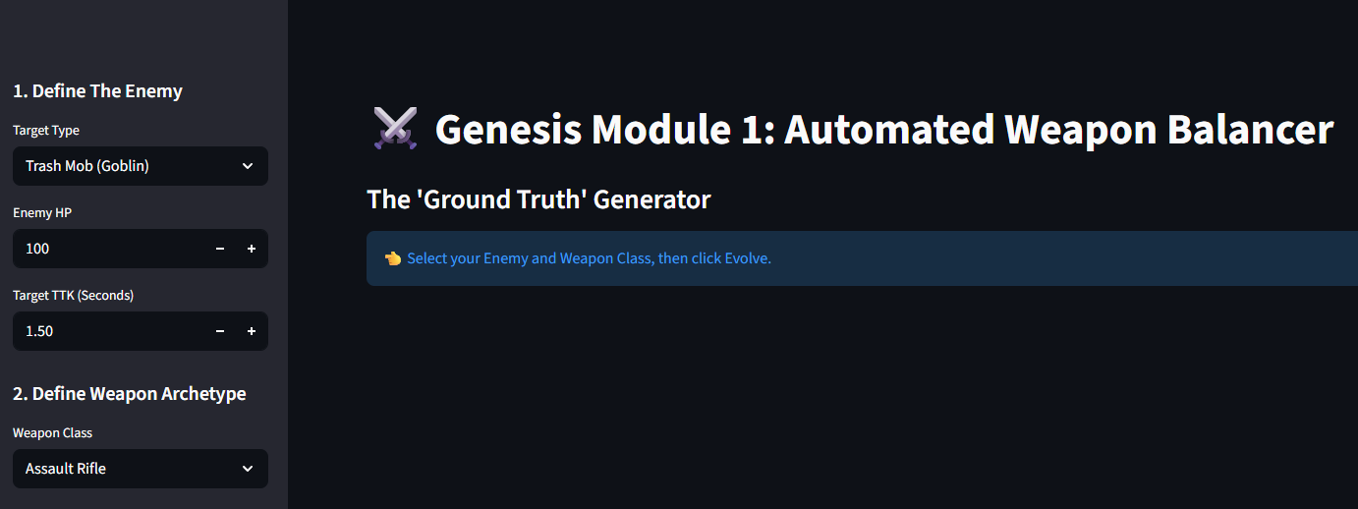
Genesis Module 1: Automated Weapon Balancer
Procedural Content Generation using Genetic Algorithms
Source: Genesis Weapon Balancer dashboard
By Ryan Gilbert

Slide 2
Manual Game Balancing
Complexity: A weapon with 3 stats (Damage, Fire Rate, Mag Size) has over 1,000,000 possible combinations.
Human Error: Developers "guess" numbers, leading to "Overpowered (OP)" meta-weapons that ruin player experience.
Time Cost: Manual playtesting takes weeks per weapon.

Slide 3
Evolutionary Computation (The "Creator")
Concept: Instead of guessing, we "breed" weapons.
Selection: We keep the top 10% of weapons that are closest to the target kill-time.
Crossover: We mix the stats of the survivors (Parent A + Parent B = Child).
Mutation: Randomly tweak stats (Damage +/- 5) to discover new archetypes.

Slide 4
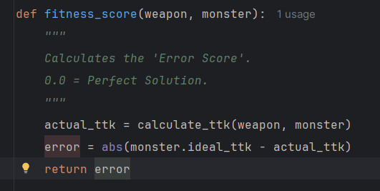
Technical Implementation (Python)
Physics Engine: A discrete-event simulator that calculates "Time-To-Kill" (TTK) including reload penalties.
The Discriminator: A fitness function f(x) that calculates the error distance from the target.
Tech Stack: Python 3.10, NumPy (Vectorized Math), Streamlit (Real-time Visualization).
Source: src/genetic_engine.py

Slide 5
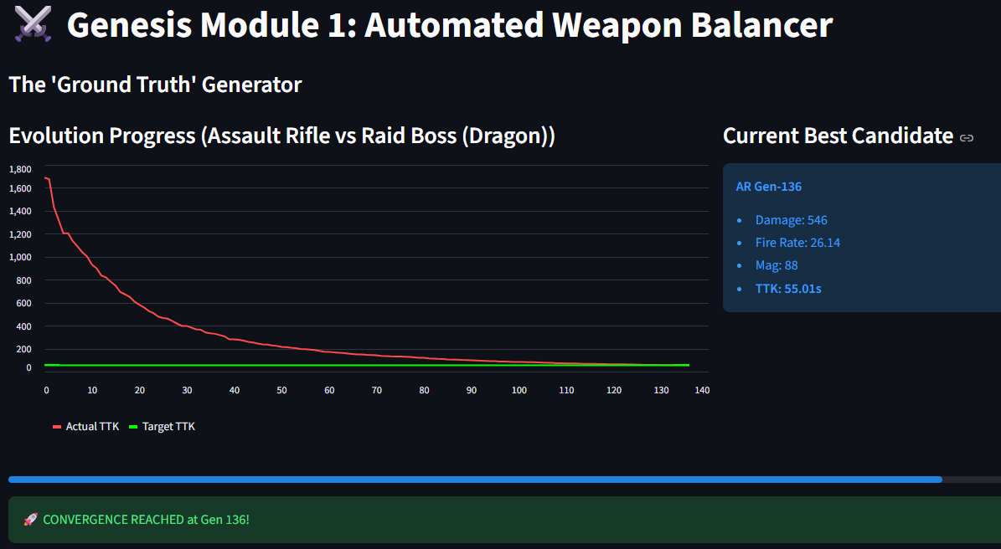
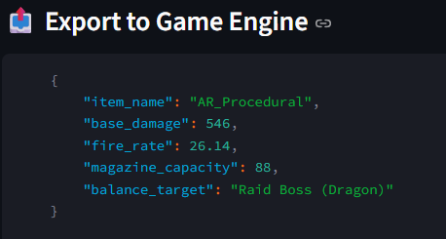
Zero-Shot Optimization
Speed: Converges on the mathematical optimal solution in <30 generations (approx 200ms).
Precision: Achieves 0.05s tolerance against the target.
Scalability: Can balance 100+ unique weapons simultaneously.
Source: dashboard/app.py

