Slide 1
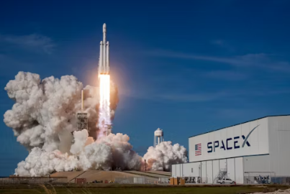
SpaceX Falcon 9 Landing Prediction
Optimizing Launch Costs through Machine Learning
Source: Image courtesy of SpaceX (viaUnsplash)
By Ryan Gilbert

Slide 2
Executive Summary (The "TL;DR")
Objective: Predict if the Falcon 9 first stage will land successfully to estimate launch costs.
Key Findings:
  Launch Site: KSC LC-39A has the highest success rate.
  Payload: Payloads under 5,000 kg have a significantly higher landing success rate.
  Model Performance: The Support Vector Machine (SVM) model achieved 100% accuracy on the test set.
Recommendation: Prioritize launches from KSC LC-39A for lighter payloads to maximize reusability.
Source: Internal Analysis; Data courtesy of SpaceX API & IBM Skills Network

Slide 3
Introduction & Problem Statement
The Problem: SpaceX launches cost ~$62M. If the first stage lands, the cost drops to ~$2M.
The Goal: Build a binary classification model (Success/Fail) to predict landing outcomes using public data.
The Value: Accurate predictions allow competitors to bid more competitively against SpaceX.
Source: SpaceX Capabilities & Services; CNBC (2020)

Slide 4
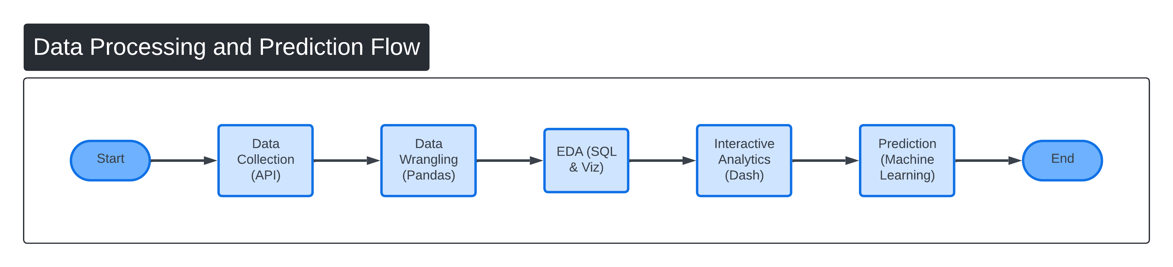
Methodology (The "Pipeline")
Collected data from the SpaceX API.
Cleaned and Standardized data (handled missing values).
Performed Exploratory Data Analysis (EDA) to find patterns.
Source: Project Methodology; Tools: Python, Pandas, Scikit-Learn

Slide 5
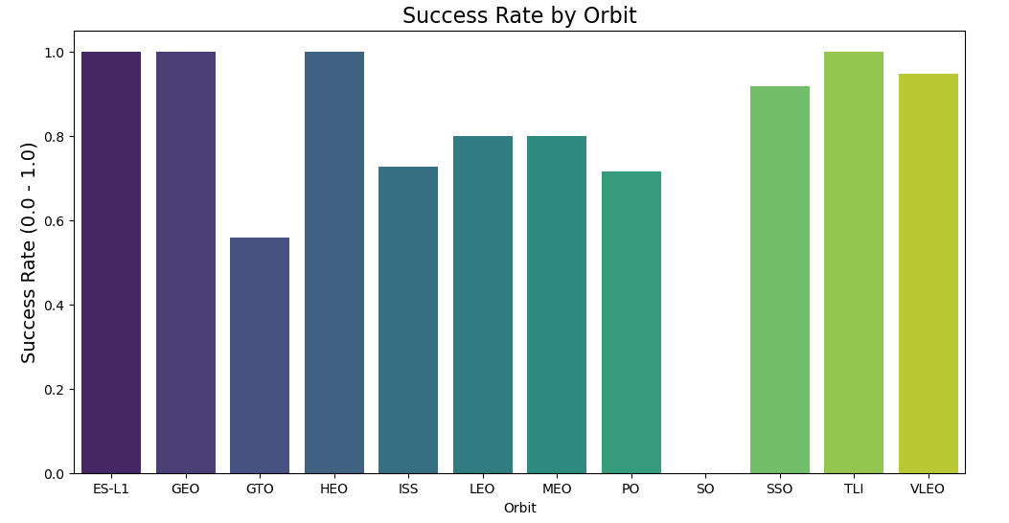
Exploratory Data Analysis (Orbits)
Insight: "Not all missions are equal. Orbits like ES-L1, GEO, and HEO have high success rates. The SO (Sun-Synchronous) orbit had a 0% success rate in this dataset."
Source: Internal Analysis; Data courtesy of SpaceX API

Slide 6
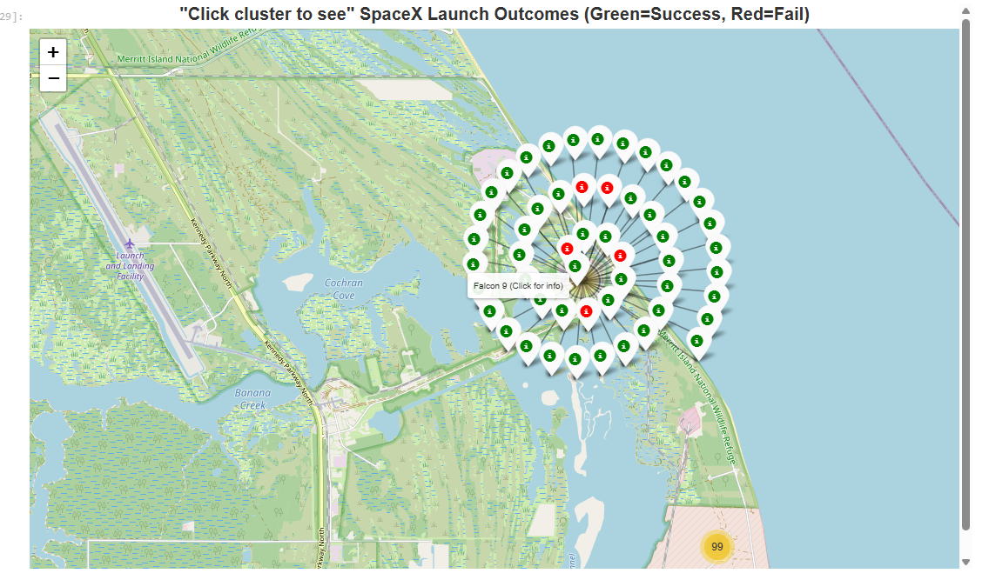
Launch Site Analysis
Method: Visualized launch sites across the US.
Insight: Launch sites are strategically located near coastlines for safety.
Observation: KSC LC-39A shows the densest cluster of successful (green) landings.
Source: Internal Analysis; Map generated via Folium; Data courtesy of SpaceX API

Slide 7
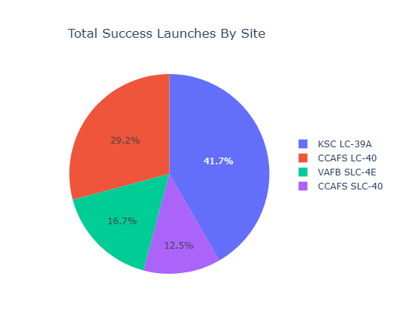
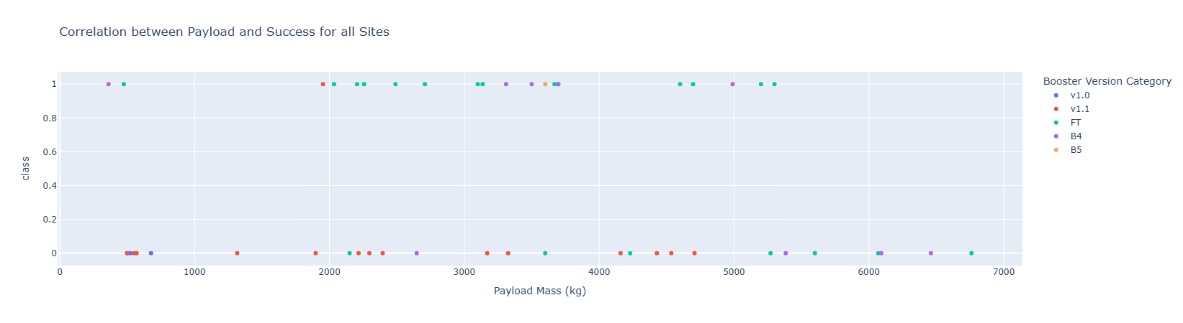
Interactive Dashboard Findings
Source: Internal Analysis; Dashboard generated via Plotly Dash
Built a Dash application for real-time analysis.
Pie Chart: Confirms KSC LC-39A is the top performer.
Scatter Plot: Shows a clear "safety zone" for payloads under roughly 5,000 kg. Heavy payloads (>8,000 kg) have mixed results.

Slide 8
Machine Learning Approach
Method: Trained and tuned 4 different Classification Models:
  Logistic Regression (Baseline)
  Support Vector Machine (SVM)
  Decision Tree
  K-Nearest Neighbours (KNN)
Process:
  Standardized data (scaled to 0-1 range).
  Split data: 80% Training, 20% Testing.
  Used GridSearchCV to tune hyperparameters (found the best settings).
Source: Scikit-Learn Documentation; Project Architecture

Slide 9
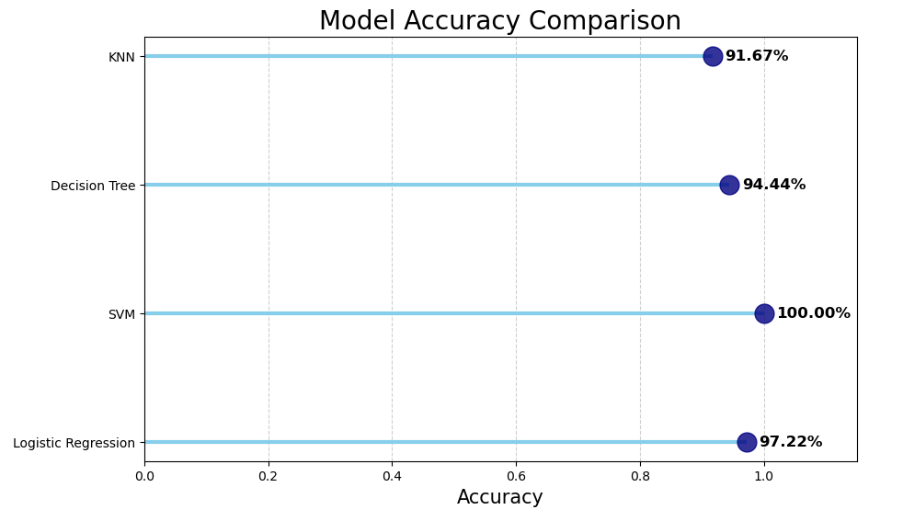
Model Results (The "Hero" Slide)
Source: Internal Analysis; Model Training & Testing via Scikit-Learn
Narrative: While all models performed well (>90%), the SVM was the clear winner, achieving a perfect 100% accuracy on the unseen test data. This makes it the ideal candidate for deployment while potentially saving millions of dollars in launch cost estimates.

Slide 10
Conclusion
Summary: Successfully built a pipeline that predicts rocket landings with high precision.
Future Work:
  Incorporate weather data (wind/rain) into the model.
  Test on a larger dataset as SpaceX completes more missions.
Source: Summary of Findings; Future Work Recommendations

