Slide 1
Controller area network protocol

Slide 2
Introduction:
CAN bus is a vehicle bus standard designed to allow microcontroller and devices to communicate with each other in vehicle.
It is a message based protocol.
It is present in both physical and data link layer of OSI (Open System Interconnection) layers.
CAN operates mainly at the Physical layer and Data link layer.
It is a multi-master serial bus.

Slide 3
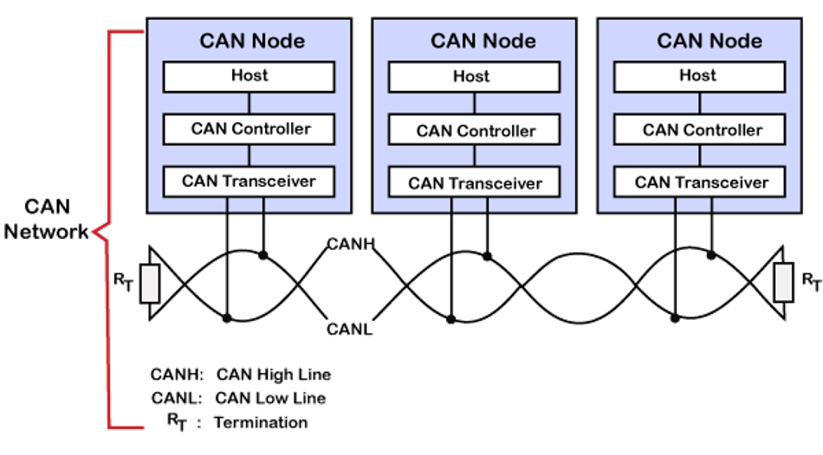
CAN Controller Architecture:

Slide 4
Message Frame:
Start of frame
Arbitration field
Control field
Data field
CRC field
Acknowledgement field
End of frame

Slide 5
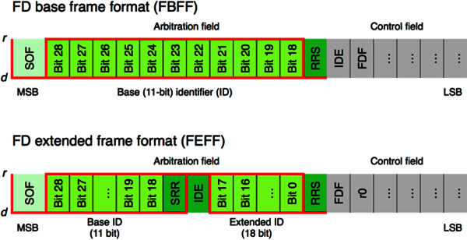
Message Frame Structure:

Slide 6
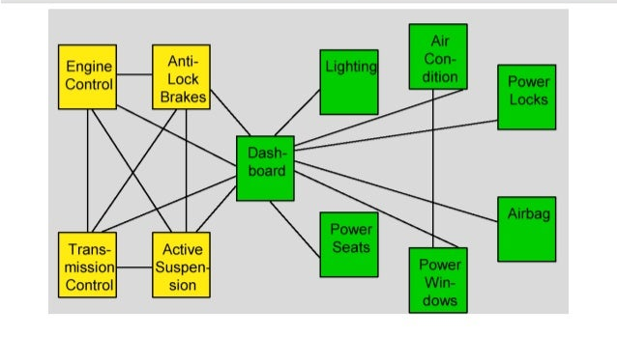
Before CAN:

Slide 7
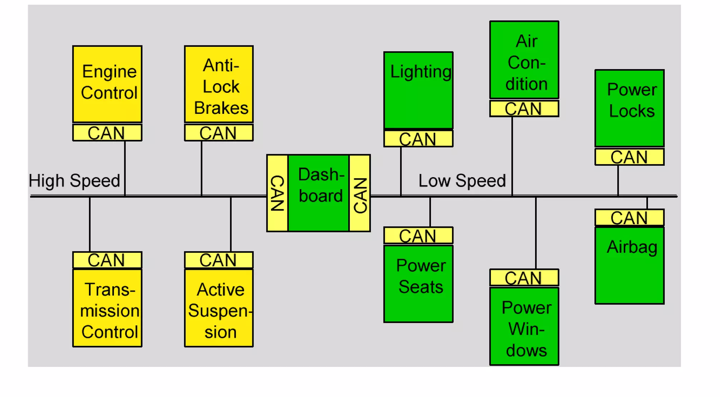
After CAN:

Slide 8
Real World Applications:
Automotive
Military vehicles
Industrial machinery
Medical systems
Agriculture machinery
Marine control and navigation
Elevator control systems

Slide 9
CAN Characteristics:
All messages are broadcast.
Any node is allowed to broadcast a message.
Each message contains an ID that identifies the source or content of a message.
Each receiver decides to process or ignore each message.

Slide 10
Characteristics:
Bit Rate/Bus Length
1M bit/sec 40meters(131feet)
500k bit/sec 100meters(328 feet)
250k bit/sec 200meters(656 feet)
125k bit/sec 500meters(1640feet)

Slide 11
CAN Arbitration:
CSMA/CA
All nodes must wait for an idle bus condition.
If two nodes begin transmitting simultaneously, they then participate in an arbitration process.
Wired-AND mechanism.
The node with the lower ID number wins the arbitration and continues transmitting its message.
The loser of the arbitration backs off and re-tries.

Slide 12
CAN Data Protection and Error Handling:
Bit Monitoring
Sender task
Compares every bit placed on the CAN bus with the actual bus level.
Descripency indicates a bit monitoring error and results in error handling.
Stuff check
Receiver task
Compares arriving k bit stream for a sequence of six homogeneous bits.
Detection of a sixth homogeneous bit indicates bit stuffing error and results in error handling

Slide 13
CAN Advantages:
High performance under light loads.
Low cost.
Reliable.
Robust.

Slide 14
CAN Disadvantages:
Unfair access: Node with high priority can hog the network.
Starvation for some particular nodes.

