Slide 1
Alcohol and Education:
Trends Between Drinking Habits and Grades
Brett Carey, Ryan Grayson, Nina Jannatifar
Notes:
Presentation template is from Slidesgo

Slide 2
Dataset Information
List Of Variables
This was a large dataset comprising of two separate csv files with 33 different variables each. The data in these files were collected from two Portuguese high schools with the goal of predicting student performance in classes. The data was collected from students in Math and Portuguese courses and the variables included the students grades, alcohol consumption patterns, and various other social, demographic, and school-related factors.
Main variables featured in our analyses:
sex
binary
'F' - female; 'M' - male
studytime (weekly study time)
numeric
1 - <2 hours; 2 - 2 to 5 hours; 3 - 5 to 10 hours; 4 - >10 hours
Walc (weekend alcohol consumption) numeric
1 - very low to 5 - very high
G3 (final grade)
numeric
from 0 to 20
Notes:
1-2 min
https://www.kaggle.com/datasets/whenamancodes/alcohol-effects-on-study
Alcohol Effects on Study
2 datasets with 33 variables each!
Key variables:
Weekend Alcohol Consumption (on scale of 1-5 with 5 being high consumption)
Biological Sex (male/female)
G3 -> final grade for the course
Weekly study time
Course (Math or Portuguese)

Slide 3
Question 1
Is there a significant difference in the relationship between final grades and weekend alcohol consumption for math compared to Portuguese?
Hypothesis: We hypothesize that the correlation between final Portuguese grades and alcohol consumption will be slightly stronger than the correlation between math grades and alcohol consumption (and we anticipate a negative correlation for both). Some studies have shown that genetics play a large role in math ability, whereas practice and effort often play a larger role in language ability. Assuming that greater alcohol consumption will typically lead to less time spent on academics, our hypothesis follows that the Portuguese grades would be more heavily hindered by high alcohol consumption.
Notes:
30 s

Slide 4
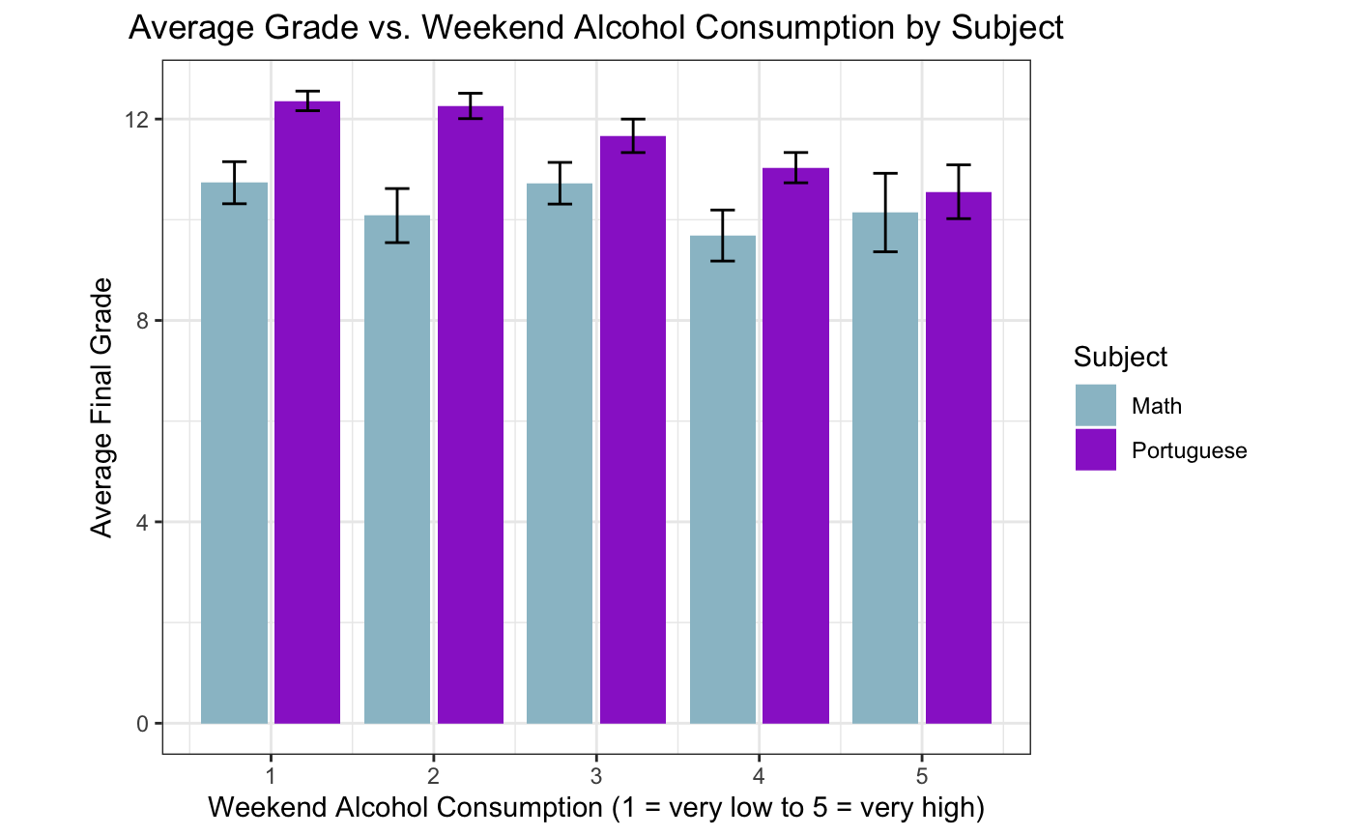
Graph 1
Graph 1
Notes:
1-2 min

Slide 5
Question 2
What is the relationship between weekend drinking and total study time for math students and does this differ for males and females?
Hypothesis: We hypothesize that higher weekend alcohol consumption will correlate with lower average total study time, but we do not expect to see a significant difference in the magnitude of correlation between males and females. This assumes that a higher level of alcohol consumption will generally lead to students spending less time studying, causing the negative relationship we hypothesize. Women in general feel the effects of drinking more quickly than men due to biological differences. However, the variable measuring weekend alcohol consumption is a qualitative level and not a quantity, so we expect men and women who report the same level of consumption to experience essentially the same negative effect on their study habits.
Notes:
30s

Slide 6
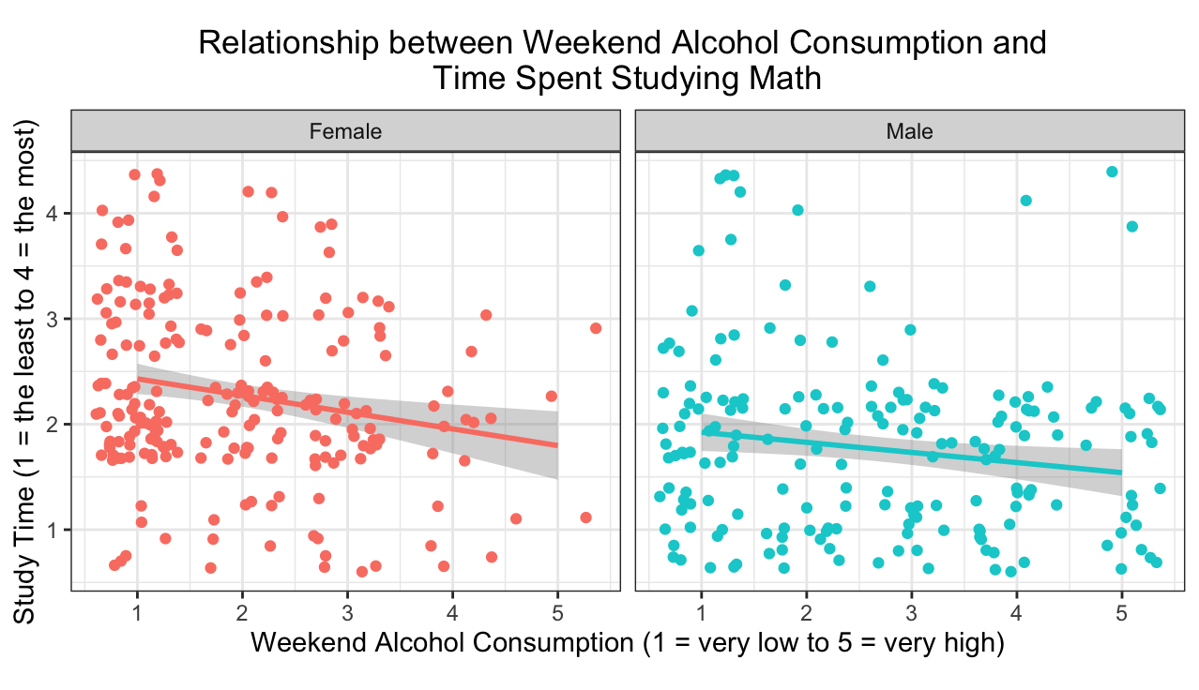
Graph 2
Notes:
1-2 min

