Slide 1
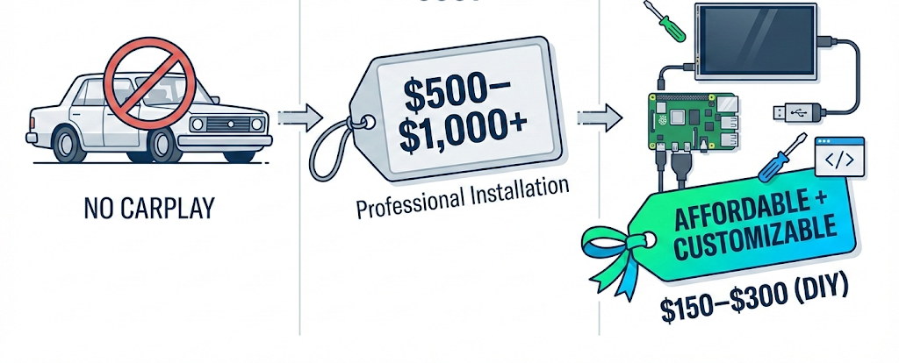
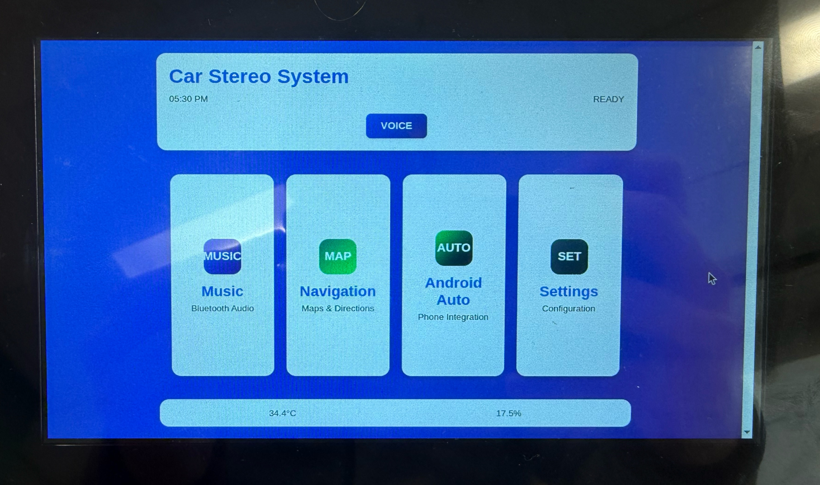
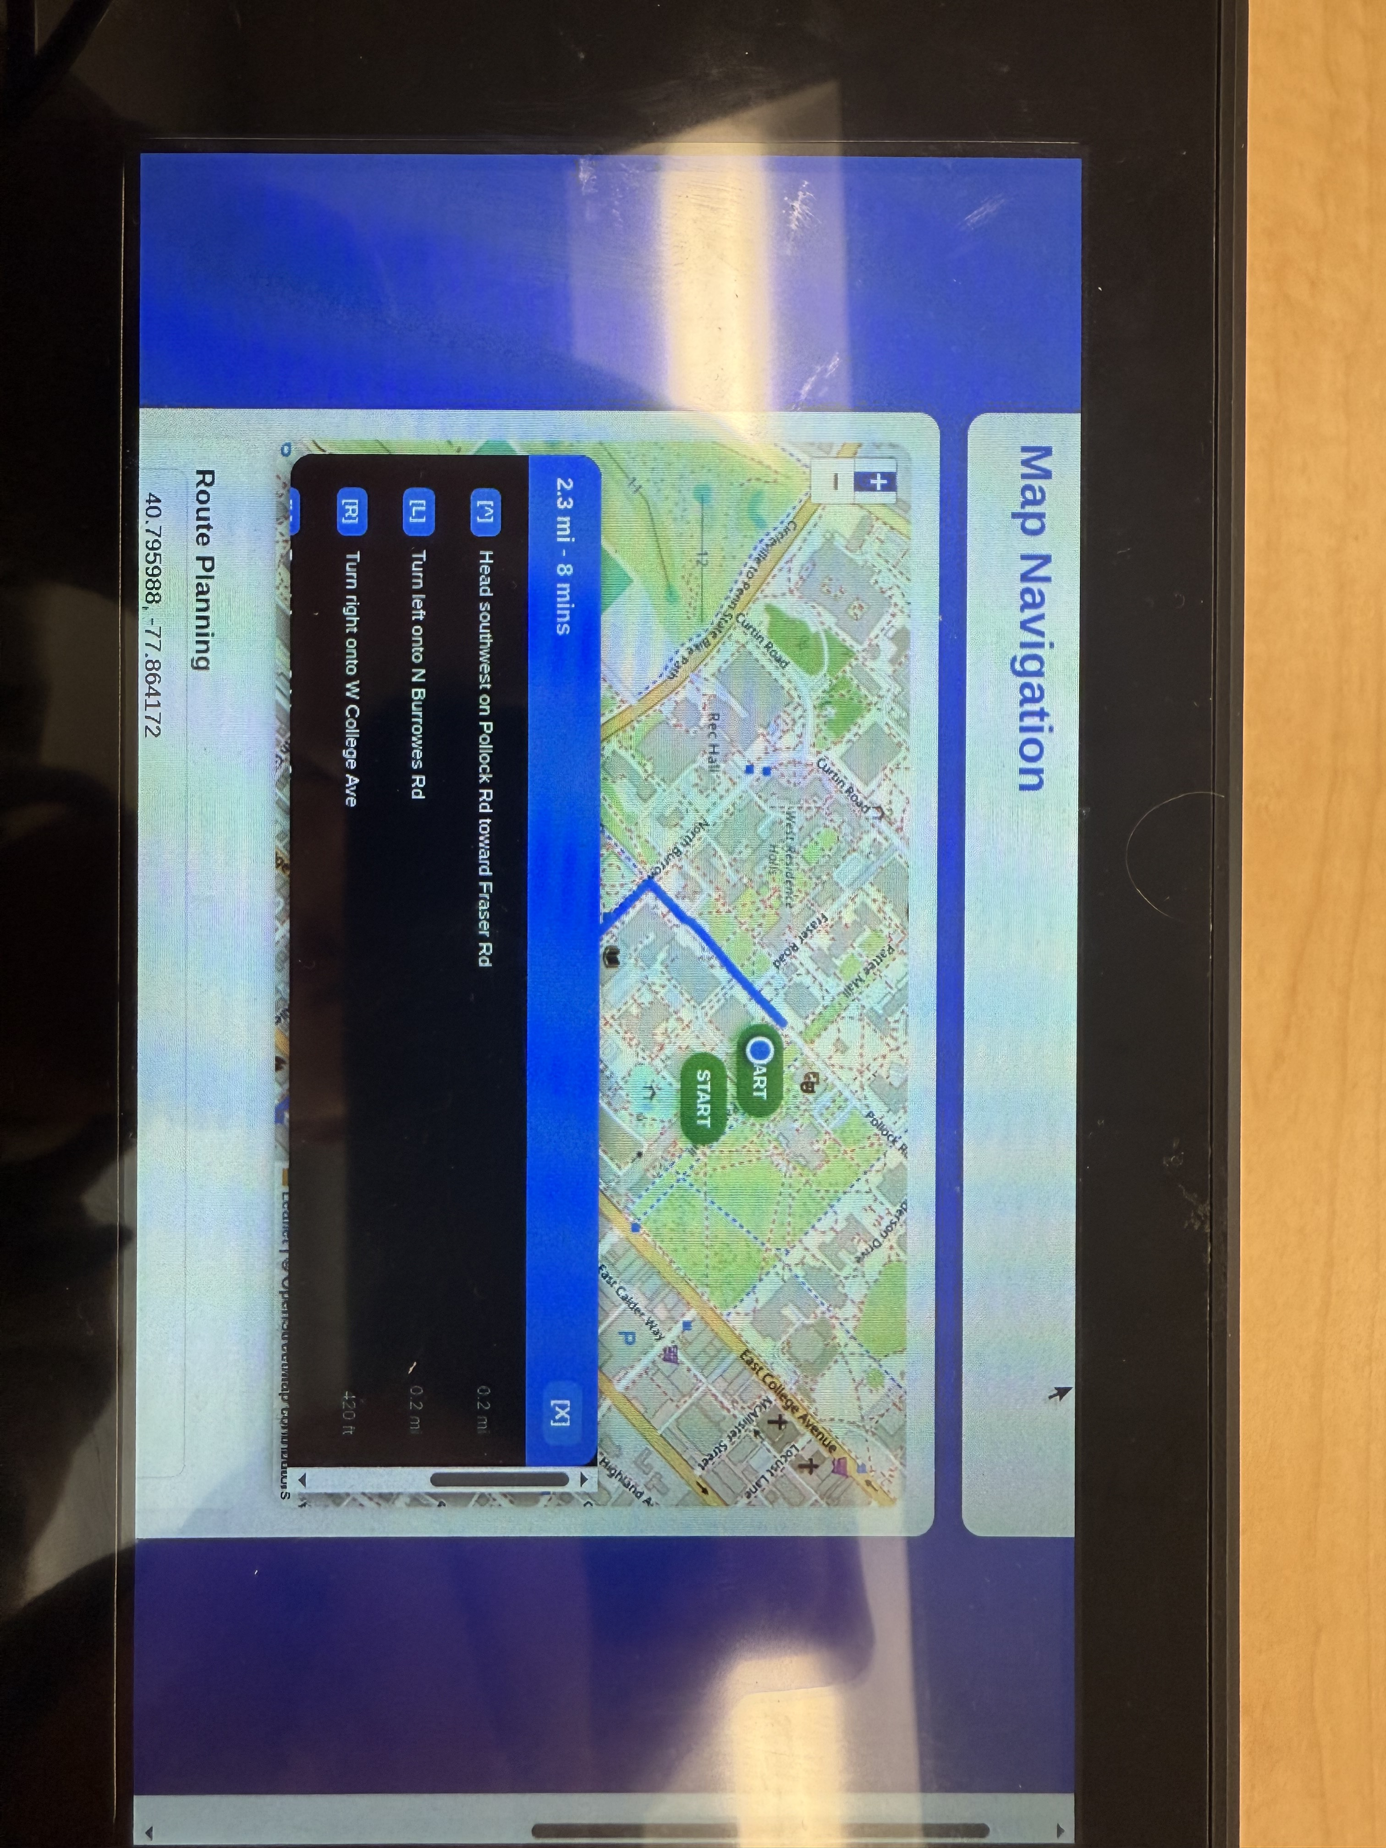
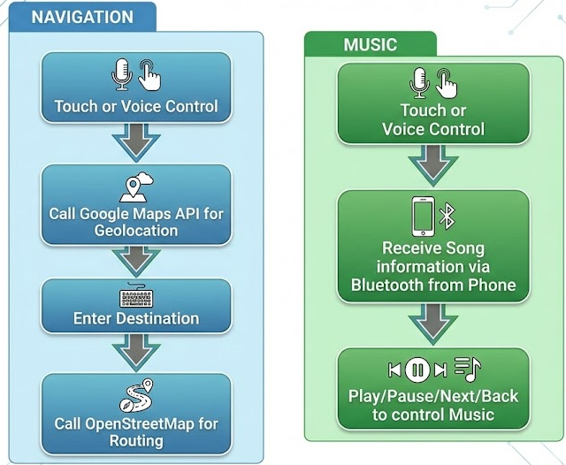
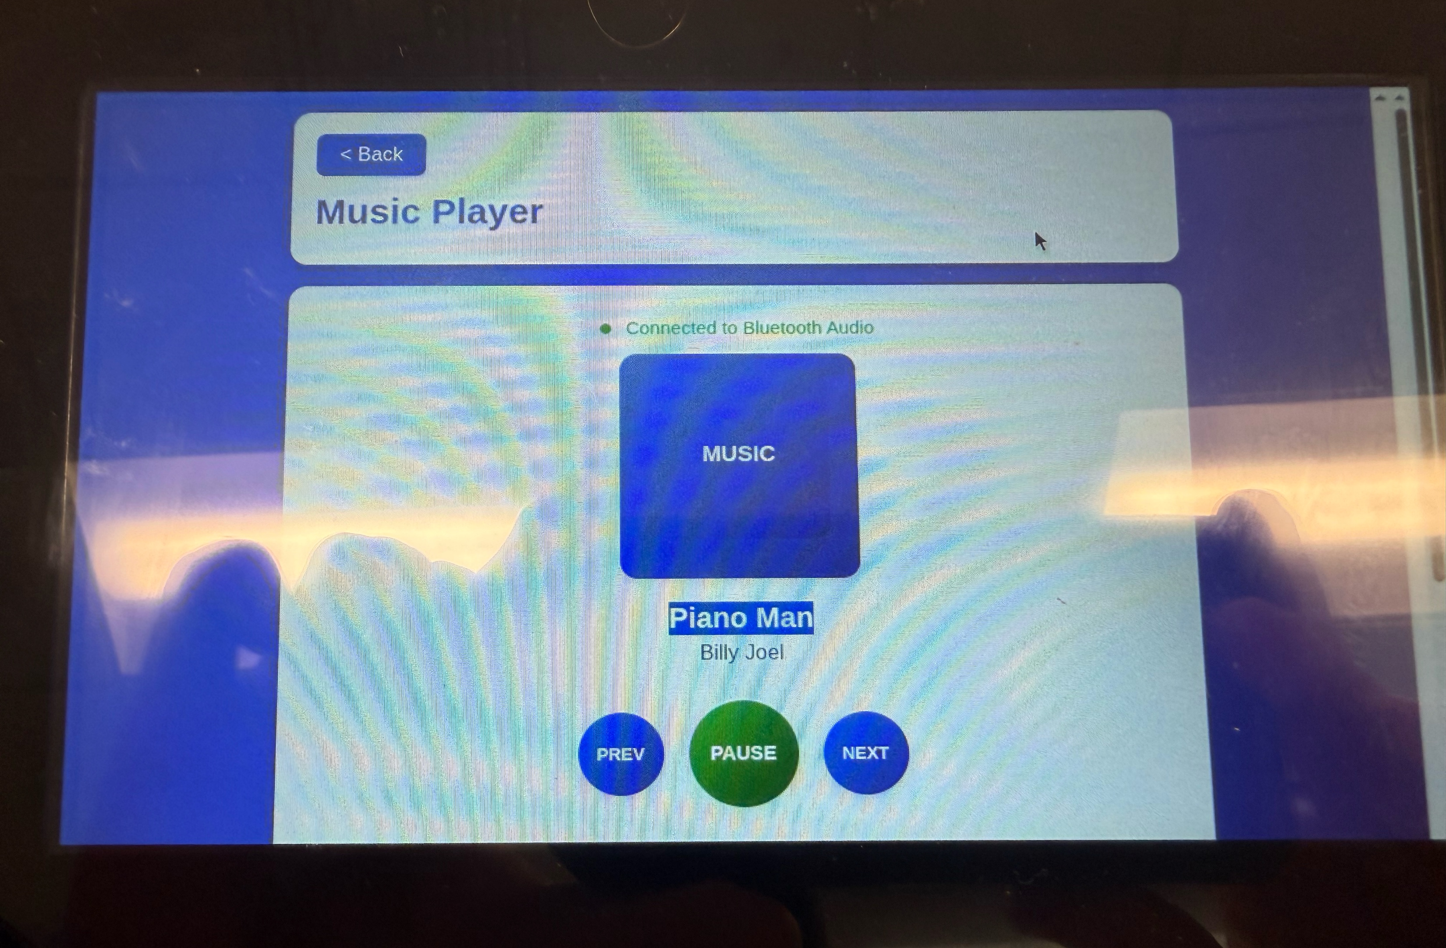

OpenDrive: Open-Source Infotainment & Sensing Platform
Authors: Ryan Greene and Charles Brocato
Instructor: Dr. Xiaozhen Wang
Abstract
Many cars still lack modern infotainment systems like Apple CarPlay, and aftermarket options typically cost $500–$600. Our project provides a low-cost alternative by building a functional CarPlay-style system for $120 using a Raspberry Pi, a custom touchscreen UI, and the Google Maps API. The system supports music playback and live navigation, demonstrating that essential in-car features can be delivered affordably and efficiently.
Motivation:
Older Vehicle
Typical Aftermarket Cost
OpenDrive Unit
User Interface:
Home Screen: Provides quick access to music, navigation, Android Auto, and system settings, while offering integrated voice control and real-time vehicle data such as temperature and air pressure. (Left)
Figure 1. Motivation Graphic
Features:
The CarPlay Infotainment System consists of:
Raspberry Pi hardware running the core system
React-based touchscreen interface for user interactions
Python backend services handling media control, navigation requests, and Wi-Fi-based location
Google Maps API for accurate route rendering and real-time location
Wi-Fi geolocation used to estimate the user’s position when GPS hardware is unavailable
User actions—such as selecting music, starting navigation, or adjusting settings—flow from the touchscreen to the backend services, which then update the UI accordingly.
Figure 2. Home screen
Navigation Screen: Uses Google Maps API for real-time directions and location updates via Wi-Fi. (Right)
Figure 3. Navigation Menu
Music Screen: Allows playback control, playlist navigation, and local media browsing. (Left)
Figure 4. Music Menu
Market Survey:
About 60% of vehicles currently driven lack Apple CarPlay, representing over 150 million vehicles in the United States alone. Budget-conscious drivers and DIY hobbyists represent a strong target segment.
Conclusion and Future Work
The CarPlay Infotainment System successfully delivers an accessible and functional infotainment experience at a fraction of typical market cost. The project demonstrates that modern in-car connectivity can be achieved without expensive proprietary hardware.
Future improvements may include:
Integration of Bluetooth audio and hands-free calling
Voice assistant capabilities
Optional GPS module for even higher location accuracy
Support for additional apps and media formats
A refined and more compact hardware enclosure
Feature | Our System | Aftermarket
Price | $120 | $500-$600
Navigation | Google Maps | Carplay-Based maps
Music | Local + Streaming Support | Carplay
Open Source | Yes | No
Installation | Simple, DIY friendly | Requires rewiring or shop Installation

