Slide 1
Data Science: Transforming Information into Understanding
Ryan French
Applied Data Science
Syracuse University
School of Information Studies

Slide 2

A Little Bit About Me…
Current MS in Applied Data Science student
Undergraduate degree in Information Management & Technology from the School of Information Studies
Data enthusiast!
Architecting systems
Designing data pipelines
Using data to make decisions

Slide 3
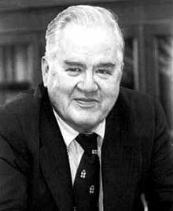
What is Data Science?
Using data to make decisions
Heavily multidisciplinary field
Mathematics for model building
Programming for implementation
Subject matter expertise
Originally coined by John W. Tukey
Data analysis should put more emphasis on the scientific method
In the modern silicon era, what would he think now?

Slide 4
MS Applied Data Science Program Objectives
Describe a broad overview of the major practice areas of data science.
Collect and organize data.
Identify patterns in data via visualization, statistical analysis, and data mining.
Develop alternative strategies based on the data.
Develop a plan of action to implement the business decisions derived from the analyses.
Demonstrate communication skills regarding data and its analysis for managers, IT professionals, programmers, statisticians, and other relevant professionals in their organization.
Synthesize the ethical dimensions of data science practice (e.g., privacy).

Slide 5
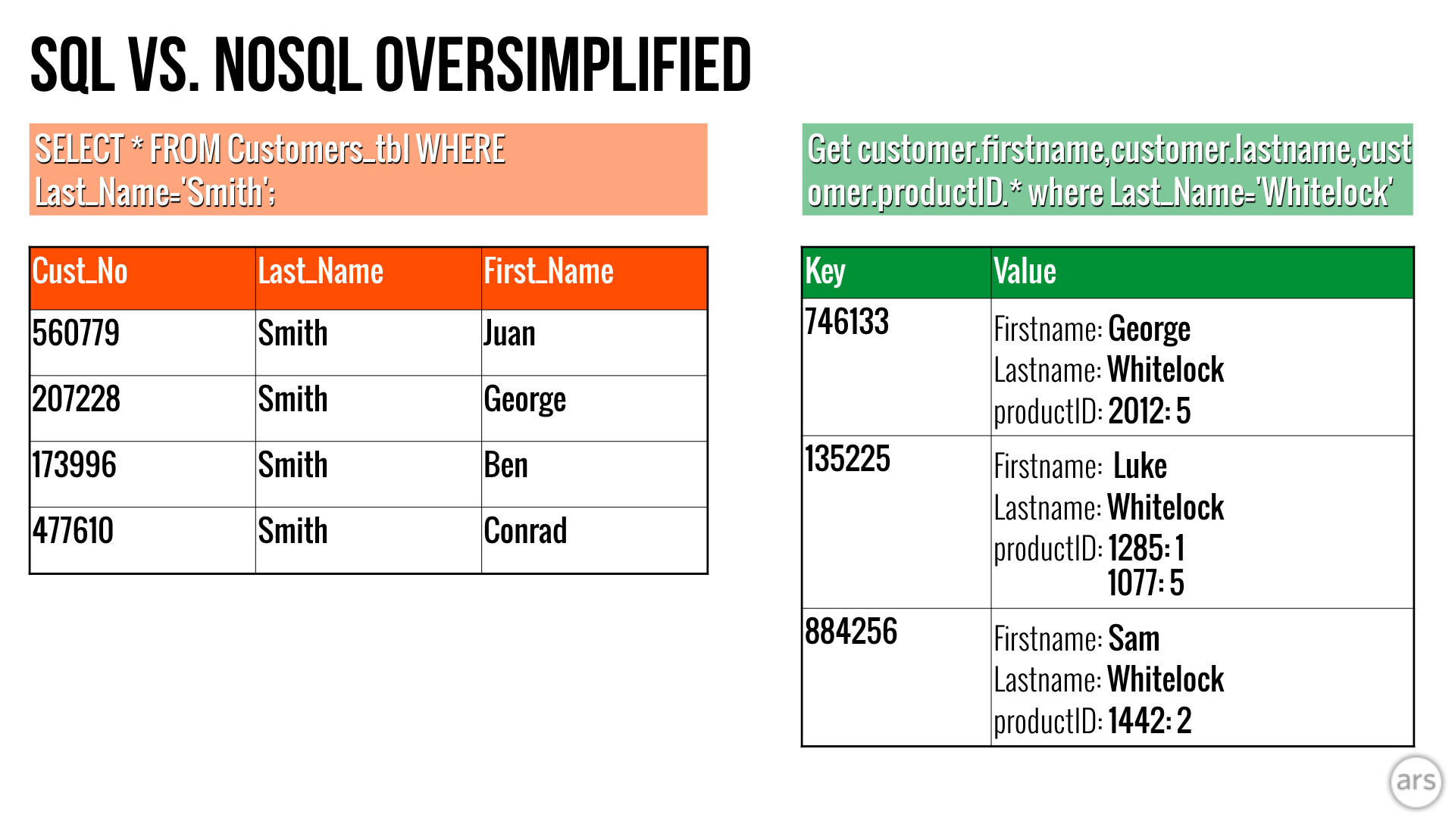
Data Collection & Organization
Typically the first step of the Data Science process
Sourcing data
Flat files
Livestreaming data
Collecting data in person
Storing & organization
Method: flat files vs database
Format: CSV vs XML, SQL vs NoSQL
Who will be accessing the data?

Slide 6
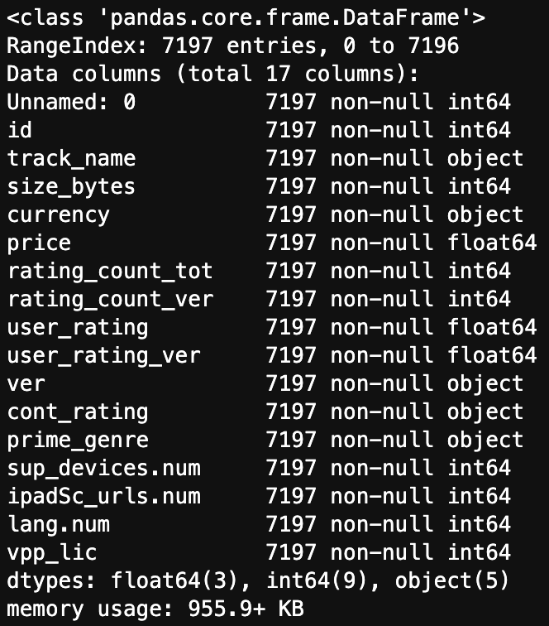
EDA & Pattern Identification
Next, examine the data gathered
Shape
Data types
Missing values
What needs to be cleaned or engineered?
Pattern identification through plotting
What does the data look like?
Are there obvious trends?
Is the data intelligible?

Slide 7
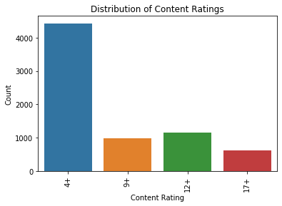
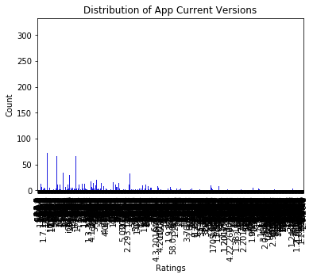
Predicting App Ratings Project Example
Data on Apple app store applications
Content ratings variable
4 categories, each representing an age rating for an app
Easy to interpret
Clear trend that most applications are rated ‘4+’
Current Versions Variable
Too many categories to view (but not a continuous variable)
Difficult to interpret, no clear trends are apparent

Slide 8

Data Cleaning & Feature Engineering
Handling missing data
Replace it, remove it, etc.
Removing bad data and outliers
Discretizing or bucketing
Creating dummy variables
Removing unhelpful/unintelligible variables
Part art, part science!

Slide 9
Predicting App Ratings Project Example
Variable which contains app’s current version
Removed any versions which contained text
Truncated versions to their major release number
Version 3.1.2 becomes version 3
Created a dummy variable to indicate apps with high ratings
‘1’ for ratings of greater than or equal to 4
‘0’ for all other applications

Slide 10
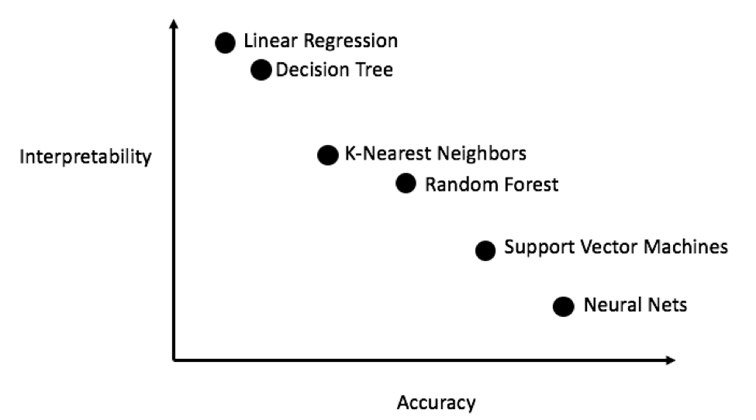
Actionable Insight
Important that insight generated is actionable
Considerations in regard to insights:
The goal of the project
what the stakeholder is interested in
how it can be accomplished (classification vs inference)
The familiarity of the stakeholder with the subject matter
The familiarity of the stakeholder with the data science techniques utilized
Some models are suited for one task over another

Slide 11
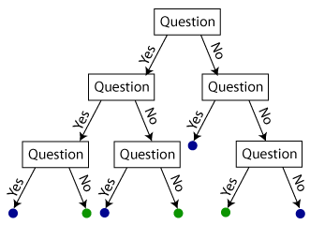
Analyzing Crime in Syracuse Example
Goal of predicting whether or not an arrest will occur
…But also important to know why this prediction is occurring
Support Vector Machine model scored better
But insight is not readily available
Random Forest Model
Slightly less accurate
Much more interpretable, even for non data scientists
For this reason, I preferred the Random Forest model

Slide 12
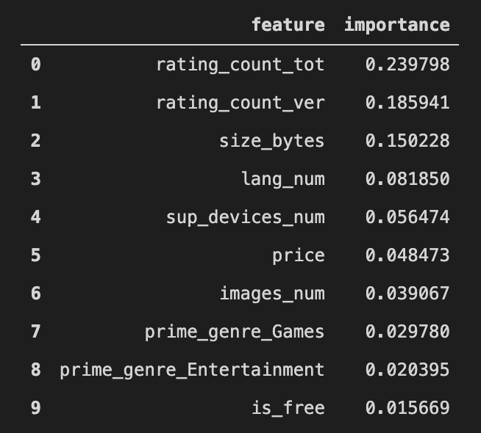
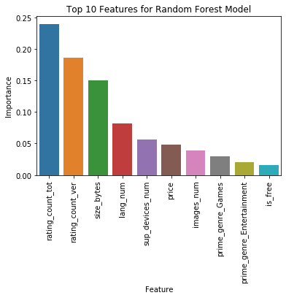
Presenting Information & Insight Visually
Advantages of visual presentation
More attractive
Easier to digest
More compact – more data can be packed in
Also more accessible to a wider audience
Text-based callouts to highlight information in visuals
Include text-based figures and context to back up points
Allows interested parties to review it at their leisure
Appendix
Footers

Slide 13
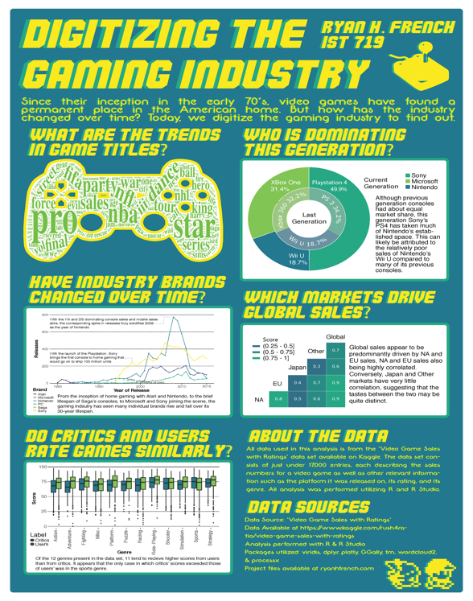
Gaming Industry Poster Project Example
Collection of visualizations about the gaming industry
Tells a cohesive story about the trends
The rise of Nintendo in the mobile market
Sony’s domination of the current home console generation vs the previous one
How user’s video game reviews compare to those posted by critics
Visually tied together through a retro-digital art style and color theme that fit the subject matter

Slide 14
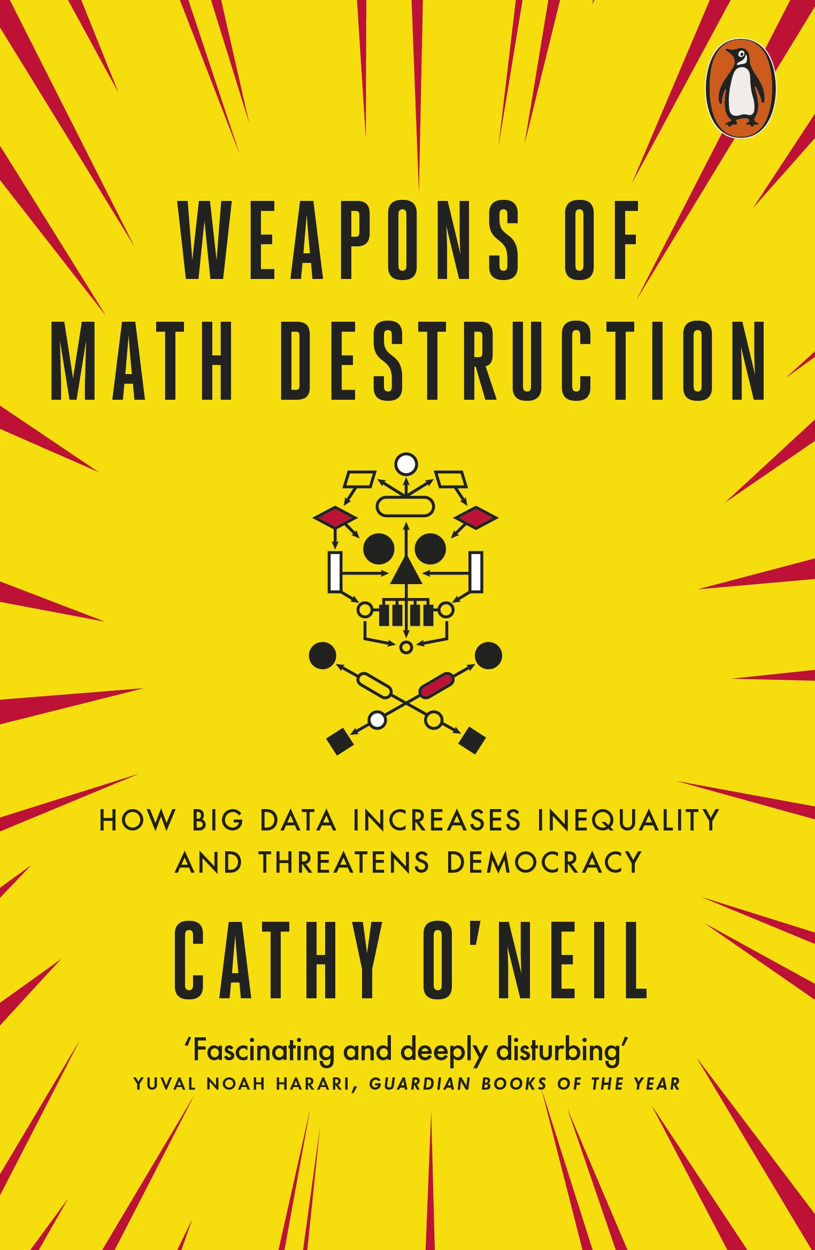
Ethical Ramifications
Data science has the potential to have a monumental positive impact on the world at large
But like any tool, it is the wielder who chooses how it is used
Cathy O’Neil’s Weapons of Math Destruction
Provides examples of ethical lapses and consequences
Emphasizes the necessity of human involvement and oversight in the data science process
Mistakes are inevitable, but recognizing them can help to reduce errors and efficiently recover when they do occur

Slide 15
Thank You!

