Slide 1

AIRLINE CUSTOMER
SATISFACTION ANALYSIS
Ryan French, Rebecca LoSurdo, Tanushree Shetty, Abhishek Singh, Zefeng Zhang

Slide 2
PROJECT OVERVIEW
Explore Airline Customer Satisfaction Surveys
129889 observances
28 variables
Determine Factors that Drive Satisfaction Level
Created Actionable Insights based on the Analysis

Slide 3
BUSINESS QUESTIONS
What variables have the most significant impact on the satisfaction of airline customers?
Which of these variables are difficult or impossible to manipulate (ex: what airport a customer flies out of)?
Which of these variables are potentially manipulatable to further increase this satisfaction (ex: how quickly a customer accumulates miles) and what possible recommendations can be made from these insights?
What topics could be useful if researched further?

Slide 4
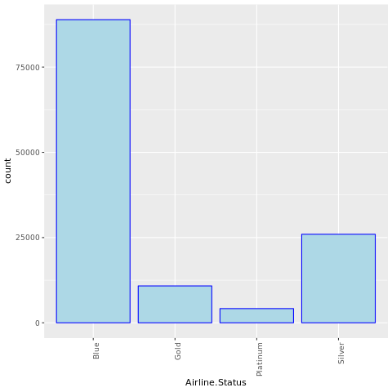
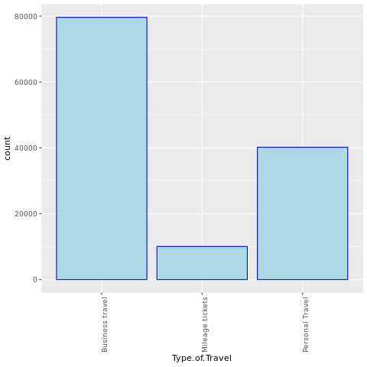
UNDERSTANDING THE DATA: Airline Analysis
Airline Status, % of Flight with other Airlines, Airline Code, Airline Name, No. Loyalty Cards, Class, Type of Travel

Slide 5
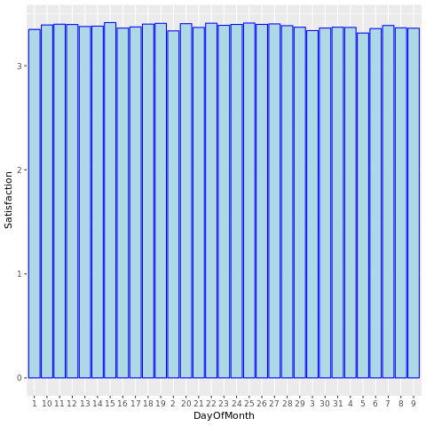
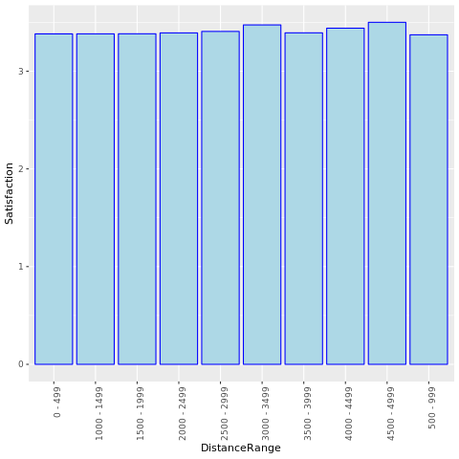
UNDERSTANDING THE DATA: Flight Analysis
Day of Month, Flight date, Flight time in minutes, Flight Distance

Slide 6
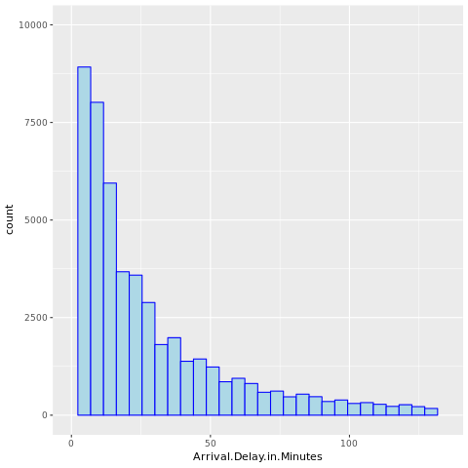
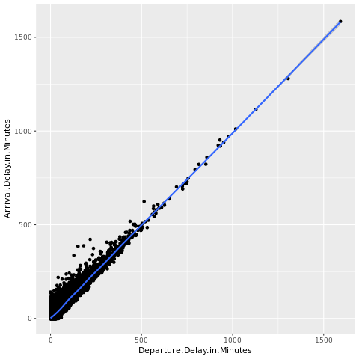
UNDERSTANDING THE DATA:
Delay Analysis
Scheduled Departure Hour, Departure Delay in Minutes, Arrival Delay in Minutes, Flight canceled, Arrival Delay greater 5 Mins

Slide 7
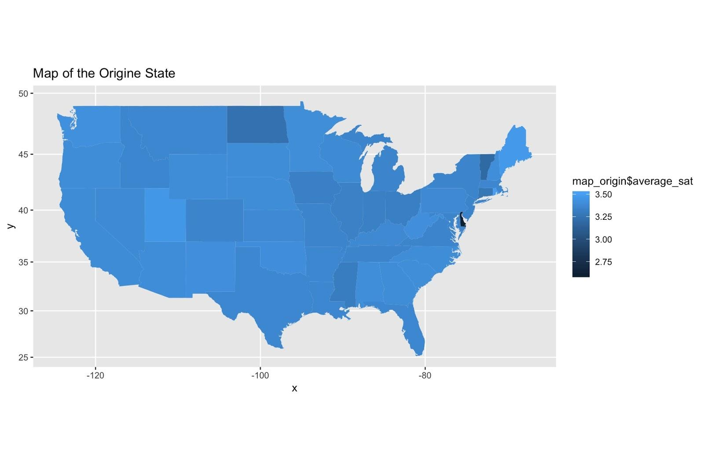
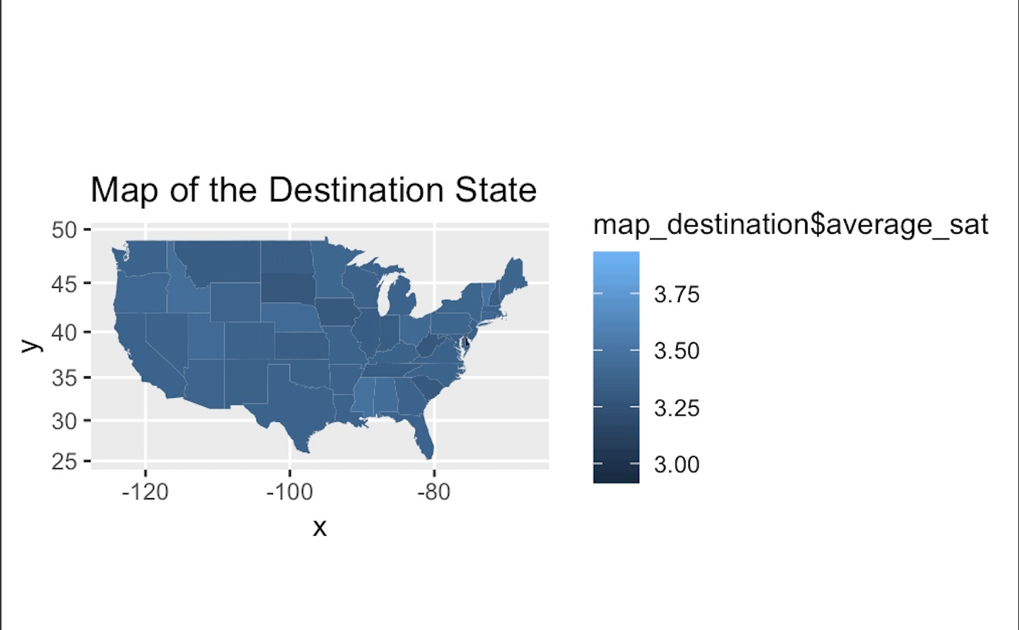
UNDERSTANDING THE DATA
-Geographic Analysis
Scheduled Departure Hour, Departure Delay in Minutes, Arrival Delay in Minutes, Flight canceled, Arrival Delay greater 5 Mins
The team split all the available variables into five groups and then explored how they affect the target variable i.e. Satisfaction.
Notes:
Delaware ranked the lowest among both the destination State and the origin Stats with much lower satisfaction comparing with other States.
The satisfaction levels among most origin States are similar and consistent.
Geographic variables are difficult for airlines to manipulate so the team focus on other variables for in depth analysis.

Slide 8
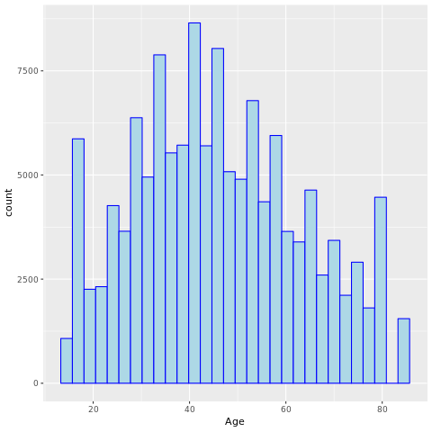
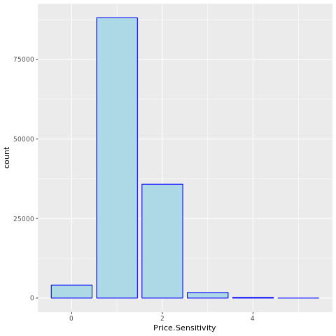
UNDERSTANDING THE DATA
- Passenger Demographics
Age, Gender, Year of First Flight, No of Flights p.a., Shopping Amount at Airport, Price Sensitivity, Eating and Drinking at Airport
The team split all the available variables into five groups and then explored how they affect the target variable i.e. Satisfaction.

Slide 9
DATA CLEANING
Focus #1: Formatting
Unique values for our variable of interest (Satisfaction):
1 2 2.5 3 3.5 4 4.5 5 4.00.5 4.00.2.00
Impact of non-numerical answers on overall data:
0.002% ( 3 / 129889 surveys)
Focus # 2: Missing Data
Per exploratory analysis, some survey fields are empty for:
Departure Delays Arrival Delays Flight Time

Slide 10
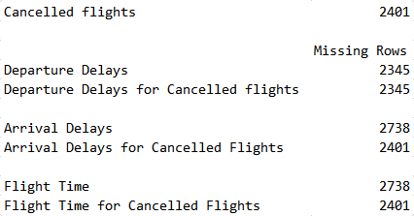
DATA CLEANING
All missing data fields for Departure Delays are from surveys whose flights were cancelled (Departure Delay = 0)
88% of the missing data fields for Arrival Delays and Flight Time were from cancelled flights
(Arrival Delay, Flight Time = 0)
388 non-cancelled flights contain blank survey data for Arrival Delay, Flight Time
Departure Delay → Arrival Delay (93%)
Flight Distance → Flight Time (95%)
Notes:
Important distinction: not all cancelled flights had a departure delay of 0 (can be delayed, then cancelled), these were left untouched
A flight that never flew can not have a flight time or arrival delay and a 0 value allows for analysis without losing other portions of the survey data
Departure Delay can account for 93% of the Arrival Delay (mid-air events) - via linear regression
Flight Distance can account for 95% of the Flight Time (head / tail winds) - via linear regression
Estimations were used in 338 surveys to provide a value for Arrival Delay, Flight Time: would need to be noted if statistically significant in overall conclusion, allowed for the inclusion of the remainder of the survey data in all statistical analysis

Slide 11
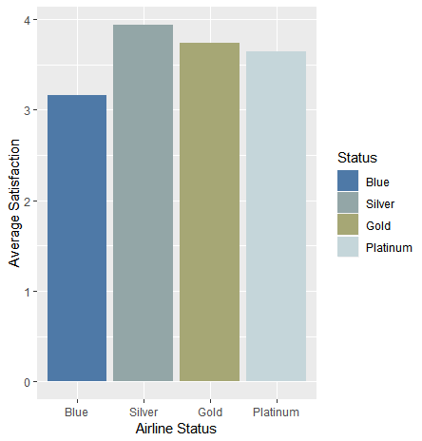
ACTIONABLE INSIGHT 1: Airline Status
Status Upgrade: Make it easier for customers to move from Blue to Silver status.
Supported by:
Logistic Regression
Linear Regression
Association Rules
Decision Tree

Slide 12
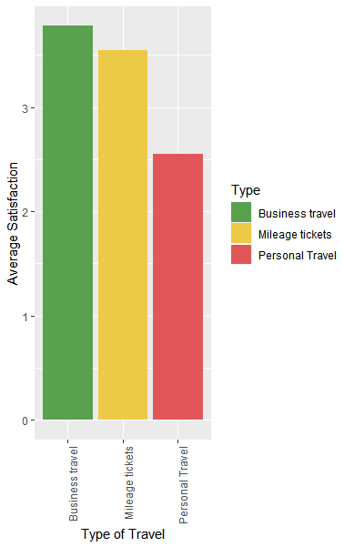
ACTIONABLE INSIGHT 2: Type of Travel
Increase mileage-ticket travellers: Offer a variety of opportunities for customers to acquire miles efficiently so that more flights are taken via earned airline miles.
Supported by:
Logistic Regression
Linear Regression
Association Rules

Slide 13
ACTIONABLE INSIGHT 3: Arrival Delay
Where possible, avoid arrival delays. If they occur, adequately compensate customers.
Supported by:
Logistic Regression
Decision Tree
Offer compensation such as meals mileage points, future travel discount.
Improve the the human factor in air-traffic performance. Using historical data about what causes delays, and develops algorithms that help air-traffic controllers and pilots better manage who's taking off and when, and be able to predict congestion.

Slide 14
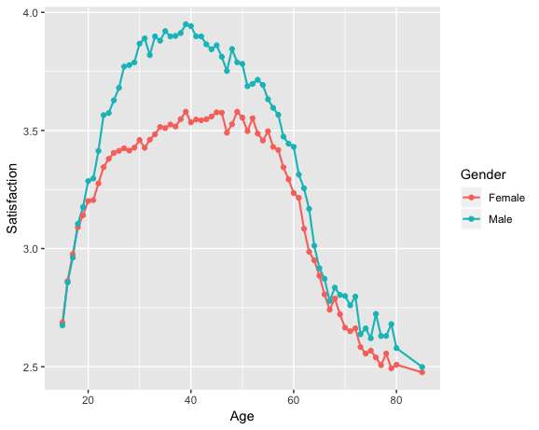
FURTHER RESEARCH
Dissatisfaction of women between their teenage and senior years.
Significant difference between women and men between teenage and retirement years
Increase of sexual assaults on flights between

Slide 15
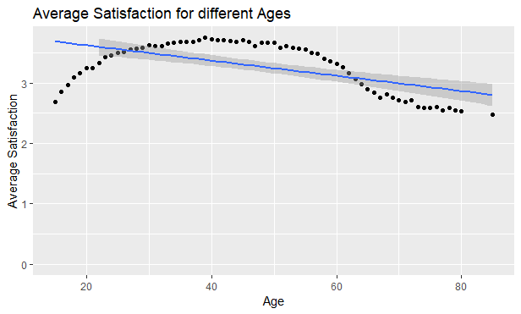
FURTHER RESEARCH
Dissatisfaction of customers in their retirement years and beyond.
Drop off around 55
Provide additional accessibility options

Slide 16
THANK YOU!

