Slide 1
Analyzing Key Indicators of Positive Reviews for iOS Apps
Ryan French

Slide 2

Apple
First company to reach 1 trillion valuation
iOS app store is carefully curated
About 2 million apps available

Slide 3
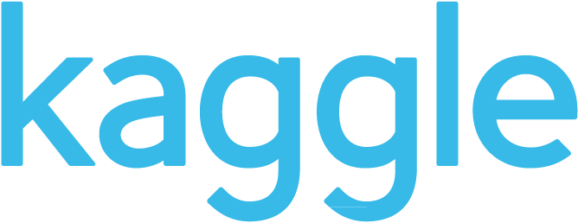
The Dataset
Sourced from Kaggle.com
7197 entries
16 columns containing app information

Slide 4
Attribute | Description | Attribute | Description
ID | App identification number | User_rating_ver | Rating (out of five) for app at current version
track_name | App name | Ver | Version number of the app
size_bytes | Size of app | Cont_rating | The applications acceptable audience (4+, 9+, etc)
Currency | System of money for payment | Prime_genre | Primary genre for the app
Price | Cost of app | Sup_devices.num | Number of devices the app supports
Rating_count_tot | Number of ratings for app | ipadSc_urls.num | Number of screenshots shown
Rating_count_ver | Number of ratings for current version of app | lang.num | Number of languages supported
User_rating | Rating (out of five) for app | vpp_lic | Whether or not Vpp device based licensing enabled

Slide 5
Problem
Can highly rated apps be predicted (> 4/5)?
Can we pick out trends that result in highly rated applications?
What are these trends?

Slide 6
Clean Data
Checked for NA values (none)
Discretized continuous variables
Cut versions to the initial number
Group version numbers over 50 into 50
Created dummy variable for high
ratings

Slide 7
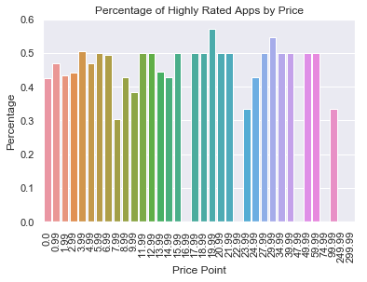
Do expensive apps receive high ratings?

Slide 8
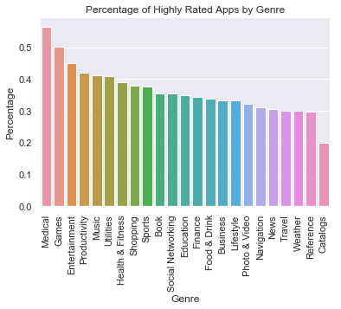
What genre has the highest percentage of highly rated apps?

Slide 9
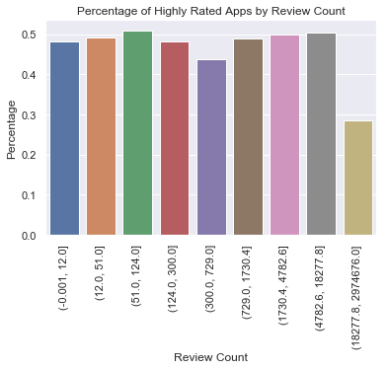
Do apps with more reviews receive higher ratings?

Slide 10
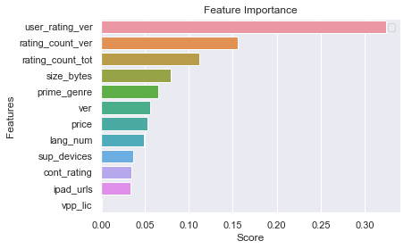
Random Forest Model
1000 trees
Accuracy: 81.6%
Precision: 78.5
Recall: 79.5%

Slide 11
Results
Highly rated applications can be predicted with 81.6% accuracy
Review count is negligible except for ~18,000, over which it is negative
Genre is important, ‘Medical’ particularly
The effect of Price is negligible

Slide 12
Thank You!

