Slide 1
Analyzing Key Indicators of Positive Reviews for iOS Apps
Ryan French

Slide 2

Apple
First company to reach 1 trillion valuation
iOS app store is carefully curated
About 2 million apps available

Slide 3

The Dataset
Sourced from Kaggle.com
7197 entries
16 columns containing app information

Slide 4
Attribute | Description | Attribute | Description
ID | App identification number | User_rating_ver | Rating (out of five) for app at current version
track_name | App name | Ver | Version number of the app
size_bytes | Size of app | Cont_rating | The applications acceptable audience (4+, 9+, etc)
Currency | System of money for payment | Prime_genre | Primary genre for the app
Price | Cost of app | Sup_devices.num | Number of devices the app supports
Rating_count_tot | Number of ratings for app | ipadSc_urls.num | Number of screenshots shown
Rating_count_ver | Number of ratings for current version of app | lang.num | Number of languages supported
User_rating | Rating (out of five) for app | vpp_lic | Whether or not Vpp device based licensing enabled

Slide 5
Problem
Can highly rated apps be predicted (> 4/5)?
Can we pick out trends that result in highly rated applications?
What are these trends?

Slide 6
Data Cleaning / Feature Engineering
Checked for NA values (none)
Created dummy variable for high ratings
Dropped unnecessary/unhelpful columns
Label encoded categorical variables
cont_rating (the age rating given to the app)
prime_genre (the main genre of the app)

Slide 7
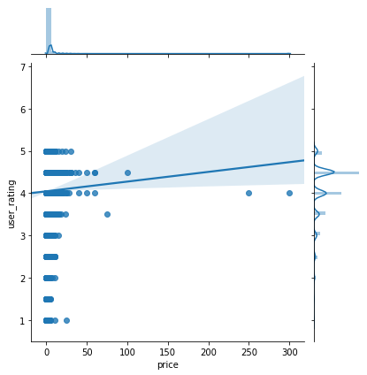
Do expensive apps receive high ratings?
Notes:
Price appears to have a correlation with a higher user rating for apps with a rating from 4 to 5 (what we consider a “highly rated” app)

Slide 8
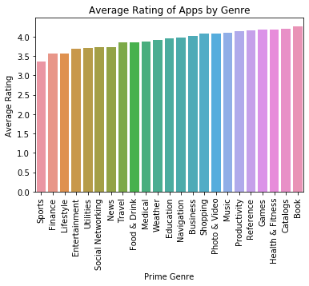
What genre has the highest percentage of highly rated apps?
Notes:
Books appear to have the highest average rating along with Catalogs which come in at ~4.2

Slide 9
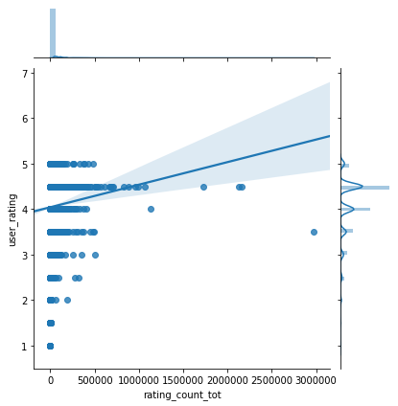
Do apps with more reviews receive higher ratings?
Notes:
Similar to Price, a high amount of reviews appears to have a correlation with a higher user rating for apps with a rating from 4 to 5

Slide 10
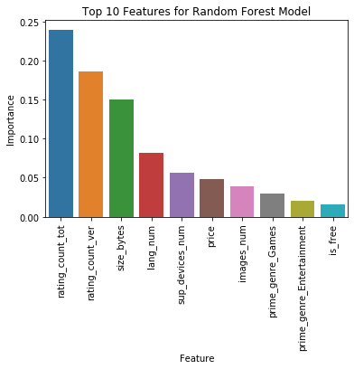
Random Forest Model
Target is highly rated (>=4/5) apps
Grid Search for optimization
5 Fold Cross Validation
Notes:
Grid Search parameters: n_estimators, max_depth, min_samples_split, min_samples_leaf
5 fold Cross Validation

Slide 11
Results
~67% AUC with optimized Random Forest
Most important indicators
rating_count_tot (number of reviews)
rating_count_ver (reviews for current version of app)
Other features of note
size_bytes (size of app in bytes)
lang_num (number of supported languages)

Slide 12
Thank You!

