Slide 1
Unit One Project:
BlackJack
Ryan Hikel

Slide 2
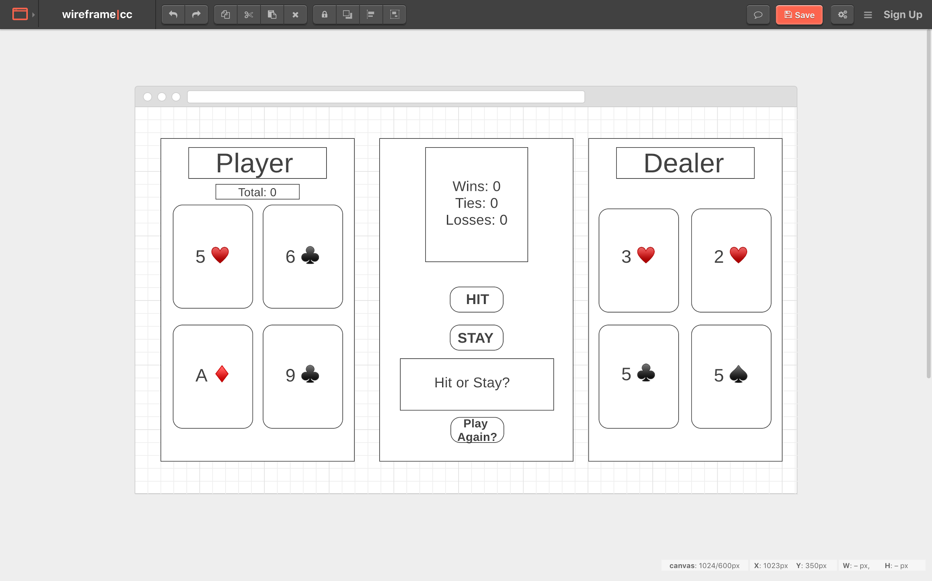

Slide 3

The landing page has a clickable button which I have added the BlackJack logo as a background image. Once clicked it directs to the actual game.

Slide 4
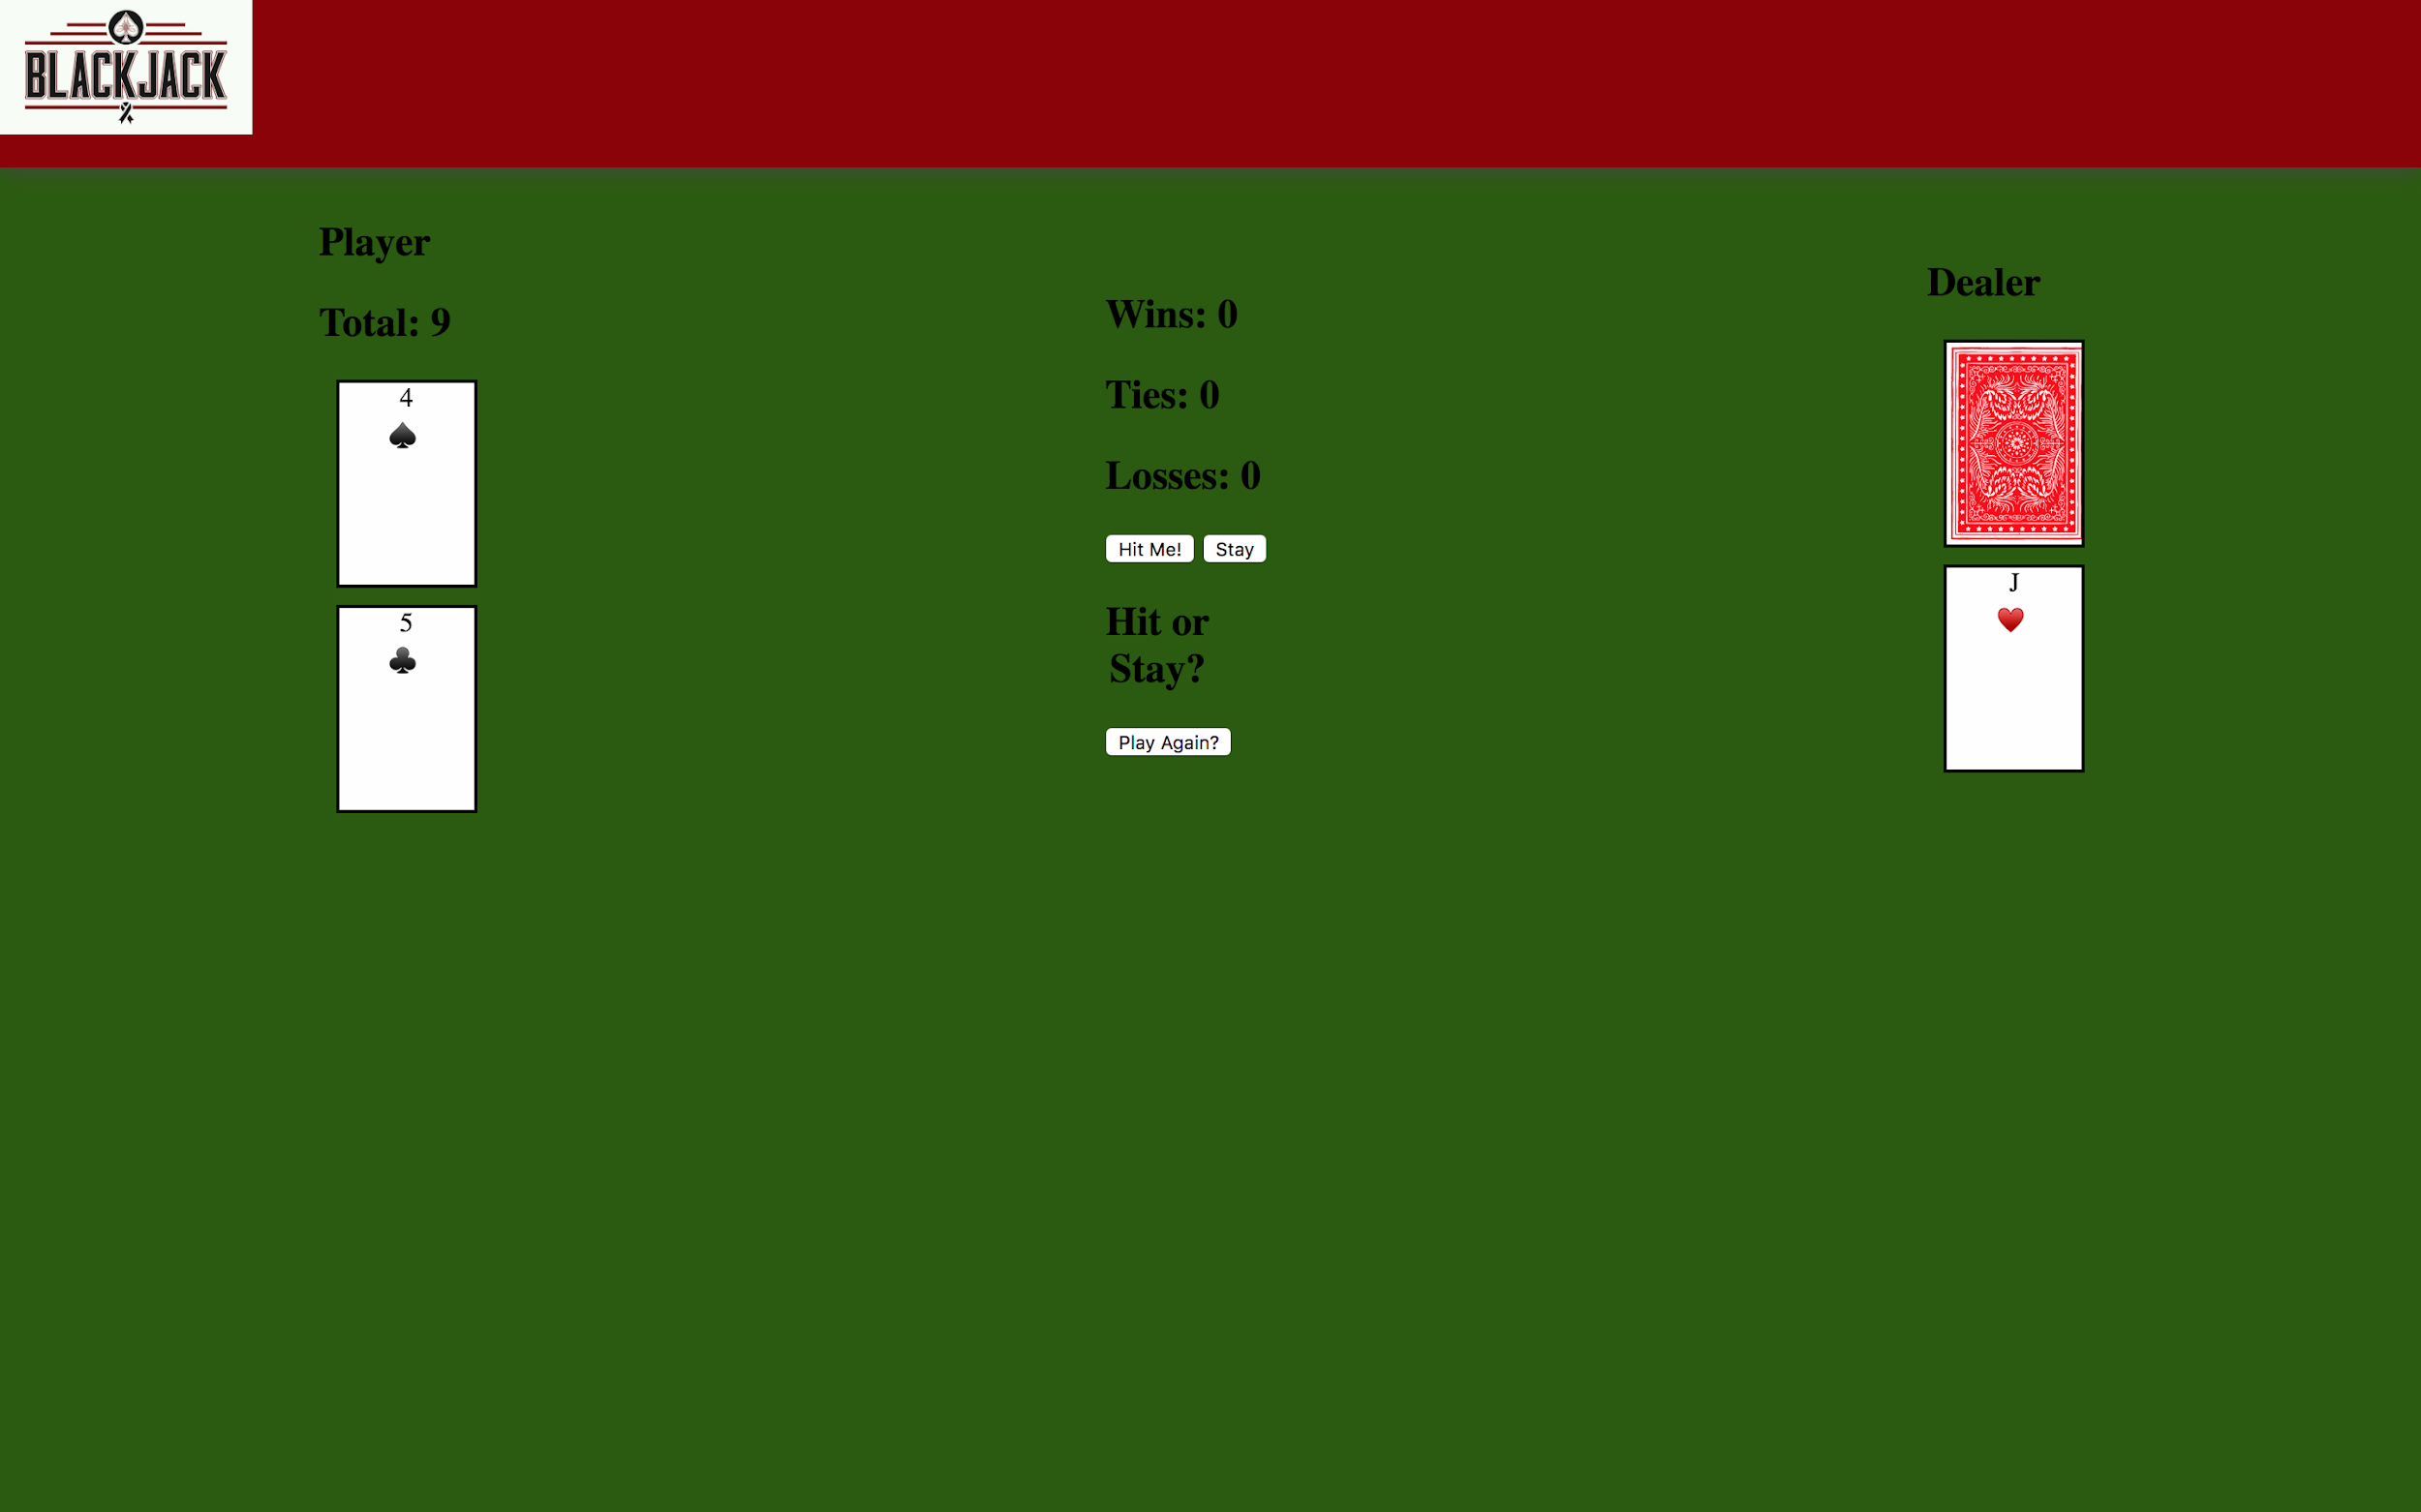
Player total is updated after every card dealt. This occurs within the dealCard function
When the stay button is clicked the event listener is removed and the dealer logic function is called and the dealers hidden card is shown
Cards come in from the top left due to the Animista css animation that I used
The play again button clears the arrays with the player cards and deals new ones
The logo in the upper left is clickable and leads back to the home page
The game starts with two cards each with the dealer having one card hidden

Slide 5
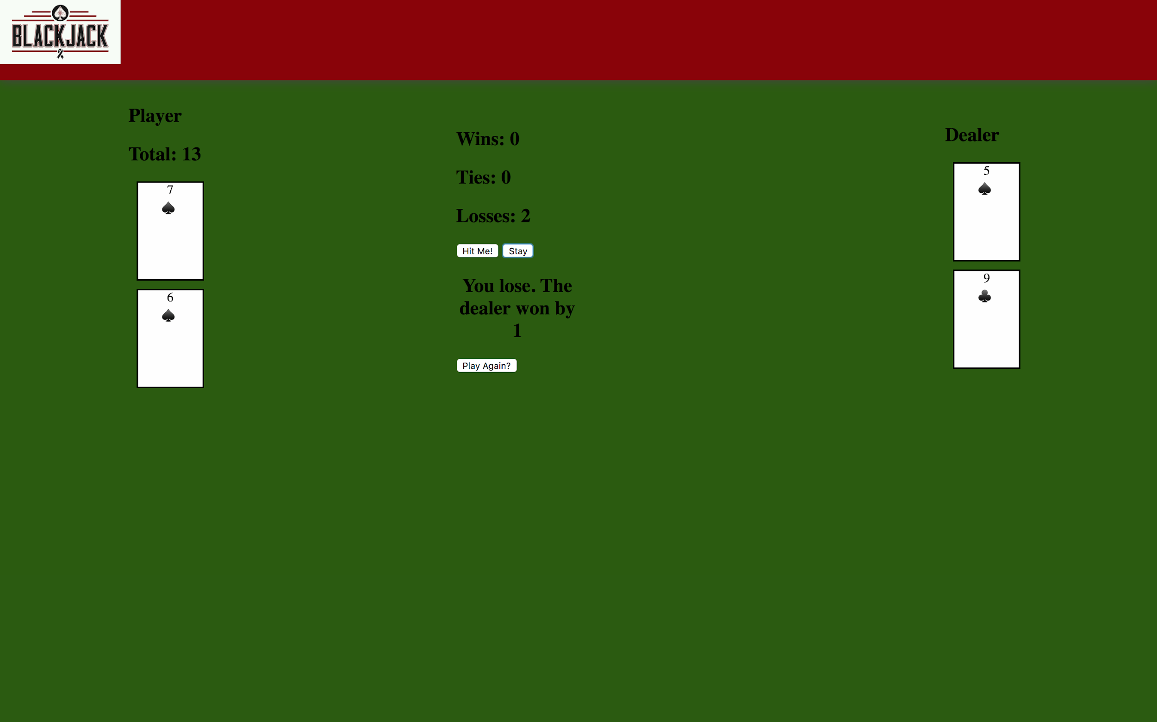
Win/Loss/Tie total updated
Dealer card flipped
Message updated from Hit or stay? To the result
The dealer will hit as long as their total is lower than that of the player

Slide 6
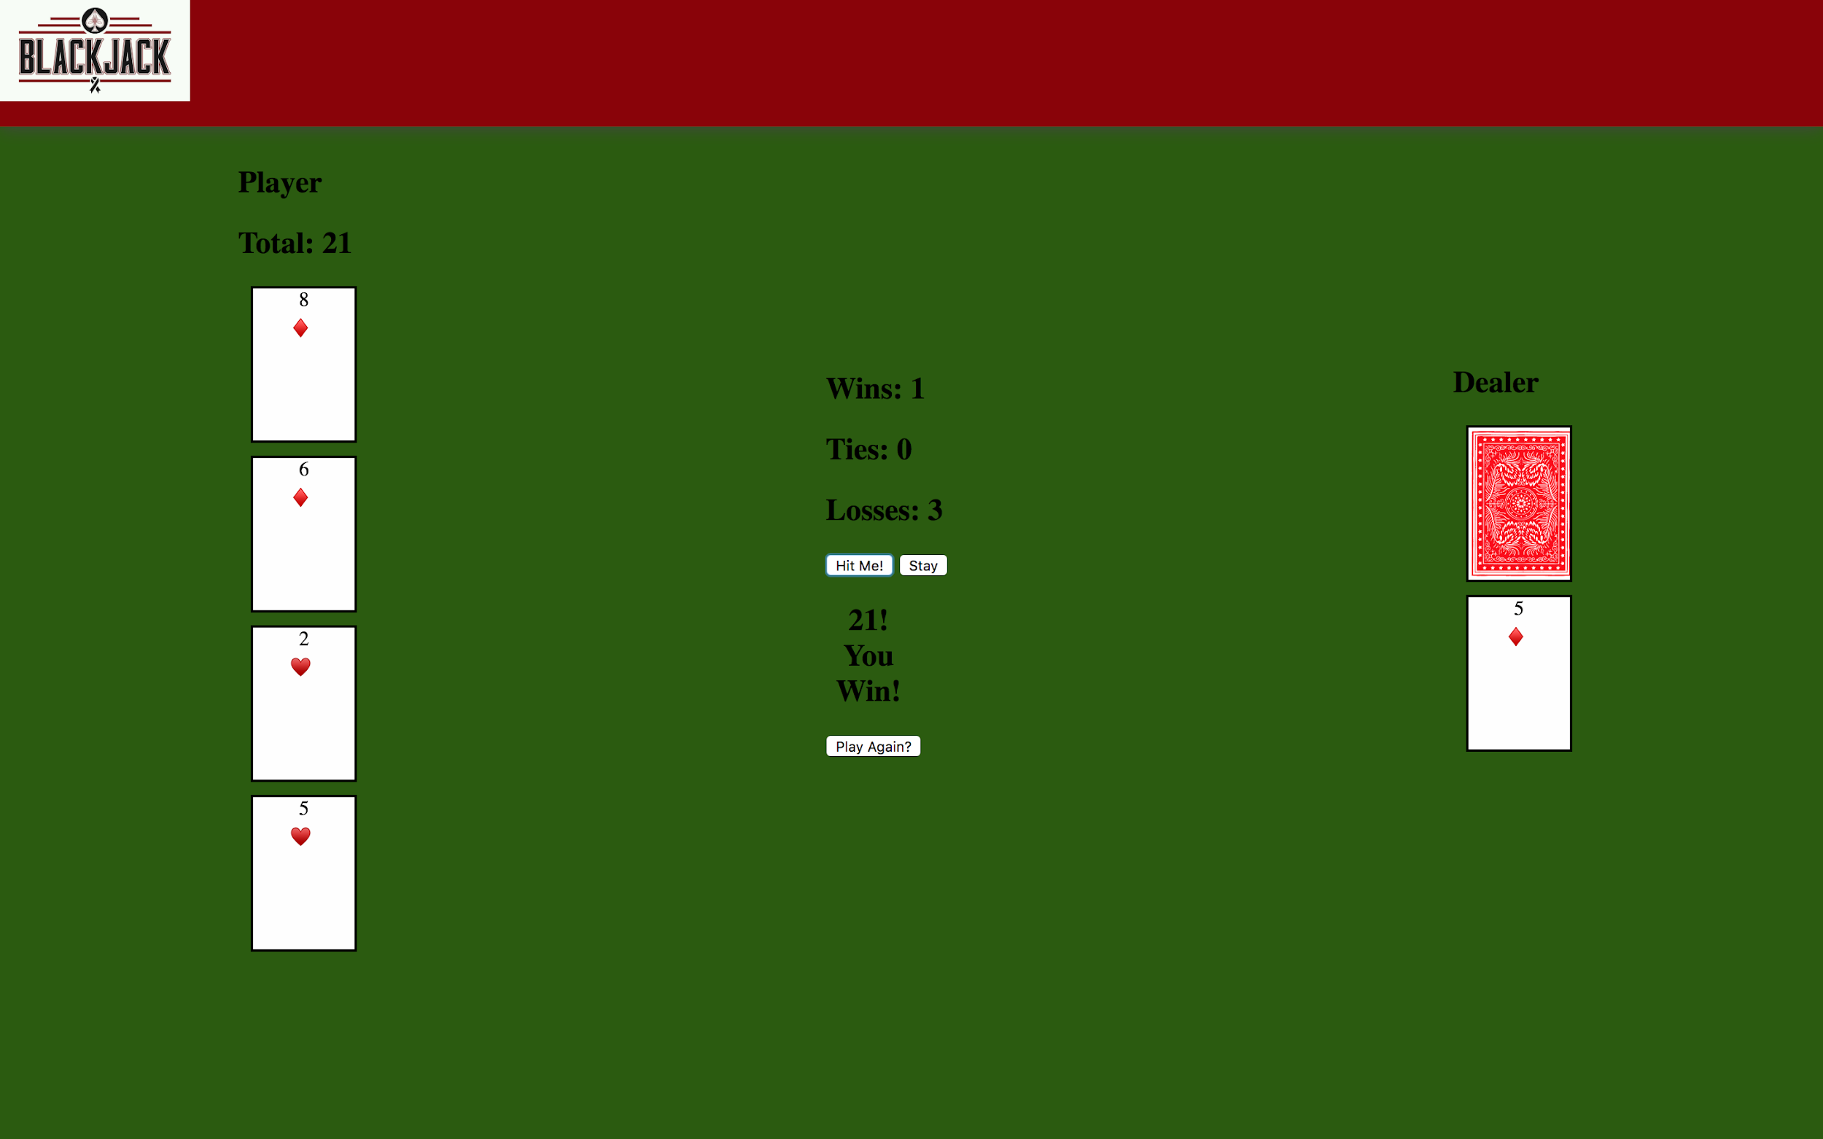

Slide 7
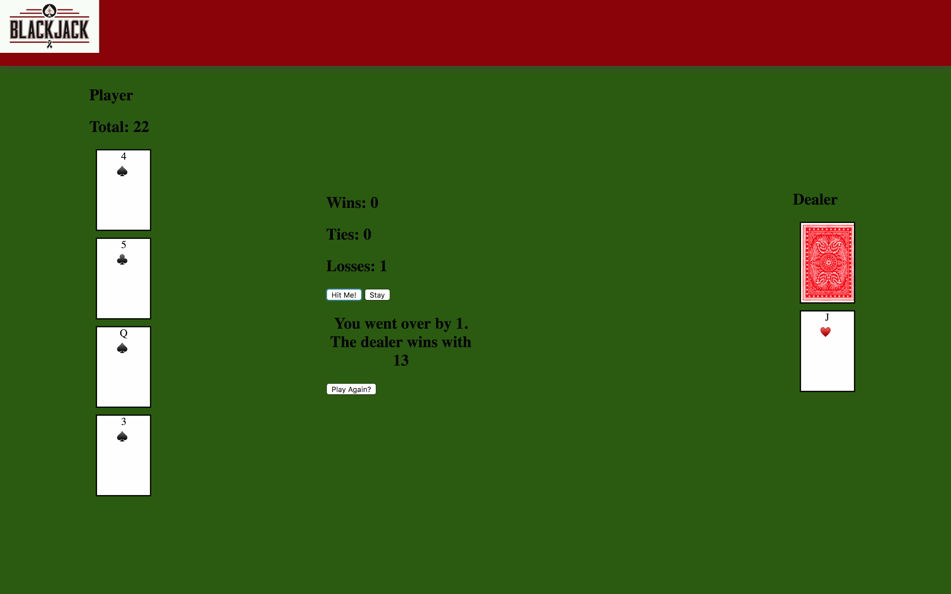
When multiple new cards are created the items start to shift in different ways. Probably poor use of flexbox
Longer messages throw the center section out of alignment
Issues with CSS

