Slide 1
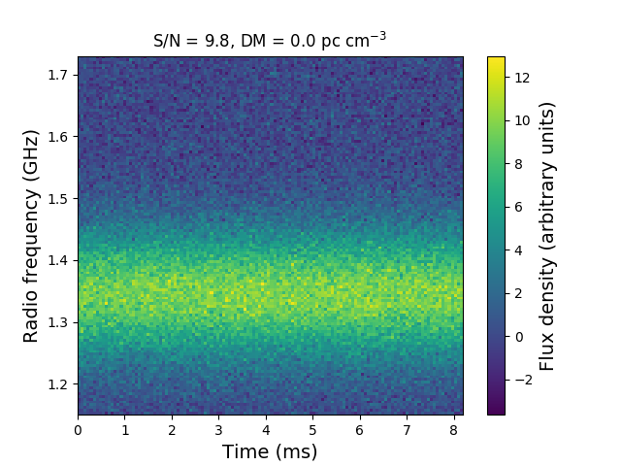
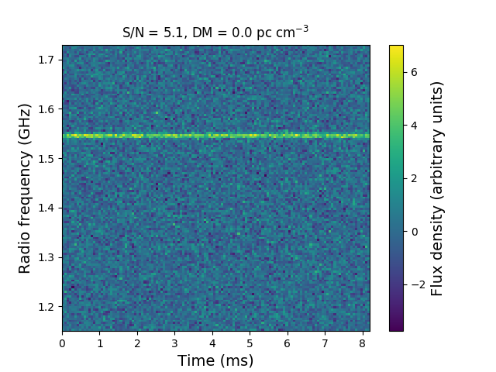
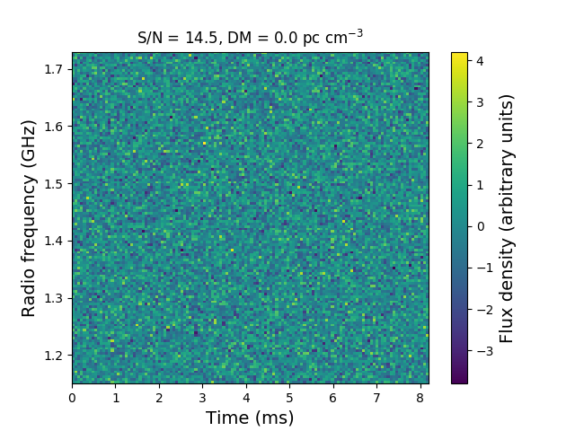
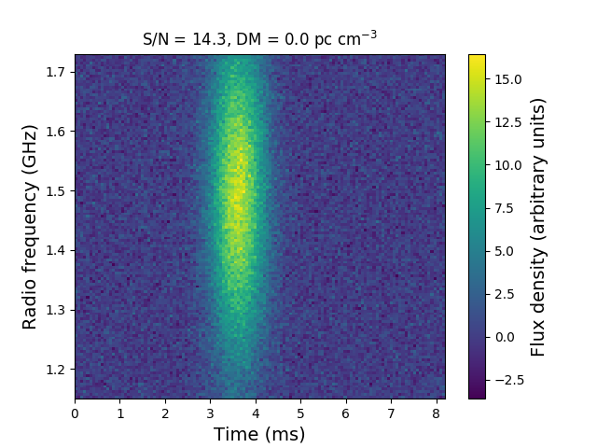
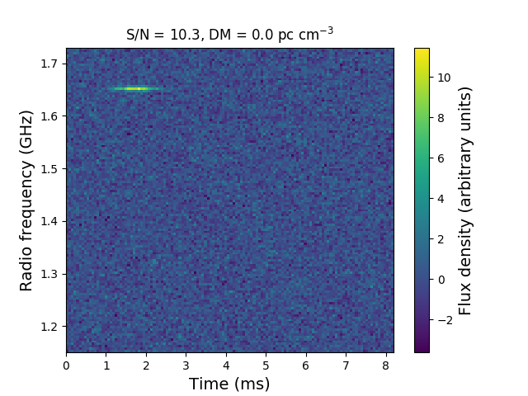
Broadband
Narrowband
128 x 128
time res = 64 μs
freq res = 4.53 MHz
Long –
Lived
Noise
Short –
Lived

Slide 2
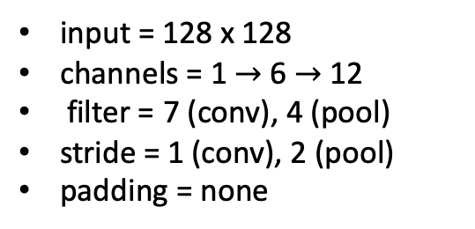
input = 128 x 128
channels = 1 $→$6 $→$ 12
filter = 7 (conv), 4 (pool)
stride = 1 (conv), 2 (pool)
padding = none

Slide 3
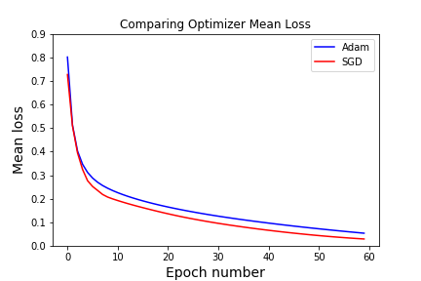
60 epochs
4,000 data points (no noise)
1,000/class x 4 classes
Learning rate = 1e-5
400 test images
Adam = 92% accuracy
SGD = 94% accuracy
Cross entropy loss
Better for classification than MSE
Adaptive Movement Estimation (Adam)
Computes adaptive learning rates for different parameters from estimates of the first and second moments of the gradients.
Stochastic Gradient Decent (SGD)
Maintains a single learning rate for all weight updates. Learning rate does not change during training.

Slide 4
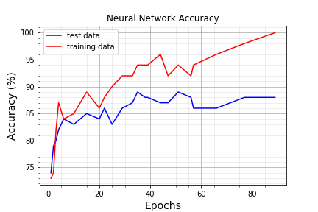
Ep | 1 | 2 | 3 | 4 | 6 | 10 | 15 | 20 | 22 | 25 | 29 | 33 | 38 | 39 | 44 | 47 | 51 | 56 | 57 | 66 | 77 | 89
Tr | 73 | 74 | 82 | 87 | 84 | 85 | 89 | 86 | 88 | 90 | 92 | 92 | 94 | 94 | 96 | 92 | 94 | 92 | 94 | 96 | 98 | 100
Te | 74 | 79 | 80 | 82 | 84 | 83 | 85 | 84 | 86 | 83 | 86 | 87 | 88 | 88 | 87 | 87 | 89 | 88 | 86 | 86 | 88 | 88
23 data points

Slide 5
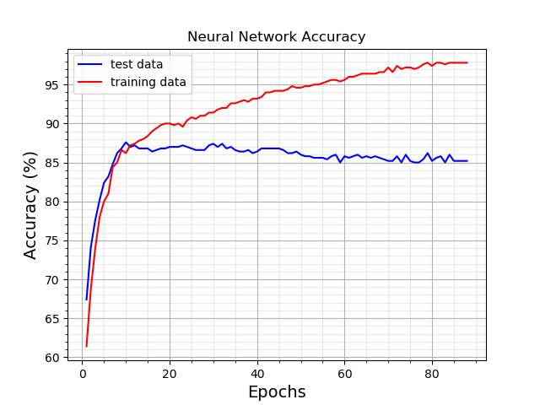

Slide 6
Loss = 0.41
Epochs = 6
Total Accuracy = 81%, 85%
Expected vs Predicted Classification Table
= test data
= training data
Predicted
 | Long-lived broadband | Long-lived narrowband | Short-lived broadband | Short-lived narrowband | Noise
Long-lived broadband | 1.0 1.0 | 0.0 0.0 | 0.0 0.0 | 0.0 0.0 | 0.0 0.0
Long-lived narrowband | 0.0 0.0 | 0.77 0.79 | 0.0 0.0 | 0.10 0.07 | 0.13 0.14
Short-lived broadband | 0.01 0.0 | 0.0 0.0 | 0.96 0.98 | 0.01 0.0 | 0.02 0.02
Short-lived narrowband | 0.0 0.0 | 0.13 0.05 | 0.0 0.0 | 0.33 0.51 | 0.54 0.44
Noise | 0.0 0.0 | 0.0 0.0 | 0.0 0.0 | 0.0 0.0 | 1.0 1.0
Expected

Slide 7
Loss = 0.28
Epochs = 20
Total Accuracy = 84%, 86%
Expected vs Predicted Classification Table
= test data
= training data
Predicted
 | Long-lived broadband | Long-lived narrowband | Short-lived broadband | Short-lived narrowband | Noise
Long-lived broadband | 0.99 0.99 | 0.0 0.0 | 0.1 0.1 | 0.0 0.0 | 0.0 0.0
Long-lived narrowband | 0.0 0.0 | 0.85 0.78 | 0.0 0.0 | 0.06 0.16 | 0.09 0.06
Short-lived broadband | 0.1 0.0 | 0.1 0.0 | 0.97 1.0 | 0.1 0.0 | 0.0 0.0
Short-lived narrowband | 0.0 0.0 | 0.09 0.08 | 0.0 0.0 | 0.66 0.76 | 0.25 0.16
Noise | 0.0 0.0 | 0.0 0.0 | 0.0 0.0 | 0.28 0.17 | 0.72 0.83
Expected

Slide 8
Loss = 0.15
Epochs = 57
Total Accuracy = 86%, 94%
Expected vs Predicted Classification Table
= test data
= training data
Predicted
 | Long-lived broadband | Long-lived narrowband | Short-lived broadband | Short-lived narrowband | Noise
Long-lived broadband | 1.0 1.0 | 0.0 0.0 | 0.0 0.0 | 0.0 0.0 | 0.0 0.0
Long-lived narrowband | 0.0 0.0 | 0.88 0.88 | 0.0 0.0 | 0.04 0.01 | 0.08 0.11
Short-lived broadband | 0.01 0.0 | 0.0 0.0 | 0.98 1.0 | 0.01 0.0 | 0.0 0.0
Short-lived narrowband | 0.0 0.0 | 0.07 0.04 | 0.0 0.0 | 0.67 0.85 | 0.26 0.11
Noise | 0.0 0.0 | 0.02 0.0 | 0.0 0.0 | 0.22 0.02 | 0.76 0.98
Expected

Slide 9
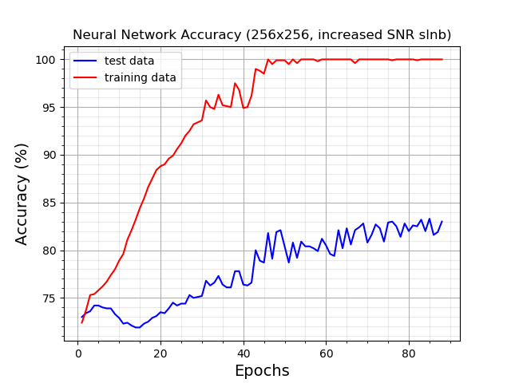
All Categories
Increased SNR slnb

Slide 10
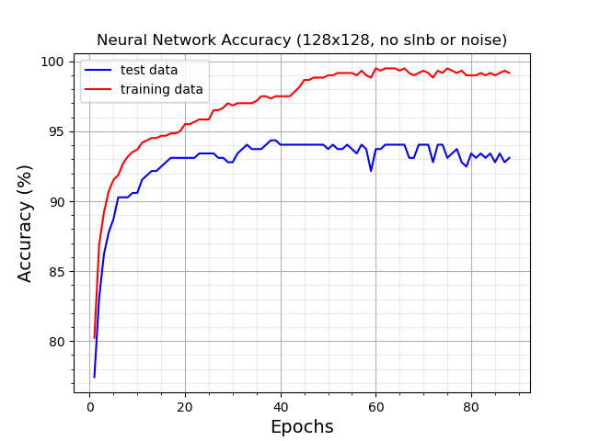
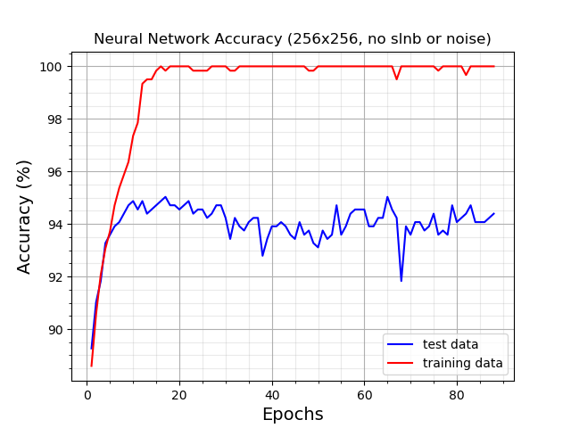
no SLNB, no noise

Slide 11
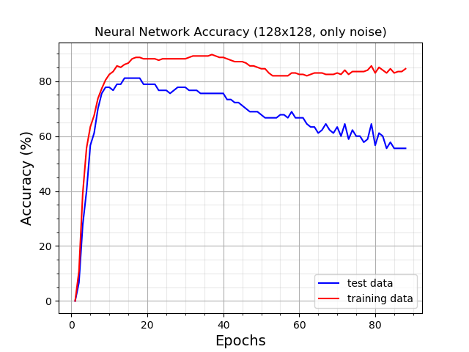
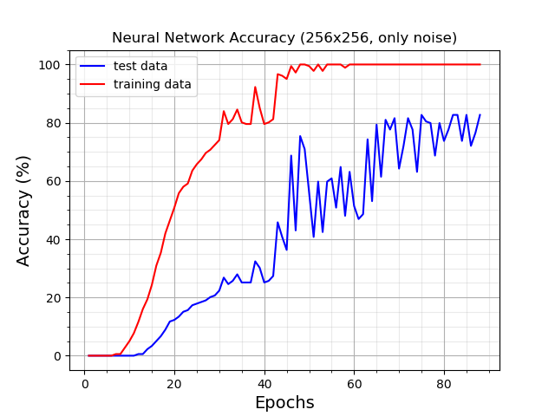
Only noise

Slide 12
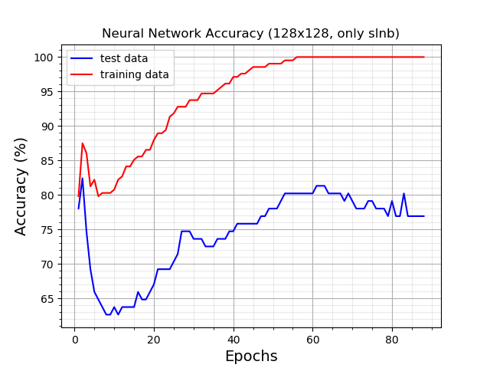
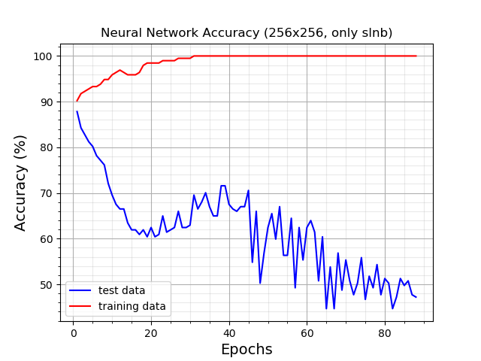
Only slnb
Increased SNR slnb

Slide 13
Loss = 0.21
Epochs = 10
Total Accuracy = 73%, 77%
Expected vs Predicted Classification Table
*Increased SNR slnb
= test data
= training data
Predicted
 | Long-lived broadband | Long-lived narrowband | Short-lived broadband | Short-lived narrowband | Noise
Long-lived broadband | 1.0 1.0 | 0.0 0.0 | 0.0 0.0 | 0.0 0.0 | 0.0 0.0
Long-lived narrowband | 0.0 0.0 | 0.88 0.92 | 0.0 0.0 | 0.12 0.08 | 0.0 0.0
Short-lived broadband | 0.0 0.01 | 0.0 0.0 | 0.99 0.98 | 0.01 0.01 | 0.0 0.0
Short-lived narrowband | 0.0 0.0 | 0.30 0.04 | 0.0 0.0 | 0.70 0.96 | 0.0 0.0
Noise | 0.0 0.0 | 0.0 0.0 | 0.0 0.0 | 1.0 0.96 | 0.0 0.04
Expected

Slide 14
Loss = 0.0
Epochs = 89
Total Accuracy = 81%, 100%
Expected vs Predicted Classification Table
*Increased SNR slnb
= test data
= training data
Predicted
 | Long-lived broadband | Long-lived narrowband | Short-lived broadband | Short-lived narrowband | Noise
Long-lived broadband | 1.0 1.0 | 0.0 0.0 | 0.0 0.0 | 0.0 0.0 | 0.0 0.0
Long-lived narrowband | 0.0 0.0 | 0.85 1.0 | 0.0 0.0 | 0.10 0.0 | 0.05 0.0
Short-lived broadband | 0.0 0.0 | 0.0 0.0 | 0.98 1.0 | 0.01 0.0 | 0.01 0.0
Short-lived narrowband | 0.0 0.0 | 0.22 0.0 | 0.01 0.0 | 0.51 1.0 | 0.26 0.0
Noise | 0.0 0.0 | 0.03 0.0 | 0.0 0.0 | 0.27 0.0 | 0.7 1.0
Expected

Slide 15
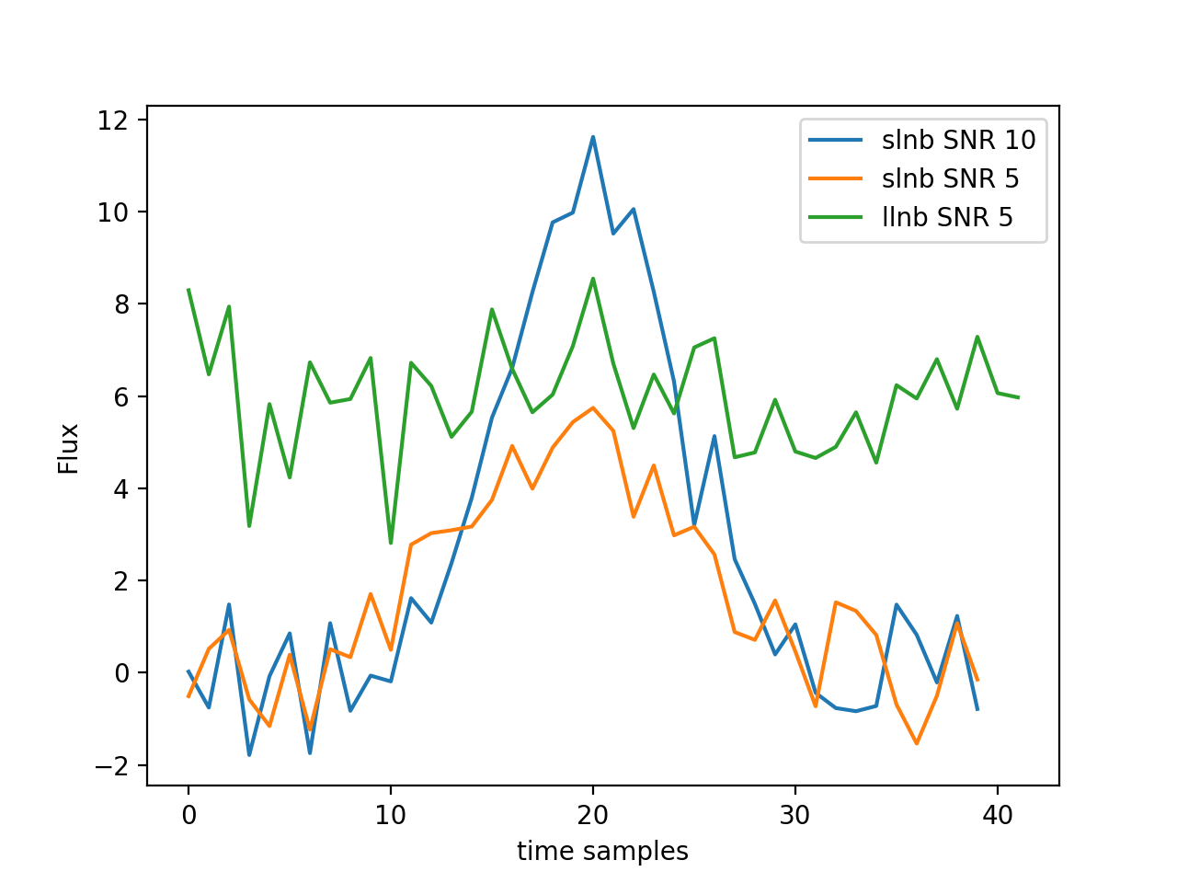
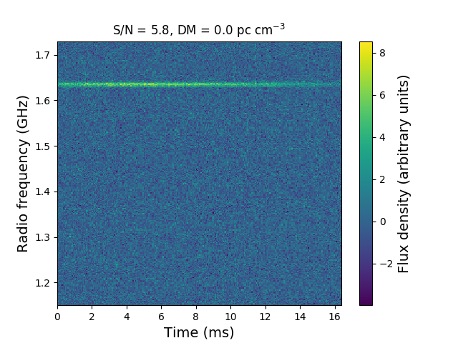
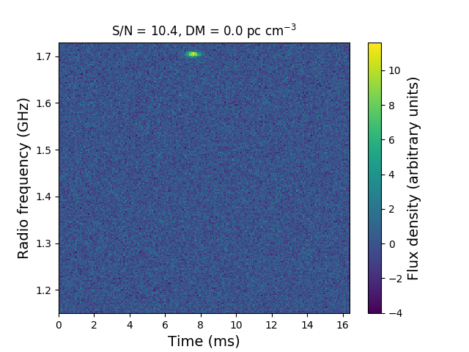
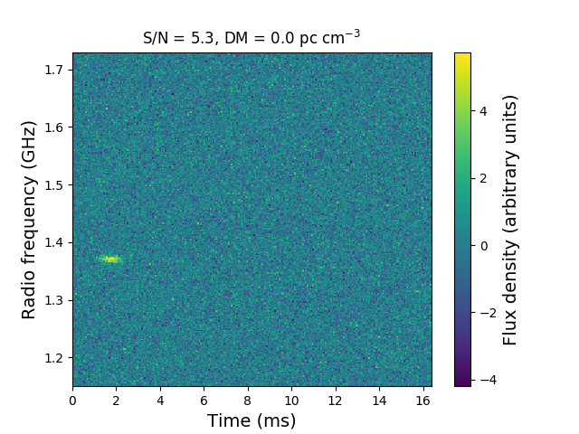
Notes:
Flux vs time samples

Slide 16
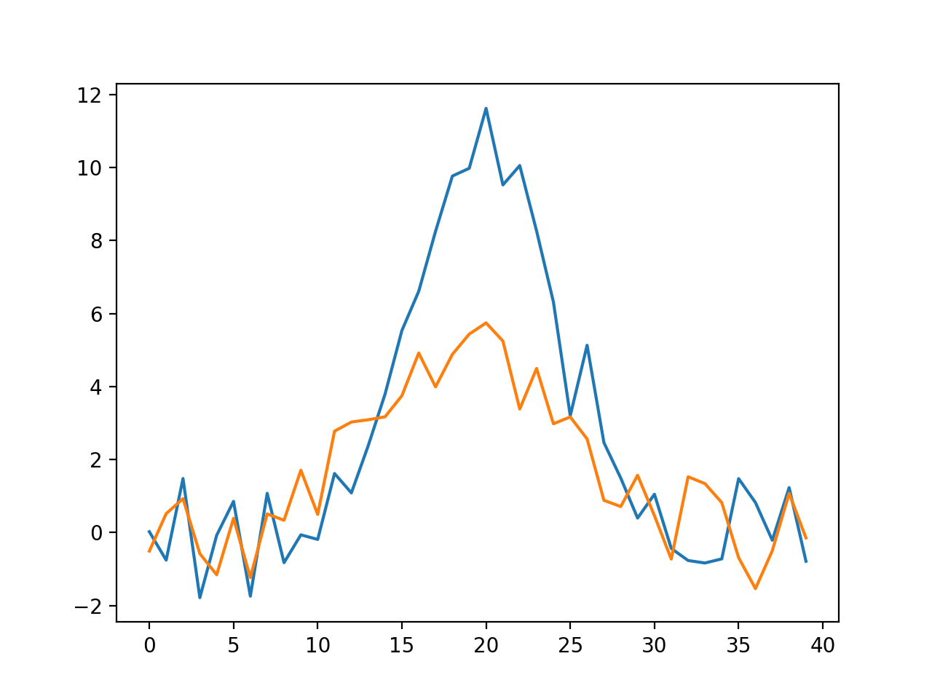
Notes:
Flux vs time samples

Slide 17
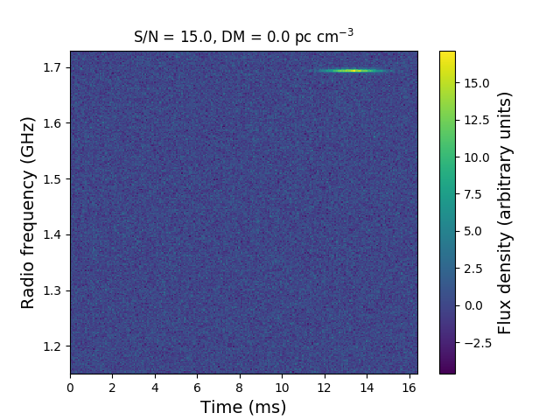
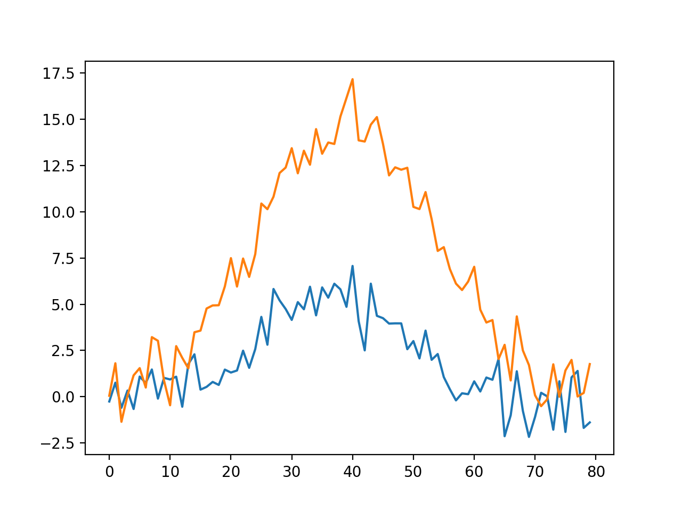
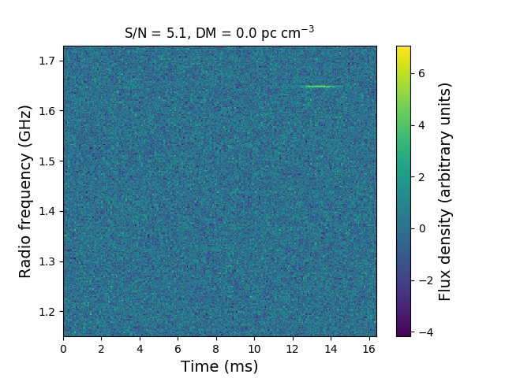

Slide 18
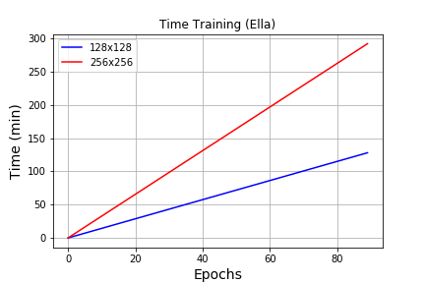

Slide 19
Next
Incorporate real-world data (FRB 121102) http://seti.berkeley.edu/frb121102/technical.html
Split up data arrays to fit into network
Using smoothing techniques outlined by Akshay in jupyter notebook to identify label bursts for training

Slide 20
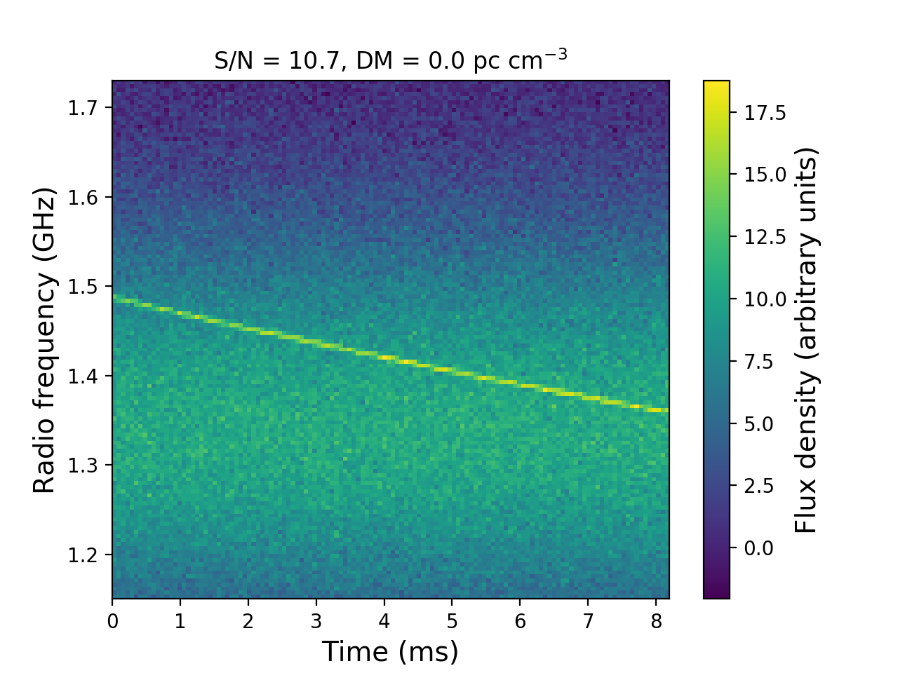
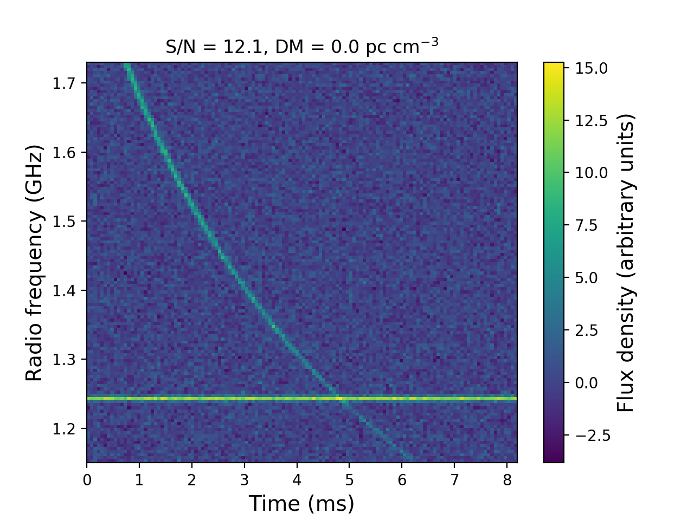
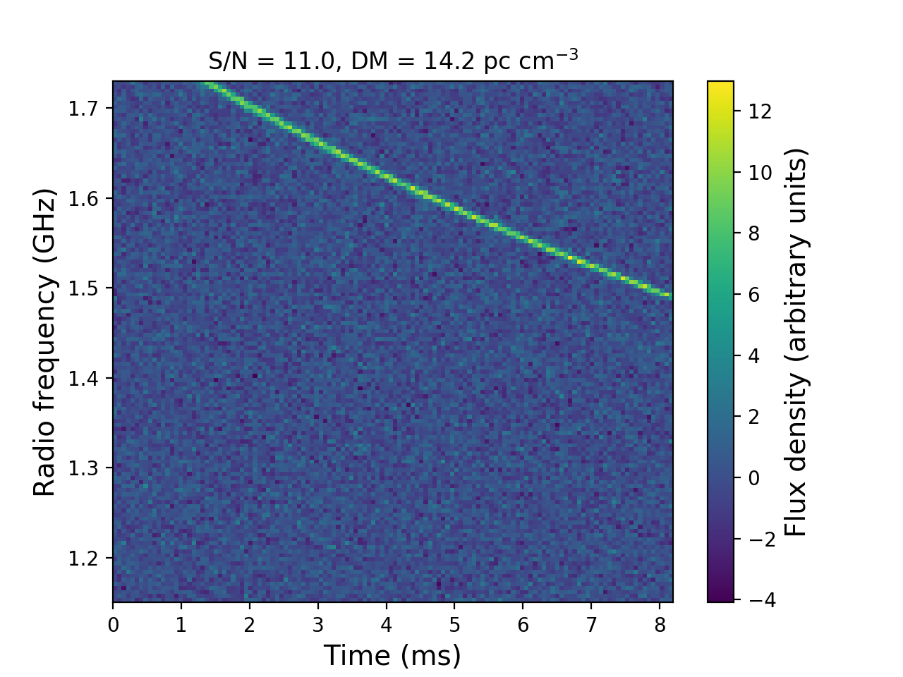
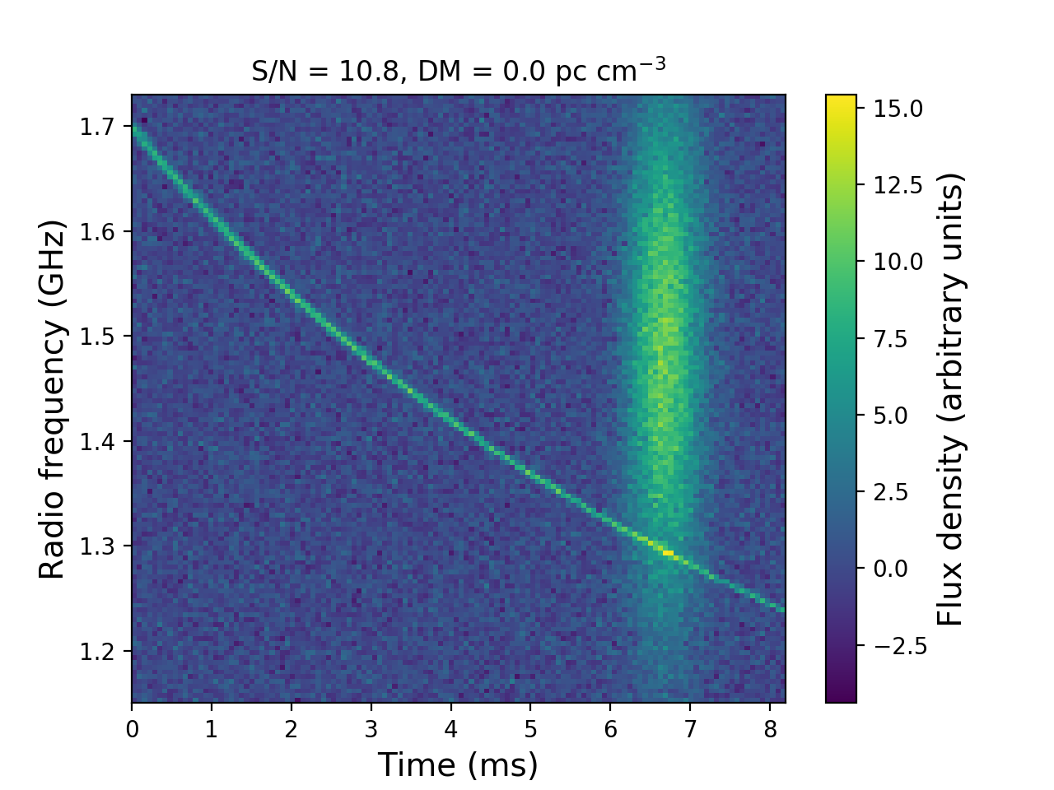
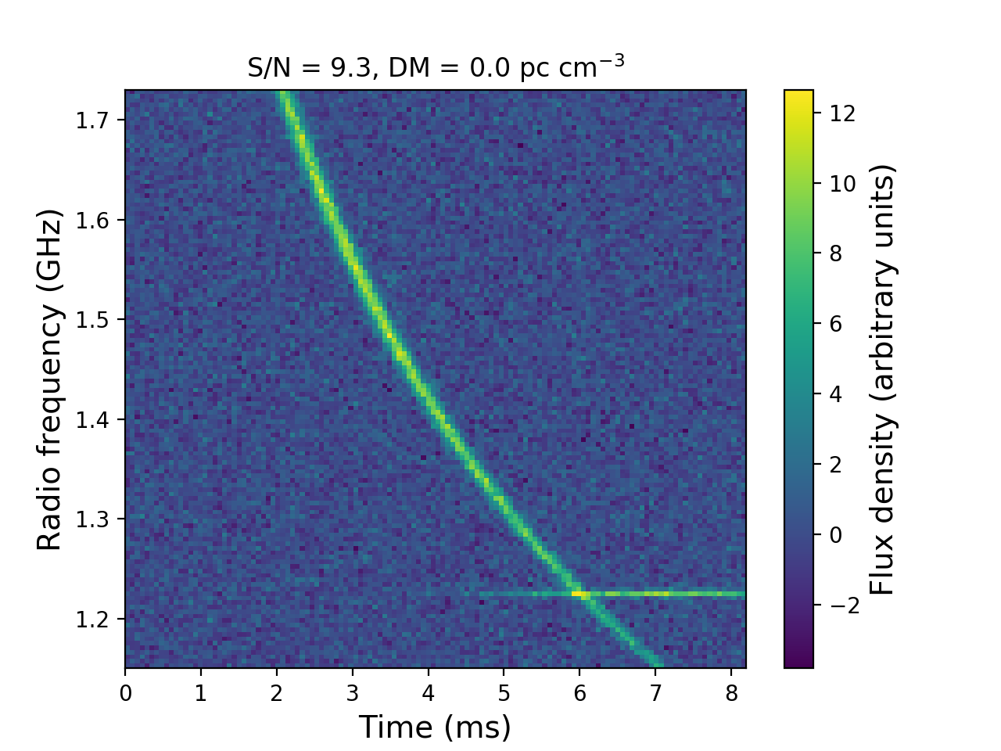
pulse + RFI
just pulse

