Slide 1
POC Success Plan
For Delta Arc Corp.

Slide 2




Key Issues
Security & Risk
Engineering Overhead
Data Governance
Prior Tool Failure

Slide 3
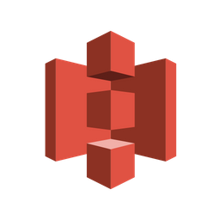
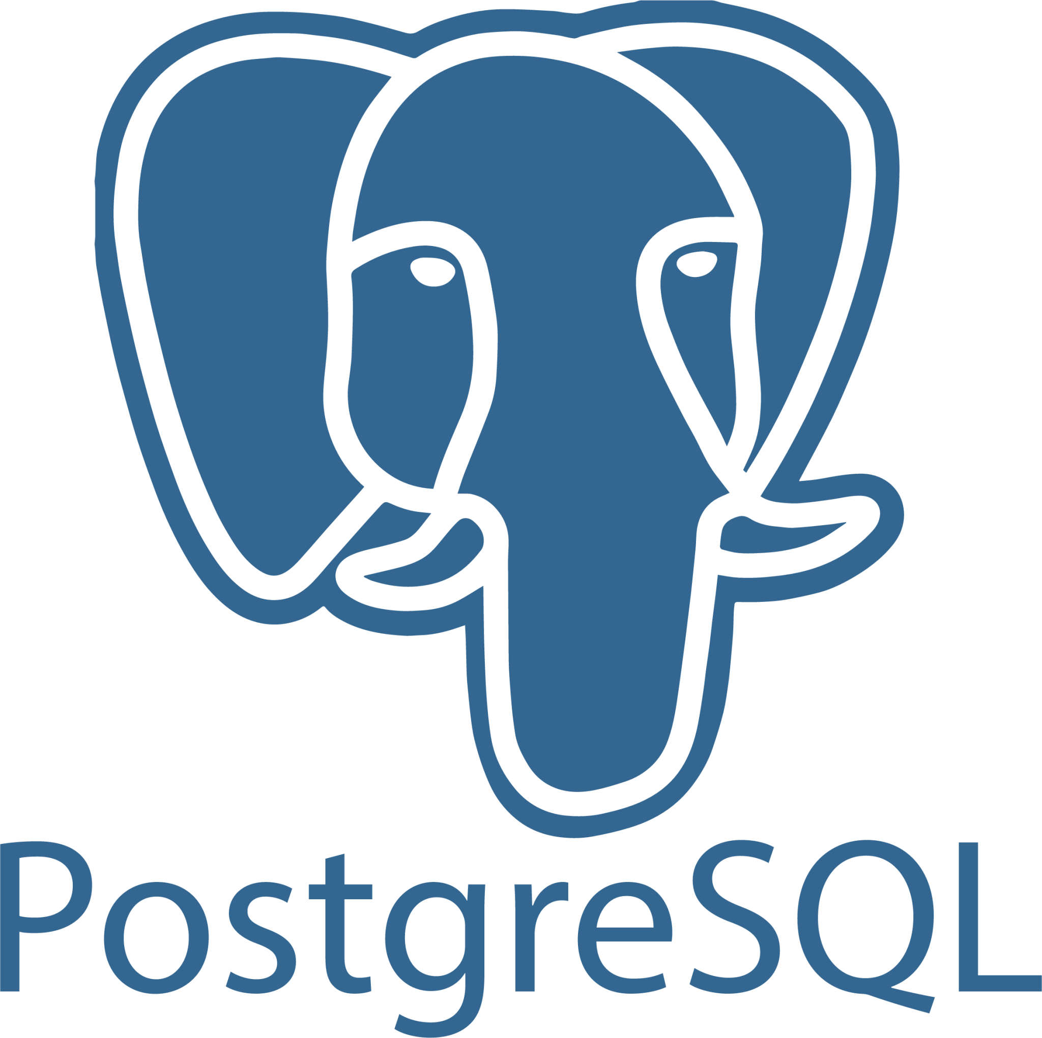



Environment & Data Flow
Extract
Landing Zone
Raw + Cleaned + Presentation Zone
via Matillion

Slide 4
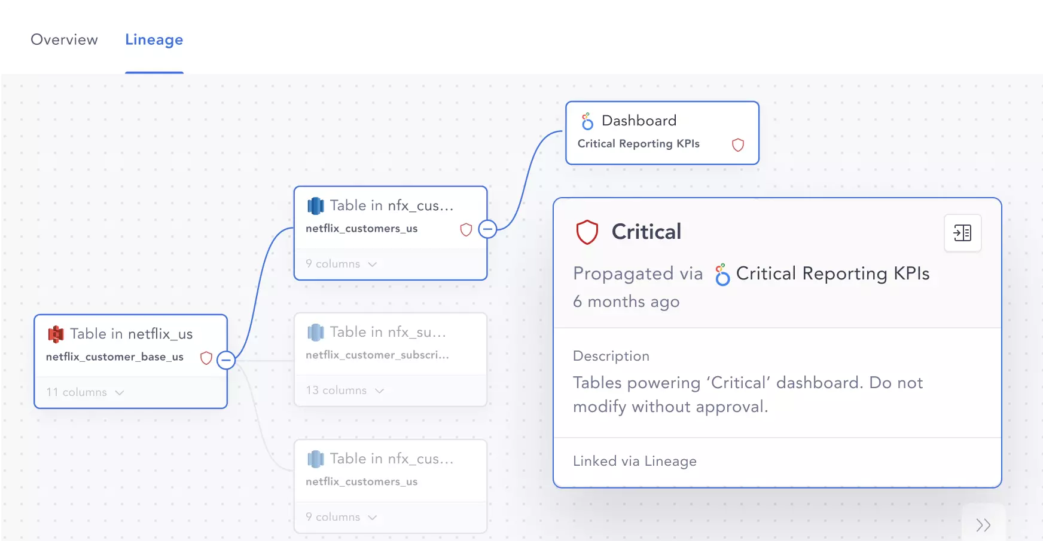

Lineage Impact
No visibility from source to report
Breakages after upstream changes
No ownership or accountability
Duplicated work and inconsistent logic
Inability to audit or comply
Source of Truth
Notes:
“When lineage is missing, you lose the ‘source of truth’—which leads to broken dashboards, redundant work, and poor decisions. In a regulated space like fintech, it also becomes nearly impossible to prove how data is handled, which is a real compliance risk.”

Slide 5
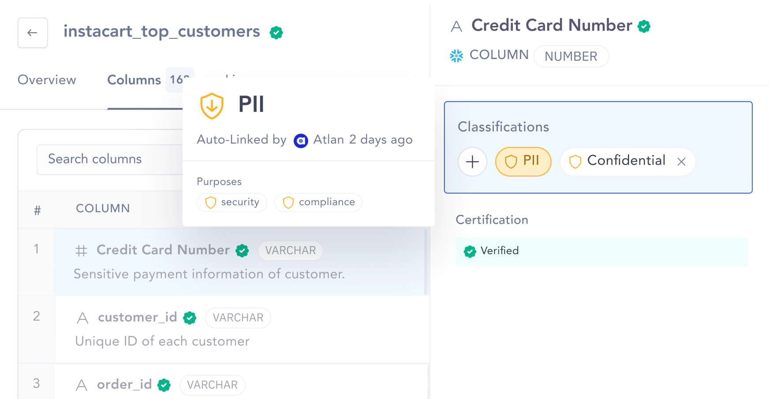
PII Classification
High risk of non-compliance
Can’t prioritize protection of critical data
Overexposed data or excessive restriction
Engineering overhead during reviews
Notes:
“When lineage is missing, you lose the ‘source of truth’—which leads to broken dashboards, redundant work, and poor decisions. In a regulated space like fintech, it also becomes nearly impossible to prove how data is handled, which is a real compliance risk.”

Slide 6
Tech Stack Compatibility
TOOL | PURPOSE | ATLAN SUPPORT | NOTES
Postgres | Source DB | ✅ Native | Incremental via Airflow
S3 | Landing Zone | ✅ Native | Supports AWS library
Snowflake | Data Warehouse | ✅ Native | Zone-based modeling support
Matillion | Transformation Tool | ⬛️ Indirect | Supports pushdown via Snowflake
Looker | BI Tool | ✅ Native | Downstream lineage included
Airflow | Orchestration | ✅ Native | DAG tracking for lineage visibility
JumpCloud | SSO | ✅ Native | For secure login & role provisioning

Slide 7
No lineage across stack
Native connectors across pipeline
Validate lineage from Postgres → Looker
No data inventory or PII view
Collaborative glossary with ownership assignment
Auto-classify and tag PII in Snowflake
Manual schema change triage
Automated classification, custom tags
At least 5 terms added collaboratively
Lack of shared understanding
Version-aware lineage + impact visualization
Simulate upstream change, trace impact in Looker
Collaboration gaps
Plug-and-play setup (unlike OvalEdge)

Slide 8






Timeline
Day 1
Day 4-5
Day 9-10
Day 13-14
Kickoff &
Access setup
Initial Lineage Load & PII Tagging
Schema Impact Demo
Wrap Up
& Report
Source Connectors
(Postgre, S3, Snowflake, Looker)
Glossary workshop
Propagation setup
Feedback
Day 2-3
Day 7-8
Week 11-12

