Slide 1
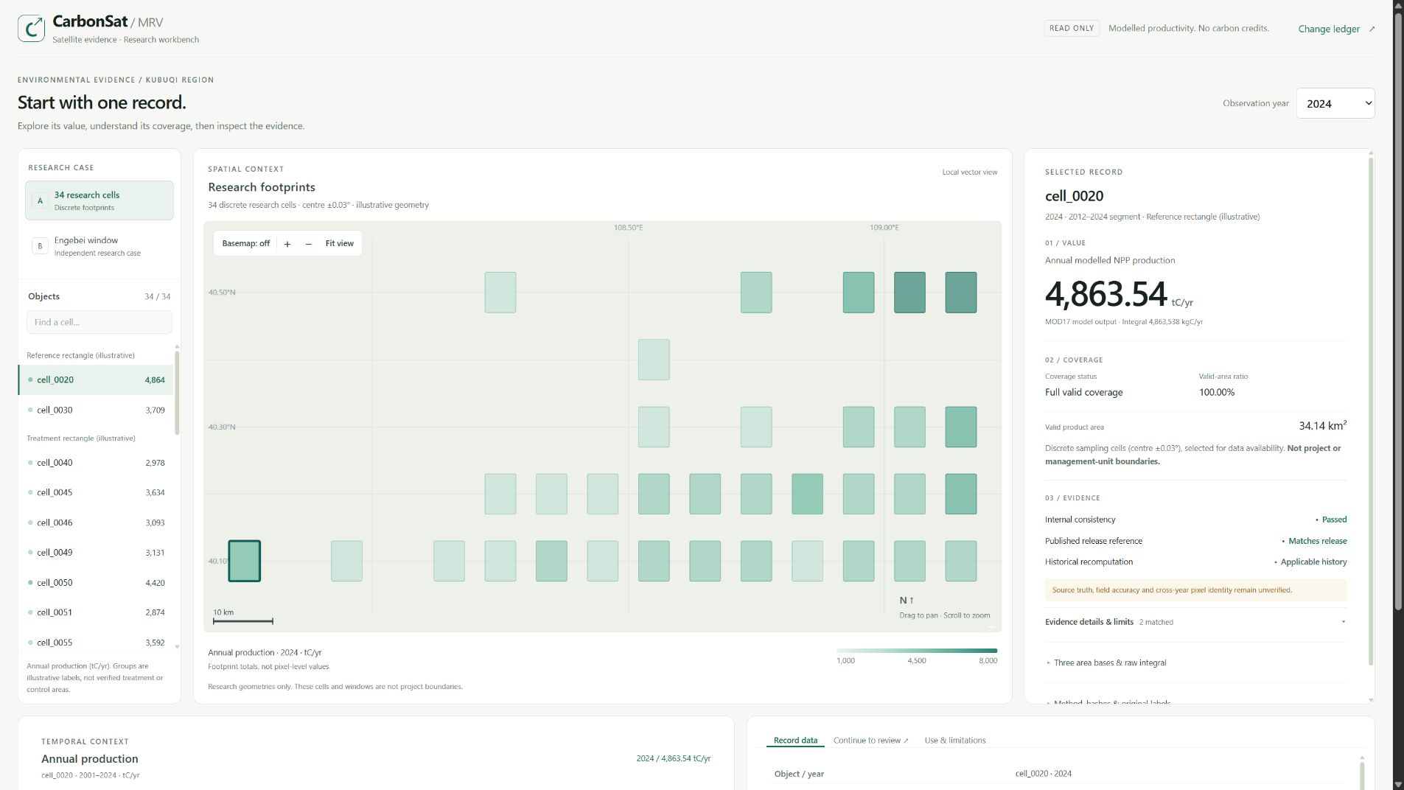
TRACK 4: CLIMATE DATA & ENVIRONMENTAL MONITORING
WORKING RESEARCH PROTOTYPE
CarbonSat-MRV
Satellite evidence for
environmental review
For environmental researchers and reviewers.
Inspect satellite results with their coverage and evidence. Two anomaly models support review preparation; a historical Sepolia pilot provides a public registration reference.
PAPER TEAM
Actual English workbench: value, coverage and evidence for one record
Ryan Li / Tai Ye / QY Li
IEEE ClimateChain 2026
01
Notes:
PPT 1 · Opening
Planned video time: 0:00-0:18 (target total 4:40; leave 20 s inside the 5:00 limit).
PURPOSE
Establish, in one screen: Track 4 (Climate Data & Environmental Monitoring), the review use case for
environmental data, and the target users (environmental researchers and reviewers). The screenshot is
the product, not decoration.
FACTS ON THIS PAGE
Working research prototype. Two separately trained unsupervised models support review preparation.
One historical descriptive record is registered on Sepolia and is described as a public reference only.
SOURCE
Team credit and project name reproduce the supplied deck. The screenshot is the actual English
workbench, captured as software state; it is not a user trial.
Formal EN/CN narration to be written after V6 is approved.
Do not read the team names or the footer aloud.

Slide 2
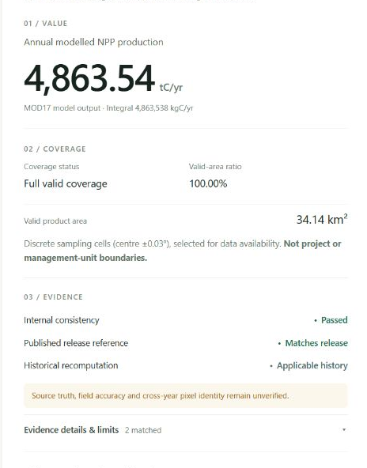
THE REVIEWER'S QUESTION
CarbonSat-MRV
What evidence supports this vegetation result?
A reviewer needs its valid footprint, comparison limits and evidence status.
4,863.54
Area basis
Which valid footprint does this value cover?
tC/yr · cell_0020 · 2024
Annual modelled NPP production on the valid product footprint
Comparability
Which comparisons are permitted within the same cell and analysis segment?
Modelled NPP does not establish net carbon removal or credit quantities.
Evidence status
Which checks apply, and what remains unverified?
Actual English workbench, record detail
IEEE ClimateChain 2026 / Climate Data & Environmental Monitoring
02
Notes:
PPT 2 · The reviewer's question
Planned video time: 0:18-0:40.
PURPOSE
Turn the value 4,863.54 tC/yr into a question: what evidence supports it? Three review questions
(area basis, comparability, evidence status) are answered later in the demonstration and closed on
page 6.
FACTS ON THIS PAGE
cell_0020, 2024: annual modelled NPP production on the valid product footprint, 4,863.54 tC/yr.
Valid area 34.14 km2, valid-area ratio 100% (page 7). Modelled NPP does not establish net carbon
removal or credit quantities.
Formal EN/CN narration to be written after V6 is approved.
Do not present the value as a carbon sink, a removal or a credit quantity.

Slide 3
ANOMALY PRESCREENING
CarbonSat-MRV
Two unsupervised models for anomaly prescreening
Separately trained Isolation Forest models produce advisory scores for review prioritisation.
 | FVC model | NPP model family
Input dataset | 3,420 cell-years across 90 cells | 816 cell-years across 34 cells
Feature examples | FVC, NDVI, observation-quality fields, temporal change | NPP, temporal change, valid-area ratio, era indicator
Evaluation design | Held-out cells | Time and cell holdouts
Output | Advisory anomaly scores | Advisory anomaly scores
Saved models and score tables support local reproduction.
Task exports are rule-derived. Real anomaly-detection performance remains unverified.
Both models are Isolation Forest. Scores are advisory and only order human review; the browser performs no model inference.
IEEE ClimateChain 2026 / Climate Data & Environmental Monitoring
03
Notes:
PPT 3 · Two unsupervised models
Planned video time: 0:40-1:10.
PURPOSE
Show the technical contribution: two model families, separately trained, on two different input sets,
each producing advisory scores that only order human review.
EXACT IDENTITIES (for questions)
FVC model, CarbonSat-AnomalyIF-v1.1: input 3,420 rows / 90 cells, 1987-2024, 7 features
(fvc, ndvi, clearPixelRatio, spatialCoverage, sensorAgreement, fvcJump, yearNorm).
Training 2,736 rows / 72 cells; spatial holdout 684 rows / 18 cells. 3,420 is the input count,
not the training count. Stored grid scores reproduce 3,420 / 3,420.
NPP family, CarbonSat-NPP-AnomalyIF-v1.0: input 816 rows / 34 cells, 2001-2024, 8 features
(npp, nppJump, nppRelJump, nppZscore, validAreaRatio, varJump, yearNorm, eraFlag).
Formal scoring model uses 816 rows. Time holdout 544 / 272 rows; cell holdout 624 / 192 rows.
BOUNDARIES
Both are Isolation Forest. The NPP formal model and its two holdout instances are different roles,
not three algorithms. The FVC 90-cell input and the NPP 34-cell input are different sets: this is not
two models voting on the same data, and the Engebei window is not a second trained model.
FVC v1.1 is a separate development repair; see page 10 for its impact. Scores are advisory, are not
probabilities, and the browser performs no model inference. Task exports are rule-derived.
Formal EN/CN narration to be written after V6 is approved.
No percentage accuracy, contamination rate or test pass rate may be used to decorate model quality.

Slide 4
BLOCKCHAIN: HISTORICAL PILOT
CarbonSat-MRV
A public reference for one historical record
Sepolia stores a single-record payload hash, method version and declaration category for later comparison.
OFF-CHAIN · LOCAL BUNDLE
HISTORICAL SEPOLIA PILOT
Full evidence package
cell_0030_2012
A2 land-cover stream
DESCRIPTIVE_NPP_ONLY
Engebei research case
ANCHORED FIELDS
packHash — single-record payload
Local Merkle batch root
methodVersion
Stored locally. Not written to the chain.
declarationCategory
Registration records a reference. It does not establish scientific validity or certify carbon credits.
Contract 0x248EFE2E5579613d47e9Abe743d7528fBECE3c88 ↗ Register tx 0x79dee25dba251dc339049ca3d91400f32d5fbb5dacb85def9e507262303e450f ↗
Payload packHash 0xb3cd7107866918846f3a99f04350c037f046ae7864e7c045f8b0108c2cc75402
One historical record only. No new transaction, deployment or credit issuance.
IEEE ClimateChain 2026 / Climate Data & Environmental Monitoring
04
Notes:
PPT 4 · Historical Sepolia registration
Planned video time: 1:10-1:30.
PURPOSE
Show that a public registration experiment was actually carried out, and state its exact scope:
one record, three anchored fields, everything else stored locally.
FACTS ON THIS PAGE
Network Sepolia (chainId 11155111). Record cell_0030_2012. Anchored: packHash of the single-record
payload, methodVersion (CarbonSat-NPP-Evidence-v1.0), declarationCategory (DESCRIPTIVE_NPP_ONLY).
Not anchored: whole-bundle packSha256, A2 land-cover stream, per-file source verification, Engebei
case, local Merkle batch root. No IPFS. Attribution status stays insufficient_evidence.
Contract and both transaction links on the slide come from chain_anchor_config_HISTORICAL.json and
open the Sepolia explorer. This deck performs no chain readback and no transaction.
WHY IT MATTERS
Local files support computation and checking; a public registration gives a reference that exists
outside our own website. This is one recorded pilot, not proof that a chain is indispensable, and not
decentralised verification of all data.
Formal EN/CN narration to be written after V6 is approved.
Never draw an arrow from the whole bundle or from the models to the chain, and never merge the
bundle sha256 with the single-record payload hash.

Slide 5
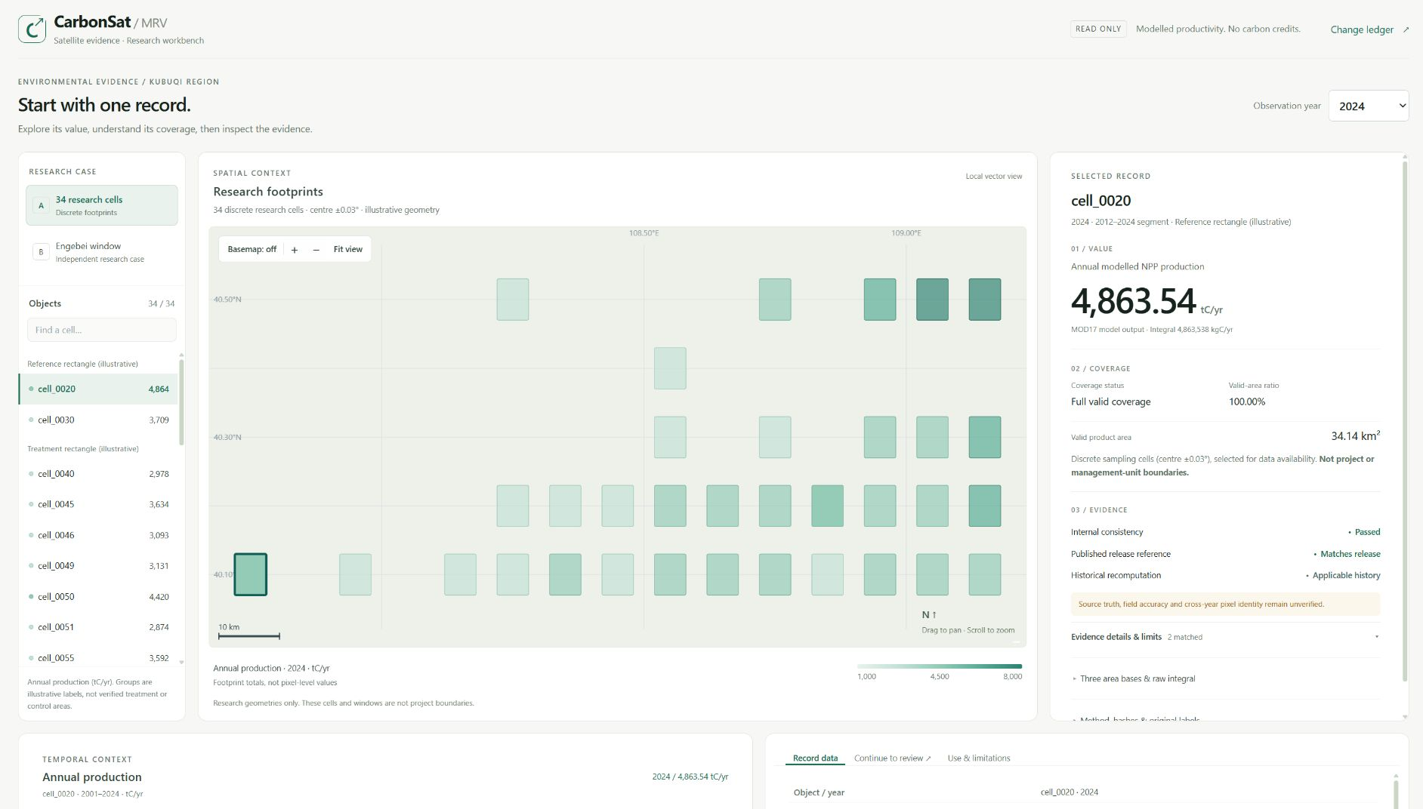
WORKBENCH DEMONSTRATION
CarbonSat-MRV
Record-linked evidence inspection
Keep the selected cell and year in context while inspecting the result and opening its ledger entry.
01
Value with coverage
Inspect production beside its valid area and coverage.
1
02
Evidence with scope
Distinguish local checks, release-reference agreement and historical source checks.
2
03
Linked review
Carry the selected cell and year into the change ledger.
3
Numbered annotations identify the demonstration steps.
Actual English workbench, cell_0020 · 2024
IEEE ClimateChain 2026 / Climate Data & Environmental Monitoring
05
Notes:
PPT 5 · Demonstration route
Planned video time: 1:30-1:45. Switch to the live browser at 1:45.
PURPOSE
Orient the audience before the live segment: one record, three actions. Keep this page short; it
does not repeat page 6.
ANNOTATIONS
The three badges are annotation overlays placed on blank areas of the real interface: 1 on the right
margin of the Value / Coverage block, 2 at the top of the Evidence block, 3 on the bottom tab row next
to Continue to review. They cover no figure and no label, and the interface itself is unchanged.
Formal EN/CN narration to be written after V6 is approved.
Do not claim any click happens on this slide; the browser does that.

Slide 6
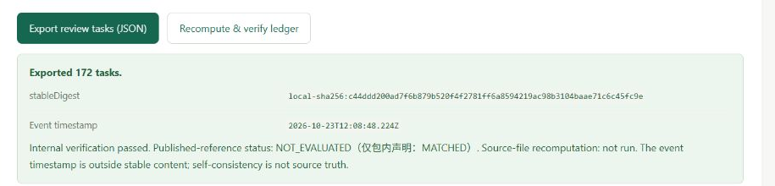
DELIVERED RESULT
CarbonSat-MRV
A review task list for the next reviewer
Hand over unresolved questions with their record identity and interpretation limits.
WHAT THE NEXT REVIEWER RECEIVES
172 rule-derived review tasks
The complete task list, exported as JSON.
Stable task-content digest
Compare task content independently of the event timestamp.
Actual export panel: complete rule task list, stable digest, event timestamp
Entry-specific limits
Keep open questions and claim limits available for follow-up.
Ledger comparisons stay within one cell and analysis segment. Cross-cell and cross-2012 comparisons are refused.
Next: independent reviewers test whether they can interpret coverage correctly and export a review task.
Field accuracy, real-user benefits and anomaly-detection performance remain unverified.
IEEE ClimateChain 2026 / Climate Data & Environmental Monitoring
06
Notes:
PPT 6 · Delivered result
Planned video time: 4:20-4:40 (after the live segment, return here to close).
PURPOSE
Answer the opening question with what a reviewer actually receives, then state the verification path.
FACTS ON THIS PAGE
172 review tasks are rule-derived, exported as one complete JSON list; the count is the number of
rule tasks, not the number of anomalies found by a model. A stable task-content digest is kept
separate from the event timestamp. Entry-level claim limits stay attached to each entry.
Ledger comparisons stay within one cell and one analysis segment; cross-cell and cross-2012
comparisons are refused. Field accuracy, real-user benefits and anomaly-detection performance
remain unverified.
Formal EN/CN narration to be written after V6 is approved.
Do not convert 172 into detected environmental anomalies, saved time or user benefit.

Slide 7
APPENDIX: CASE A: A SINGLE RESEARCH CELL
CarbonSat-MRV
Production with its area basis
cell_0020, 2012–2024 only. Values are model outputs on that year's valid product footprint.
tC/yr
2024 PRODUCTION
4,863.54
tC/yr
Valid area
34.14 km²
Valid-area ratio
100%
The ratio does not prove identical pixel positions across years.
Chart rounded to 0.01 tC/yr. The 2012 break cause and cross-year pixel identity remain unverified.
IEEE ClimateChain 2026 / Climate Data & Environmental Monitoring
07
Notes:
APPENDIX: not part of the 4:40 route. Retained for questions about how one record is interpreted.
The editable chart keeps the original cell_0020 2012-2024 values, rounded for display to 0.01 tC/yr.
Valid area 34.14 km2, valid-area ratio 100% for 2024; the ratio does not prove identical pixel
positions across years, and the cause of the 2012 break remains unverified.
Formal EN/CN narration to be written after V6 is approved.

Slide 8
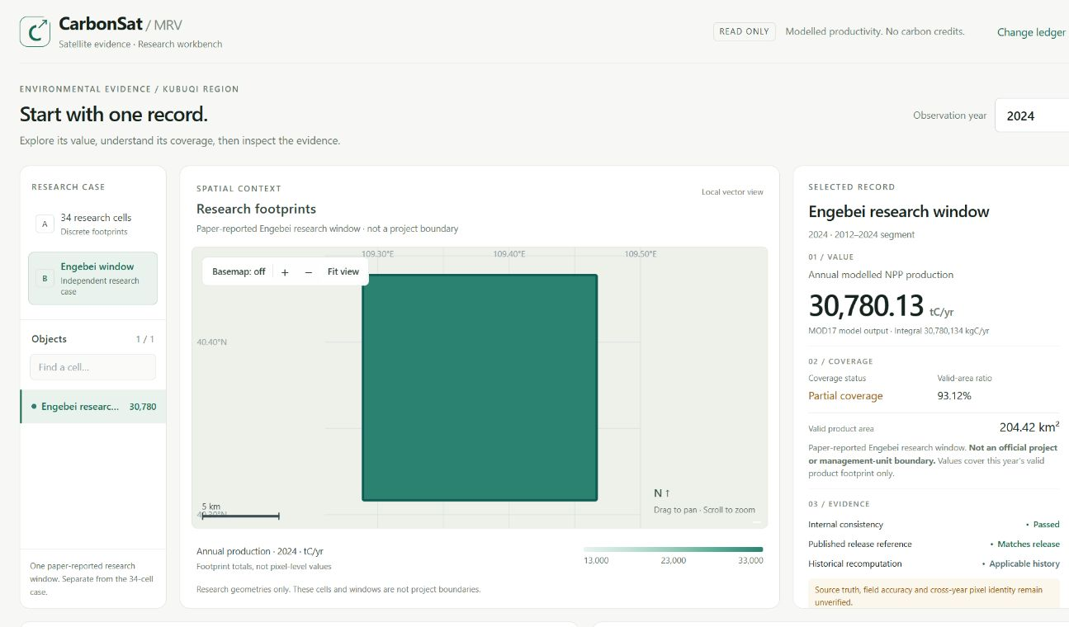
APPENDIX: CASE B: ENGEBEI
CarbonSat-MRV
Partial coverage changes the interpretation
A paper-reported research window, not an official restoration-project boundary.
93.12%
valid-area ratio
in all 24 years
2024: 30,780.13 tC/yr
Production on the valid product footprint only. No extrapolation to the whole window.
Actual English workbench, Engebei research window selected
IEEE ClimateChain 2026 / Climate Data & Environmental Monitoring
08
Notes:
APPENDIX: not part of the 4:40 route. Retained for the extrapolation question.
Engebei is a paper-reported research window (DOI 10.1109/ACCESS.2023.3255879), not a restoration
project or management-unit boundary. 24 of 24 years are PARTIAL_COVERAGE with valid-area ratio
about 0.9312. Production is reported on that year's valid product footprint only; it must not be
extrapolated to the whole window and is not converted to CO2e.
Formal EN/CN narration to be written after V6 is approved.

Slide 9
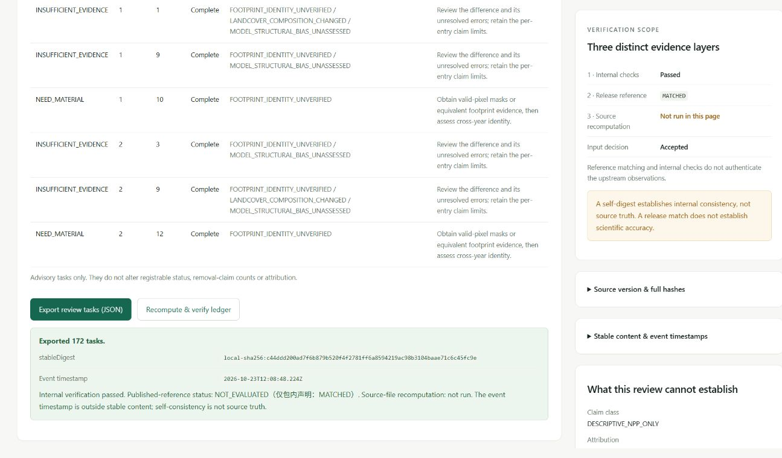
APPENDIX: REVIEW HAND-OFF
CarbonSat-MRV
A difference becomes a review task
Same cell, same era, adjacent years. Each entry carries sources and limits.
Comparability
Area consistency stays separate from pixel identity.
Explicit refusals
Cross-cell and cross-2012 comparisons are refused.
Portable hand-off
The complete rule-derived task list, with a stable digest.
Actual change-ledger and export panel
IEEE ClimateChain 2026 / Climate Data & Environmental Monitoring
09
Notes:
APPENDIX: not part of the 4:40 route. Retained for the hand-off question.
The ledger works on same cell, same era, adjacent years, and refuses cross-cell and cross-2012
comparison. The export is the complete rule-derived task list with a stable digest; partial exports
are not offered. Area consistency is not pixel identity.
Formal EN/CN narration to be written after V6 is approved.

Slide 10
APPENDIX: VERIFICATION EVIDENCE
CarbonSat-MRV
Checks with an explicit scope
Software consistency, upstream reproduction and scientific validity are different questions.
Evidence | Observed result | What it supports
Software and model checks | Historical release: 331 passing Model read-only checks: 19/19 | Local regression and score reproduction Real detection performance unverified
Upstream sample | 9 / 840 object-years Max relative diff: 1.94×10⁻¹⁶ | Sample reproduction under the specified settings
Scientific / user evidence | Ground reference: not tested Real-user study: not run | No ground accuracy or user benefit yet validated
Self-consistency is not source truth.
FVC v1.1: 3,420/3,420 grid scores reproduce in a separate development fix. The trained forest is unchanged. Real anomaly performance remains unverified.
IEEE ClimateChain 2026 / Climate Data & Environmental Monitoring
10
Notes:
APPENDIX: not part of the 4:40 route. Retained for the "what is actually verified" question.
FOUR DIFFERENT QUESTIONS, NOT ONE ACCURACY FIGURE
331 = historical full release test suite (software regression), not rerun in the FVC repair.
19/19 = model read-only checks (5 artifacts, 3,420 FVC scores, 816 NPP scores, no training).
3,420/3,420 = FVC grid scores reproduce in the v1.1 development fix.
9/840 = upstream object-year sample reproduced under the specified settings only.
FVC v1.1 IMPACT (do not clear this page)
The preprocessing inconsistency was corrected in a separate CarbonSat-AnomalyIF-v1.1 build. The
trained forest (200 trees), split thresholds, IsolationForest offset and the training imputer are
unchanged; no fit was called. 111 saved scores changed at four-decimal precision, maximum absolute
change about 0.0005. Threshold flags changed on 0 rows (168 before and after). 463 full-precision
rank positions changed; top 171 membership unchanged; all 9 existing claim scores and flags
unchanged. The synthetic PROCESS_TEST_ONLY evaluation was recomputed with the saved imputer:
precision 0.4364, recall 0.2330, F1 0.3038 - these are not real anomaly-detection accuracy and the
old v1.0 values must not be quoted for v1.1. Not merged into H1/S2 or the public demo. Model bytes
for the formal forest are unchanged; version metadata and re-serialisation changed the file hashes.
Formal EN/CN narration to be written after V6 is approved.

Slide 11
APPENDIX: PROTOTYPE ACCESS
CarbonSat-MRV
Prototype access and scope
WHAT THE LOCAL PROTOTYPE CONTAINS
HISTORICAL HOSTED DEMO
Two research cases
carbonsat-mrv.app.workbuddy.link/?sharecode=LCOGLBOECZ
Source and coverage panels
Whether this address still serves the current English build needs a fresh check. The local workbench remains the English reference.
Linked review-task export
SCOPE
Modelled NPP only. No carbon-credit calculation, no field-accuracy claim, and no additional on-chain registration.
IEEE ClimateChain 2026 / Climate Data & Environmental Monitoring
11
Notes:
APPENDIX: not part of the 4:40 route. Retained for the access question.
Local prototype contains two research cases, source and coverage panels, and the linked review-task
export. The historical hosted demo address is listed as historical: whether it still serves the
current English build needs a fresh check. No repository, video or submission link is invented here.
Formal EN/CN narration to be written after V6 is approved.

Slide 12
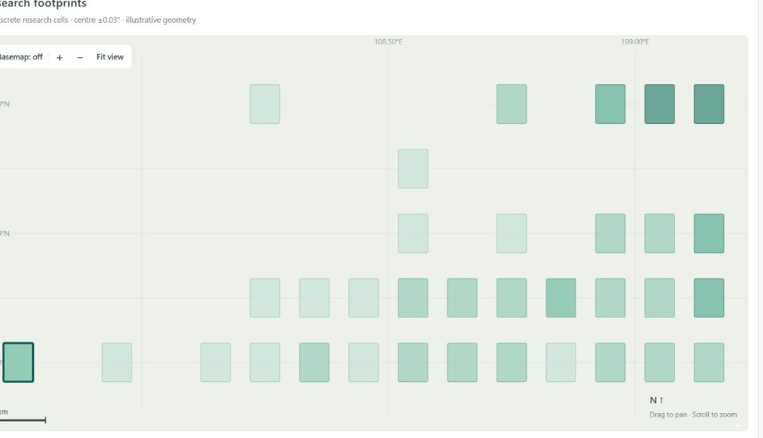
APPENDIX: DATA AND METHOD
CarbonSat-MRV
Two cases with distinct scopes
MOD17A3HGF v6.1 annual NPP with separate research extents
Scope | Case A: Kubuqi footprints | Case B: Engebei window
Spatial unit | 34 discrete research cells | 1 paper-reported rectangle
Time coverage | 2001–2024: 816 cell-years | 2001–2024: 24 window-years
Meaning of extent | Selected research footprints | Research window; not a parcel
Coverage treatment | Per-record valid area | Partial coverage in all 24 years
Case A · 34 discrete research cells, illustrative geometry
Annual production = Σ(valid NPP × pixelArea) / 1,000
NPP in kg C·m⁻²·yr⁻¹ integrated with pixel area in m² gives tC/yr.
Neither extent is an official project or management-unit boundary. The two cases are not combined or ranked.
IEEE ClimateChain 2026 / Climate Data & Environmental Monitoring
12
Notes:
APPENDIX: not part of the 4:40 route. Moved from V5 page 3 without changing any value.
Answers "what is the data and how is annual production obtained".
MOD17A3HGF v6.1 annual NPP. Case A: 34 research cells, 2001-2024, 816 cell-years. Case B: one
paper-reported window, 24 window-years, partial coverage in all 24 years.
Annual production = sum(valid NPP x pixelArea) / 1,000, with NPP in kg C m-2 yr-1 and pixel area in
m2, giving tC/yr. Neither extent is an official project or management-unit boundary, and the two
cases are not combined or ranked.
Formal EN/CN narration to be written after V6 is approved.

