Slide 1

Something Cool
The most awesome DFC project – cleaning up the beach!!!
Yuval, Naama, Maya & Ariel

Slide 2
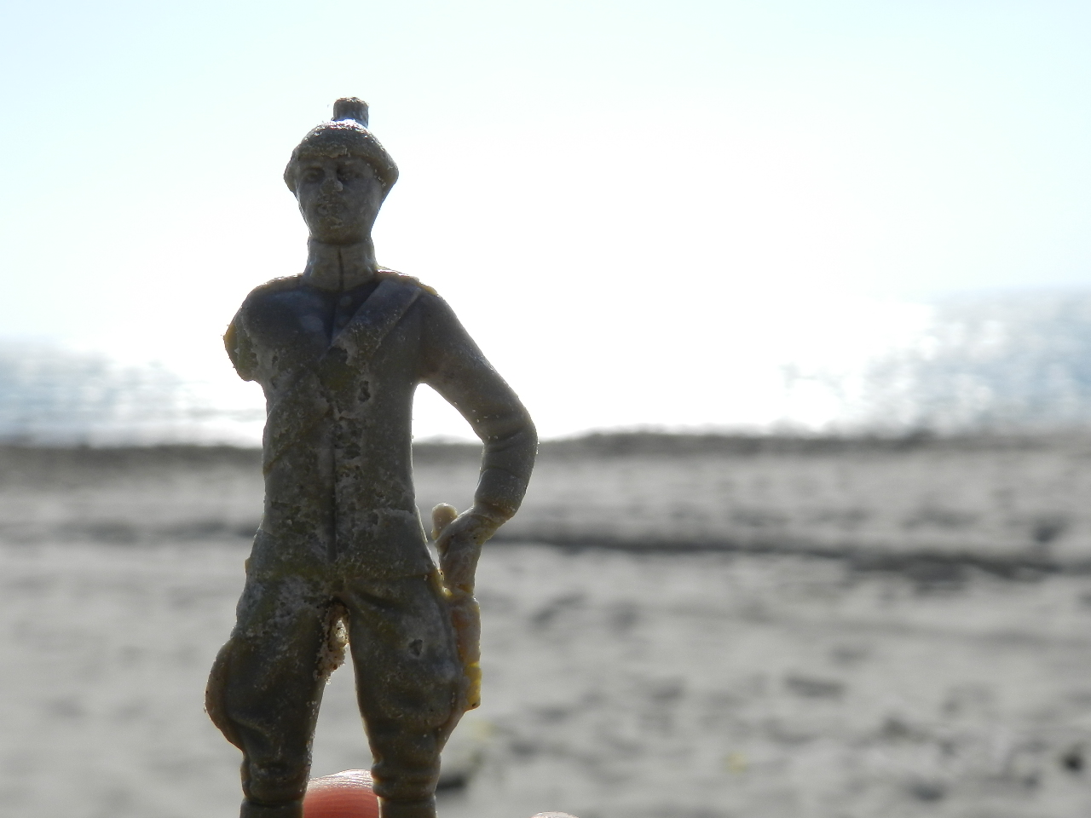
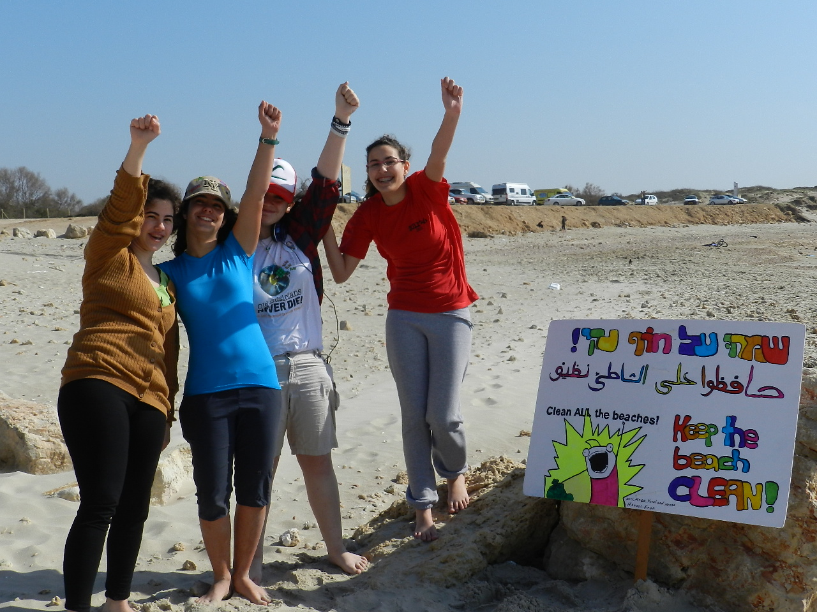

Slide 4
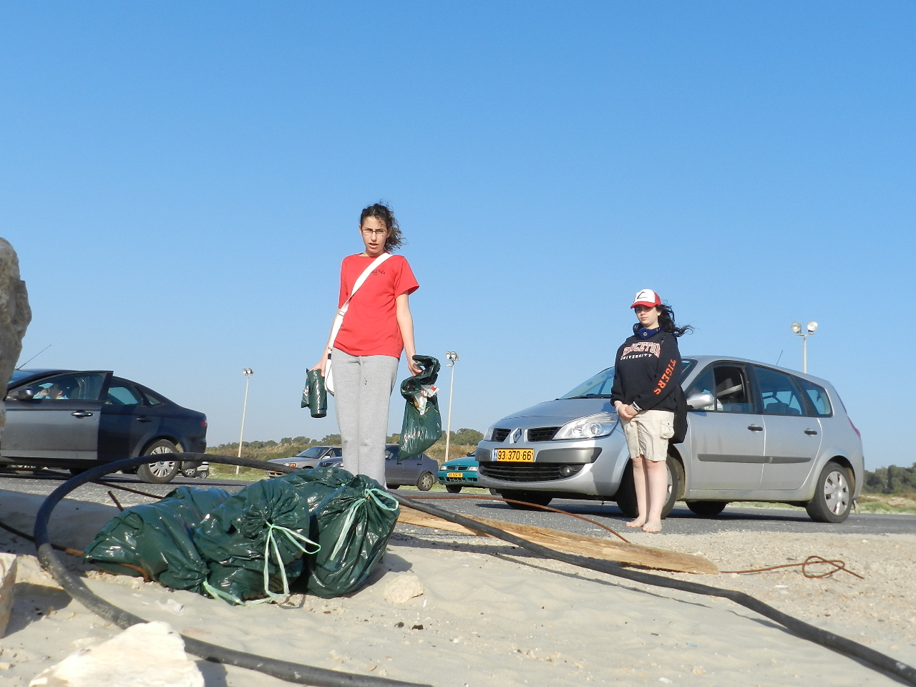

Slide 5
