Slide 1
ANOVA Analysis of Length of Music Before & After Spotify’s Release
D214 – Data Analytics Capstone

Slide 2



Introduction: RJ Calabio
BI Analyst / Developer for Fortune 500 Company
Current WGU Masters of Data Analytics Graduate Student
Alumni of University of California, Irvine. BA in Economics

Slide 3

The Problem & The Hypothesis
Problem:
We do not know whether or not songs before and after the release of Spotify, have statistically significantly changed in average length
Hypothesis:
The length of music has on average been reduced
Null-Hypothesis:
The mean of duration for songs before and after have not statistically significantly changed since the release of Spotify

Slide 4
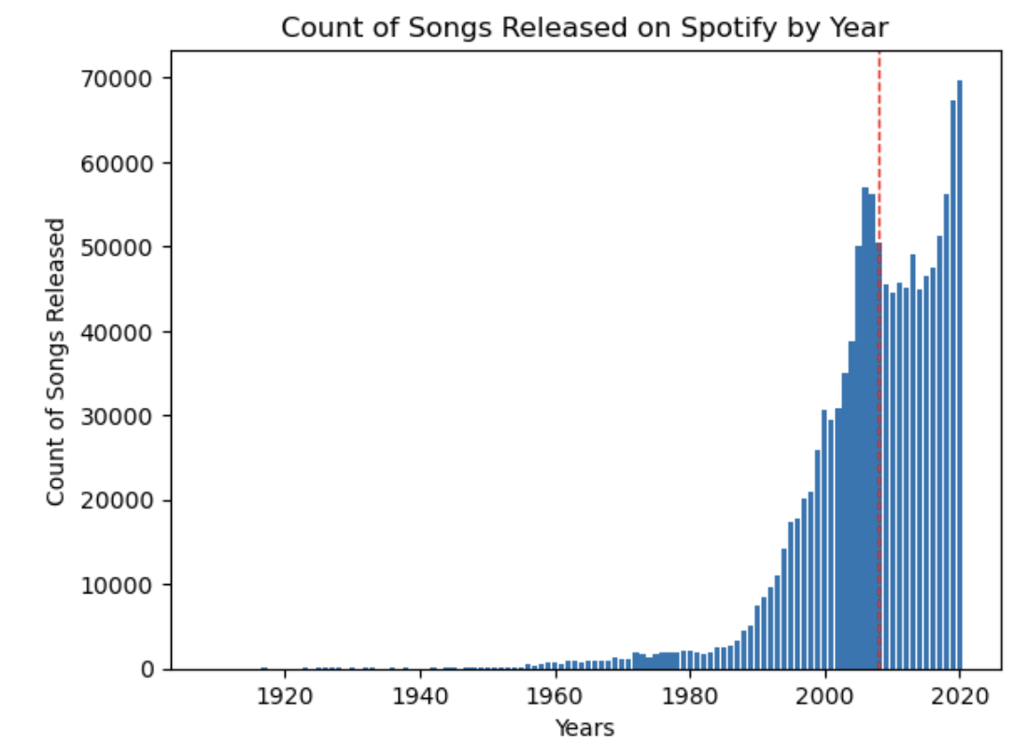
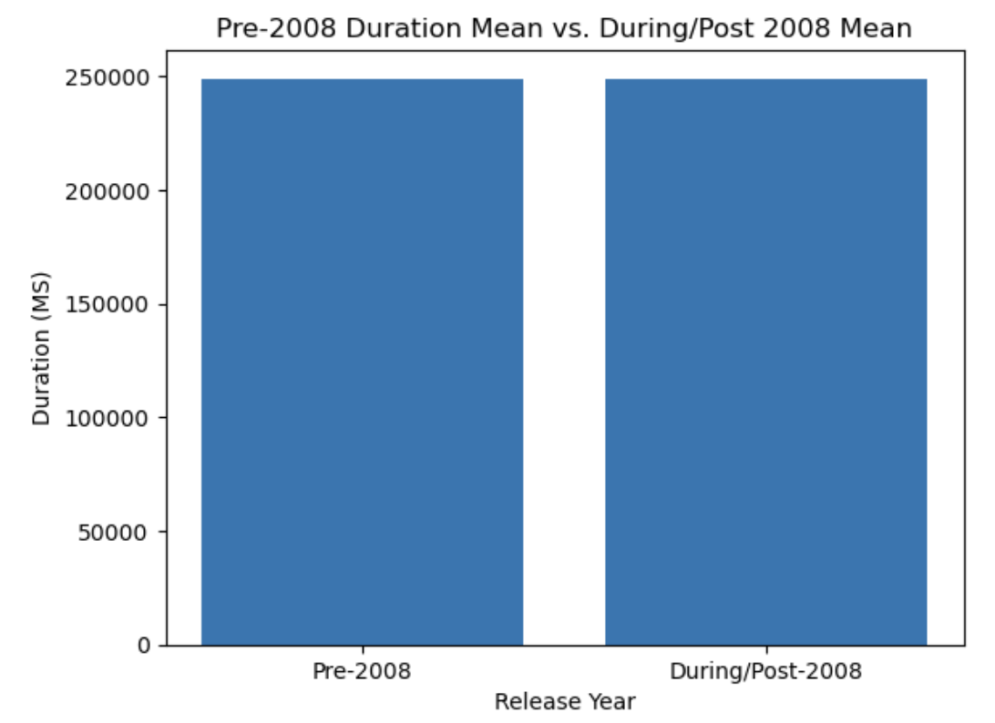

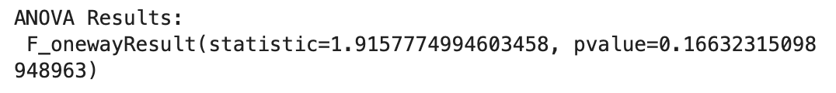
The Data-Analysis Process
Clean Data
Exploratory Data Analysis
ANOVA Analysis
Insights from output of ANOVA

Slide 5
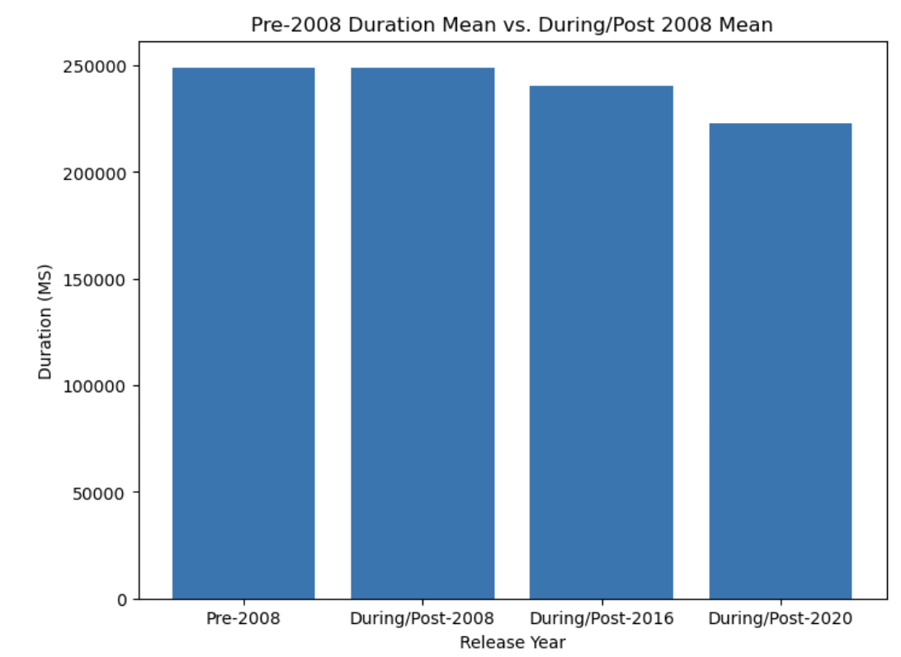
Outline of Findings
Null hypothesis is proven wrong
ANOVA proves with p-value of 16% that the means of before 2008 and during/after 2008 are statistically significantly different
Graph shows that there is downward trend, proving original hypothesis correct

Slide 6

Limitations of Techniques & Tools
Does not prove causation, only correlation
Dataset only includes music within Spotify environment, so these results are only applicable to Spotify songs
Downward trend continues after Spotify’s release date, so there is no proof that Spotify’s release itself in 2008 caused the reduction in average song duration. It could be a symptom of a larger trend in entertainment or a contributor to this trend though.

Slide 7
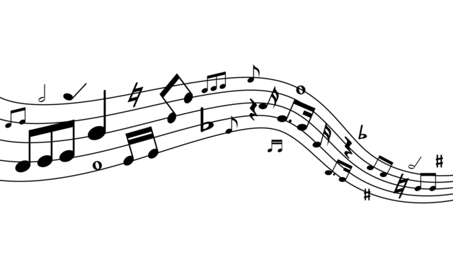
Summary of Proposed Actions
Musicians:
Take note of trends to help determine position of art
Music production companies and labels
Take note of trend in order to position for consumers better
Data Analysts
Use initial study as foundation for further research into this trend. Is this limited to music? What about how genre affects this finding?

Slide 8

Benefits of The Study
Musicians
Gives insight into what potential music consumers interests may be moving towards so they can make informed decisions when it comes to their art
Music Production Companies
Allows companies to make informed decisions about who to invest into and what type of music to invest into in order to make profit
Data Analysts
Creates foundation for further analysis and insight

Slide 9
Sources
Scipy Documention – f_oneway
https://docs.scipy.org/doc/scipy/reference/generated/scipy.stats.f_oneway.html

