Slide 1
Machine Learning Nanodegree Udacity Connect Intensive
March 5, 2017
Welcome!

Slide 2
Agenda
Time | Lesson/Activity
10:00 – 10:30 | Questions & general discussion. Submitting project guide
10:30 – 12:00 | Supervised learning: Decision tree presentation/discussion
12:00 – 1:00 | Lunch
1:00 – 2:00 | Titanic Survival decision tree mini-project
2:00 – 3:00 | Working session & 1:1s: Discuss goals and homework.
3:00 – 5:00 | Optional study time
© 2016 Udacity. All rights reserved.

Slide 3
Housekeeping
Badges- wear the entire time on campus
Goals- complete every week
Deep learning free course
Access to course
Graduate: permanent access
If you do not graduate by the end of sessions- moved to monthly subscription.
Access to the course while paying monthly subscription and permanent when you graduate.

Slide 4
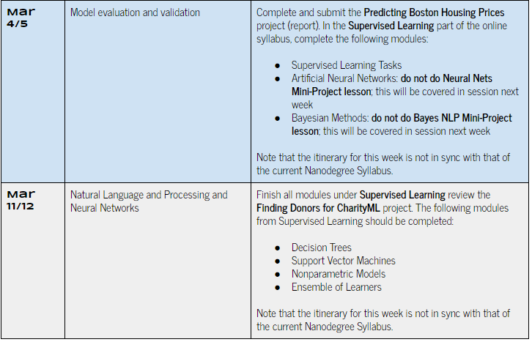
Schedule
Building a Student Intervention System
Schedule Error

Slide 5

Decision Trees
Agenda
Introduction to supervised learning
Introduction to Titanic Survival Project
Why use machine learning?: Data visualization exercise
Introduction to decision trees
Classify Titanic passenger data with a decision tree
How decisions trees are constructed (Entropy & Information Gain)
Advantages & Limitations of decision trees
Applications of decision trees
Summary

Slide 6
Supervised Learning
Generating models from labeled training data that allows for predications about unseen future data.
Predicting gas mileage example
Target variable
mpg
Predictor variables
displacement
horsepower
weight
labeled

Slide 7
Example supervised learning approaches
Analytical learning
Artificial neural network
Backpropagation
Boosting (meta-algorithm)
Bayesian statistics
Case-based reasoning
Decision tree learning
Inductive logic programming
Gaussian process regression
Group method of data handling
Kernel estimators
Learning Automata
Learning Classifier Systems
Minimum message length (decision trees, decision graphs, etc.)
Multilinear subspace learning
Naive bayes classifier
Maximum entropy classifier
Conditional random field
Nearest Neighbor Algorithm
Probably approximately correct learning (PAC) learning
Ripple down rules, a knowledge acquisition methodology
Symbolic machine learning algorithms
Subsymbolic machine learning algorithms
Support vector machines
Minimum Complexity Machines (MCM)
Random Forests
Ensembles of Classifiers
Ordinal classification
Data Pre-processing
Handling imbalanced datasets
Statistical relational learning
Proaftn, a multicriteria classification algorithm
Decision tree learning
https://en.wikipedia.org/wiki/Supervised_learning

Slide 8
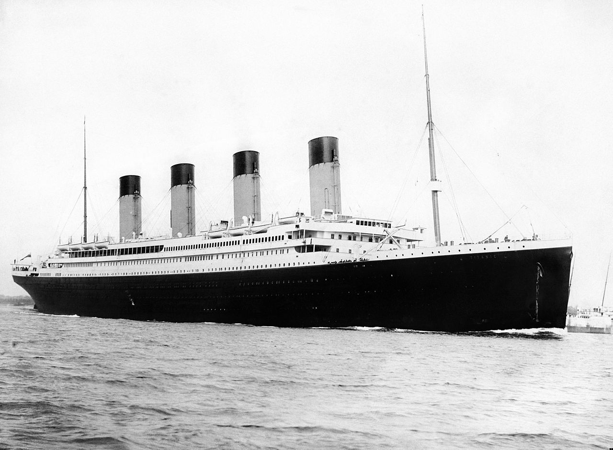
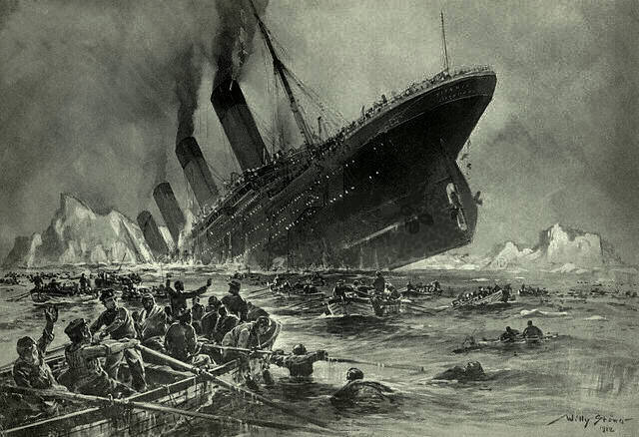
Using decisions trees to predict who survived the Titanic disaster
Can passenger manifest data be used to predict who survived?

Slide 9











Features contained in Titanic passenger manifest
Target Feature
Survived
Socioeconomic class
(Pclass)
Name
# Siblings & Spouses
(SibSP)
Sex
Age
Ticket #
Fare Price
Cabin #
Embarkation Port
# Parents & Children
(Parch)
What features can predict survival? What did you use for the project?

Slide 10

Graphical representation of “Age” and “Sex” features
Female: > 10
Male: > 10
Female: < 10
Are any patterns apparent from the data?
Male: < 10

Slide 11



Graphical representation of passenger survival outcome
Survived
Are any patterns apparent from the data?
Did Not
Survive
Machine learning algorithms can recognize patterns in data that may be very difficult or impossible for people to recognize.

Slide 12
Graphical representation of passenger survival outcome
What if the dataset contains millions of instances?

Slide 13
Splitting the data into subsets based on features
Did Not
Survive
Survived
Male
Female

Slide 14
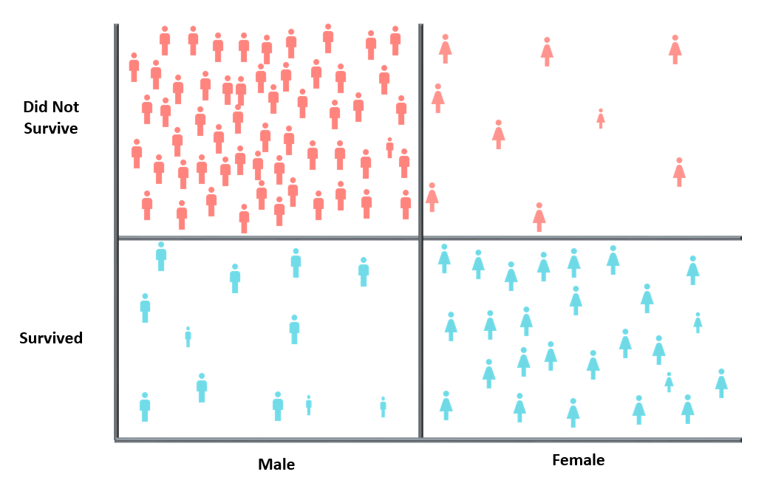

Building a decision tree from the passenger manifest data
Unclassified Passengers
Decision Trees:
Machine learning algorithms that use a tree structure to model relationships among features and predict the value of a target feature.
Sex
Male
Female
Male
n=100
Age <10
No
No
Yes
Root Node
Sex
Prediction
Did not
Survive
Survived
Survived
Branches
Male
Female
Decision Node
Age <10
Survived
74%
n=35
No
Yes
Model Accuracy: ~80%
Leaf Node
Did not Survive
85%
Survived
75%
n=61
n=4

Slide 15
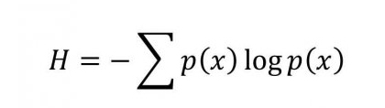
Using Entropy & Information Gain to construct decision trees
Entropy: measure of impurity in a collection of examples
Maximum Entropy= 1
Minimum Entropy= 0
Examples evenly split: entropy = 1
Examples same: entropy = 0
entropy
Information gain = entropy_{parent} - [weighted average] entropy_{children}

Slide 16
Calculating entropy & information gain for tree construction
entropy
Parent
Sex
Age < 10
Survived
P_{yes} = 3/6 = 0.5
P_{no} = 3/6 = 0.5
Female
No
Yes
Male
Yes
Yes
Male
No
No
Male
No
No
entropy_{parent} = -[0.5*log₂(0.5) + 0.5*log₂(0.5)]
entropy_{parent} = 1
Female
No
Yes
Male
No
No
n = 6

Slide 17
Calculating entropy & information gain for tree construction
Information gain = entropy_{parent} - [weighted average] entropy_{children}
Parent
P_{yes} = 2/2 = 1
P_{no} = 0
Female
Sex
Age < 10
Survived
entropy_{female} = -[1*log₂(1) + 0*log₂(0)]
entropy_{female} = 0
Female
No
Yes
Male
Yes
Yes
P_{yes} = 1/4 = .25
P_{no} = 3/4 = .75
Male
No
No
Male
Male
No
No
entropy_{male} = -[0.25*log₂(0.25) + 0.75*log₂(0.75)]
entropy_{male} = .81
Female
No
Yes
Male
No
No
IG
.46
entropy_{children} = 2/6*0 + 4/6*.81 = .54
entropy_{parent} = 1
Information Gain = 1-.54 = .46

Slide 18
Calculating entropy & information gain for tree construction
Information gain = entropy_{parent} - [weighted average] entropy_{children}
Parent
P_{yes} = 1/1 = 1
P_{no} = 0
Age < 10: Yes
entropy_{Age<10} = -1*log₂(1) - 0*log₂(0)
entropy_{Age<10} = 0
Sex
Age < 10
Survived
Female
No
Yes
Male
Yes
Yes
P_{yes} = 2/5 = .4
P_{no} = 3/5 = .6
Male
No
No
Age < 10: No
Male
No
No
entropy_{Age>10} = -[0.4*log₂(0.4) + 0.6*log₂(0.6)]
entropy_{Age>10} = .97
Female
No
Yes
Male
No
No
IG
.46
>
.19
entropy_{children} = 1/6*0 + 5/6*.97 = .81
entropy_{parent} = 1
Information Gain = 1-.81 = .19

Slide 19
Advantages & limitations of decision trees
Advantages
Simple to understand and interpret.
Able to handle both numerical and categorical data.
Performs well with large datasets.
Mirrors human decision making more closely than other approaches.
Limitations
Trees do not tend to be as accurate as other approaches.
Trees can be very non-robust, results can fluctuate with changes in training data.
Decision-tree learners can overfit the training data and not generalize well.
Information Gain biased toward attributes with more levels.
https://en.wikipedia.org/wiki/Decision_tree_learning

Slide 20

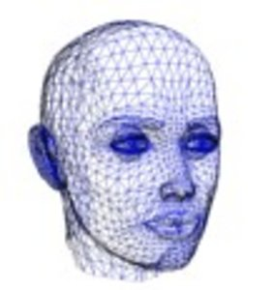



Examples of current decision tree applications
Loan Applications
Patient Diagnosis
Text Classification
Equipment Malfunctions
Face Detection
Decision trees are a powerful tool for making predictions!
https://www.microsoft.com/en-us/research/wp-content/uploads/2016/11/nrbsyk_iccv11.pdf
http://www.cs.princeton.edu/courses/archive/spr07/cos424/papers/mitchell-dectrees.pdf

