Slide 1
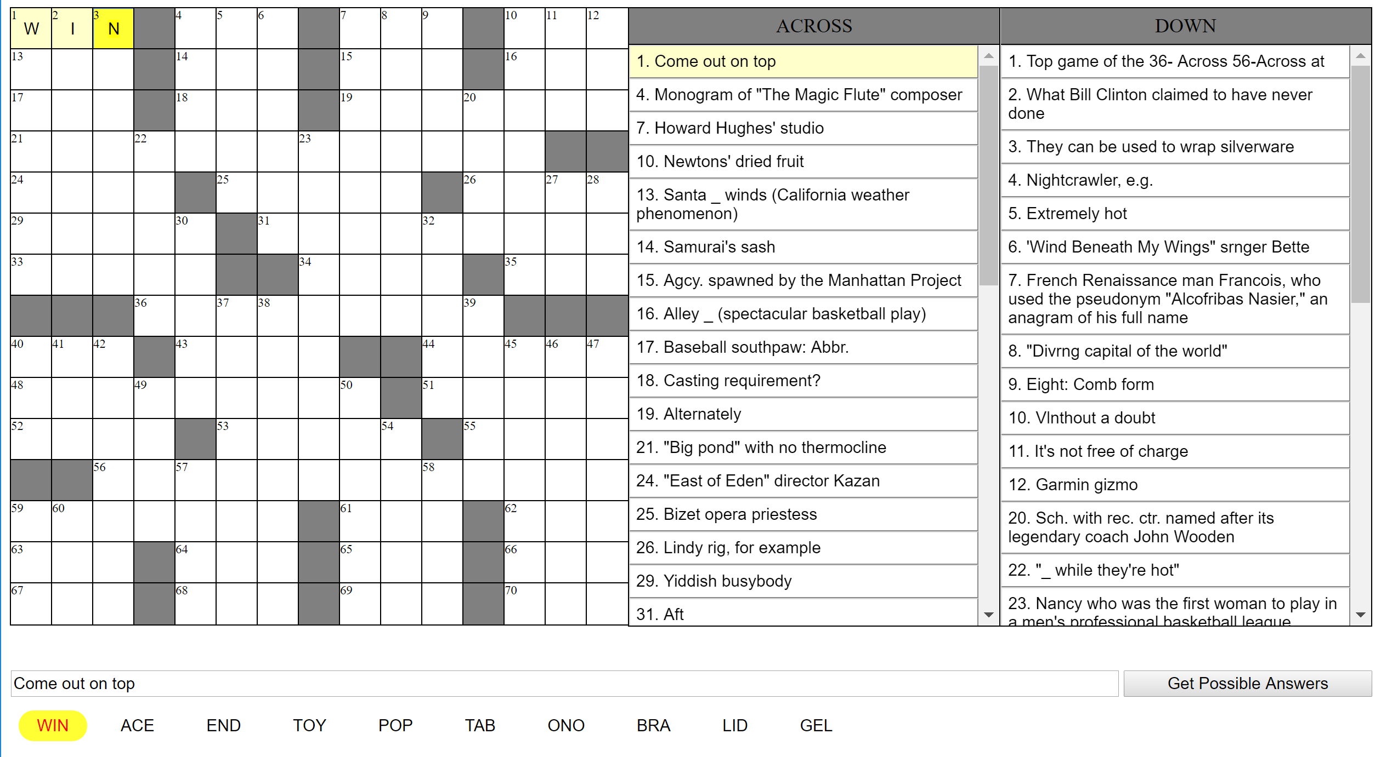
Crossword Puzzle Solver
Ryan Helmlinger
Introduction
Methods
Results
The main goal of this research project was to use computer vision to read in a picture of a crossword puzzle and display it digitally. The user interface would allow the user to intuitively solve and edit the crossword puzzle online. The program would also find the most likely solutions to each clue and solve the puzzle in the background. This way the user can ask for hints along the way if necessary.
The first part of this research project that I worked on was solving the clues. At first I tried to use online APIs, like the Google API, but it was hard to me to parse the sentences and get good results. So instead I decided to scrape the web, especially at websites like Dictionary.com, which already had previous New York Times clues build into its database. This second approach worked far better. My next step was reading in the picture of the crossword puzzle. I started with the grid. I found the outline of the box first, and then check all of the horizontal and vertical lines inside the grid. Next, I checked the midpoint between each interection of the horizontal and vertical spaces to see if it was dark or light to determine if the box was filled or not. Based on where the filled squares were, I numerated the puzzle like all New York Times puzzles are enumerated. After the grid, I used Pytesseract, OCR, and PIL in order to read in the text of the puzzle. I then parsed the text and figured out the corresponding clue and box for the puzzle. Following that, I created the user interface, where I digitally displayed a very intuitive user interface and allowed the user to edit clues as well as ask for hints and try to solve the puzzle. Lastly, I created an algorithm that looked at all the possible answers to the clue and tried to fit them together in the puzzle.
My results for solving the clues was pretty good. Dictionary.com already had a pre-built database for New York times crossword puzzles, so it worked really well with New York Times puzzles, but still fairly well for others. The grid reading for computer vision worked really well, however the text didn’t work as well. For example, words like ‘Without a doubt’ were read as ‘Vlnthout a doubt’. This made it harder to completely solve the puzzle when the clues had typos. My user interface was pretty successful as far as implementing a user interface that was very intuitive and easy to use. My algorithm to solve the puzzle worked, but only if the correct word was in the options for each clue. If one clue was missing the word, then the whole puzzle got messed up. That’s why the minor mistakes from reading in the text made it harder to solve the entire puzzle.
Background
There wasn’t much previous work on crossword puzzles. There were a few programs/websites that generated possible answers for crossword clues, but that’s about it. There weren’t any programs to solve any entire crossword puzzles, and there definitely weren’t any computer vision programs that could read in a picture of one and create it digitally.
Conclusions
Acknowledgements
I really enjoyed working on this assignment. I feel like I learned everything I wanted to this year and felt like I accomplished most of what I wanted to. I could have fine tuned some issues, but overall it went pretty well.
I would like to thank Dr. Zacharias, the Thomas Jefferson High School for Science and Technology Senior Research Lab Directors, and Dr. Glazer.
Notes:
1

