Slide 1
Crossword puzzle solver
Ryan helmlinger

Slide 2
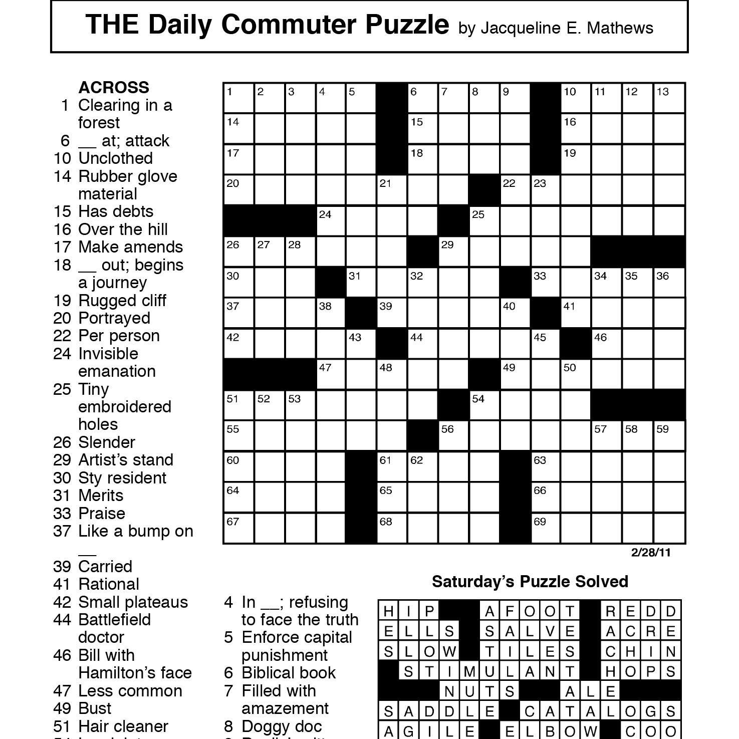
Computer vision
Read hints
Read grid
Ignore extras

Slide 3
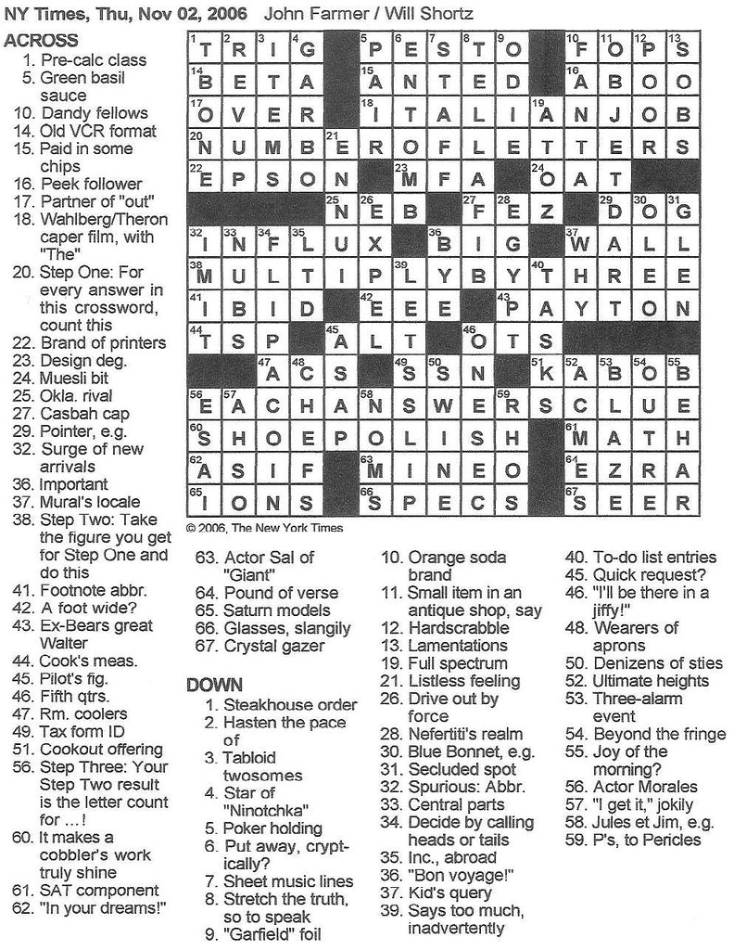
Solving puzzle
No solving API’s
Google semantics
Fit possible word choices together

Slide 4
User interface
Webpage
Allows user to enter text
Allows user to ask for hints
Allows user to upload/take photos

Slide 5
Issues
Completing computer vision
Accuracy of solving hints

Slide 6
Thanks!

