Slide 1


Walk out with your own agent swarm tonight.
“AGENT SWARM” STATION
WHAT’S READY FOR YOU
Agent definitions
Frontend, tester and reviewer roles
Watch a swarm of agents build a website in 5 minutes.
Ask questions.
Get your own team of pre-built AI agents. Designed from principles by: Andrej Karpathy, Lauren Tan, Lee Robinson
AGENTS.md
The shared rules every agent follows
Hooks
Blocks “done” until your tests pass
Skills
The exact skills the swarm used in the demo, and a Self-Improvement Loop bonus
Scan → clone → run
ryanjmichie-git/cursor-agent-swarm
Ryan Michie
Notes:
OPTION C — “The Take-Home.” Best if you want the QR to do the selling: it leads with what people leave with, and the QR is the biggest thing on screen. Check before you present: make the four repo items match what’s actually in your repo (agent roles, AGENTS.md, hooks, skills, per your demo description). 2-minute beats: 1. Open with the promise (15s): “By the time you leave tonight, you can have your own team of coding agents.” 2. The demo (35s): at Station [#], a Grok Build swarm builds a working website in about five minutes. A planner fans the work out to frontend, tester and reviewer agents running in parallel. 3. Why it beats one chat (25s): specialists with their own context, isolated worktrees, and a Stop hook that won’t accept “done” until checks pass. 4. Walk the right panel (25s): agent definitions, AGENTS.md, hooks, skills. These are the exact files from the demo, not a toy version. 5. The ask (20s): “Scan, clone, run it on your own project tonight. Come find me at Station [#].”

Slide 2
We built a starter kit, then tested it
WHAT WE DID
01 / BUILD
02 / REHEARSE
03 / COMPARE
04 / LEARN
Starter kit
Live demo
Bake-off
Learning loop
We built a small website repo for a swarm of AI agents.
It holds agent roles, shared rules, a quality gate and saved procedures (skills).
Three agents built three page sections at the same time.
We planted a coding error. The gate caught it, and the agent fixed it in about a minute.
Two tasks, one set of automated scores:
Build a dashboard (4 setups).
Fix 16 planted defects in an 8-screen app (3 setups).
A reviewer agent proposes a lesson from each mistake.
A person approves it, and every agent reads it next time.
Mistakes that come back become automatic checks.
Sources: cursor-agent-swarm repo, HANDOFF.md (dry run, Oct 27, 2026); grok-bakeoff harness, HANDOFF.md (pilot and sweep, Oct 27, 2026).
Ryan Michie
Notes:
We did four things in two days.
1. We built a small website repo for a swarm of agents.
2. We rehearsed the live demo. Three agents built three sections at the same time. In step 6 we planted a type error. The gate blocked the agent (4.3 s), and the agent removed the error. The turn took 1 min 11 s.
3. We ran a bake-off: a dashboard build with 4 setups, and a fix of 16 planted defects in an 8-screen app with 3 setups. One run each.
4. We added a learning loop: team lessons and checks.
Sources: cursor-agent-swarm HANDOFF.md (Acceptance status, dry run); grok-bakeoff/harness/HANDOFF.md.

Slide 3
Every agent setup passed; the swarm cost most
RESULTS
 | TASK 1: BUILD A DASHBOARD |  |  | TASK 2: FIX AN 8-SCREEN APP
Setup | Spec items met | Minutes | Cost | Defects fixed | Minutes | Cost
Swarm (planner and parallel agents) | 11 of 11 | 25.9 | $4.80 | 16 of 16 | 37.4 | $25.94
Single agent | 11 of 11 | 23.5 | $3.21 | 16 of 16 | 25.5 | $6.40
Standard spawned agents | 11 of 11 | 20.8 | $3.94 | Not run | - | -
grok.com chat (no agent tools) | 10 of 11 * | 3.9 | n/a | 0 of 16 * | ~12 | n/a
* Chat: its bar chart rendered empty (task 1). It committed one screen as a placeholder line, so the app did not load (task 2).
Cost is Grok usage across every session in a run. Chat cost was not measured.
Source: grok-bakeoff harness, results/scores.csv (checklist, minutes, cost) and sweep-results/scores.csv (fixed, minutes, cost). One run per setup, Oct 27, 2026.
Ryan Michie
Notes:
Read the table left to right.
Task 1: every Grok Build setup met 11 of 11 spec items. The chat met 10 of 11: its bar chart rendered empty.
Task 2: the swarm and the single agent fixed 16 of 16 defects. The chat fixed 0 of 16: it committed one screen as a placeholder line, so the app did not load.
The swarm cost about 4 times the single agent on task 2 ($25.94 against $6.40) for the same result.
Caveat: one run per setup. These are pilot numbers, not ranges. Cost is Grok usage summed over every session in a run. Chat cost was not measured.
Sources: grok-bakeoff/harness/results/scores.csv and sweep-results/scores.csv.

Slide 4
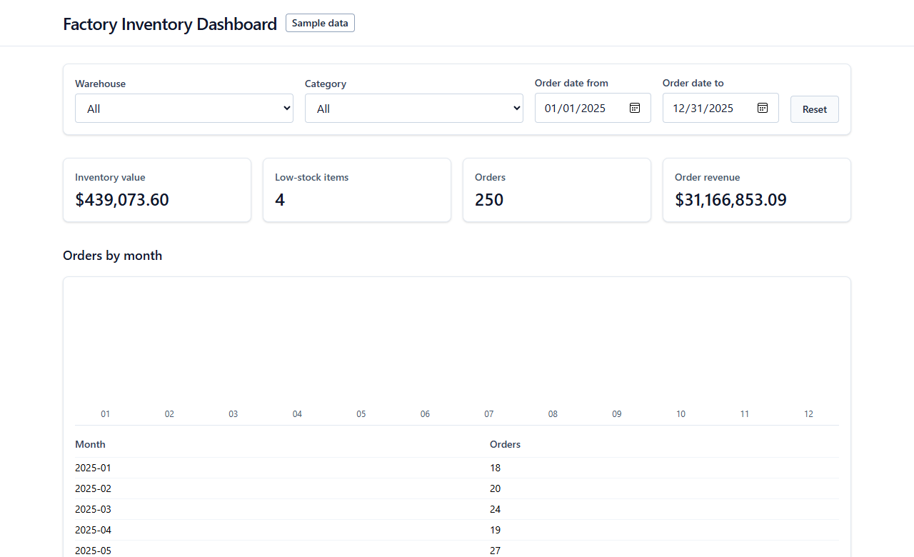
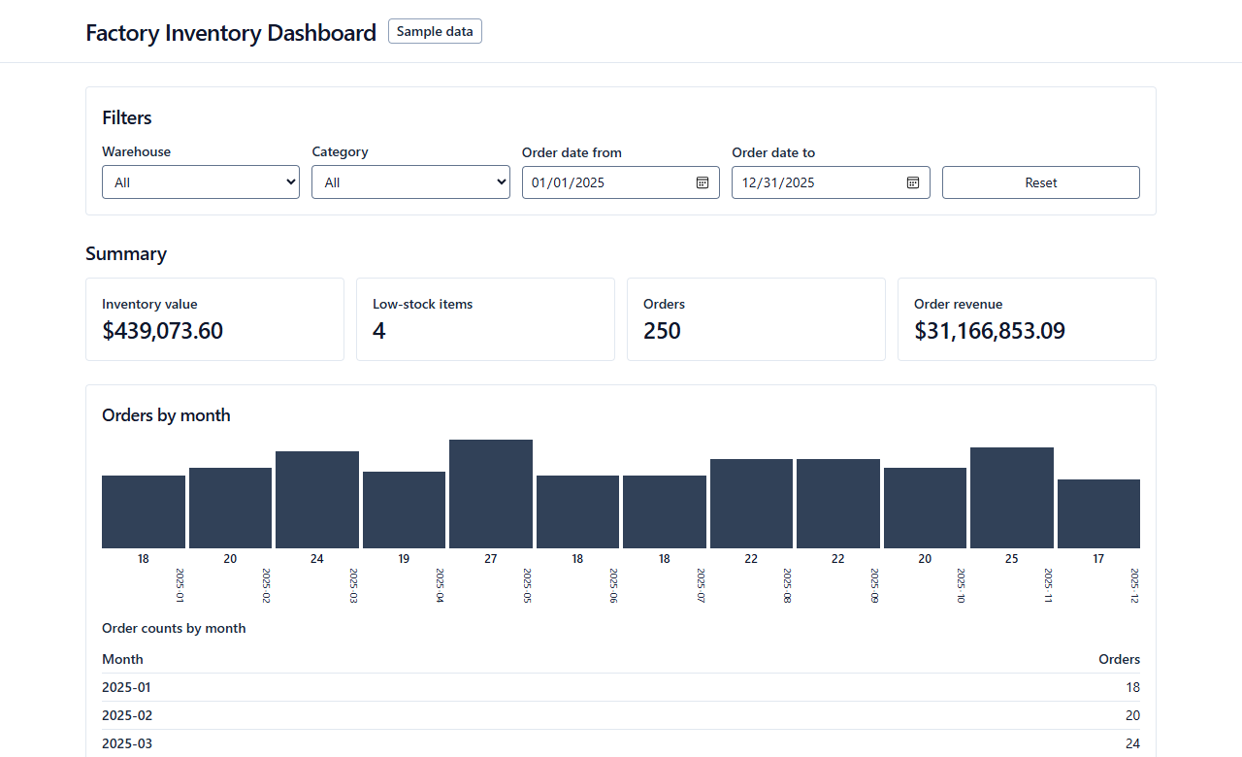
The chat’s chart came out empty
SIDE BY SIDE: TASK 1, BUILD A DASHBOARD
GROK.COM CHAT 10 of 11 spec items
GROK BUILD SWARM 11 of 11 spec items
Empty chart
12 bars
The numbers are right, but all 12 bars render at zero height. The build still passed.
The same numbers, and all 12 months render as bars.
Source: grok-bakeoff harness, results/web-1/shot-1280.png and results/swarm-1/shot-1280.png (top 780 px of each); results/scores.csv (checklist). Oct 27, 2026.
Ryan Michie
Notes:
Same task, same spec, same sample data.
Left: grok.com chat. The numbers are right, but the bar chart is empty. Each bar's height is a percentage of a parent with no set height, so every bar renders at zero (grok-bakeoff-arena run/web-1, components/Dashboard.tsx lines 229 to 237). The build passed. Only a look at the rendered page shows the problem.
Right: the Grok Build swarm. All 12 months render as bars.
Be fair: the single agent and the standard spawned agents also drew the chart (11 of 11).
This miss is now a team lesson: check the rendered chart, not only the build.

Slide 5
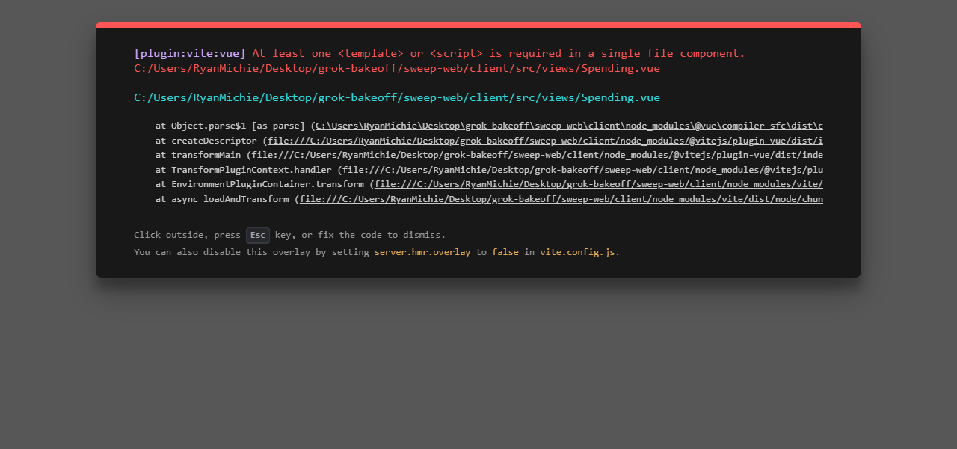
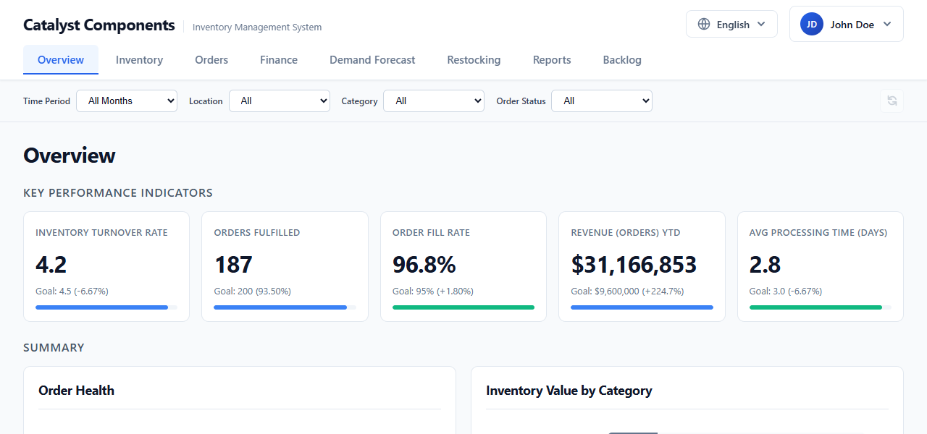
The chat’s app did not load
SIDE BY SIDE: TASK 2, FIX AN 8-SCREEN APP
GROK.COM CHAT 0 of 16 defects fixed
GROK BUILD SWARM 16 of 16 defects fixed
One placeholder file broke every screen.
Spending.vue held one line: PLACEHOLDER_FOR_SPENDING_CONTENT.
All 8 screens load with the corrected numbers.
It fixed 8 listed data bugs and 8 unlisted accessibility defects.
Source: grok-bakeoff harness, sweep-results/web-1/dashboard.png and sweep-results/swarm-1/dashboard.png (top 600 px); sweep-results/scores.csv (fixed). Oct 27, 2026.
Ryan Michie
Notes:
Same app, same list of issues, same 35-minute cap.
Left: grok.com chat. It committed Spending.vue as one line, PLACEHOLDER_FOR_SPENDING_CONTENT (grok-bakeoff-sweep commit 9669ea8). The app cannot compile that file, so every screen shows this error. Score: 0 of 16. Its pull request also claimed a Dashboard fix that is not in its diff.
Right: the Grok Build swarm. All 8 screens load. It fixed 16 of 16 planted defects.
Be fair: with Spending.vue restored by hand, the chat's work scored 12 of 16 (sweep-results/scores.csv, diagnostic row). The single agent also fixed 16 of 16, for $6.40 against the swarm's $25.94.
Both misses are now team lessons, and the placeholder one is an automatic check.

Slide 6
Research backs guardrails over more agents
INDUSTRY RESEARCH
WHAT THE EVIDENCE SAYS
WHAT THE BUILDERS SAY
90%
of nearly 5,000 respondents use AI at work. AI amplifies what a team already has.
DORA 2025 report
Lee Robinson Cursor blog, Jan 2026
“Add rules only when you notice the agent making the same mistake repeatedly.”
46%
of developers distrust the accuracy of AI tools; 33% trust it (33,244 responses).
Stack Overflow Developer Survey 2025
Lauren Tan pstack plugin for Cursor
“Encode the rule as a lint, metadata flag, runtime check, or script instead of more text.”
15×
more tokens for multi-agent systems than for chats. Coding is less parallel than research.
Anthropic Engineering, Jun 2025
Andrej Karpathy YC talk, Jun 2025
“…we as humans are doing the verification. It is in our interest to make this loop go as fast as possible.”
Sources: DORA 2025 (Google Cloud blog, Sep 23, 2025); Stack Overflow Developer Survey 2025 (AI section); Anthropic Engineering (Jun 13, 2025); Cursor blog (Jan 9, 2026); cursor/plugins pstack README; YC AI Startup School talk (Jun 17, 2025).
Ryan Michie
Notes:
Main point: the research agrees with our results. Guardrails decide whether AI helps. More agents add cost.
Left side:
- DORA 2025: 90% of nearly 5,000 respondents use AI at work. Quote: "AI doesn't fix a team; it amplifies what's already there." Without strong automated testing and fast feedback, more change brings instability. https://cloud.google.com/blog/products/ai-machine-learning/announcing-the-2025-dora-report
- Stack Overflow 2025: 46% distrust the accuracy of AI tools; 33% trust it (33,244 responses). https://survey.stackoverflow.co/2025/ai
- Anthropic: multi-agent systems use about 15x more tokens than chats. Their multi-agent system beat a single agent by 90.2% on an internal research eval, but "most coding tasks involve fewer truly parallelizable tasks than research." https://www.anthropic.com/engineering/multi-agent-research-system
Right side:
- Lee Robinson, Cursor blog, Jan 9, 2026: "Add rules only when you notice the agent making the same mistake repeatedly." The same post says: "Check your rules into git so your whole team benefits." https://cursor.com/blog/agent-best-practices
- Lauren Tan, pstack plugin README in cursor/plugins: "Encode the rule as a lint, metadata flag, runtime check, or script instead of more text." https://github.com/cursor/plugins/tree/main/pstack
- Andrej Karpathy, YC AI Startup School, Jun 17, 2025: AI does the generation; people do the verification; keep that loop fast. https://www.youtube.com/watch?v=LCEmiRjPEtQ
Check before you present: the Karpathy words come from a third-party transcript (singjupost.com). Confirm them against the video.
Current roles: Lee Robinson now works at SpaceX (formerly Cursor). Lauren Tan now works at xAI. Karpathy joined Anthropic in May 2026. The quotes date from the sources above.
Left out: the METR 2025 slowdown study. METR now marks those results as out of date.

Slide 7
The spec and the gate did the most work
VALUE BY PART, HIGHEST FIRST
1
Project spec
It turned “done” into checks; every Grok Build setup met 11 of 11 spec items.
2
Hooks (the gate)
No agent can finish until type-check, lint, tests and build pass.
3
Agent roles
A separate reviewer caught a low-contrast border that the builder missed.
4
Rules (AGENTS.md)
One owner per file let three agents build at the same time with no collisions.
5
Skills
A saved procedure runs the same plan, build and review steps on every run.
6
Team lessons
Each approved lesson reaches every agent and teammate on the next pull.
7
Launchers
They load only the repo’s setup, so the demo matches what a new user gets.
Sources: grok-bakeoff results/scores.csv (checklist); cursor-agent-swarm HANDOFF.md (dry run); reviewer finding on grok-bakeoff-arena run/swarm-1, FilterBar.tsx:17.
Ryan Michie
Notes:
This ranking is our judgment from one run per setup.
1. The spec: every Grok Build setup met 11 of 11 spec items (scores.csv, checklist).
2. The gate: it caught the planted type error in rehearsal. In the bake-off it never had to block. Its value is the guarantee that no turn ends with failing checks.
3. Agent roles: the reviewer caught a border at 2.63:1 contrast. WCAG 2.2 asks for 3:1. The swarm fixed it before it finished.
4. Shared rules: one owner per file. Three agents built at the same time with no collisions.
5. Skills: the website-swarm skill runs plan, build, wire and review the same way each time.
6. Team lessons: new this week. We have no run data on them yet.
7. Launchers: the demo loads only the repo's setup, not the presenter's personal setup.

Slide 8
Start small, then add agents
YOUR NEXT STEPS
1
Clone the repo tonight. Run the demo on your own machine.
TAKE IT HOME
Scan → clone → run
2
Write one AGENTS.md file: your stack, your commands and who owns each file.
The same agents, rules, hooks and skills you saw in the demo.
3
Add one gate. An agent is not done until your tests pass.
4
Add a reviewer before you add more builders. More agents cost more.
Measure one real task: time, cost and defects. Turn repeat mistakes into checks.
ryanjmichie-git/cursor-agent-swarm
Team guide: docs/TEAM-WORKFLOW.md
5
Repo: github.com/ryanjmichie-git/cursor-agent-swarm. Team guide: docs/TEAM-WORKFLOW.md. Cost comparison: grok-bakeoff sweep-results/scores.csv (cost).
Ryan Michie
Notes:
Close with five steps. Each one is small.
1. Clone the repo and run the demo.
2. Write one AGENTS.md: stack, commands, and file owners.
3. Add one gate. Done means the tests pass.
4. Add a reviewer before more builders. In our fix task, the swarm cost $25.94 and the single agent cost $6.40 for the same 16 of 16 result.
5. Measure one real task. Turn each repeat mistake into a check.
Then point to the QR code and the team guide, docs/TEAM-WORKFLOW.md.

