Slide 1
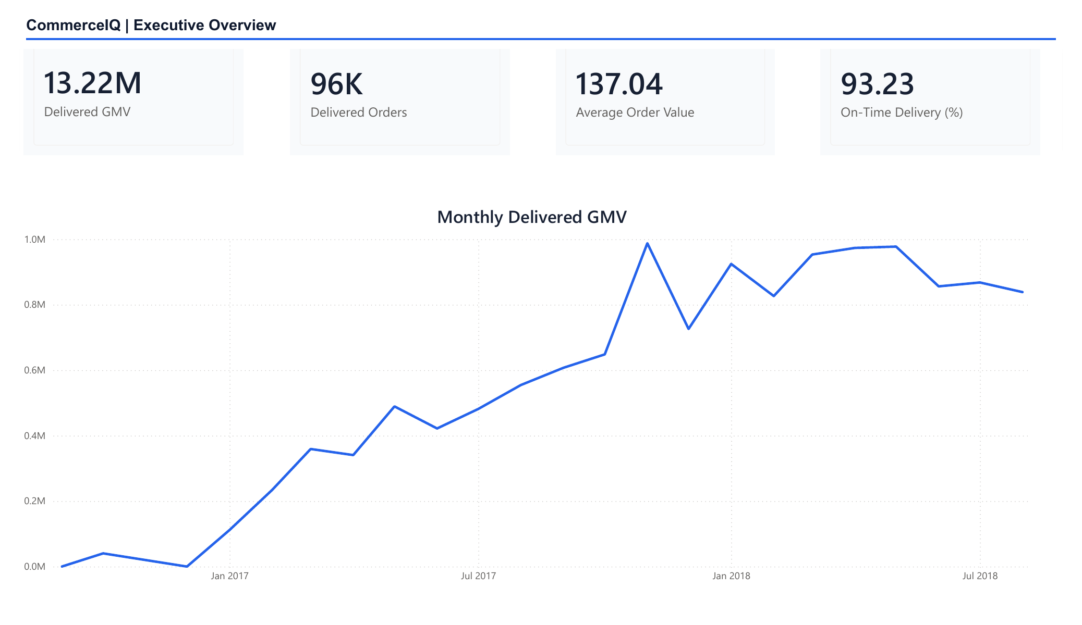
PORTFOLIO CASE STUDY · OLIST E-COMMERCE
CommerceIQ
End-to-End
E-Commerce Analytics
Python · PostgreSQL · SQL · Power BI
A reproducible analysis from raw files to stakeholder action.
Analytics internship interview presentation
Notes:
Open with the business problem: demonstrate an analyst workflow that is technically reproducible and decision-oriented. CommerceIQ uses the public Olist marketplace data and deliberately stops short of machine learning because the highest-value work is data quality, SQL, KPI design, and stakeholder communication.
[Sources]
- README.md
- images/commerceiq-dashboard-1.png
- https://www.kaggle.com/datasets/olistbr/brazilian-ecommerce
[/Sources]

Slide 2
A governed pipeline turns public CSVs into stakeholder decisions
Each layer has one responsibility, so metrics are defined once and remain reproducible.
01
02
03
04
05
06
Raw CSVs
Audit
Clean
PostgreSQL
SQL
Power BI
Immutable source
Schema + quality
Validated tables
Relational model
Named analyses
Decision layer
Proof of reproducibility: transactional loads, integrity checks, checksum manifests, 23 automated tests, and a dashboard that consumes validated analytical extracts—not raw files.
COMMERCEIQ · INTERVIEW CASE STUDY
2
Notes:
Walk left to right. The audit never modifies raw data. Cleaning rules are reusable Python. PostgreSQL enforces the relational contract. Named SQL queries define KPI grain and filters. Power BI consumes pre-validated extracts. Mention that this separation prevents metric drift between notebooks and dashboards.
[Sources]
- docs/architecture.md
- docs/data_model.md
- docs/kpi_definitions.md
[/Sources]

Slide 3
Scale is meaningful—but service and retention define the opportunity
The marketplace generated substantial delivered GMV and generally strong delivery performance. The clearest upside is to protect the minority of late orders and convert the large base of one-time buyers.
R$13.22M
93.23%
3.00%
Delivered item GMV
On-time delivery
Repeat-customer rate
96,478 delivered orders
Comparable delivered orders
Largest visible growth opportunity
COMMERCEIQ · INTERVIEW CASE STUDY
3
Notes:
Use these three numbers to frame the project. Delivered GMV excludes freight. On-time delivery compares calendar dates for orders with comparable timestamps. Repeat customers use customer_unique_id and at least two delivered orders. The data window limits permanent churn conclusions.
[Sources]
- reports/analytics/executive_summary.csv
- docs/kpi_definitions.md
- docs/executive_summary.md
[/Sources]

Slide 4
Late delivery is the clearest customer-experience signal
8.6×
Higher low-review rate
8+ days late vs. 2+ days early
4.30 → 1.70
Average review score
Early delivery vs. 8+ days late
Action
Prevent and communicate
Escalate exceptions before promised dates
Association, not proof of causation; still large and consistent enough to prioritize operational action.
COMMERCEIQ · INTERVIEW CASE STUDY
4
Notes:
This is the core analytical finding. Compare the first and last bars, then connect the result to action: identify at-risk orders before the estimated date, prioritize high-value regions and categories, and communicate proactively. Be explicit that the analysis is observational.
[Sources]
- reports/analytics/delivery_review_relationship.csv
- docs/conclusion.md
[/Sources]

Slide 5
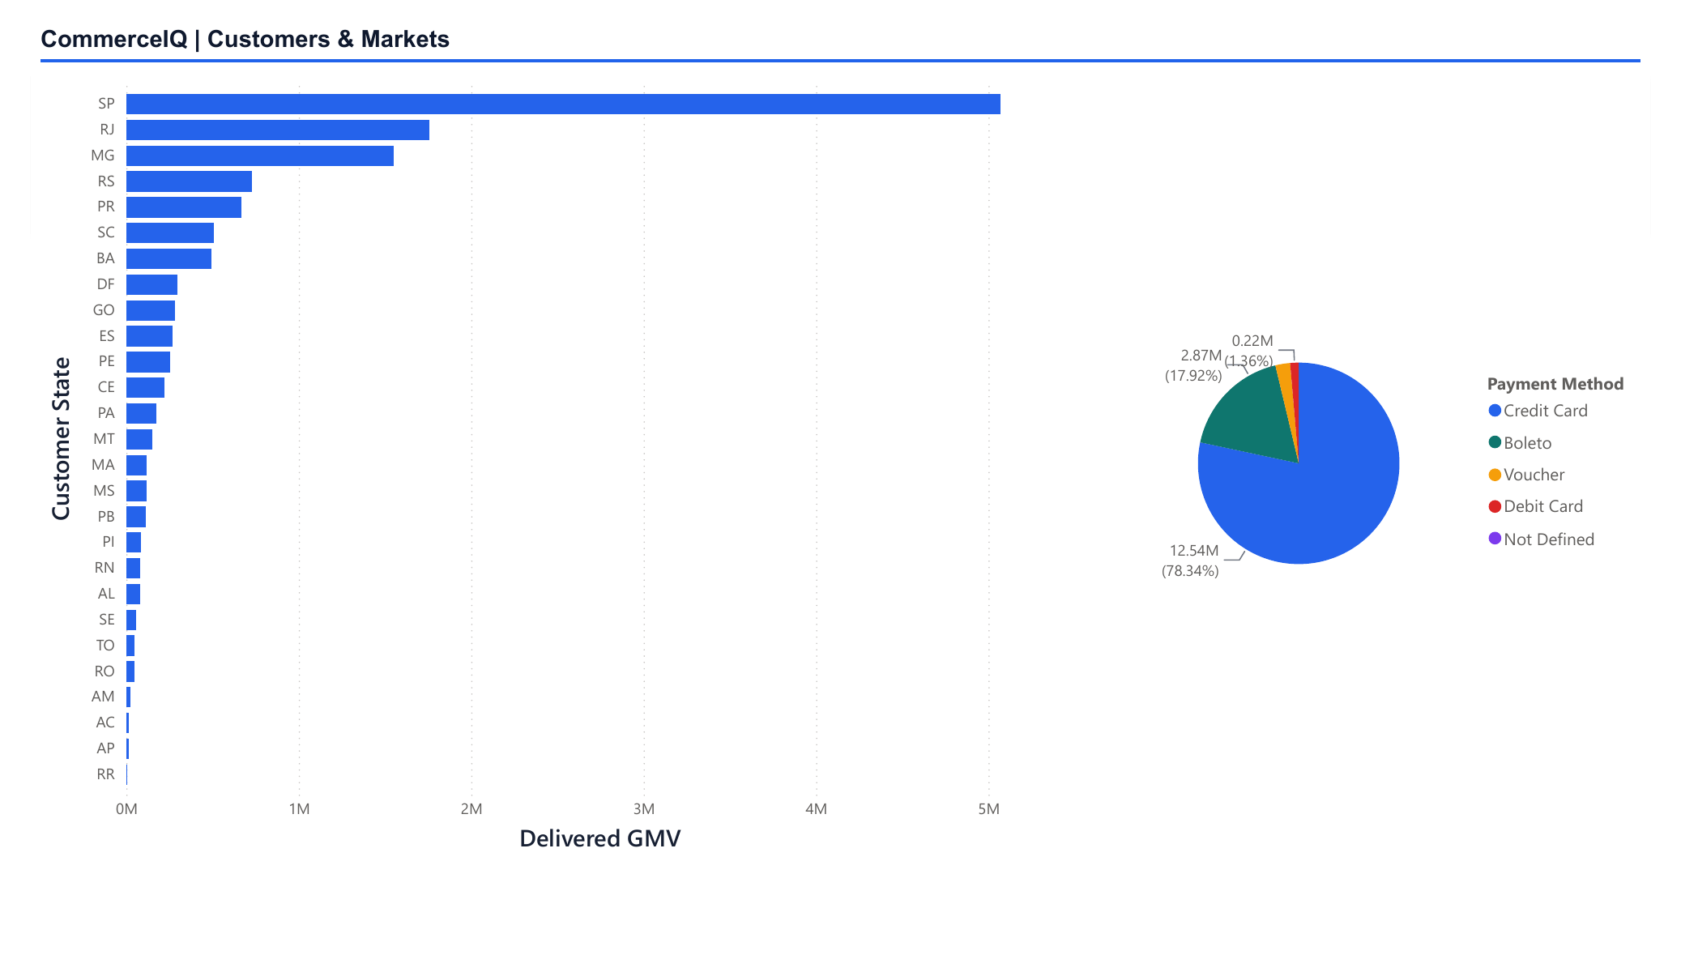
Commercial value is concentrated; retention remains shallow
38.33%
of delivered GMV comes from São Paulo
63.38%
comes from SP, RJ, and MG combined
78.34%
of payment value uses credit cards
3.00%
of delivered customers repeat in-window
Implication: start operational controls in the highest-value states, then test retention programs rather than treating national averages as the whole story.
COMMERCEIQ · INTERVIEW CASE STUDY
5
Notes:
Explain the prioritization logic. Geographic concentration makes targeted monitoring efficient. Payment concentration means installment and payment method detail should remain visible. The low observed repeat rate motivates controlled post-purchase, replenishment, and service-recovery tests, but should not be called permanent churn.
[Sources]
- reports/analytics/state_performance.csv
- reports/analytics/payment_method_performance.csv
- reports/analytics/executive_summary.csv
- images/commerceiq-dashboard-3.png
[/Sources]

Slide 6
Protect experience while scaling—and test retention deliberately
The analysis resolves into three practical actions.
01
02
03
Prevent late-order exceptions
Prioritize where value is concentrated
Run retention experiments
Build a watchlist using estimated date, seller, carrier handoff, and destination state.
Monitor service levels first in the highest-GMV states and categories.
Test post-purchase, replenishment, and service-recovery journeys with customer_unique_id.
What this project proves: Python engineering · relational modeling · advanced SQL · KPI governance · Power BI · business communication
COMMERCEIQ · END-TO-END ANALYTICS PLATFORM
6
Notes:
Close by resolving the opening question. The project does not claim profit or causal impact because the dataset lacks costs, acquisition spend, and experimental assignment. The value is a defensible analytical foundation and a focused recommendation. Invite questions about modeling decisions, SQL grain, or dashboard design.
[Sources]
- docs/conclusion.md
- docs/kpi_definitions.md
- README.md
[/Sources]

