Slide 1
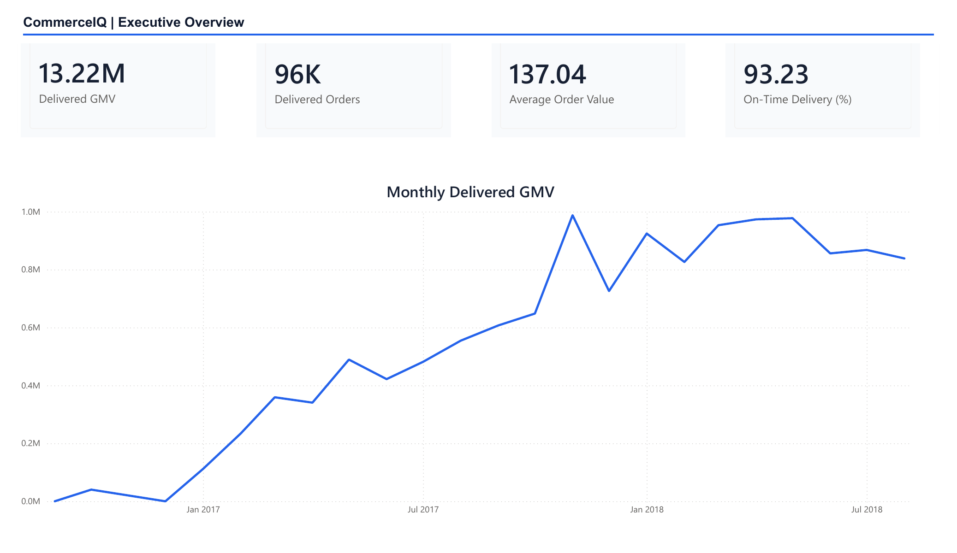
OLIST E-COMMERCE · PROJECT WALKTHROUGH
CommerceIQ
From Raw Files to
Business Decisions
Python · PostgreSQL · SQL · Power BI
Nine source files, one traceable analytics workflow.
Brazilian Olist public e-commerce dataset
Notes:
I used the public Olist dataset because it behaves like a real marketplace: multiple related files, inconsistent grains, and enough operational detail to make the business questions interesting. This walkthrough follows the data from ingestion to the dashboard.
[Sources]
- Local asset: images/commerceiq-dashboard-1.png
- Local project: README.md

Slide 2
I built the project in layers so every number can be traced back
Raw files stay untouched, and each step has a check before the next one begins.
01
02
03
04
05
06
Raw CSVs
Audit
Clean
PostgreSQL
SQL
Power BI
9 source files
Schema + types
Rules in Python
Relational tables
Reusable KPIs
Interactive report
If a schema, key, relationship, row-count, or SQL check fails, the pipeline stops before the dashboard is refreshed.
COMMERCEIQ · PROJECT WALKTHROUGH
2
Notes:
The raw CSVs are never modified. The audit runs first, then reusable cleaning rules create processed tables. PostgreSQL enforces the relational model, SQL defines the metrics, and Power BI reads validated extracts rather than raw files.
[Sources]
- Local project: docs/architecture.md
- Local code: src/data_quality.py, src/cleaning_pipeline.py, src/database_loader.py

Slide 3
Preprocessing makes the later analysis trustworthy
The audit discovers each file, checks its grain, and records problems without touching the original data. Cleaning and validation then run from reusable Python functions.
9 files
1.55M rows
23 tests
Audit the source
Clean consistently
Validate relationships
Rows, columns, missing values,
duplicates, keys, timestamps
Types and text standardized;
raw files stay immutable
Primary keys, foreign keys,
row counts, and checksums
COMMERCEIQ · PROJECT WALKTHROUGH
3
Notes:
The audit found nine source files and 1,550,922 source rows. It checks shape, missingness, duplicates, likely keys, timestamps, relationships, and business rules. The original files stay untouched, and 23 tests protect the reusable logic.
[Sources]
- Local output: reports/data_quality/audit_summary.json
- Local tests: tests/
- Local notebooks: notebooks/01_data_quality_audit.ipynb

Slide 4
The strongest pattern appears when delivery slips
8.6×
Higher low-review rate
8+ days late vs. 2+ days early
4.30 → 1.70
Average review score
Early delivery vs. 8+ days late
Operational use
Catch exceptions early
Escalate before promised dates
This is an association, not proof that lateness caused each review.
COMMERCEIQ · PROJECT WALKTHROUGH
4
Notes:
The clearest analytical pattern is the relationship between delivery timing and low reviews. I would use this as an operational prioritization signal, not claim that lateness caused every poor review.
[Sources]
- Local output: reports/analytics/delivery_review_relationship.csv
- Local SQL: sql/advanced_analysis.sql

Slide 5
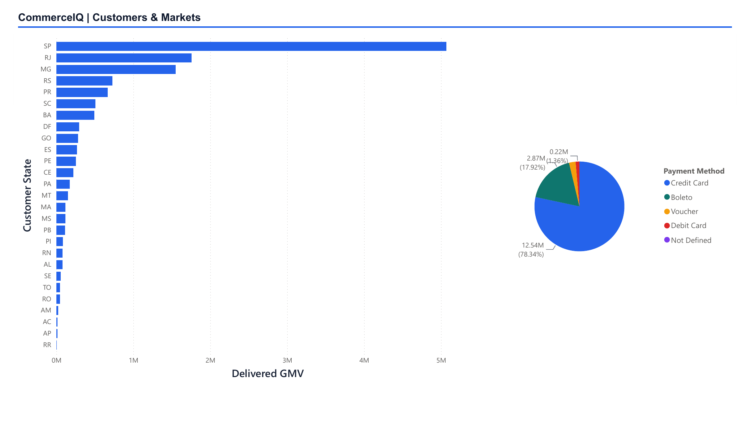
Value is concentrated in a few markets
38.33%
of delivered GMV comes from São Paulo
63.38%
comes from SP, RJ, and MG combined
78.34%
of payment value uses credit cards
3.00%
of delivered customers repeat in-window
Monitor service levels first in SP, RJ, and MG, then compare with the rest of the marketplace.
COMMERCEIQ · PROJECT WALKTHROUGH
5
Notes:
The dashboard makes concentration easy to see. SP, RJ, and MG account for most delivered GMV, while credit cards dominate payment value. The state selector supports focused market comparison.
[Sources]
- Local asset: images/commerceiq-dashboard-3.png
- Local outputs: reports/analytics/state_performance.csv, reports/analytics/payment_method_performance.csv

Slide 6
Where I would take the analysis next
The patterns suggest three practical follow-ups.
01
02
03
Catch late orders earlier
Focus the first rollout
Test repeat-purchase ideas
Flag orders using estimated date, seller, carrier handoff, and destination state.
Monitor service levels first in the highest-GMV states and categories.
Compare post-purchase, replenishment, and service-recovery journeys.
Next data I would add: product cost and marketing spend, so the project can move from GMV and retention signals to contribution margin and acquisition economics.
COMMERCEIQ · PROJECT WALKTHROUGH
6
Notes:
The next step is not a machine-learning model. It is better operational follow-up and richer economics. Product cost and marketing spend would allow contribution-margin and acquisition analyses that the public data cannot support today.
[Sources]
- Local project: docs/conclusion.md
- Local project: docs/kpi_definitions.md

