Slide 1
3-2 : INFERENCE FOR A SINGLE QUANTITATIVE VARIABLE
MAT 2100: INTRODUCTION TO STATISTICS
GRACE COLLEGE
LAST UPDATED SEPTEMBER 7, 2023


Slide 2


Slide 3
THE JESUS CREED
Hear, O Israel: The Lord our God, the Lord is one.
Love the Lord your God with all your heart and with all your soul and with all your mind and with all your strength. The second is this: Love your neighbor as yourself.


Slide 4
SAMPLING WORDS (CONT.)


Slide 5
Let’s reconsider the population of words in the Gettysburg Address you first looked at in a previous exploration. Suppose instead of looking at the proportion of short words (3 or fewer letters) we look at the number of letters per word.


Slide 6
EXERCISE 1
Is number of letters per word a quantitative or categorical variable? Why?


Slide 7
EXERCISE 2
Suggest a statistic (a single number) you could calculate from your sample that summarizes the number of letters per word variable.


Slide 8
EXERCISE 3
What parameter are you hoping to estimate with your statistic? (Hint: Be clear how this relates to the population.)


Slide 9
EXERCISE 4
How could we explore whether the sampling methods used previously are unbiased in estimating the parameter you identified in #3? What does it mean to be unbiased in this context?


Slide 10
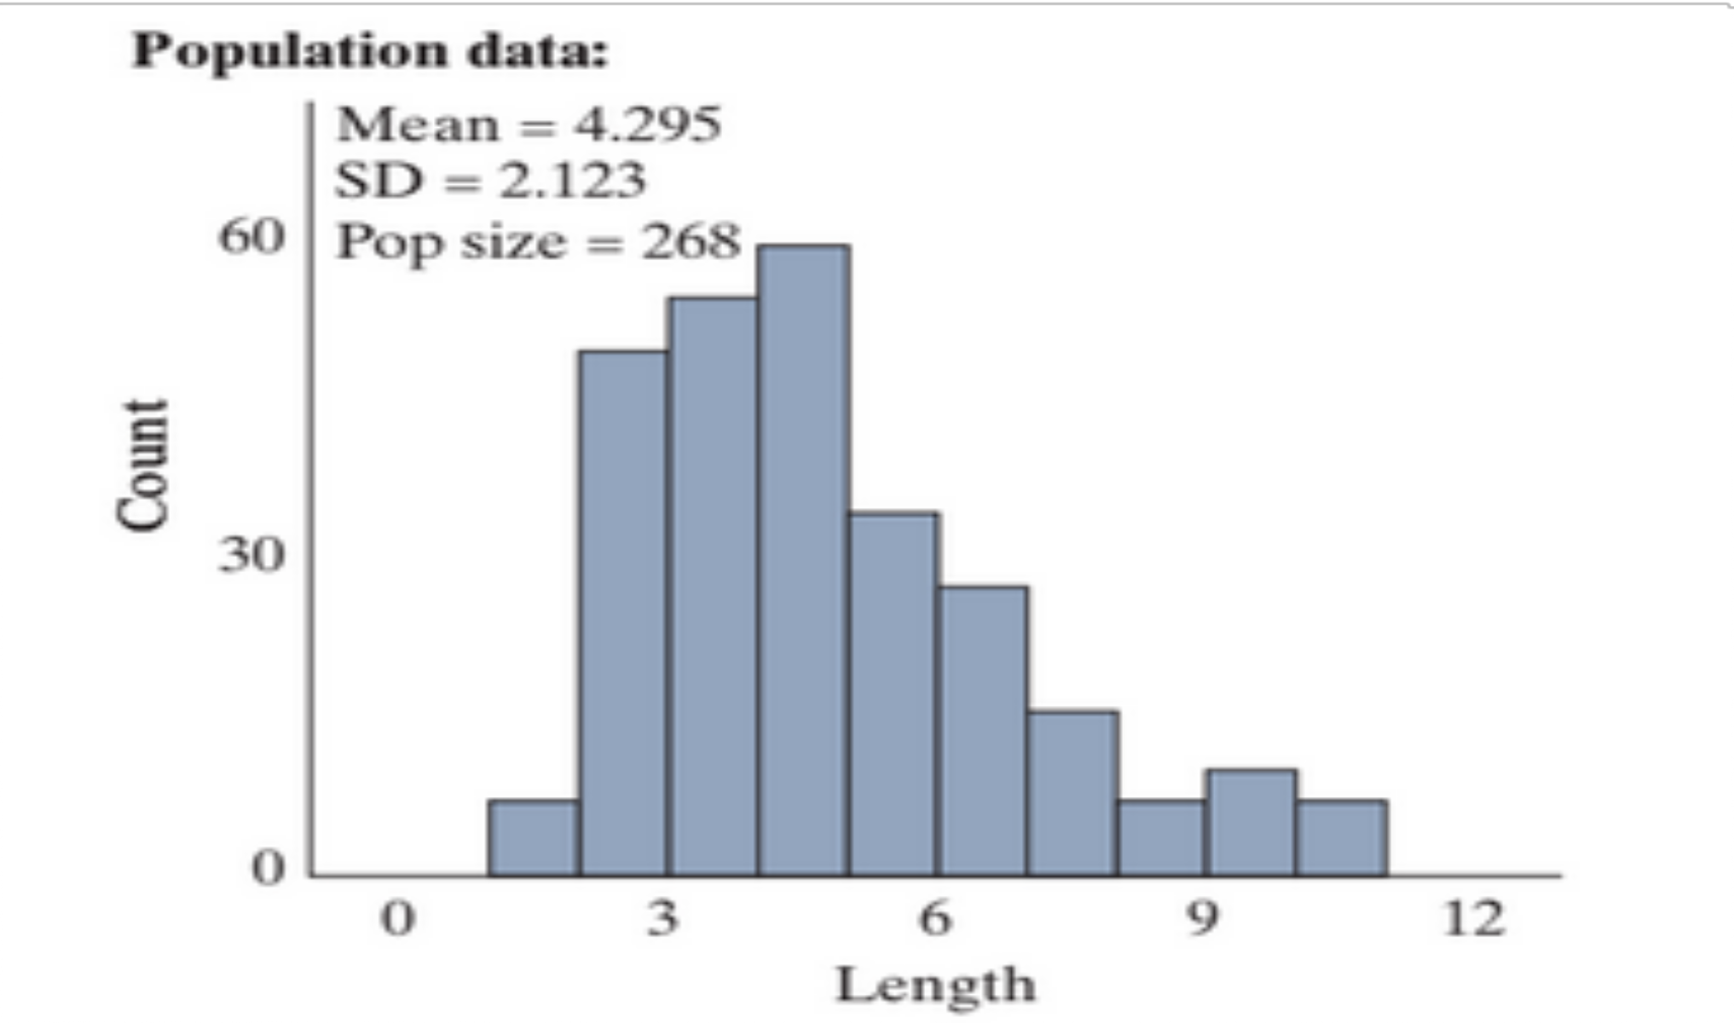
FIGURE 5:
Population distribution for lengths of words (number of letters per word) in the Gettysburg address


Slide 11
DEFINITION 6:
DEFINITION ():
A distribution of data is skewed if it is not symmetric and, instead, the bulk of values tend to fall on one side of the distribution with a "longer tail" on the other. Right-skewed distributions have their tail on the right, and left-skewed distributions have their tail on the left.


Slide 12
With skewed data, we might prefer to measure the “center” of the distribution with the median rather than the mean.


Slide 13
DEFINITION 7:
DEFINITION ():
The median is the middle data value when the data are sorted in order from smallest to largest.


Slide 14
EXERCISE 8
The mean is found to be 4.295 letters, do you think the median is larger or smaller than 4.295? Briefly explain your reasoning.


Slide 15
EXERCISE 9
Summarize the behavior of this population. Recall that when we have a quantitative variable, we should talk about shape, center (using the mean and/or the median), variability (using the standard deviation), and outliers, as well as making sure that we are making comments relevant to the context of the study.


Slide 16
TABLE 11:
Statistics
x = sample mean
s = sample standard deviation
Parameters
μ = population mean
σ = population standard deviation


Slide 17
Note that we are focusing on the mean and the standard deviation.


Slide 18
EXERCISE 12
Identify the values of μ and σ for the length of words in the Gettysburg Address.


Slide 19
To evaluate our sampling method for a quantitative variable, we want to see whether the means from diﬀerent samples center around the population mean.


Slide 20
EXERCISE 13
What term do we use to describe a sampling method where the distribution of the statistic centers around the population mean?


Slide 21
To evaluate our sampling method for a quantitative variable, we want to see whether the means from diﬀerent samples center around the population mean.


Slide 22
EXERCISE 14
What term do we use to describe a sampling method where the distribution of the statistic centers around the population mean?


Slide 23
EXERCISE 15
Open the Sampling Words applet. Make sure that the Variable is set to "Length." Check the Show Sampling Options box, change the Sample size to 5, and press Draw Samples.


Slide 24
Notice that the graph on the left in the applet and in [REF=TODO] is the population, the graph in the middle is your sample, and the mean of this sample is placed in the graph on the right. Fill in your results for the middle and right most graphs in [REF=TODO] . Also indicate the value of the sample mean that you obtained.


Slide 25
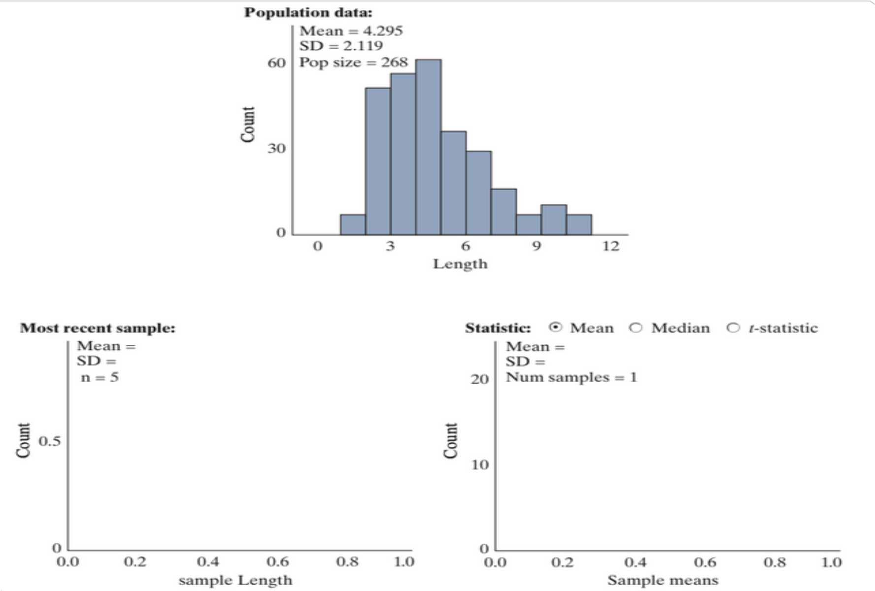
FIGURE 16:
Outputs in the Sampling Words applet


Slide 26
EXERCISE 17
If we were to repeat the process in #9 thousands of times, predict the behavior of the distribution of sample means—the graph all the way to the right in the applet. (Shape? Center? Variability? Compared to the population?) Sketch your prediction, changing the horizontal axis scale if necessary.


Slide 27
EXERCISE 18
Change the Number of samples from 1 to 9999 (for 10,000 samples) and press Draw Samples.


Slide 28
EXERCISE 18A:
Create a sketch of the distribution in the box below — including carefully labeling the horizontal axis and indicating what each dot on the graph represents. (Hint: How many dots do you have? What would you/the applet do to add one more dot to the graph?)


Slide 29
EXERCISE 18B:
Describe the shape of the distribution of sample means. How does it compare to the shape of the population?


Slide 30
EXERCISE 18C:
What is the mean of the sampling distribution of sample means? How does it compare to the mean of the population?


Slide 31
EXERCISE 18D:
What is the standard deviation of the sampling distribution of sample means? How does it compare to the standard deviation of the population?


Slide 32
EXERCISE 19
Does simple random sampling for quantitative data appear to be an unbiased sampling method? How are you deciding?


Slide 33
EXERCISE 20
Suppose we wanted less sample-to-sample variation in the sample means. What would you change about the sampling process?


Slide 34
REMARK 21:
KEY IDEA .
When taking random samples from a large population (more than 20 times the size of the sample), the distribution of sample means will
Center around the population mean (μ)
Have a standard deviation smaller than the population,
population standard deviation
σ
SD(X) =
=
√sample size
√n
3. Be approximately normal when the sample size is large (by the Central Limit Theorem or if the population distribution is normally distributed)


Slide 35
Like with proportions, we see that the sample mean (x) is unbiased for estimating the population mean, but now we have a diﬀerent formula for predicting the standard deviation of the statistic.


Slide 36
EXERCISE 22
Use your applet output to verify that the standard deviation of sample means is approximately equal to σ/√n


Slide 37
The Central Limit Theorem tells us that we can also assume that the distribution of sample means is approximately normal when the sample size is large. How large is large? We cannot check the number of successes and failures because we are working with a quantitative variable. But in a similar manner, the sampling distribution will look normal as long as the population distribution is not too skewed. As we increase the sample size, the distribution of sample means will look more and more like a normal distribution. Generally, if the sample size is at least 20 we can assume that distribution of sample means is approximately normal. We also have a new case—the distribution of sample means will behave like a normal distribution for any sample size, if the population shape is itself approximately normal.


Slide 38
EXERCISE 23
Next you will change the sample size from 5 to 10. Predict how this will impact the shape, center, and variability of the distribution of sample means.


Slide 39
EXERCISE 24
Generate 10,000 random samples of 10 words. Sketch the resulting distribution of sample means, remembering to carefully label the horizontal axis. Were your predictions about how the increased sample size would impact the shape, center, and variability accurate?


Slide 40
EXERCISE 25
Using what you have seen so far, which is least likely:
Randomly picking one word from the Gettysburg Address and finding it be 6 letters or more.
Randomly picking 5 words from the Gettysburg Address and finding the mean of the 5 words to be 6 letters or more in length.
Randomly picking 10 words from the Gettysburg Address and finding the mean of the 10 words to be 6 letters or more in length.
Explain your reasoning.


Slide 41


