Slide 1
Cooperative Control and Modeling for Narrow Passage Traversal with an Ornithopter MAV and Lightweight Ground Station

Slide 2
Outline
Motivation
Hardware
Cooperative System
System Identification
Model Verification
Simulation result
Experimental verification
Conclusions

Slide 3
Outline
Motivation
Hardware
Cooperative System
System Identification
Model Verification
Simulation result
Experimental verification
Conclusions

Slide 4
Motivation
Mobile robotics platforms can be limited in capabilities at small scales
Power, size, weight constraints
Cooperation between these systems can allow for completion of objectives that are infeasible for the robots individually

Slide 5
Goal
Demonstrate the feasibility of cooperation between limited mobile robots to navigate to a common goal
Develop a tracking platform that could be used on a small-scale mobile robot
Develop a model to predict successful navigation
Achieve simplified model of complex behavior of flapping-winged MAV
Difficult nonlinear dynamics
Noisy sensing from flapping movements

Slide 6
Outline
Motivation
Hardware
Cooperative System
System Identification
Model Verification
Simulation result
Experimental verification
Conclusions

Slide 7
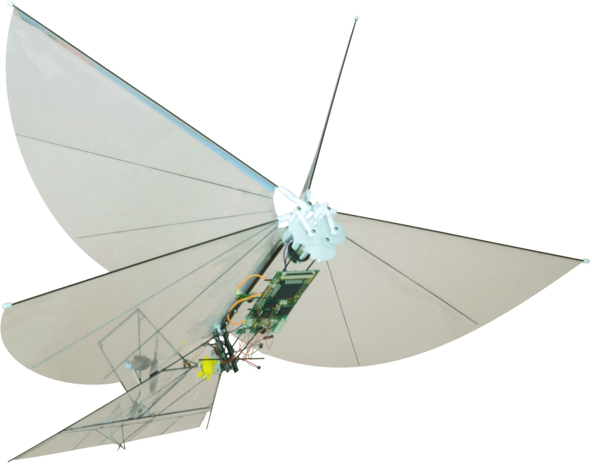
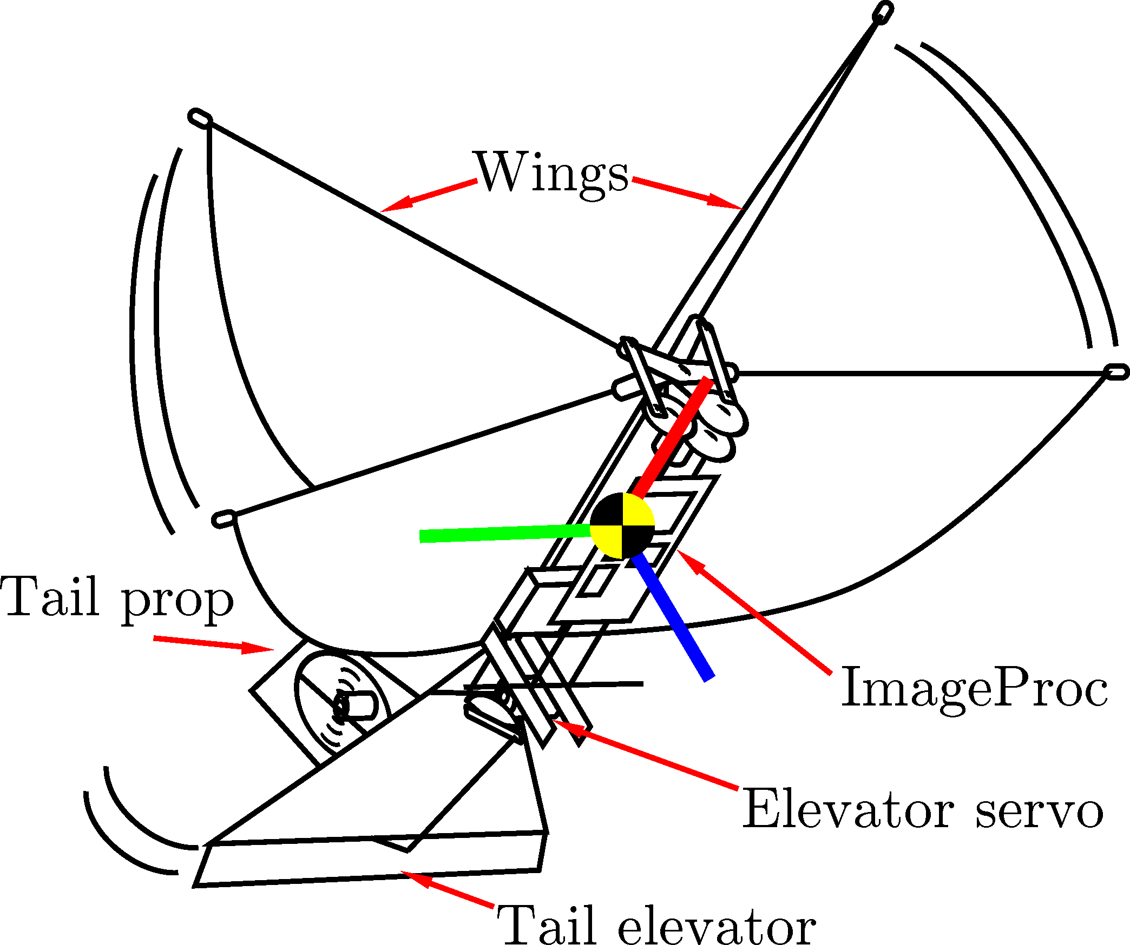
MAV Platform
Built around Silverlit i-Bird RC flyer power train
Tail propeller and servo-controlled elevator for yaw and pitch control
ImageProc 2.4 controller
40 MIPS microprocessor
6 DOF IMU
IEEE 820.15.4 radio
Motor drivers

Slide 8
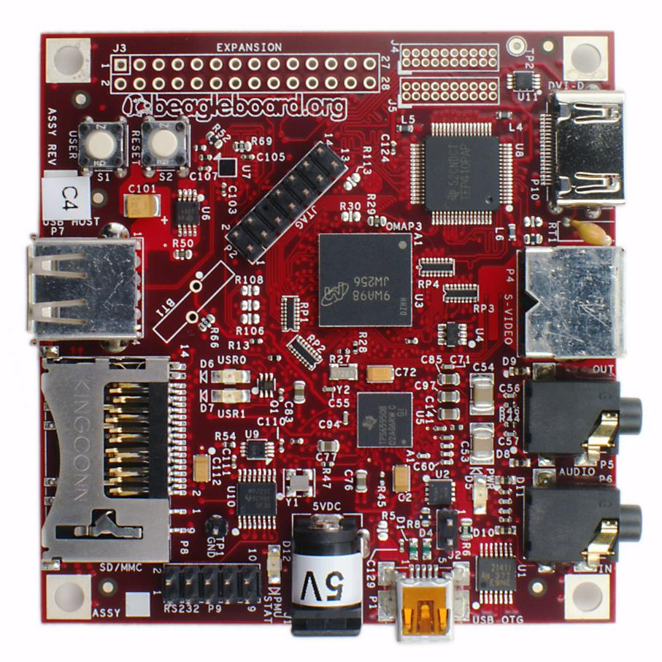
Ground Station Platform
ARM-based BeagleBoard
OMAP 3530 processor
128MB RAM
Consumes 1W power during our experiments
37g
Off-the-shelf USB web camera
63° viewing triangle
Communicates with IEEE 802.15.4 USB radio module

Slide 9
Outline
Motivation
Hardware
Cooperative System
System Identification
Model Verification
Simulation result
Experimental verification
Conclusions

Slide 10
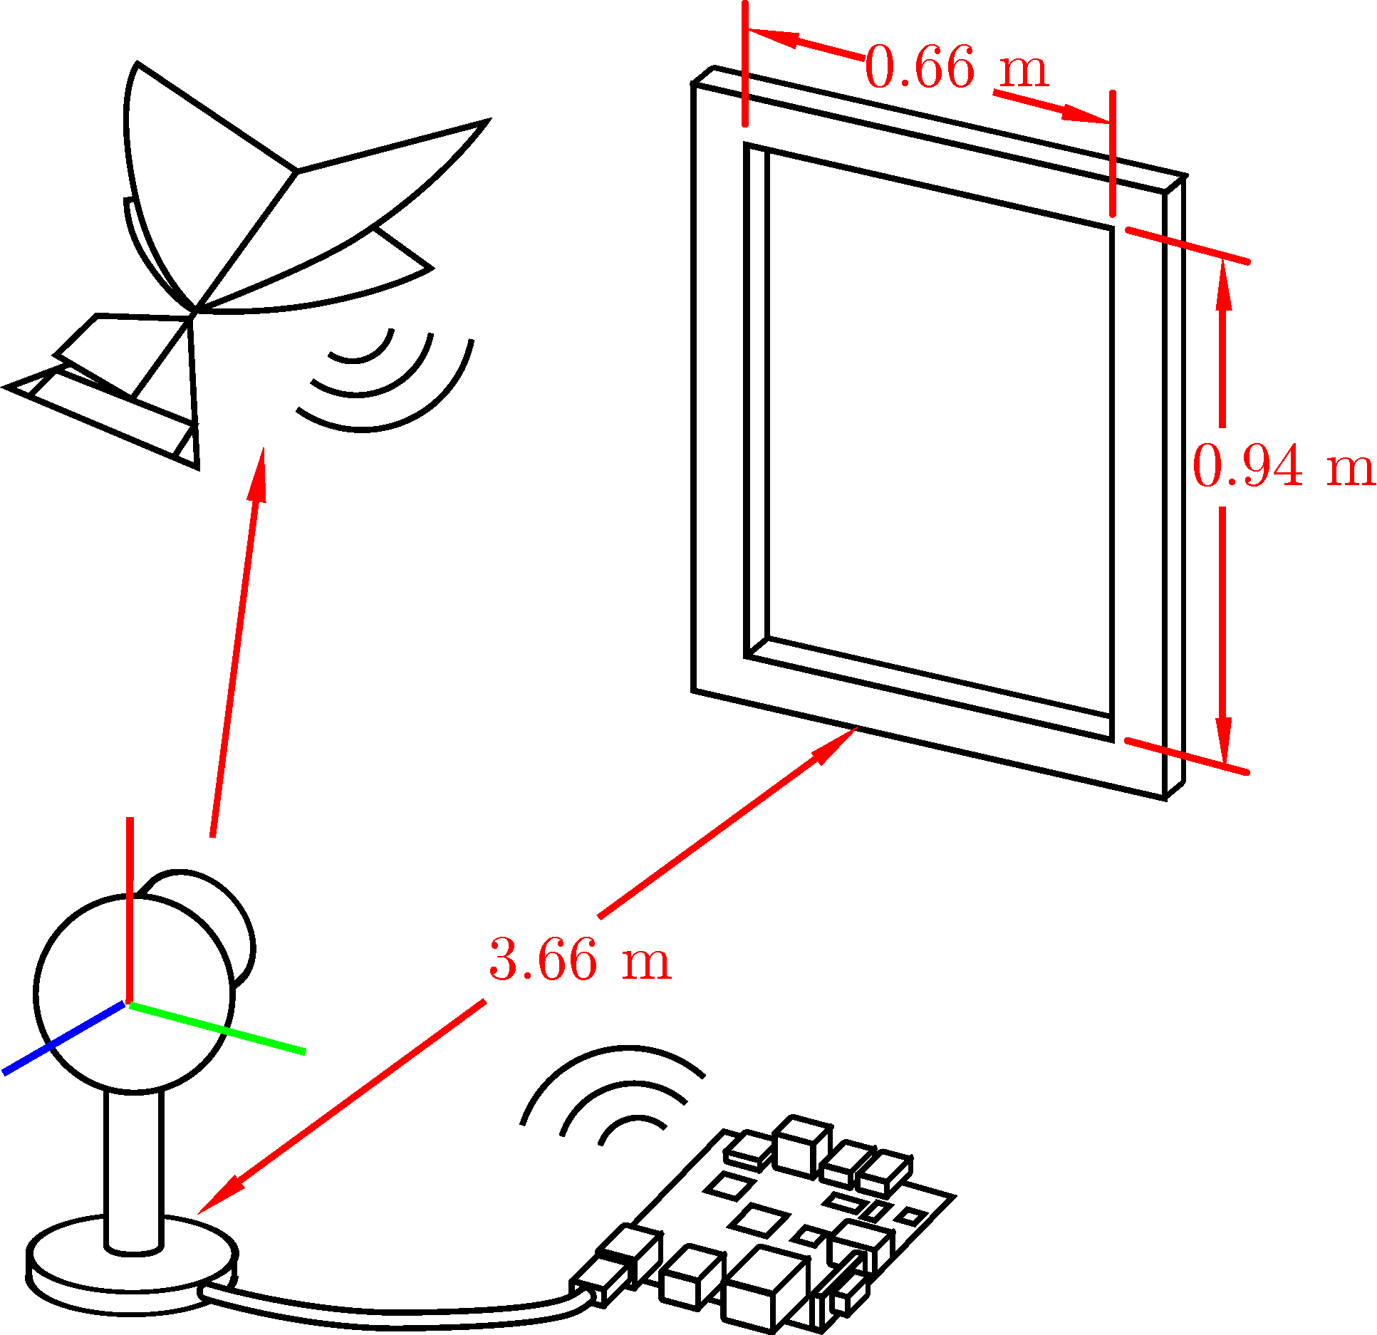
Experimental Setup
Mutual coordinate plane centered at camera
Camera tracks location of robot
Proper rotation to head towards window computed on ground station
Ground station transmits heading to robot
Robot steers to set heading using on-board controller

Slide 11
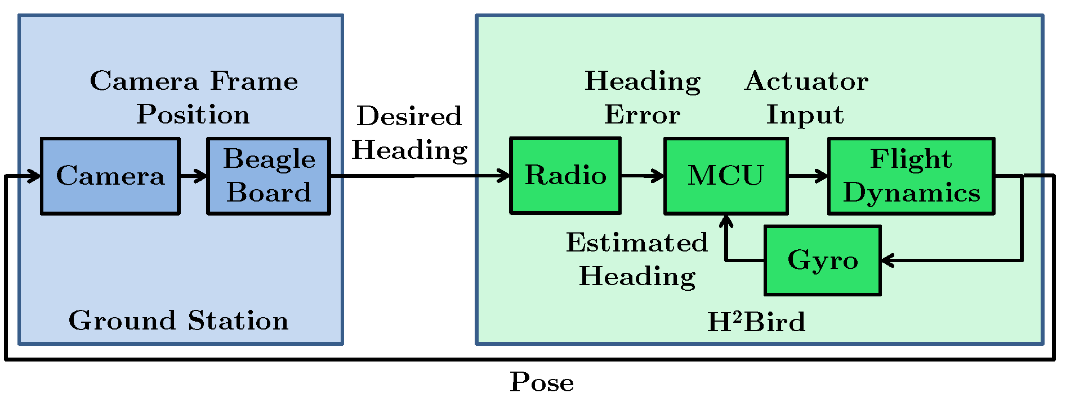
Top Level Hardware Interaction

Slide 12
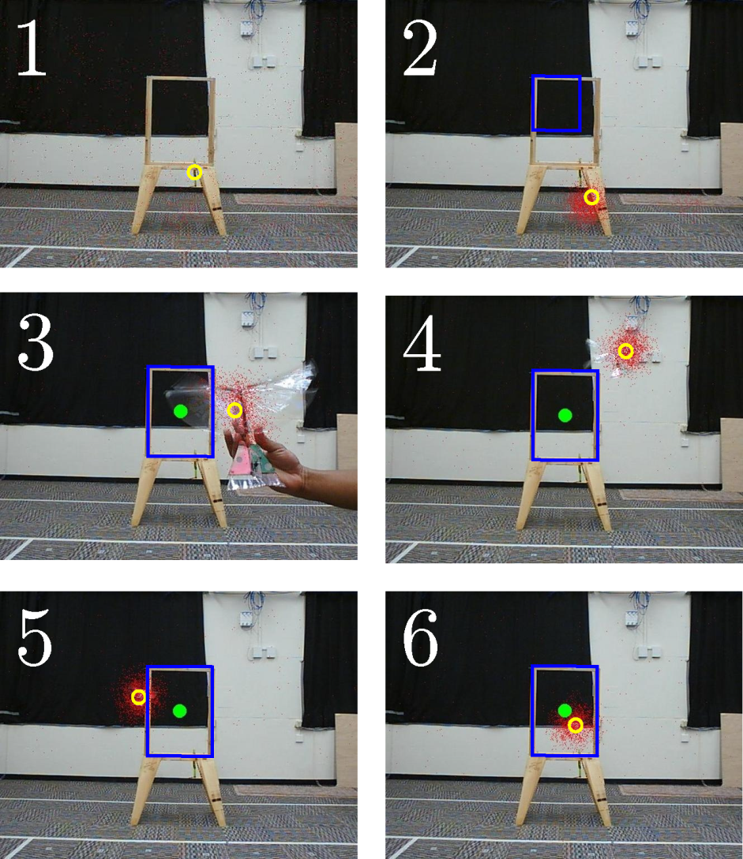
Tracking
Particle filter used to find most likely robot location
Motion model: Gaussian centered around each particle position with ε-random uniform sampling
Emission model: motion tracking via background subtraction
Boundary of window selected manually

Slide 13
Outline
Motivation
Hardware
Cooperative System
System Identification
Model Verification
Simulation result
Experimental verification
Conclusions

Slide 14
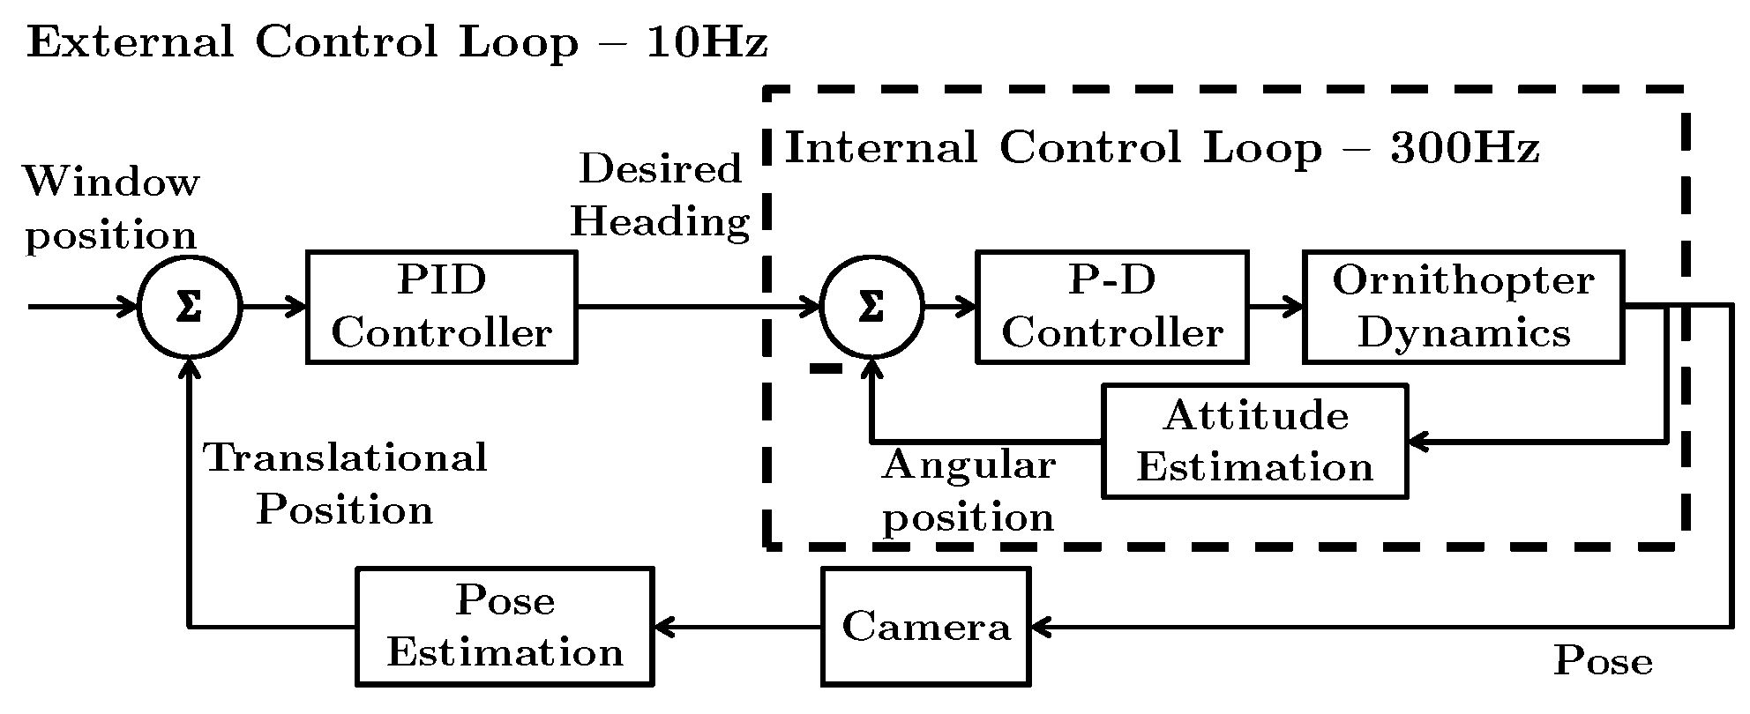
Software Control Loop

Slide 15

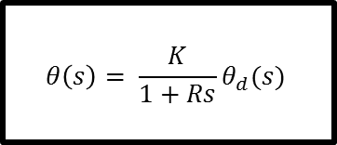

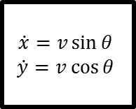

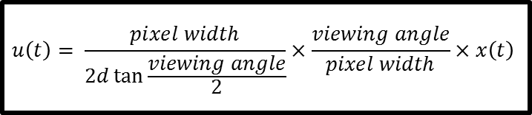



System Model
$$u\left(t\right)= \frac{pixel width}{2d\tan{\frac{viewing angle}{2}}}×\frac{viewing angle}{pixel width}×x\left(t\right)$$
$$u$$
Proportional-Integral-Derivative Controller
$$x$$
$$θ_{d}$$
Camera Latency
Transmission Latency
$$θ_{d}$$
$$\begin{matrix}\dot{x}=v\sin{θ} \\ \dot{y}=v\cos{θ}\end{matrix}$$
$$θ\left(s\right)= \frac{K}{1+Rs}θ_{d}(s)$$
$$x,y$$
$$θ$$

Slide 16
Outline
Motivation
Hardware
Cooperative System
System Identification
Model Verification
Simulation result
Experimental verification
Conclusions

Slide 17
Experiments
Simulation
Determine reachable sets for successful window navigation
Geometrically and in simulation
Monte Carlo simulation to determine probability of success for given start location
Each point in 10cm grid, simulate 40 trials of randomly sampled headings from -90° to +90°
Real-world
20 trials starting in front of the window, facing direction of window plane
60 trials in a 5cm starting grid along edges of view space, facing direction of window plane

Slide 18
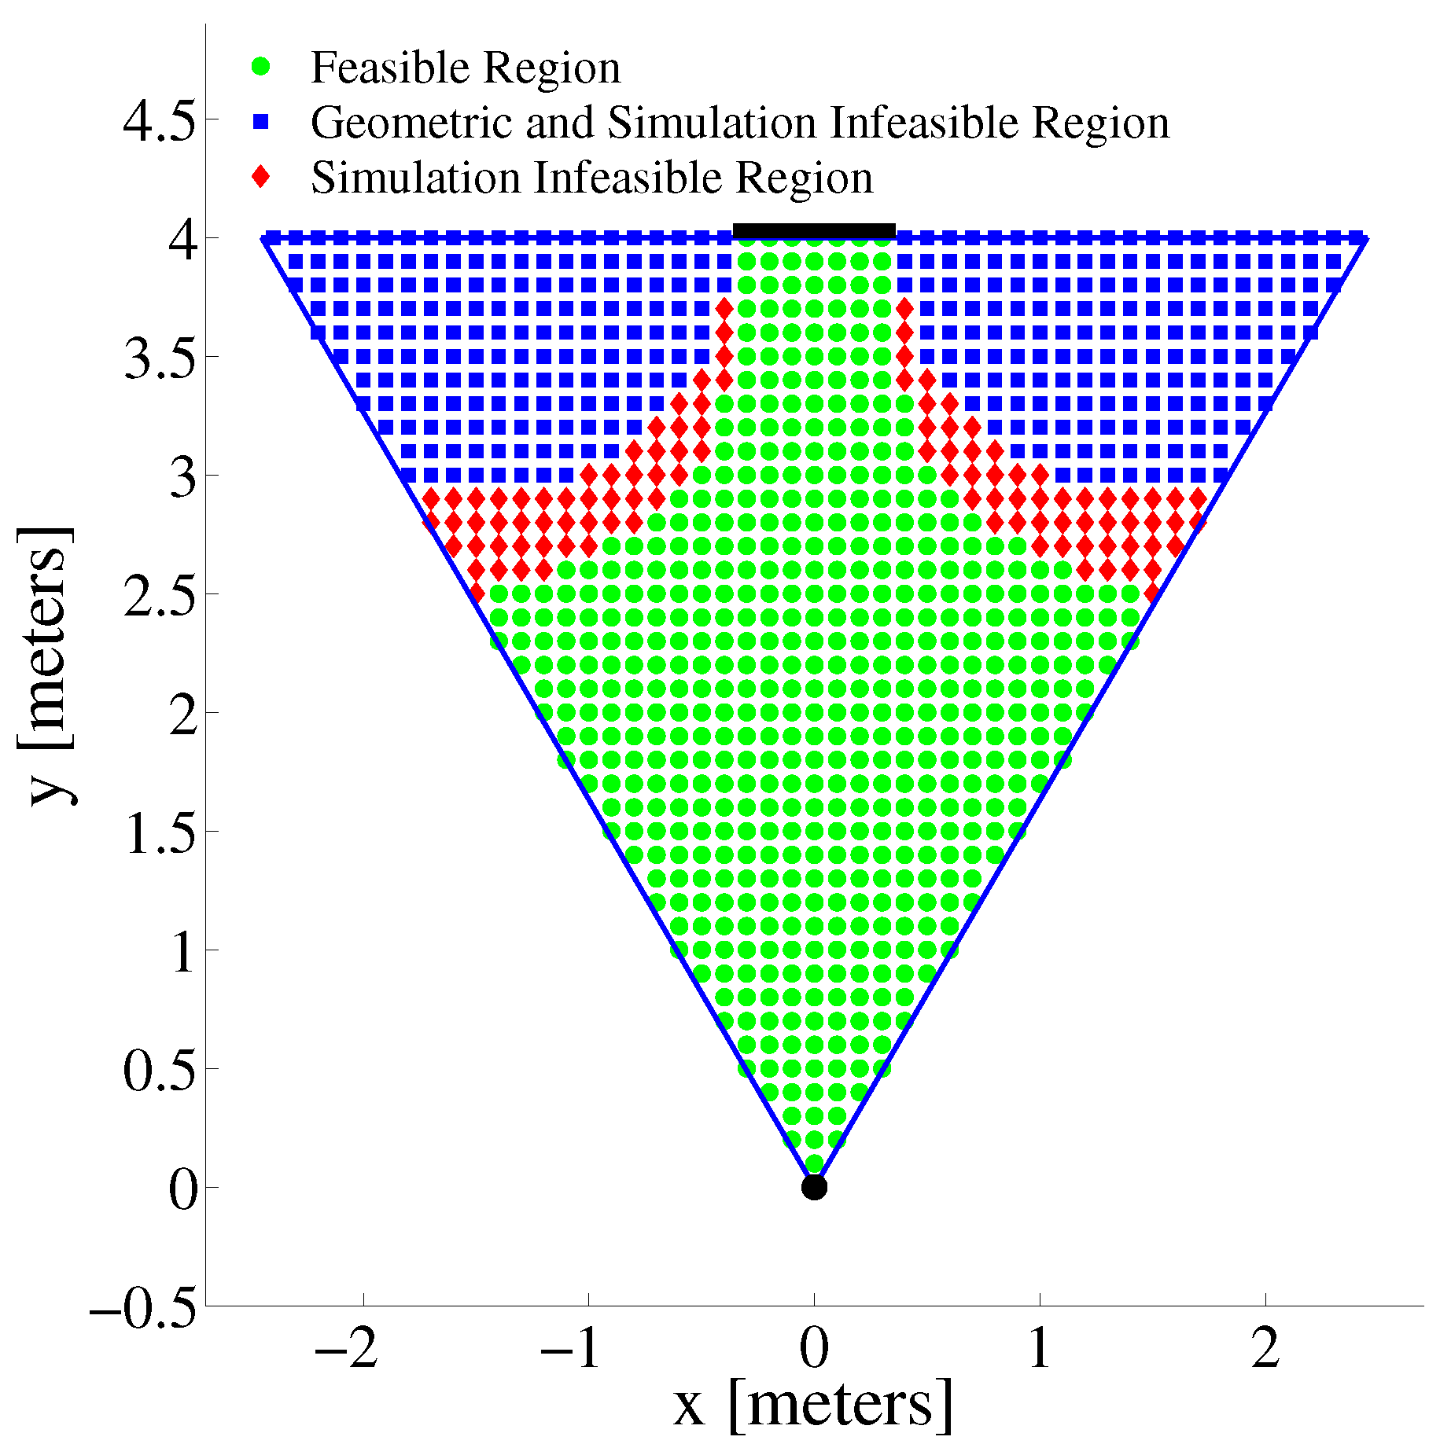
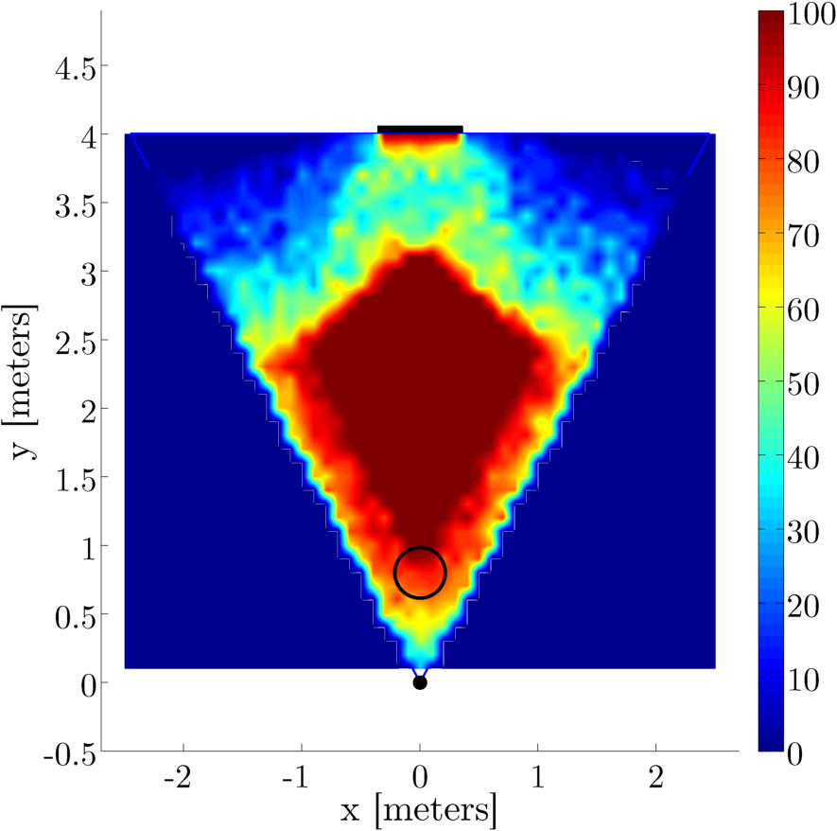
Model Predicted Feasible Regions

Slide 19
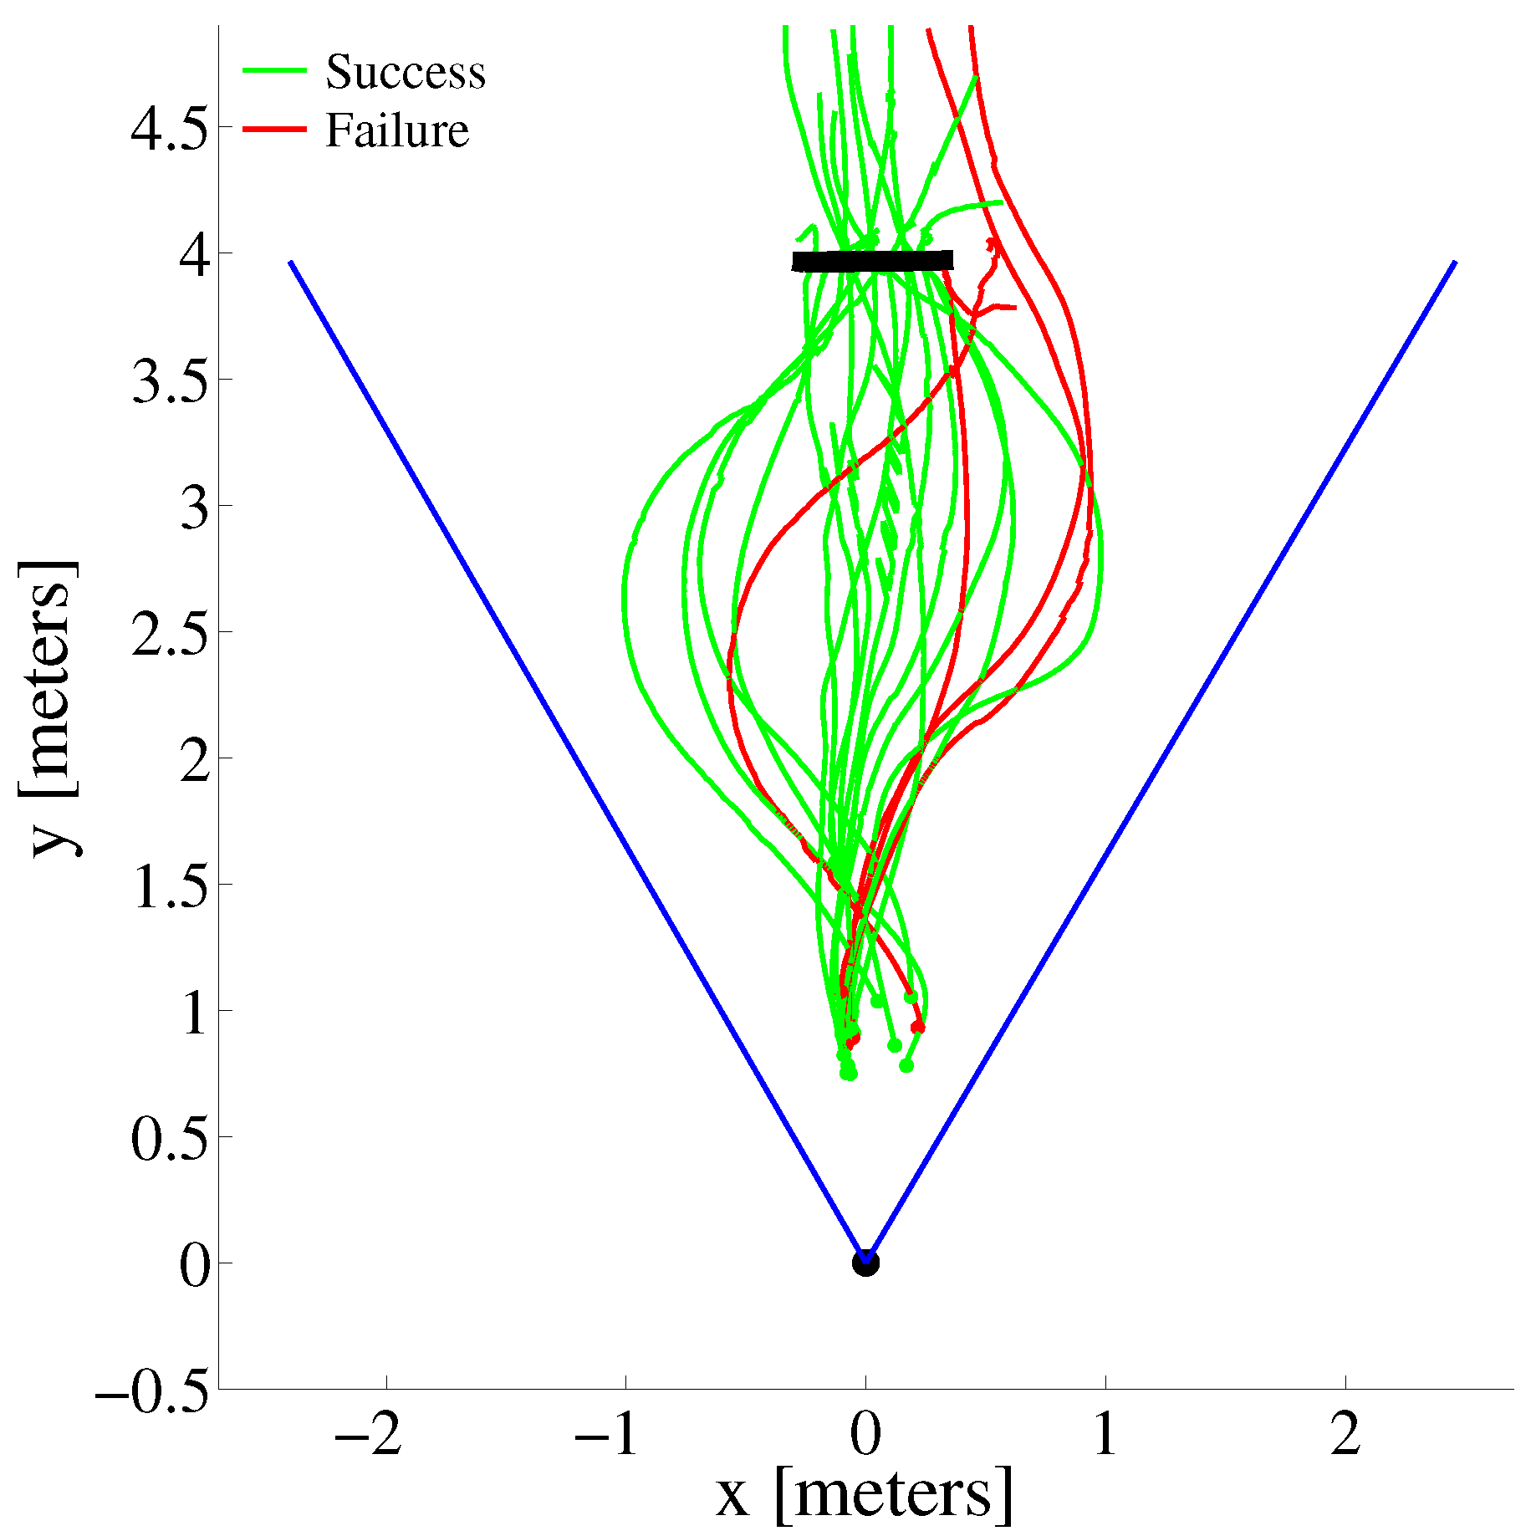
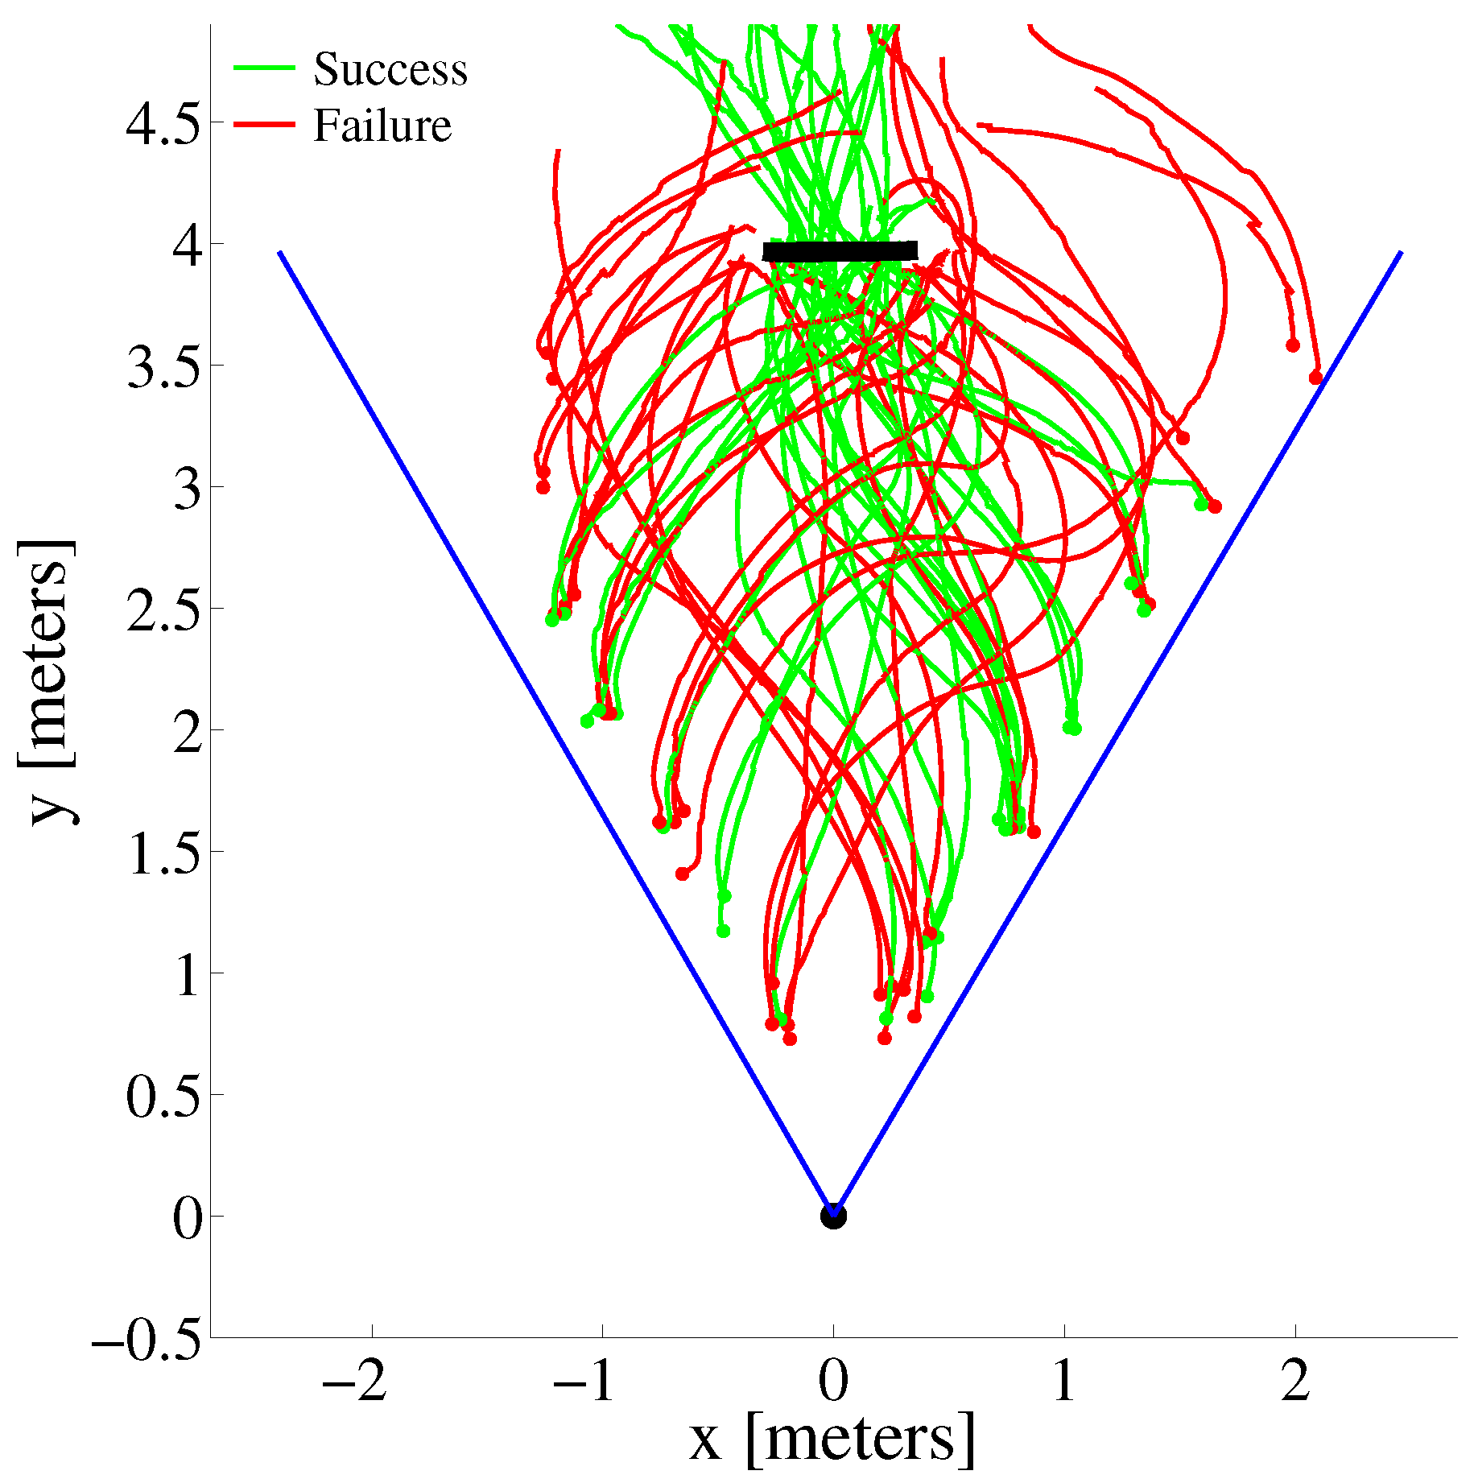
Experimental Results

Slide 20
Outline
Motivation
Hardware
Cooperative System
System Identification
Model Verification
Simulation result
Experimental verification
Conclusions

Slide 21
Conclusions
Model accurate predictor of chance of success at a given start point
Low computational cost
Could be used to determine point to begin control to ensure success
A single camera is not sufficient to reliably guide the robot to the goal
Lack information about the complete pose of the robot

Slide 22
Future Work
Talk about VLR and multi-view localization method

Slide 23
Acknowledgements

Slide 24
References

