Slide 1
Cooperative Control and Modeling for Narrow Passage Traversal *with an Ornithopter MAV and Lightweight Ground Station

Slide 2
Outline
Motivation
Hardware
Cooperative System
System Identification
Model Verification
Simulation result
Experimental verification
Conclusions

Slide 3
Outline
Motivation
Hardware
Cooperative System
System Identification
Model Verification
Simulation result
Experimental verification
Conclusions

Slide 4
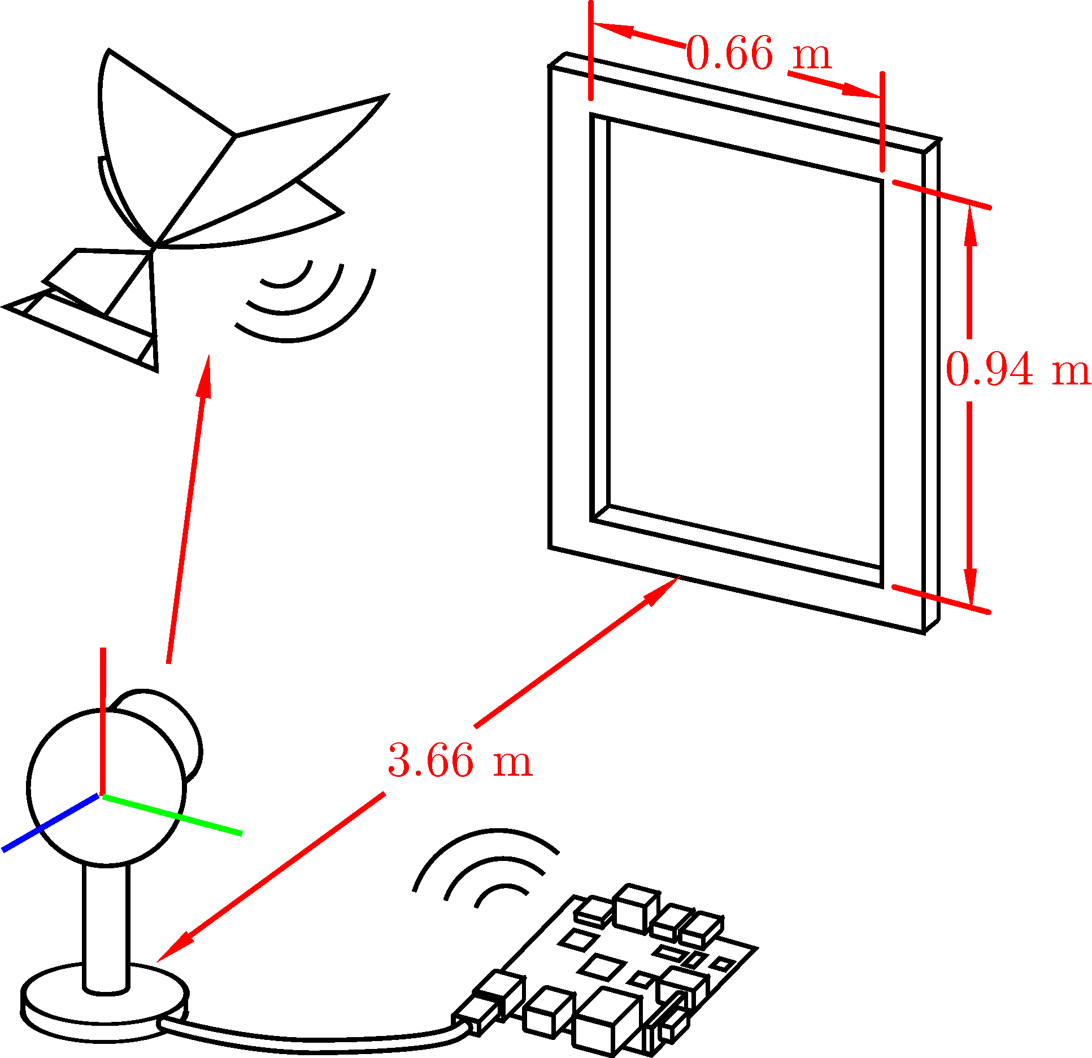
Scenario
Want to guide flapping-winged MAV through a window
MAV requires lightweight electronics
No visual sensing
Ground station uses camera to track location of MAV
Sends headings to MAV to guide it to the window

Slide 5
Motivation
Mobile robotics platforms limited in capabilities at small scales
Power, size, weight constraints
Cooperation between these systems allows for completion of objectives that are infeasible for the robots individually

Slide 6
Goal
Demonstrate feasibility of cooperation between limited mobile robots to navigate to a common goal
Develop a tracking platform that could be used on a small-scale mobile robot
Develop a model to predict successful navigation
Achieve simplified model of complex behavior of flapping-winged MAV
Difficult nonlinear dynamics
Noisy sensing from flapping movements

Slide 7
Experimental Setup
Shared global ref frame between camera and robot
Camera tracks location of robot
Ground station computes heading required to reach window
Ground station transmits desired heading to robot
Robot steers to desired heading using on-board controller

Slide 8
Outline
Motivation
Hardware
Cooperative System
System Identification
Model Verification
Simulation result
Experimental verification
Conclusions

Slide 9
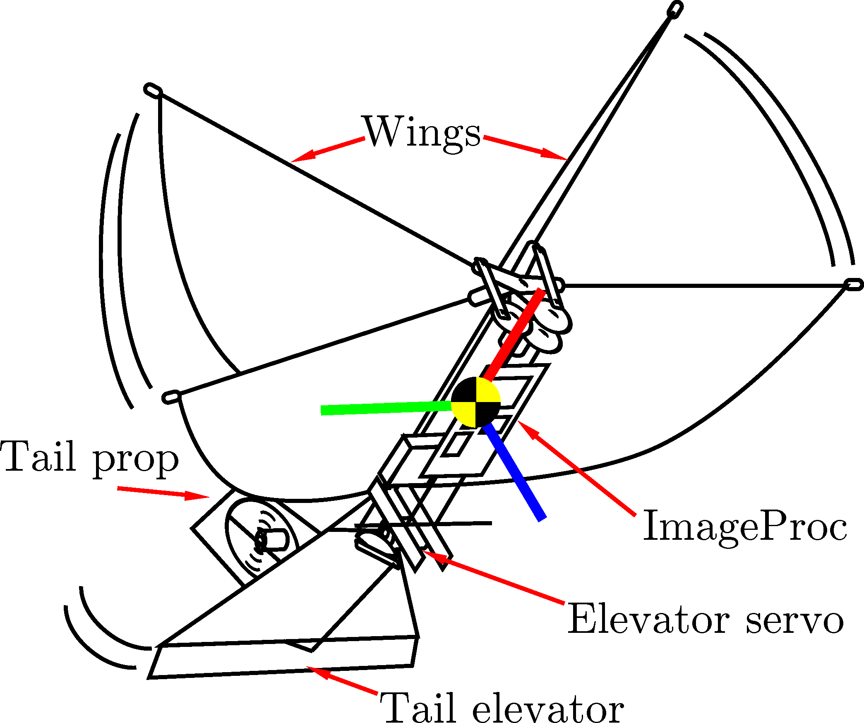
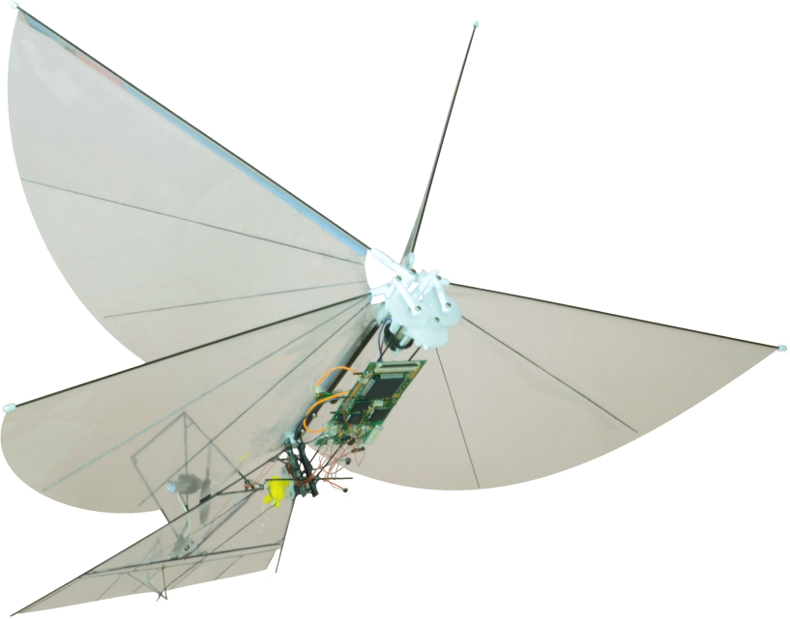
MAV Platform
Built around Silverlit i-Bird RC flyer power train
Tail propeller and servo-controlled elevator for yaw and pitch control
ImageProc 2.4 controller
40 MIPS microprocessor
6 DOF IMU
IEEE 820.15.4 radio
Motor drivers

Slide 10
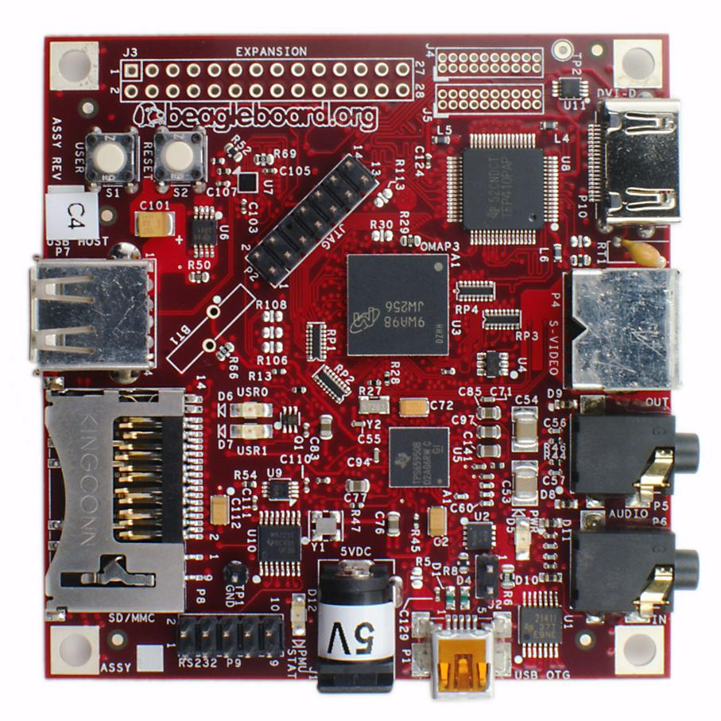
Ground Station Platform
ARM-based BeagleBoard
OMAP 3530 processor
128MB RAM
Consumes 1W power during our experiments
Off-the-shelf USB web camera
63° viewing triangle
Communicates with IEEE 802.15.4 USB radio module

Slide 11
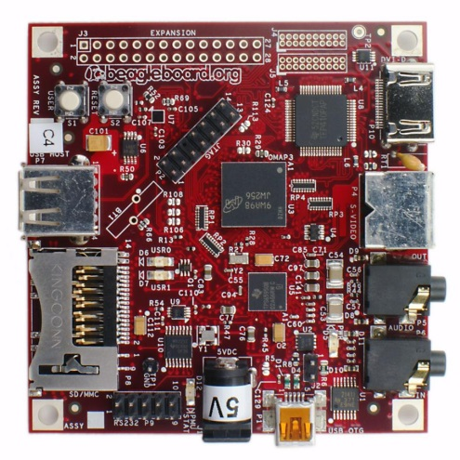

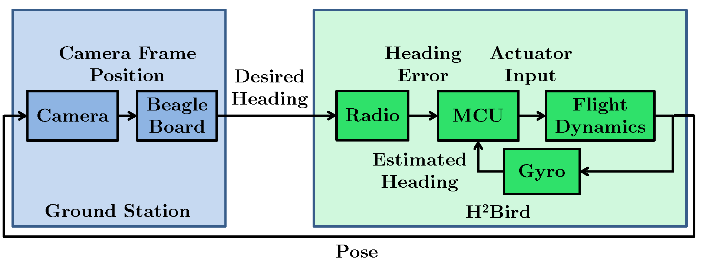
Top Level Hardware Interaction

Slide 12
Outline
Motivation
Hardware
Algorithms
System Identification
Model Verification
Simulation result
Experimental verification
Conclusions

Slide 13
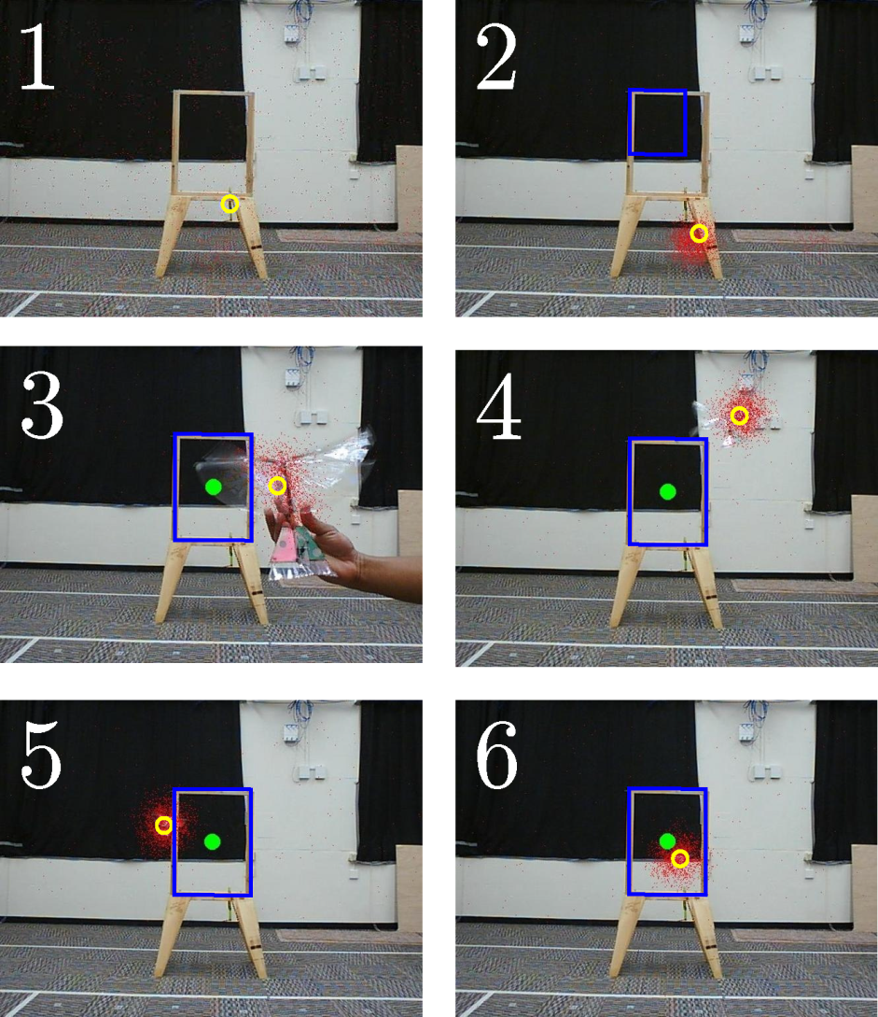
Tracking
Particle filter used to find most likely robot location
Motion model: Gaussian centered around each particle position with ε-random uniform sampling
Emission model: motion tracking via background subtraction
Boundary of window selected manually

Slide 14
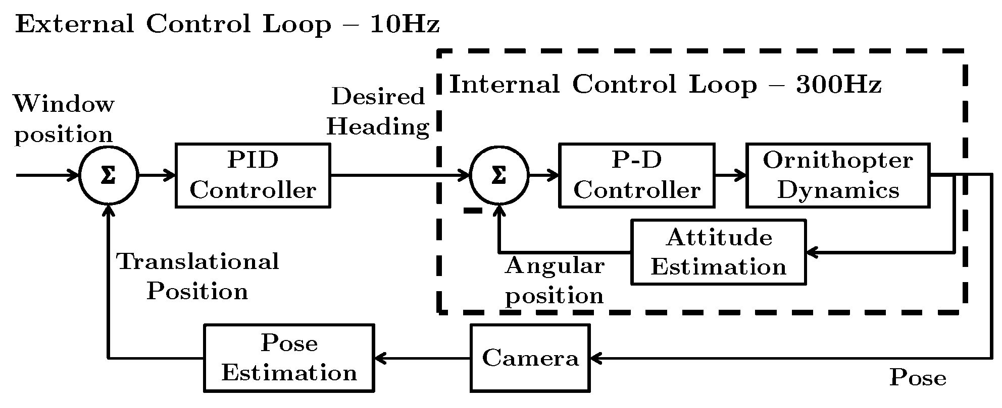
Software Control Loop

Slide 15
Outline
Motivation
Hardware
Cooperative System
System Identification
Model Verification
Simulation result
Experimental verification
Conclusions

Slide 16

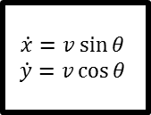

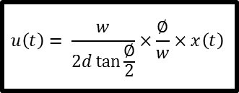





System Model
H²Bird
$$θ_{d}$$
$$u\left(t\right)= \frac{w}{2d\tan{\frac{∅}{2}}}×\frac{∅}{w}×x\left(t\right)$$
$$u$$
PID Controller
Transmission Latency
$$θ\left(s\right)= \frac{K}{1+Rs}θ_{d}(s)$$
$$θ$$
$$\begin{matrix}\dot{x}=v\sin{θ} \\ \dot{y}=v\cos{θ}\end{matrix}$$
$$x$$
Camera Latency
$$x,y$$
$$x,y$$
x,y – H²Bird location in camera frame in pixels
v – H²Bird forward velocity
𝛳 – H²Bird heading
𝛳_{d} – desired H²Bird heading
u – geometrically computed heading input
𝜙 – viewing angle of camera
w – width of camera frame in pixels
Ground Station
Notes:
Same layout, key

Slide 17
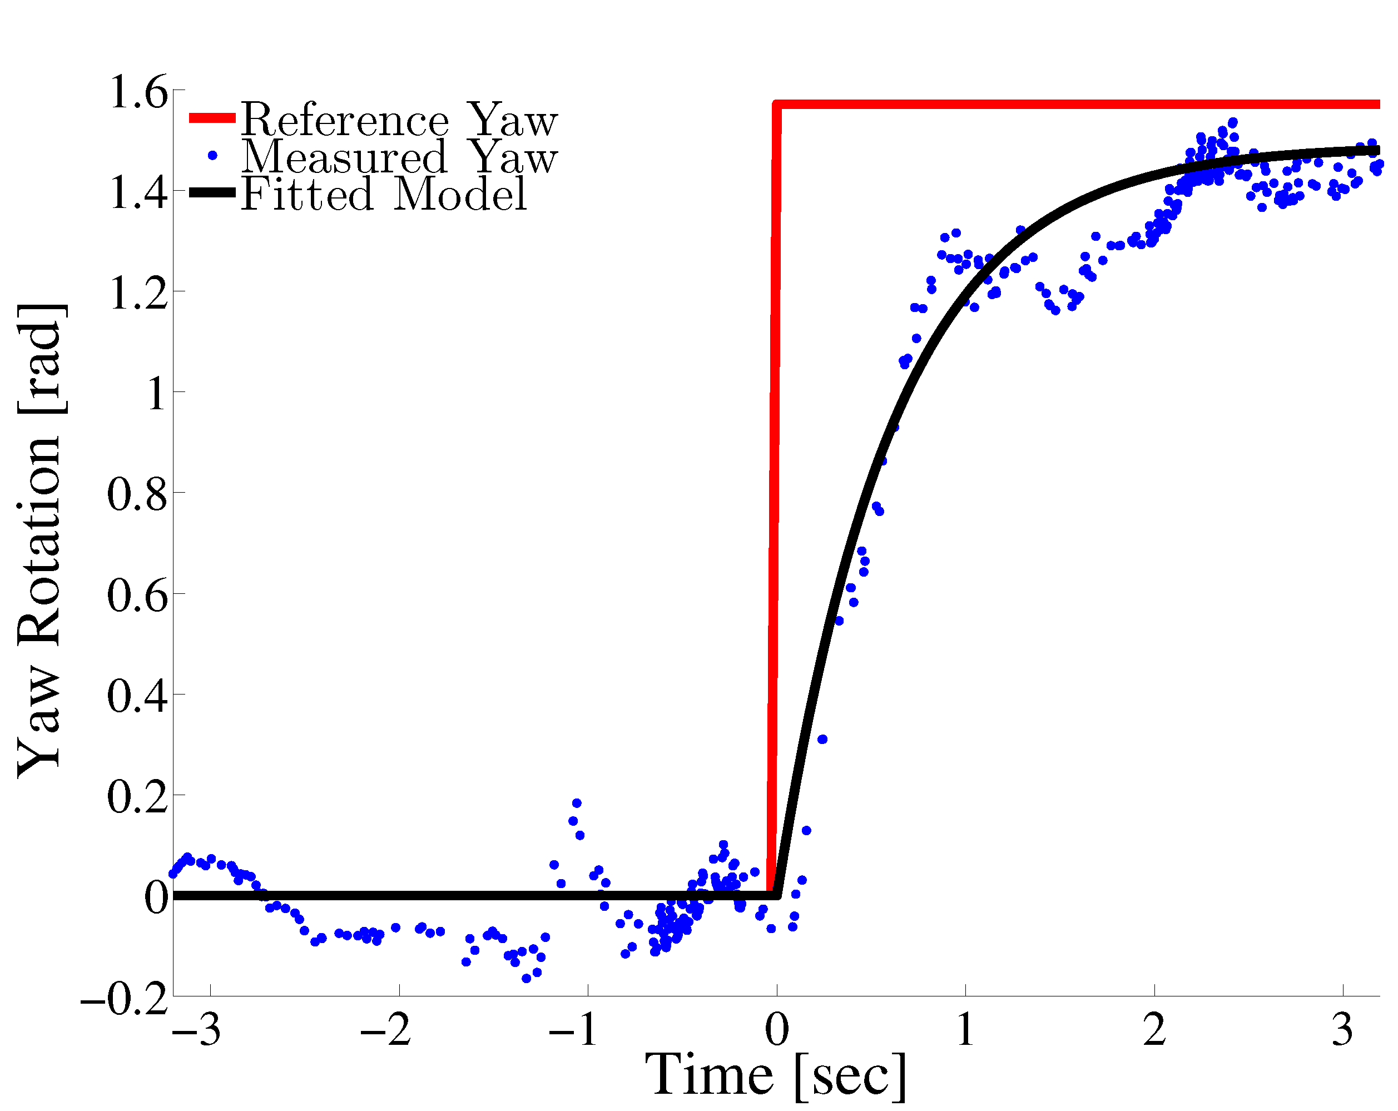






Identification Methods
H²Bird
$$θ_{d}$$
$$u\left(t\right)= \frac{w}{2d\tan{\frac{∅}{2}}}×\frac{∅}{w}×x\left(t\right)$$
$$u$$
PID Controller
Transmission Latency
$$θ\left(s\right)= \frac{K}{1+Rs}θ_{d}(s)$$
$$θ$$
$$\begin{matrix}\dot{x}=v\sin{θ} \\ \dot{y}=v\cos{θ}\end{matrix}$$
$$x$$
Camera Latency
$$x,y$$
$$x,y$$
Ground Station
Notes:
Same layout, key

Slide 18

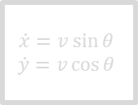

System Model
H²Bird
$$θ_{d}$$
$$u\left(t\right)= \frac{w}{2d\tan{\frac{∅}{2}}}×\frac{∅}{w}×x\left(t\right)$$
$$u$$
PID Controller
Transmission Latency
$$θ\left(s\right)= \frac{K}{1+Rs}θ_{d}(s)$$
$$θ$$
$$\begin{matrix}\dot{x}=v\sin{θ} \\ \dot{y}=v\cos{θ}\end{matrix}$$
$$x$$
Transmission latency
Ping robot from ground station and measure round-trip time
Camera latency
Point camera at black screen that transitions to white
Measure time between when screen changes and when camera detects the change
Camera Latency
$$x,y$$
$$x,y$$
Ground Station
Notes:
Same layout, key

Slide 19
System Model
H²Bird
$$θ_{d}$$
$$u\left(t\right)= \frac{w}{2d\tan{\frac{∅}{2}}}×\frac{∅}{w}×x\left(t\right)$$
$$u$$
PID Controller
Transmission Latency
$$θ\left(s\right)= \frac{K}{1+Rs}θ_{d}(s)$$
$$θ$$
$$\begin{matrix}\dot{x}=v\sin{θ} \\ \dot{y}=v\cos{θ}\end{matrix}$$
$$x$$
Camera Latency
$$x,y$$
$$x,y$$
Control input u determined geometrically
PID controller parameters determined experimentally
Ground Station
Notes:
Same layout, key

Slide 20
Outline
Motivation
Hardware
Cooperative System
System Identification
Model Verification
Simulation result
Experimental verification
Conclusions

Slide 21
Experiments
Simulation
Determine reachable sets for successful window navigation
Geometrically and in simulation
Monte Carlo simulation to determine probability of success for given start location
Each point in 10cm grid, simulate 40 trials of randomly sampled headings from -90° to +90°
Notes:
sim

Slide 22
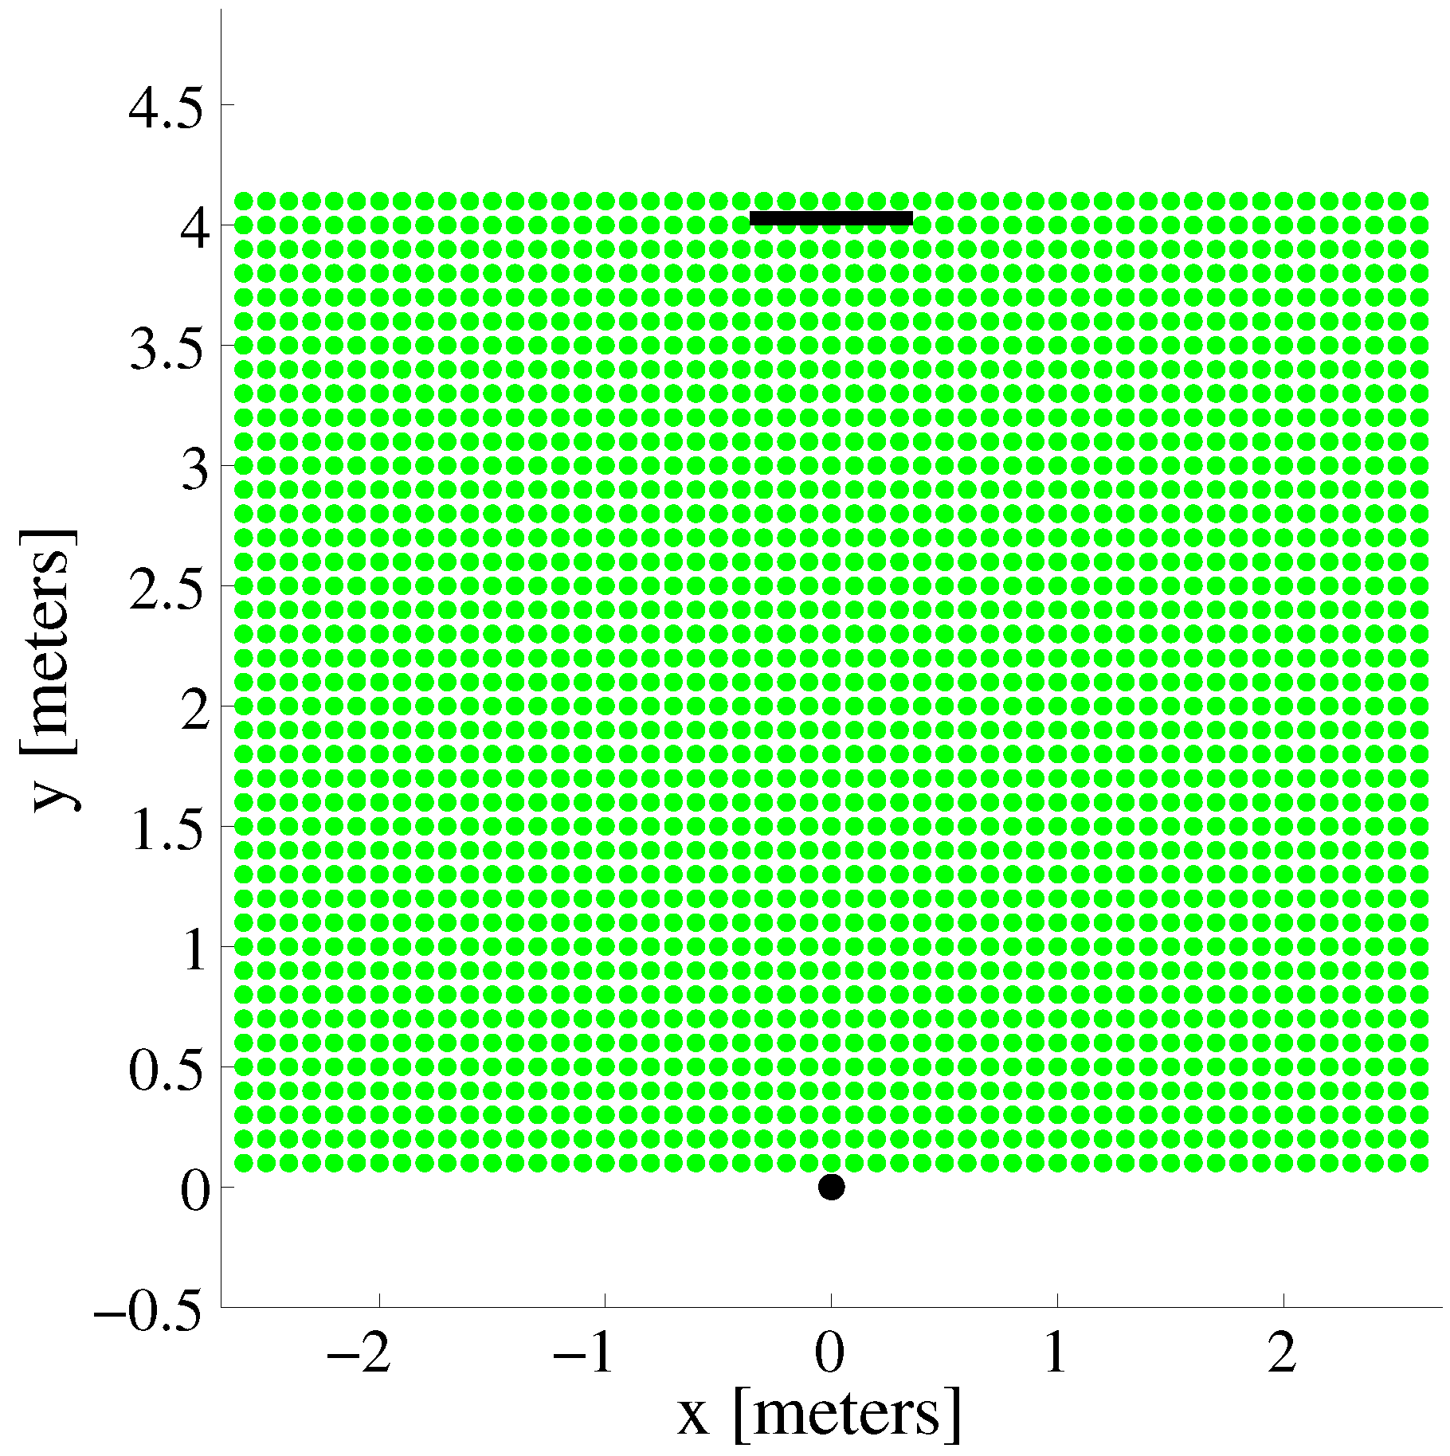
Model Predicted Feasible Regions

Slide 23
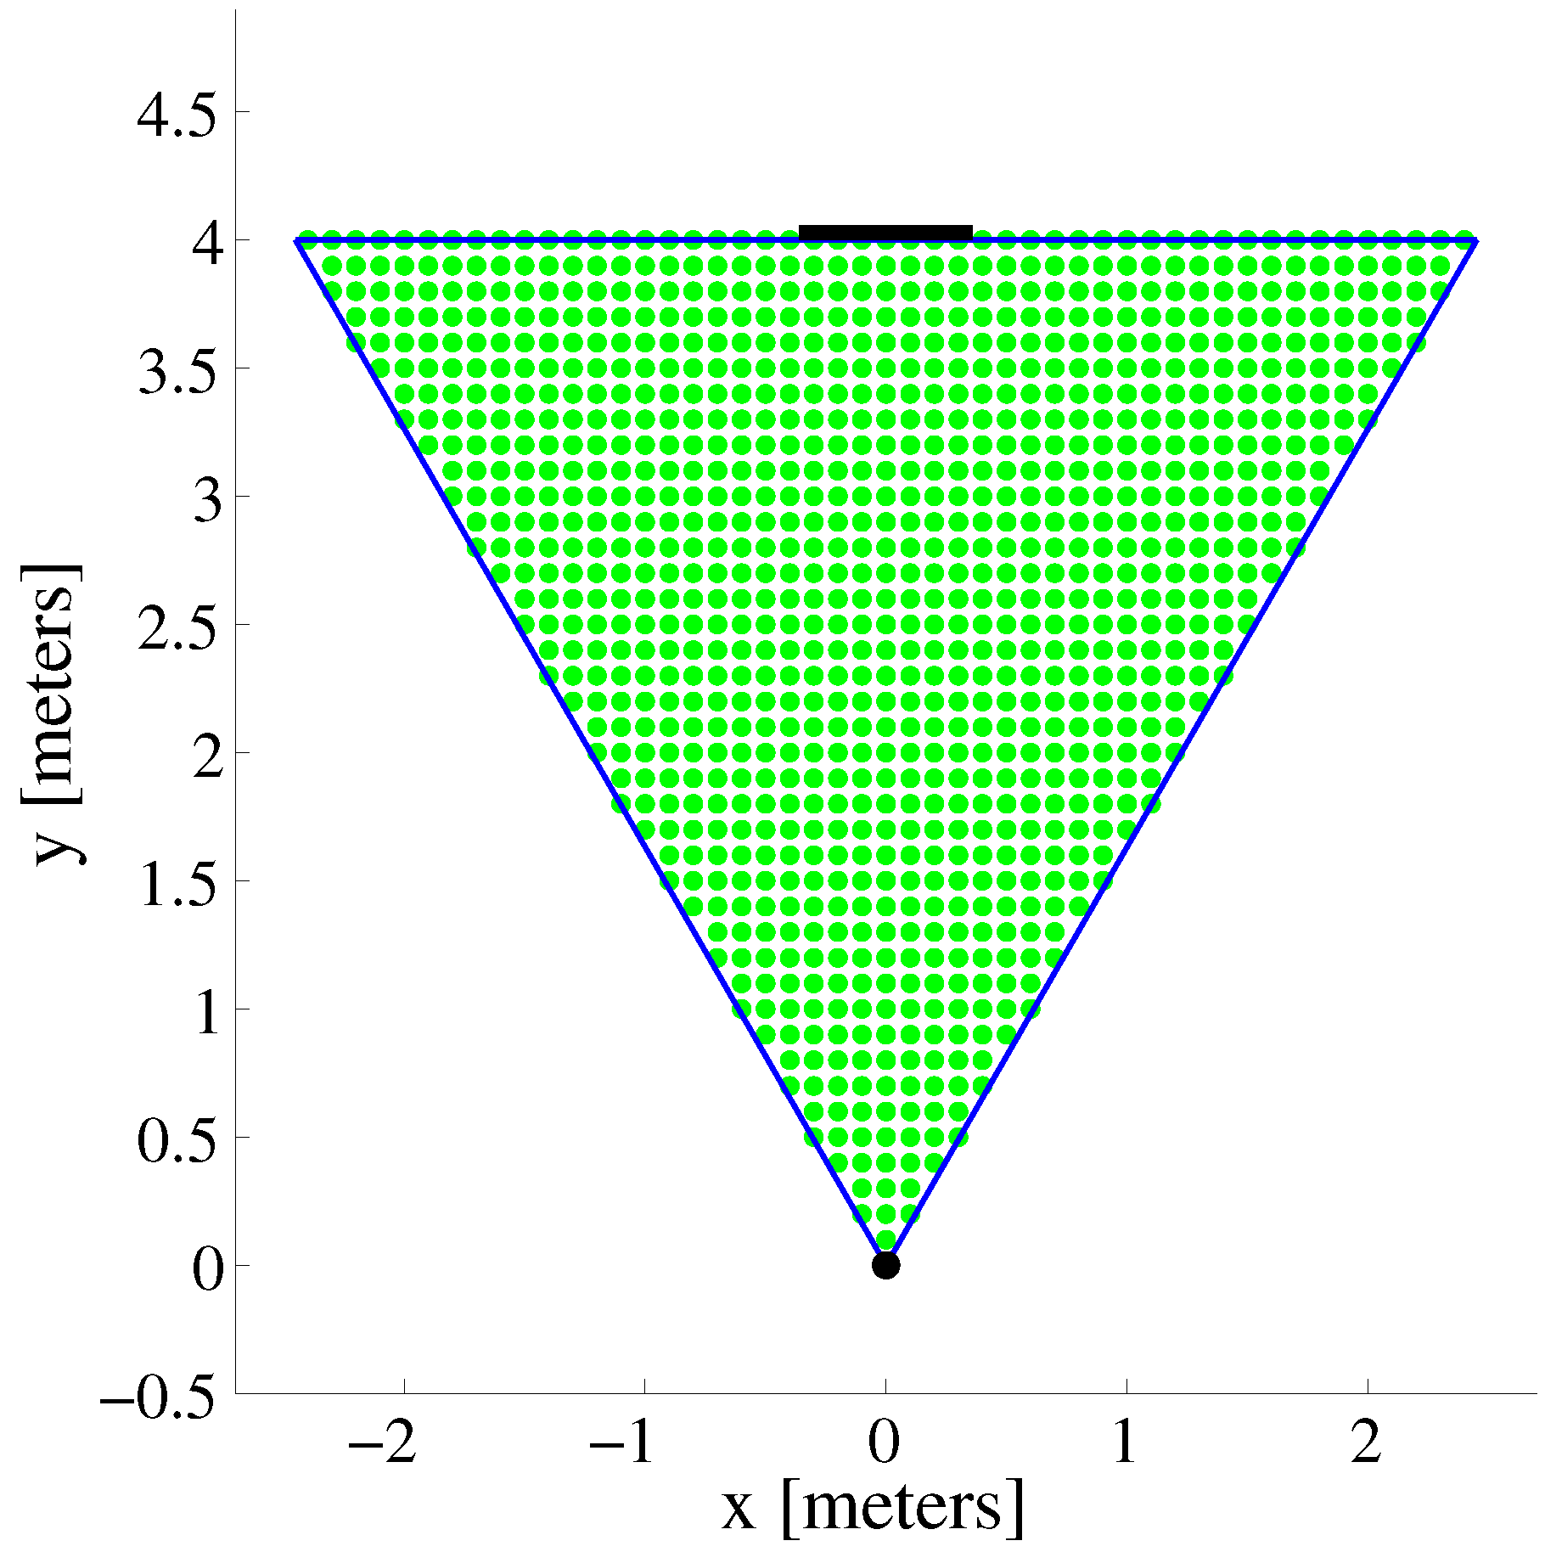
Model Predicted Feasible Regions

Slide 24
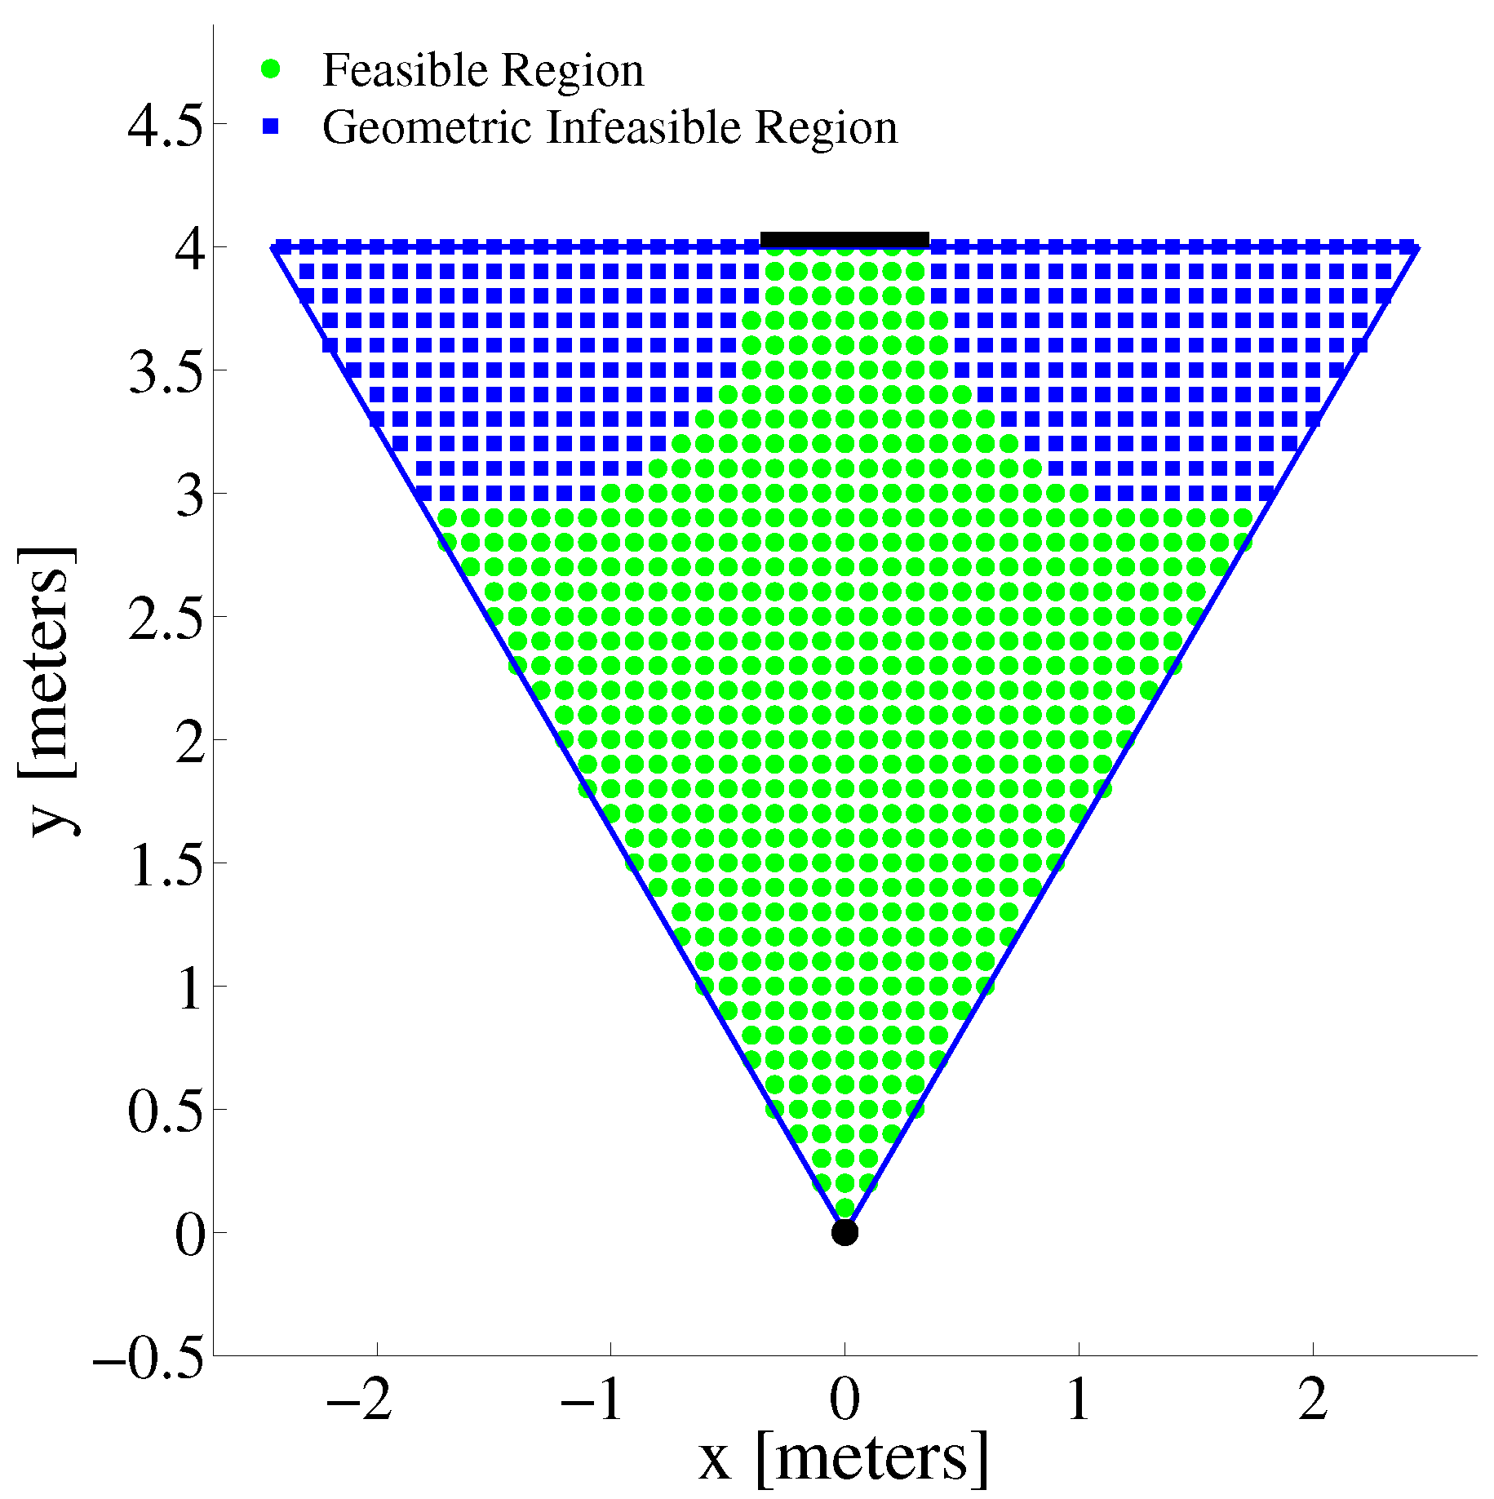
Model Predicted Feasible Regions

Slide 25
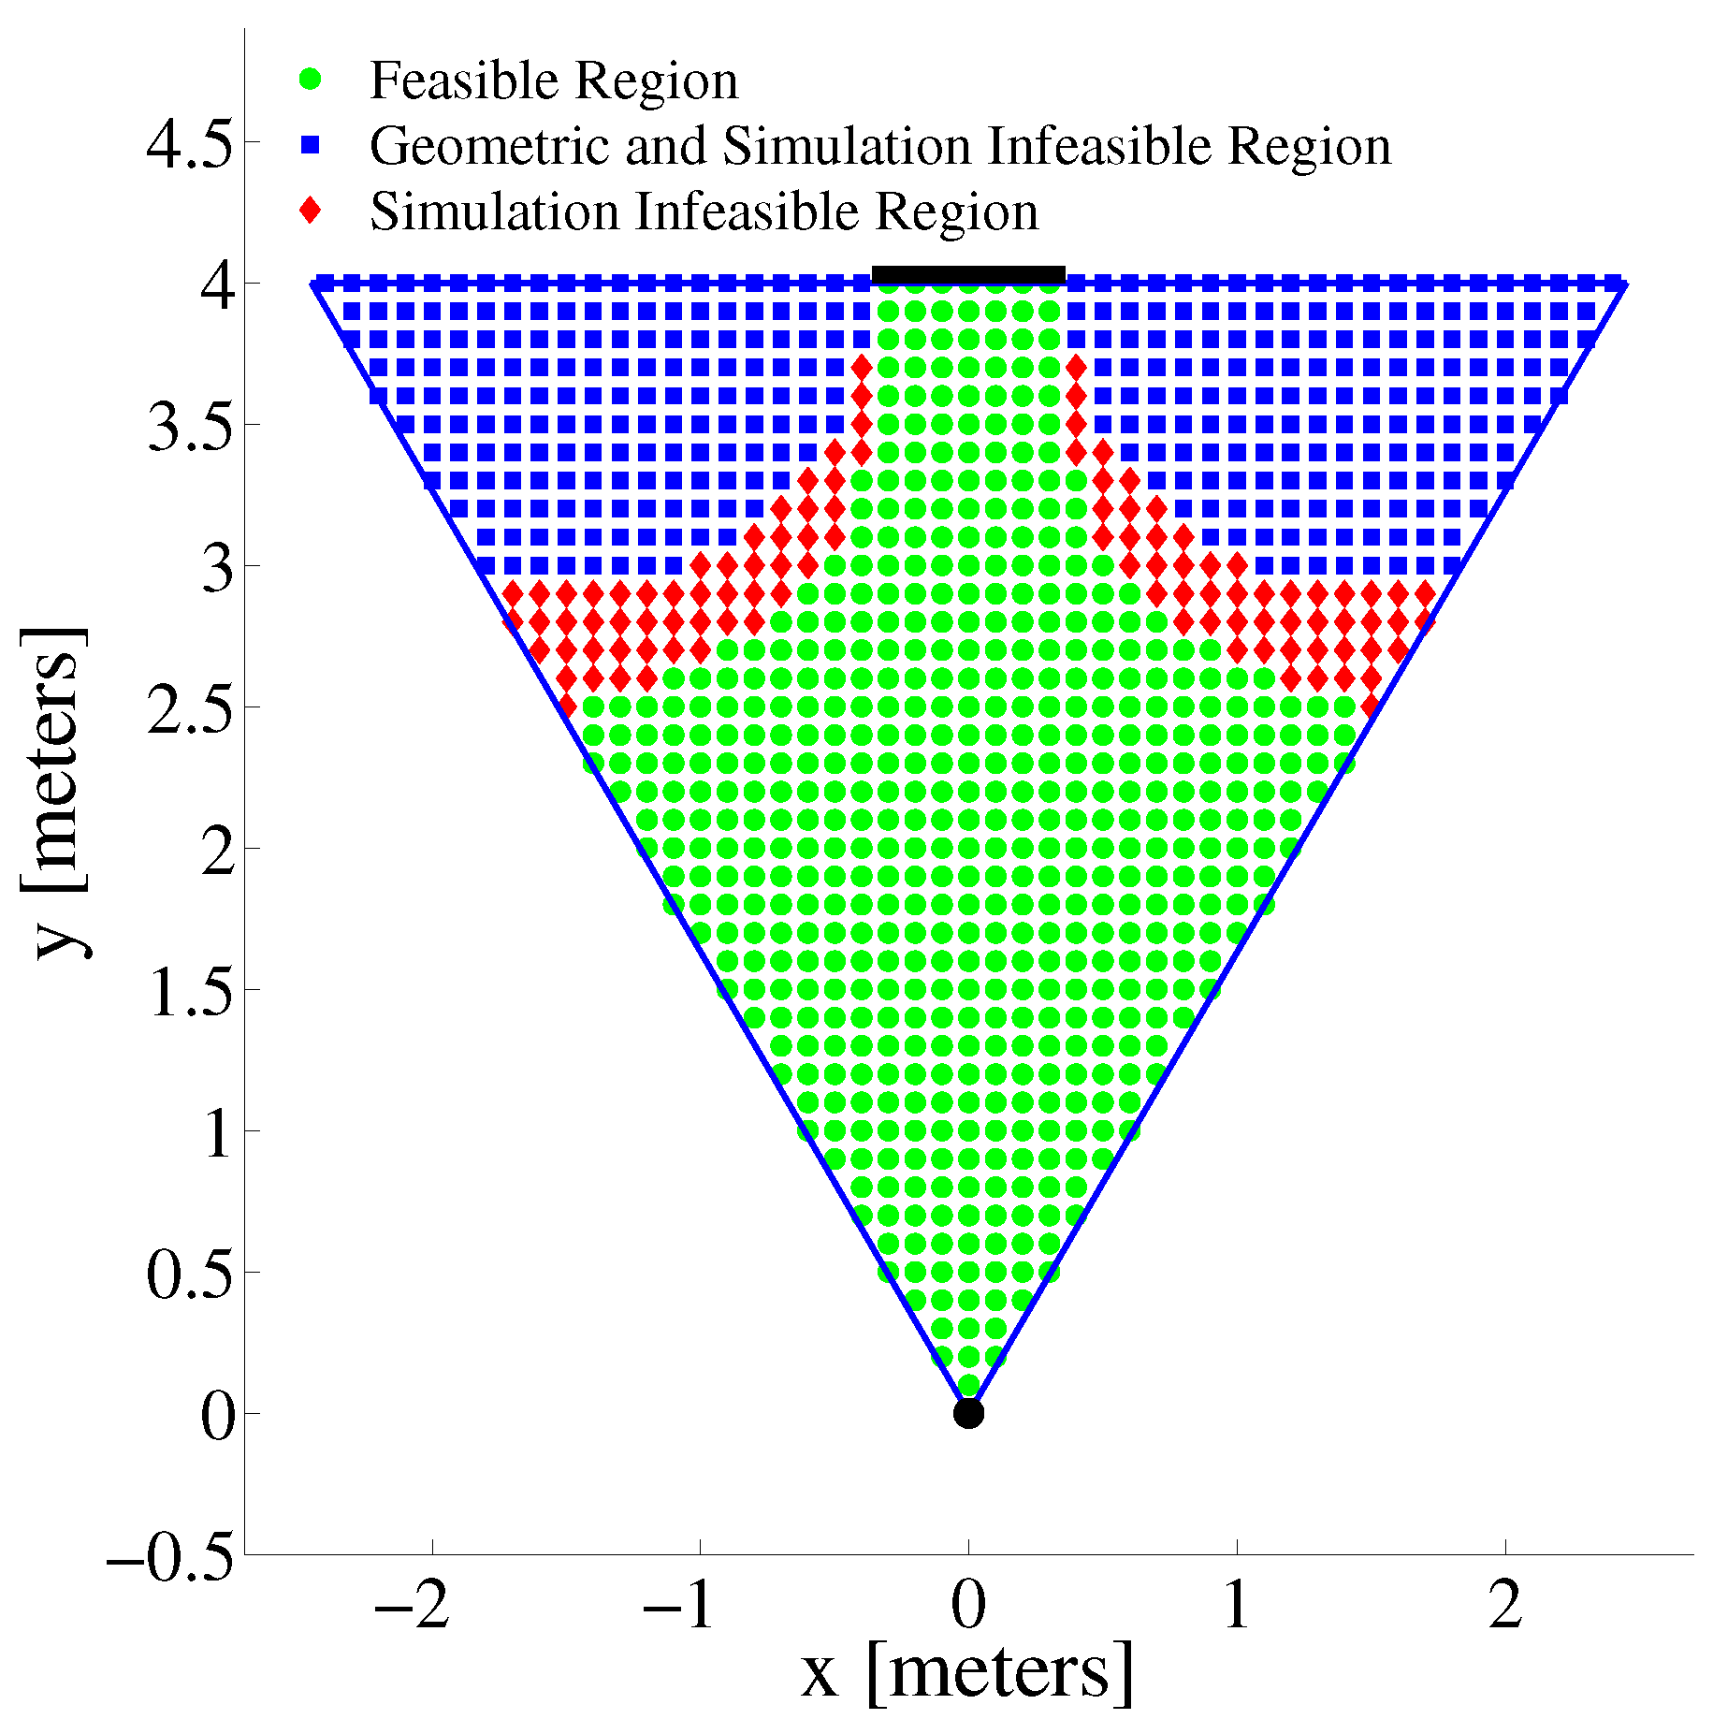
Model Predicted Feasible Regions

Slide 26
Experiments
Real-world
20 trials starting in front of the camera, facing direction of window plane
60 trials in a 5cm starting grid along edges of view space, facing direction of window plane
Notes:
real

Slide 27
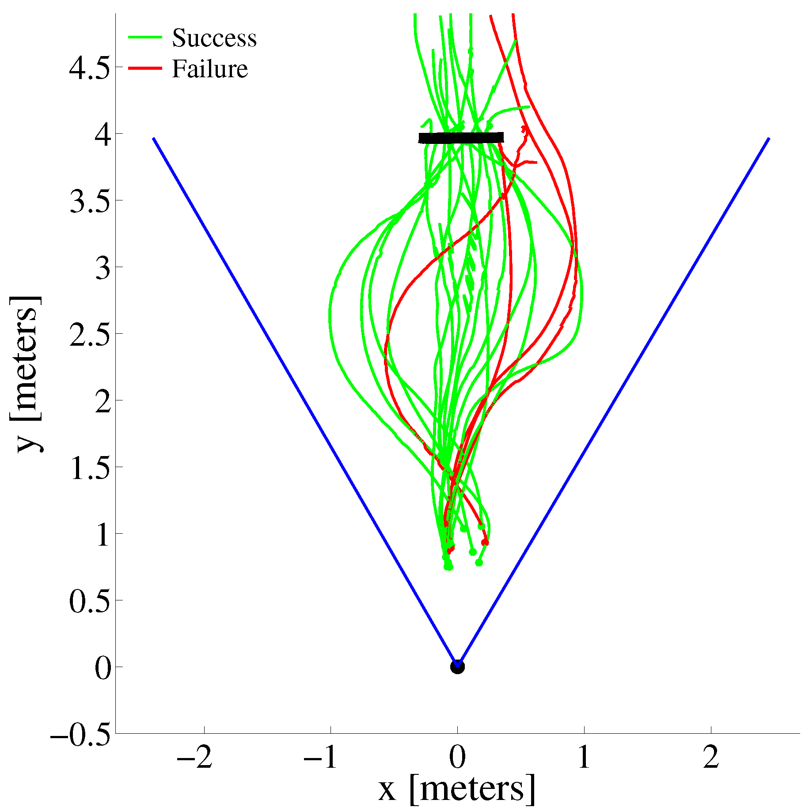
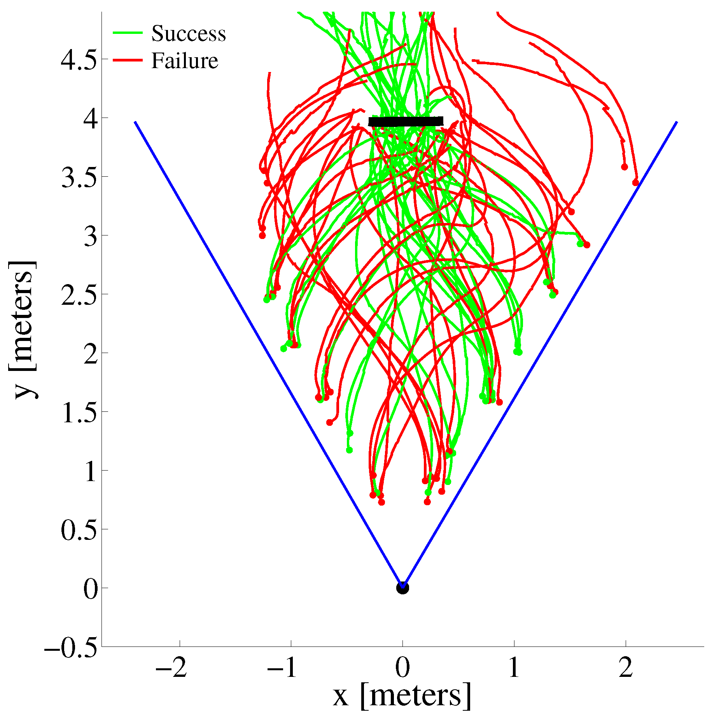
Experimental Results

Slide 28
Experiments
Simulation
Determine reachable sets for successful window navigation
Geometrically and in simulation
Monte Carlo simulation to determine probability of success for given start location
Each point in 10cm grid, simulate 40 trials of randomly sampled headings from -90° to +90°
Notes:
sim

Slide 29
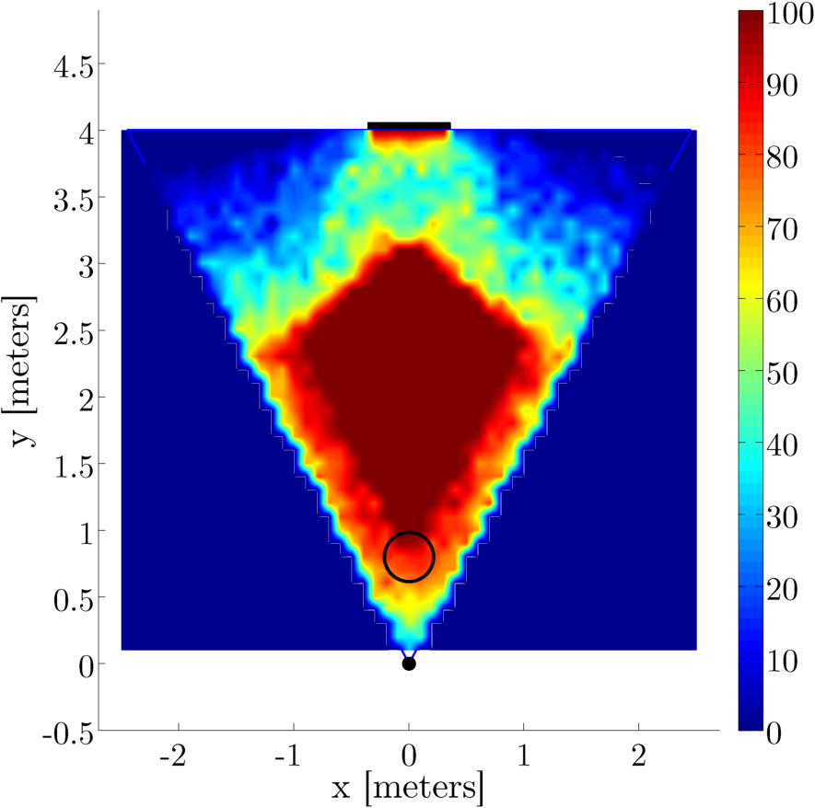
Monte Carlo Results

Slide 30
Outline
Motivation
Hardware
Cooperative System
System Identification
Model Verification
Simulation result
Experimental verification
Conclusions

Slide 31
Conclusions
Model accurate predictor of chance of success at a given start point
Low computational cost
Could be used to determine point to begin control to ensure success
Monocular tracking and control is viable
Lack information about the complete pose of the robot
With some modeling can determine regions of high success

Slide 32
Future Work
Talk about VLR and multi-view localization method

Slide 33
Acknowledgements

Slide 34
References

