Slide 1
Cooperative Control and Modeling for Narrow Passage Traversal with an Ornithopter MAV and Lightweight Ground Station

Slide 2
Outline
Motivation
Hardware
Cooperative System
System Identification
Model Verification
Simulation result
Experimental verification
Future Applications

Slide 3
Outline
Motivation
Hardware
Cooperative System
System Identification
Model Verification
Simulation result
Experimental verification
Future Applications

Slide 4
Motivation
Mobile robotics platforms can be limited in capabilities at small scales
Cooperation between these systems can allow for completion of objectives that are infeasible for the robots individually

Slide 5
Outline
Motivation
Hardware
Cooperative System
System Identification
Model Verification
Simulation result
Experimental verification
Future Applications

Slide 6
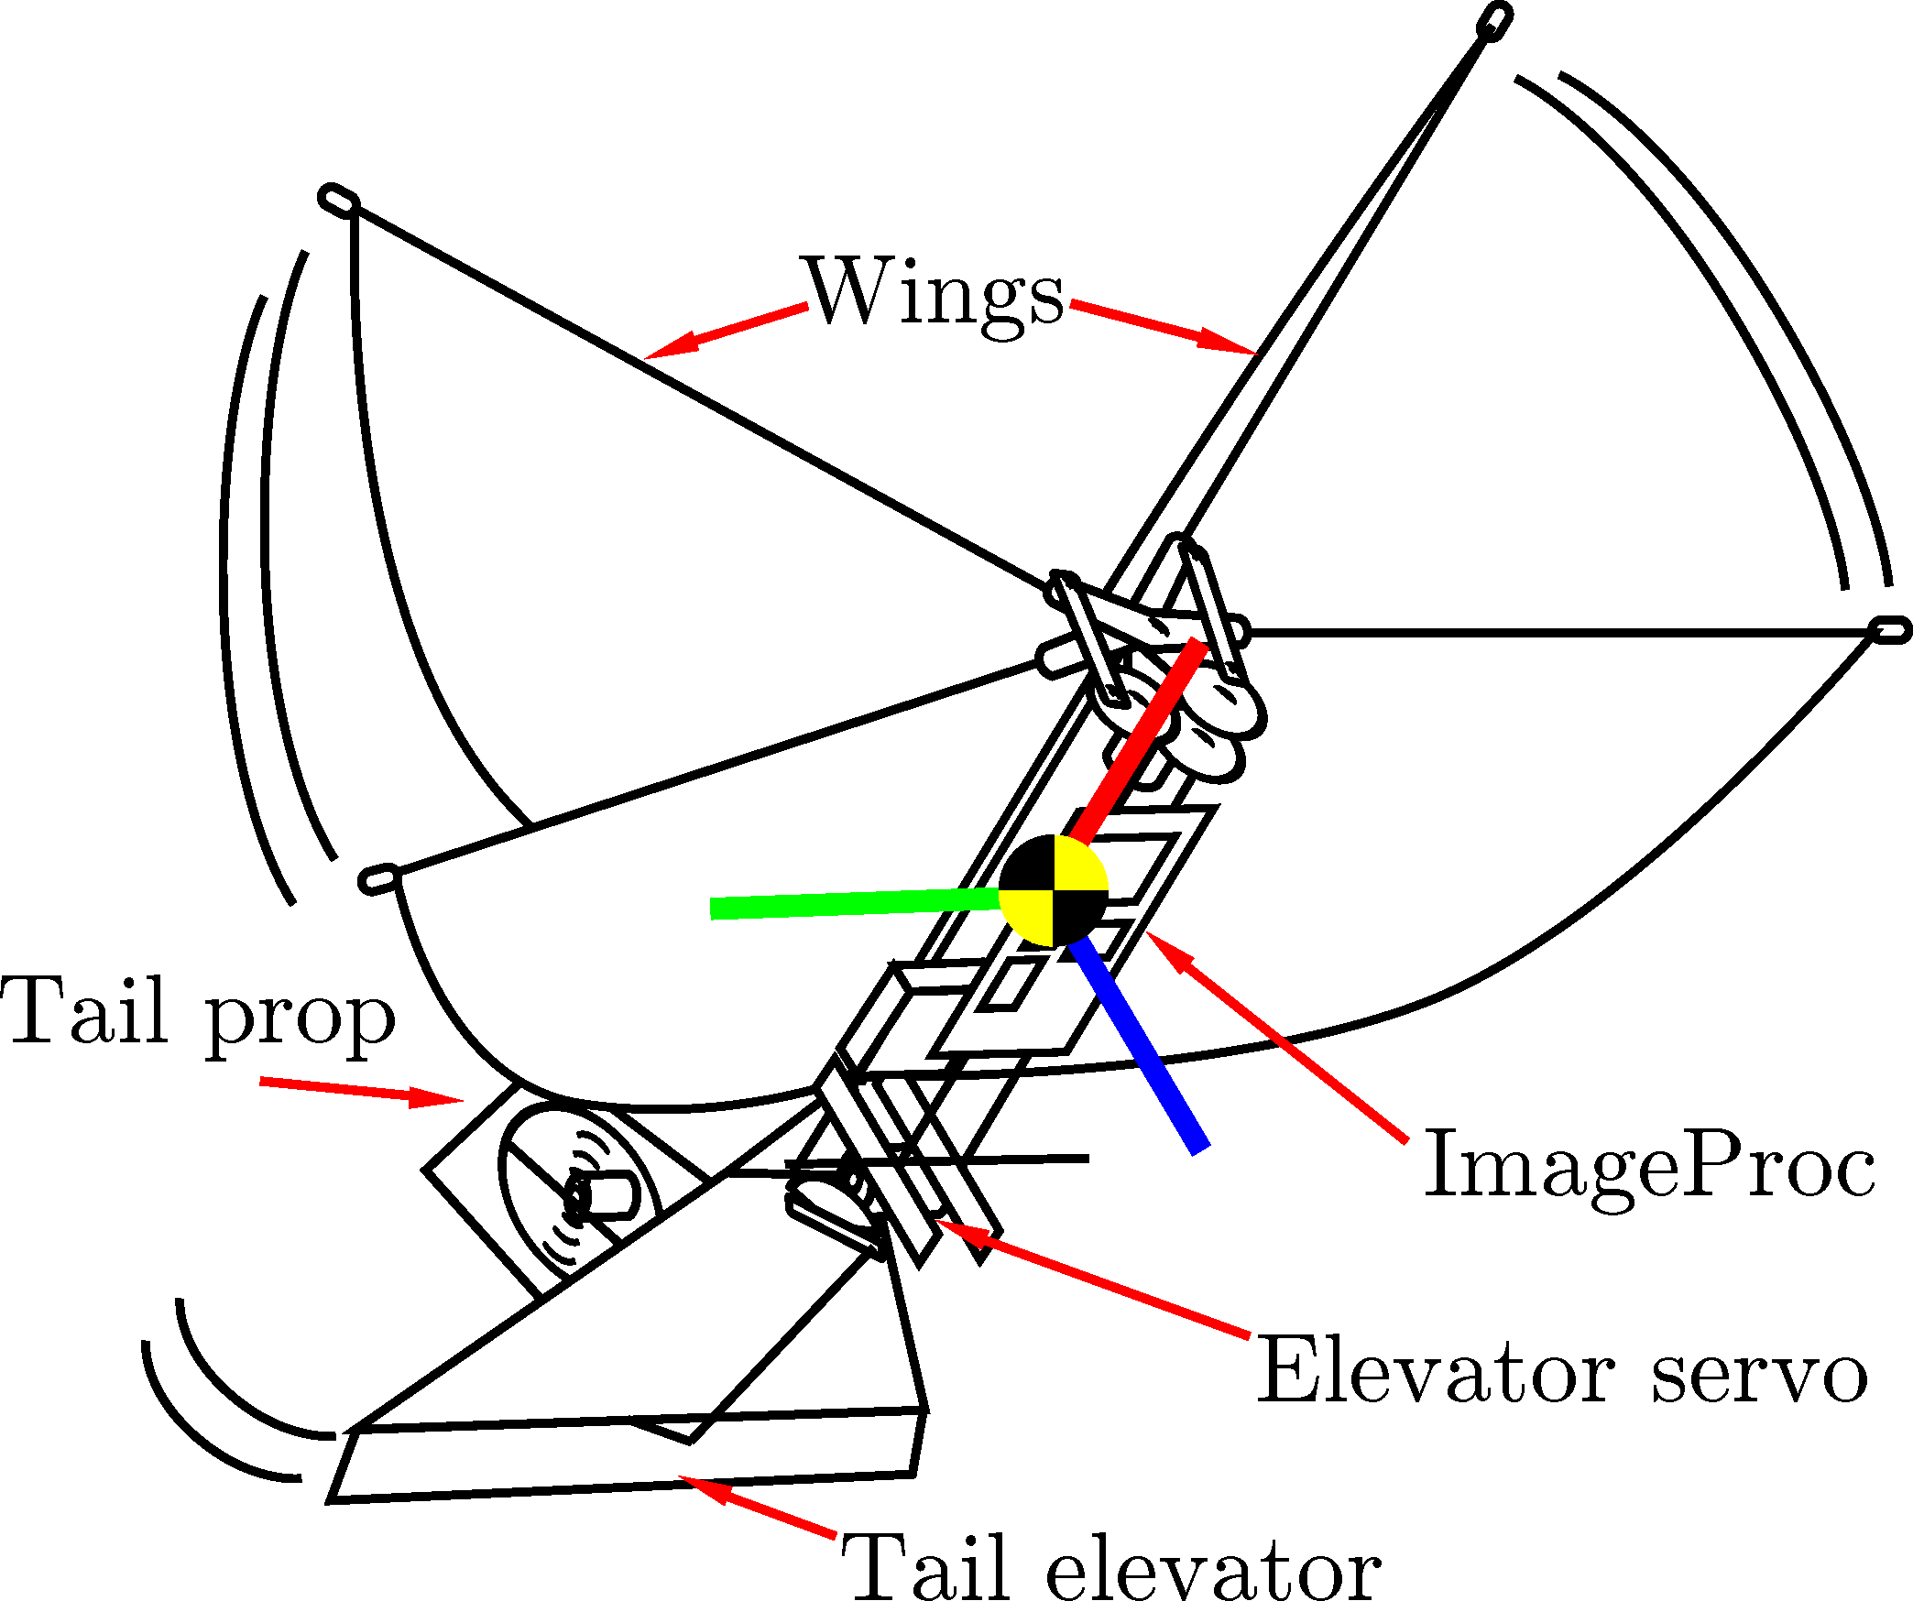

Slide 7
Outline
Motivation
Hardware
Cooperative System
System Identification
Model Verification
Simulation result
Experimental verification
Future Applications

Slide 8
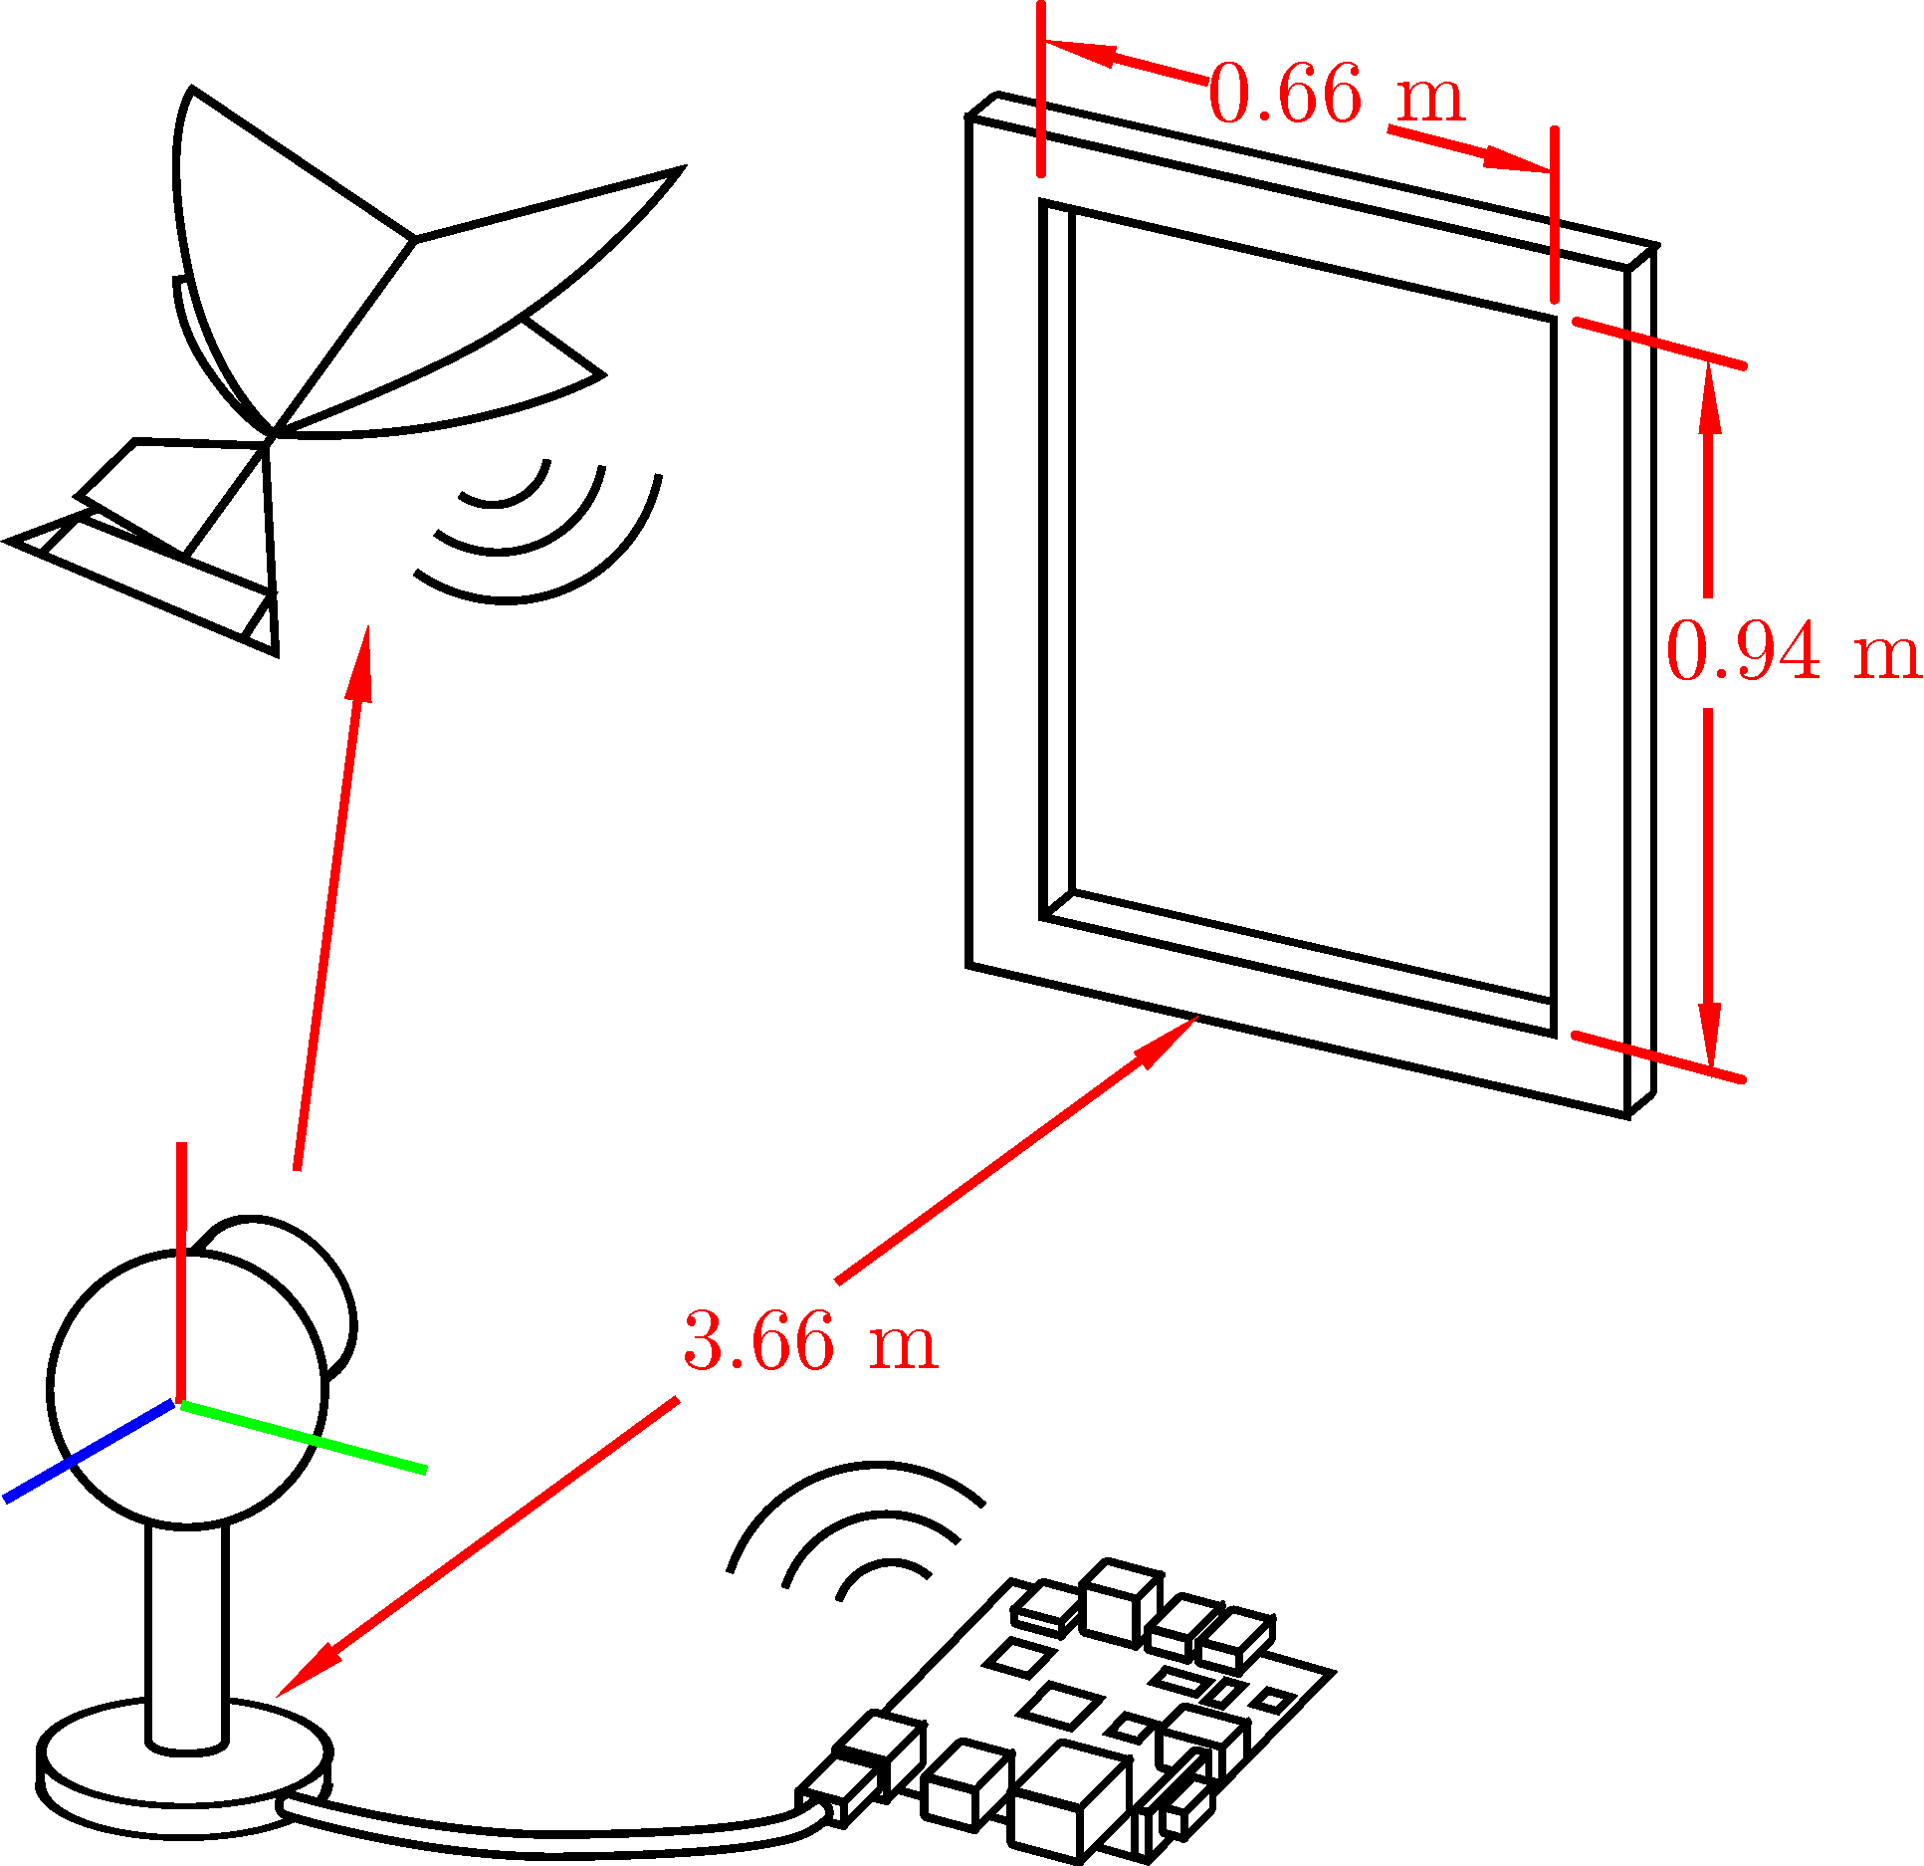

Slide 9
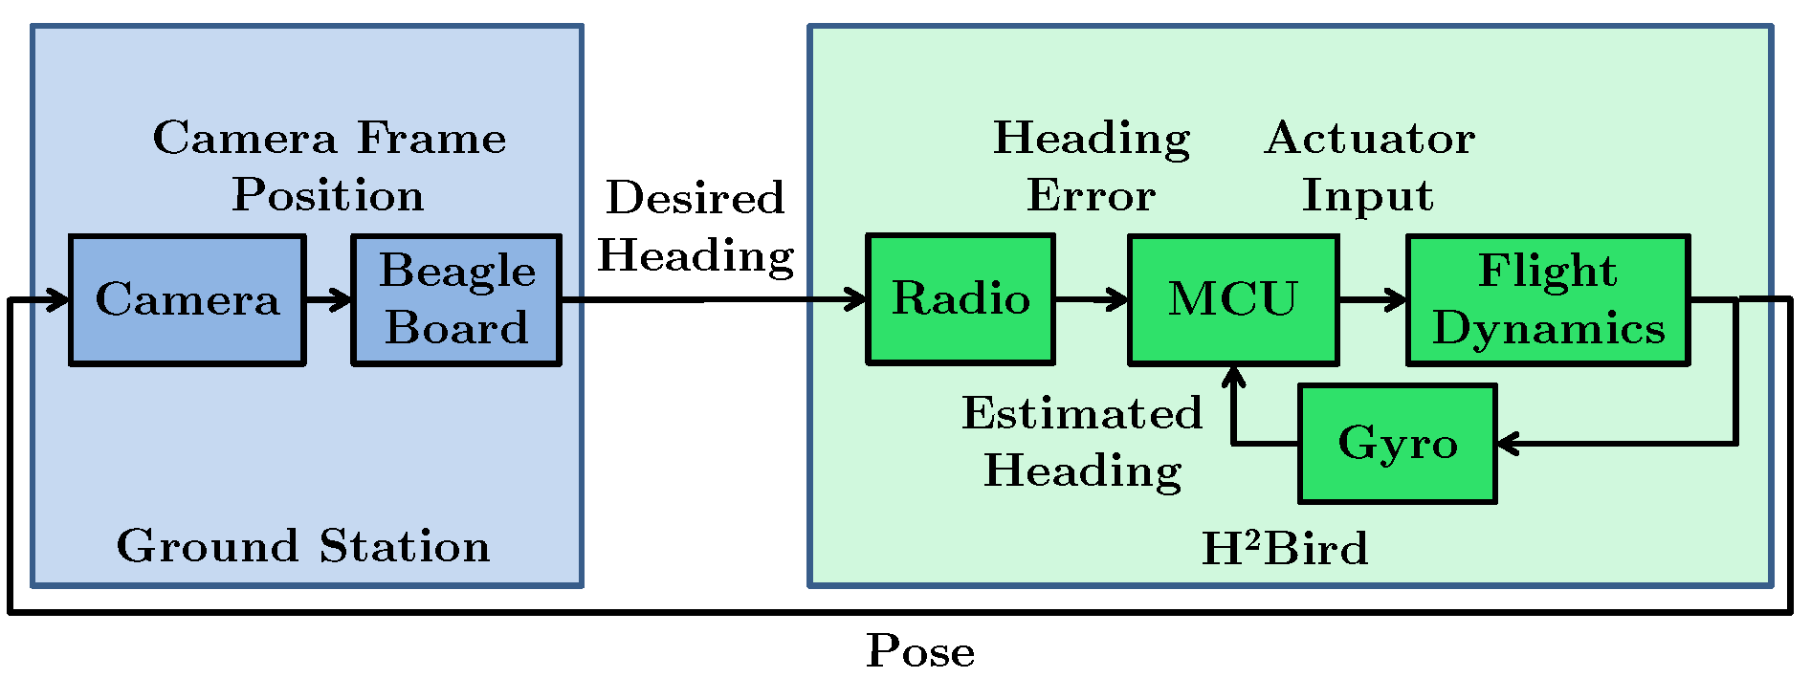

Slide 10
Outline
Motivation
Hardware
Cooperative System
System Identification
Model Verification
Simulation result
Experimental verification
Future Applications

Slide 11
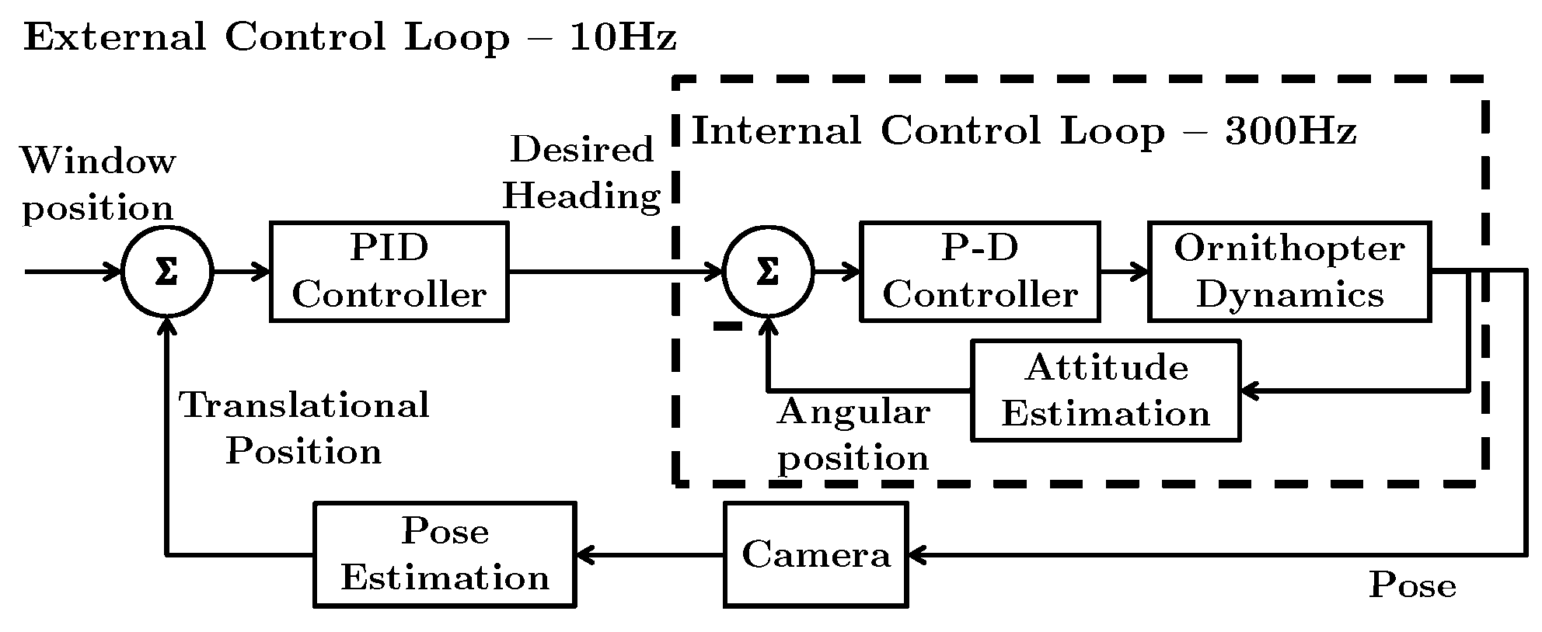

Slide 12
System Model

Slide 13
Outline
Motivation
Hardware
Cooperative System
System Identification
Model Verification
Simulation result
Experimental verification
Future Applications

Slide 14
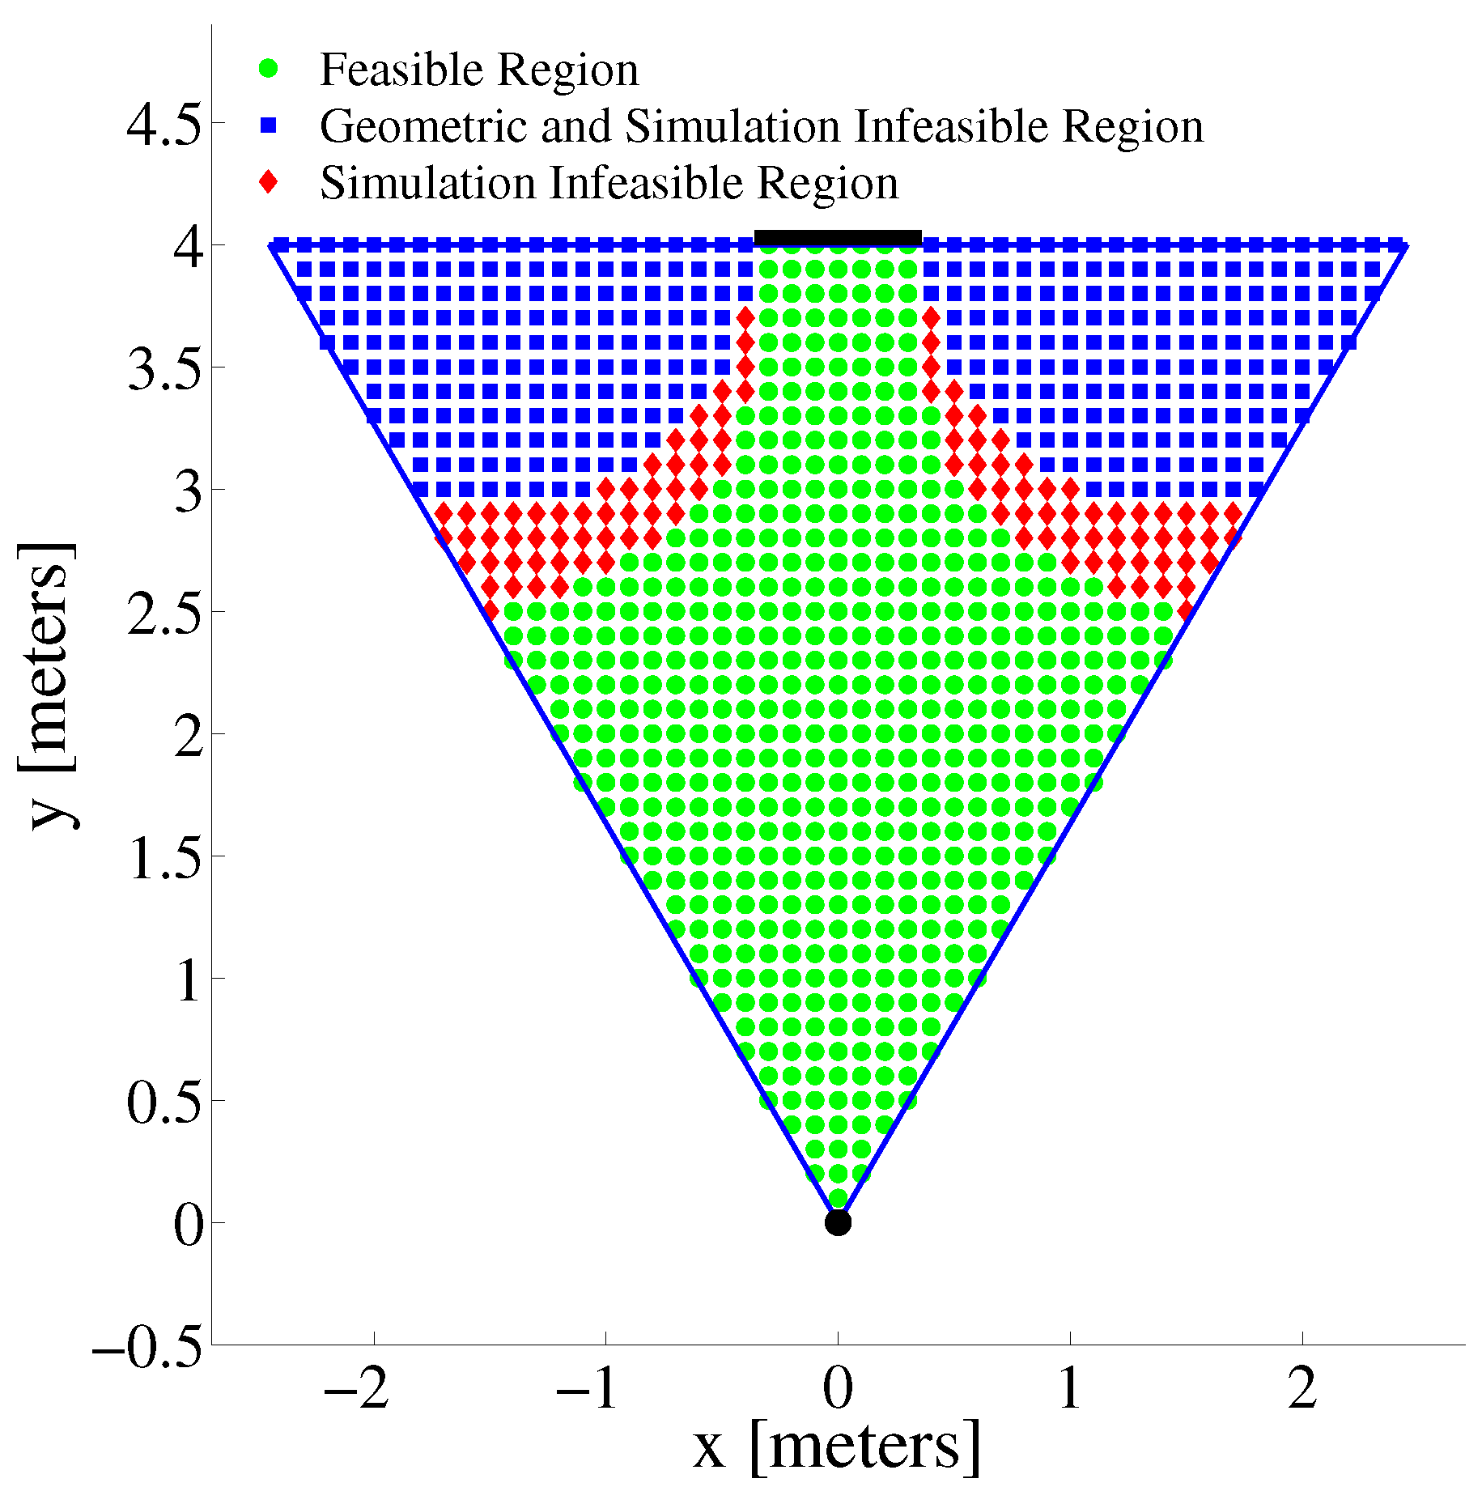
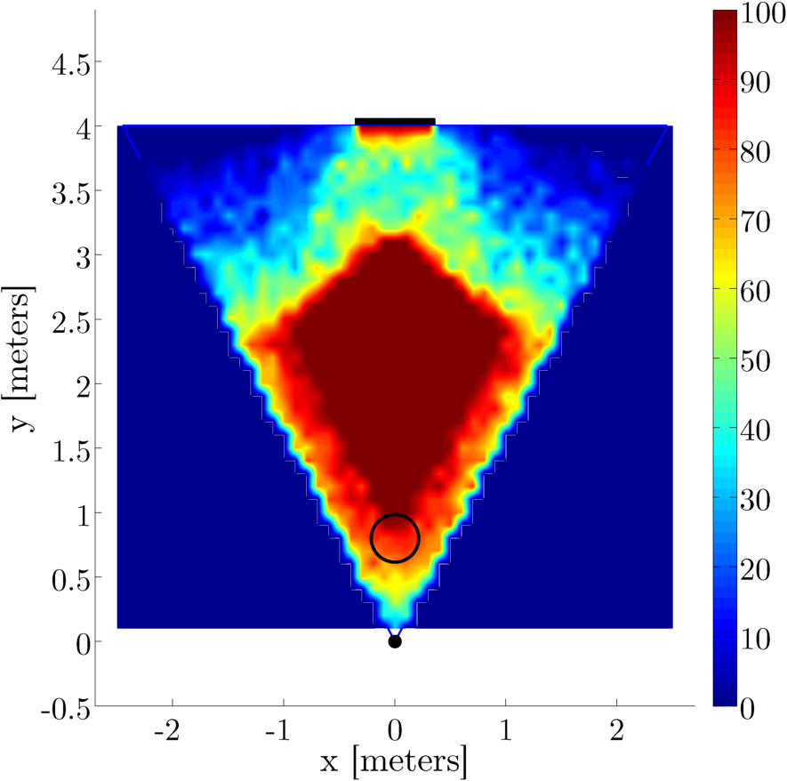
Model Predicted Feasible Regions

Slide 15
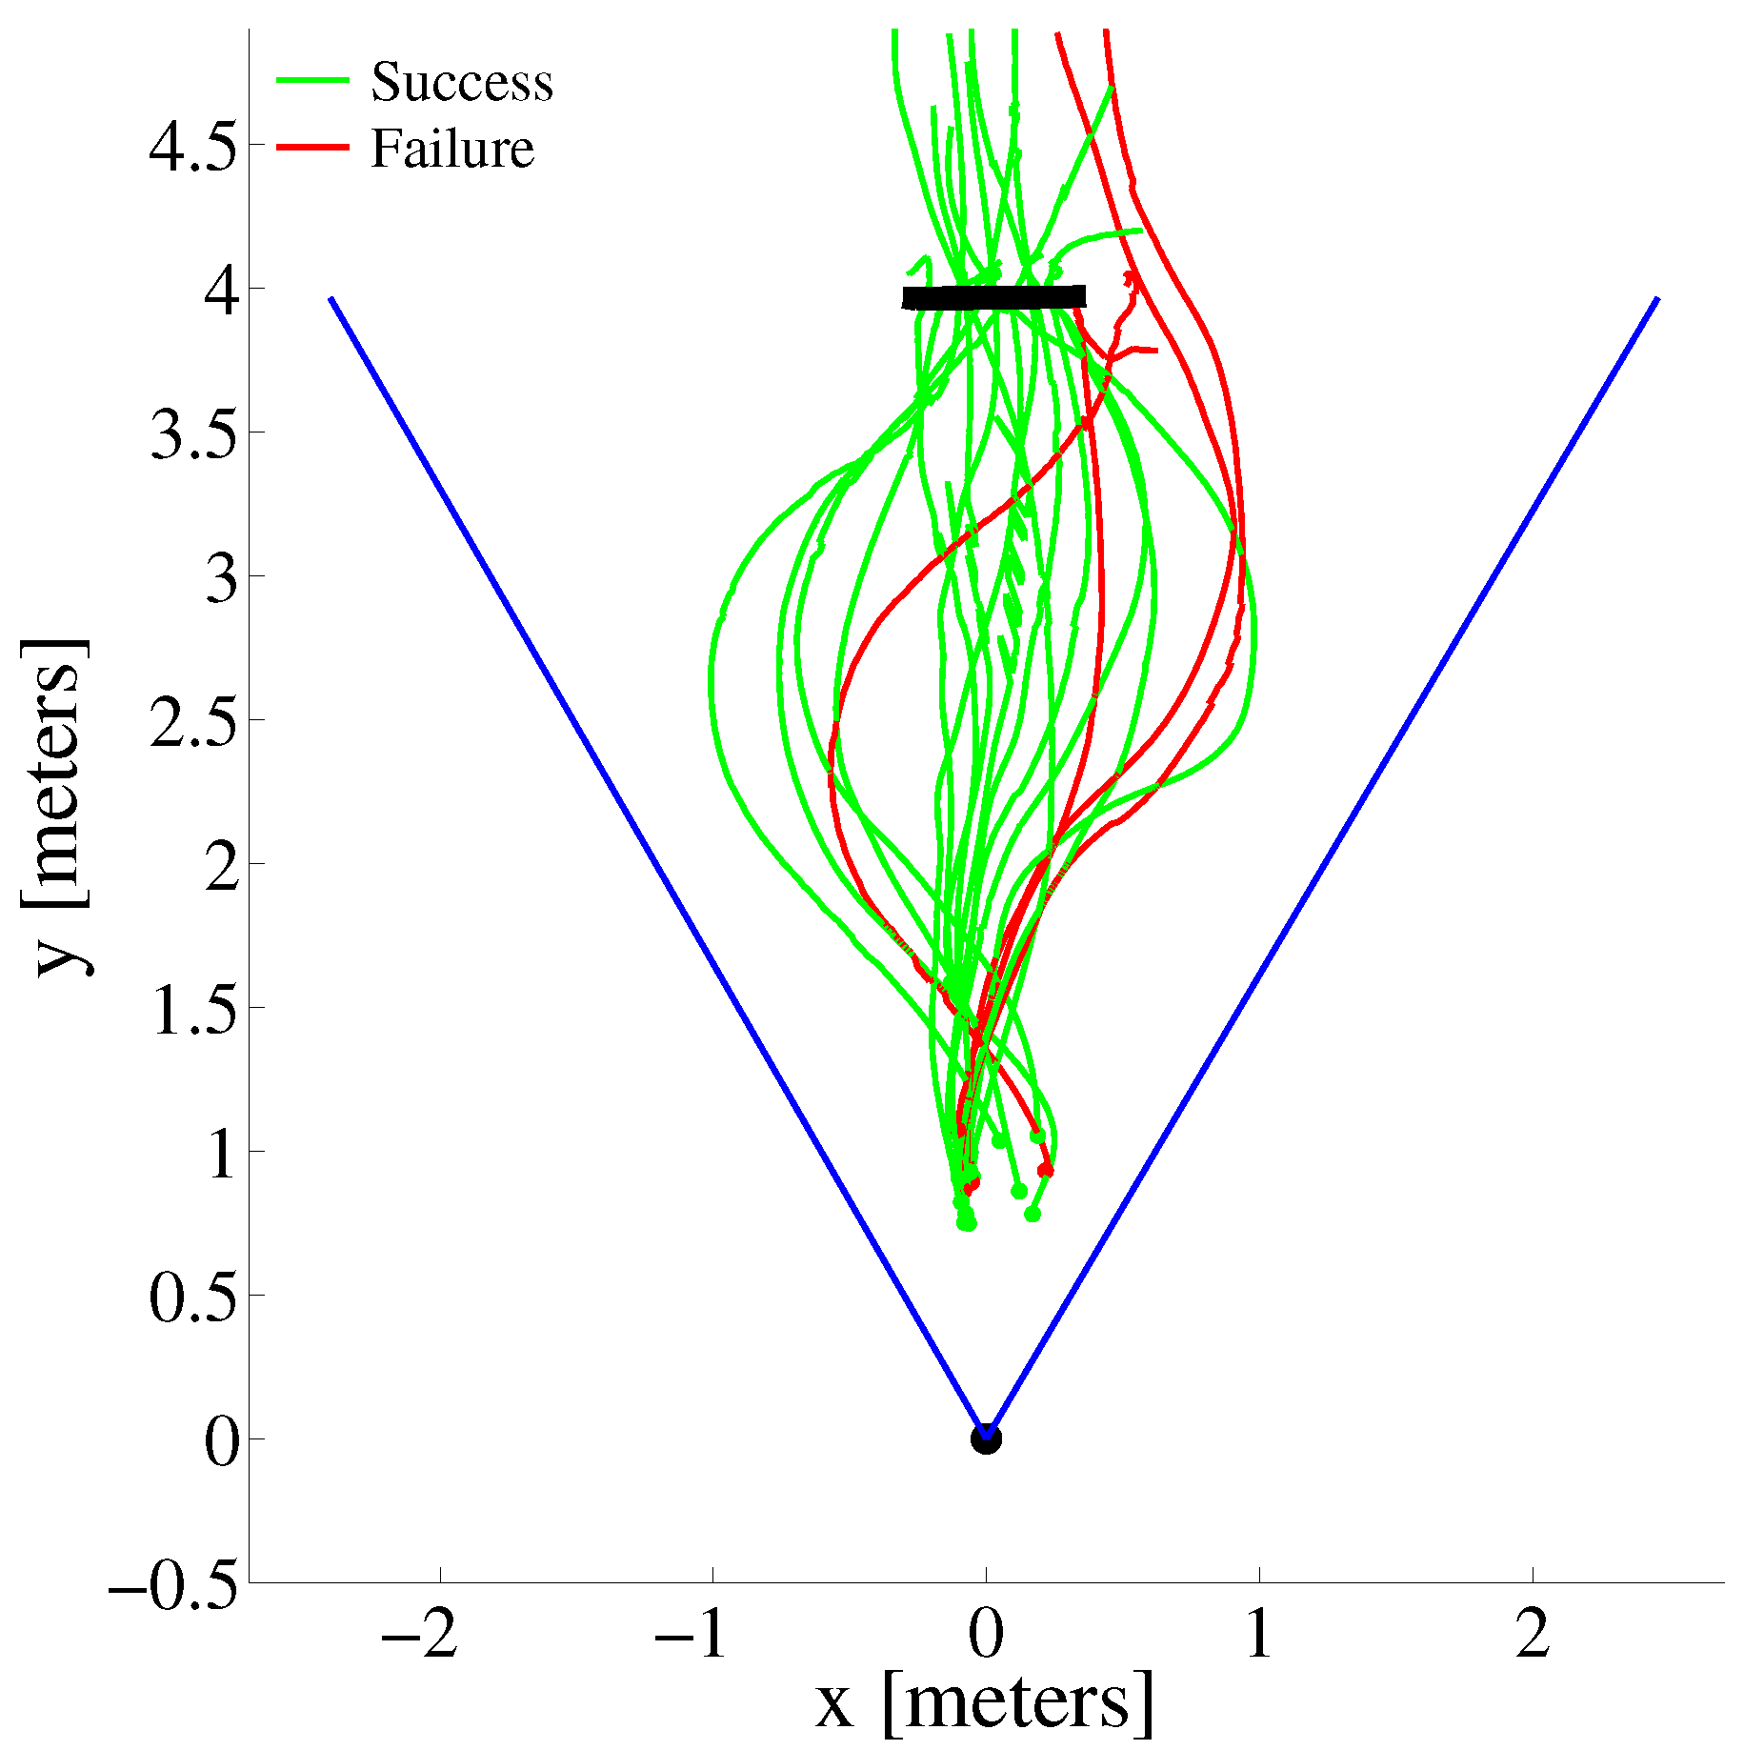
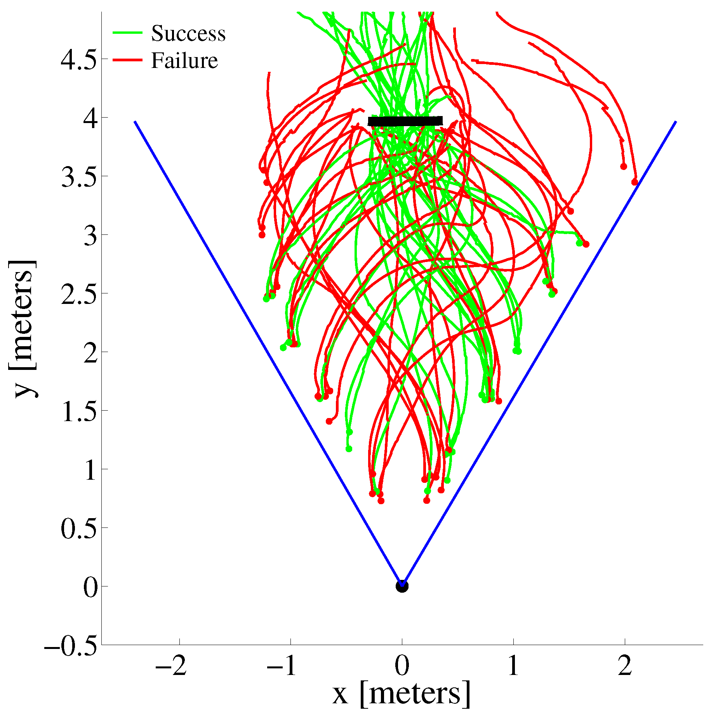
Experimental Results

Slide 16
Outline
Motivation
Hardware
Cooperative System
System Identification
Model Verification
Simulation result
Experimental verification
Future Applications

