Slide 1
Cooperative Control and Modeling for Narrow Passage Traversal with an Ornithopter MAV and Lightweight Ground Station

Slide 2
Outline
Motivation
Hardware
Cooperative System
System Identification
Model Verification
Simulation result
Experimental verification
Future Applications

Slide 3
Outline
Motivation
Hardware
Cooperative System
System Identification
Model Verification
Simulation result
Experimental verification
Future Applications

Slide 4
Motivation
Mobile robotics platforms can be limited in capabilities at small scales
Cooperation between these systems can allow for completion of objectives that are infeasible for the robots individually

Slide 5
Goal
Demonstrate the feasibility of cooperation between limited mobile robots to achieve a common goal
Weight limitations
Computational limitations
Sensor limitations

Slide 6
Outline
Motivation
Hardware
Cooperative System
System Identification
Model Verification
Simulation result
Experimental verification
Future Applications

Slide 7
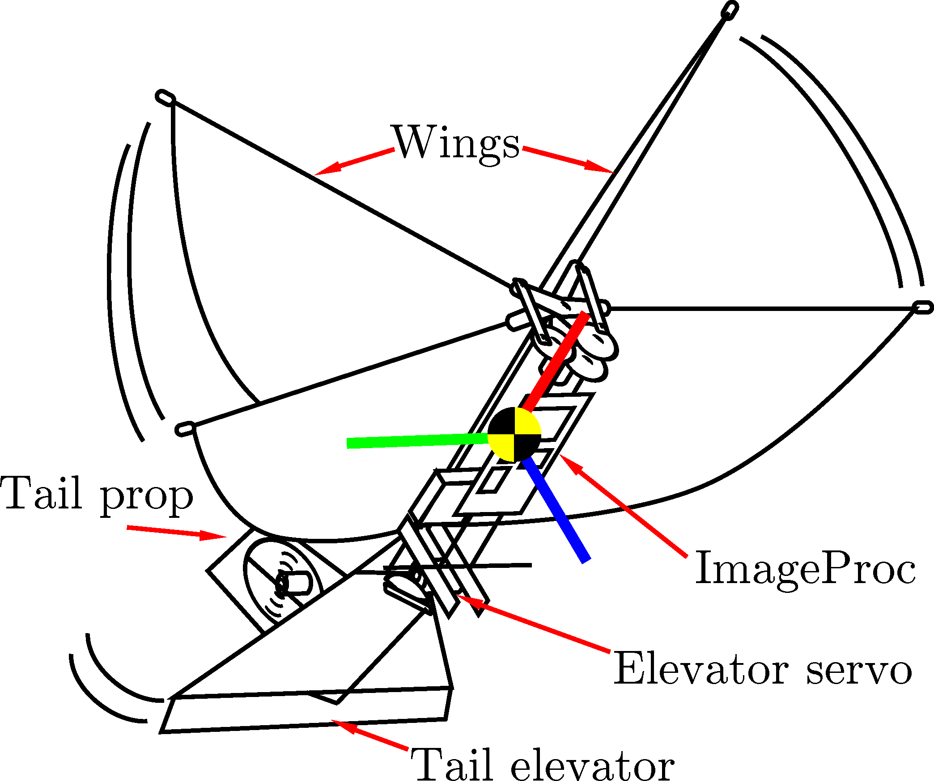
MAV Platform
Built around Silverlit i-Bird RC flyer power train
Tail propellor and servo-controlled elevator for yaw and pitch control
ImageProc 2.4 controller
40 MIPS microprocessor
6 DOF IMU
IEEE 820.15.4 radio
Motor drivers

Slide 8
Ground Station Platform
ARM-based BeagleBoard
<10g
Off-the-shelf USB web camera
Communicates with IEEE 802.15.4 USB radio module

Slide 9
Outline
Motivation
Hardware
Cooperative System
System Identification
Model Verification
Simulation result
Experimental verification
Future Applications

Slide 10
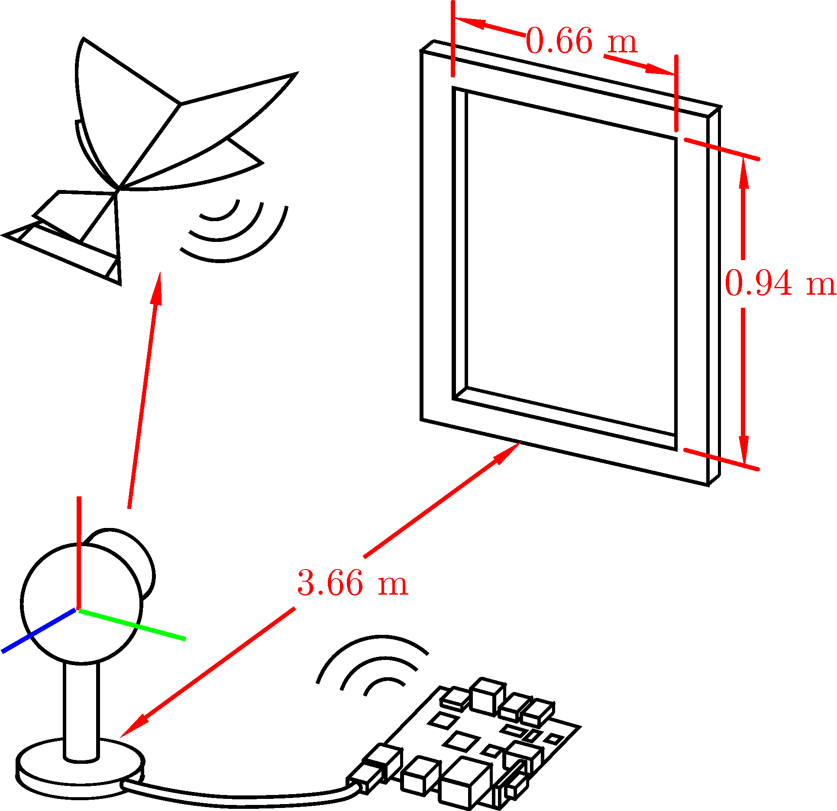
Experimental Setup

Slide 11
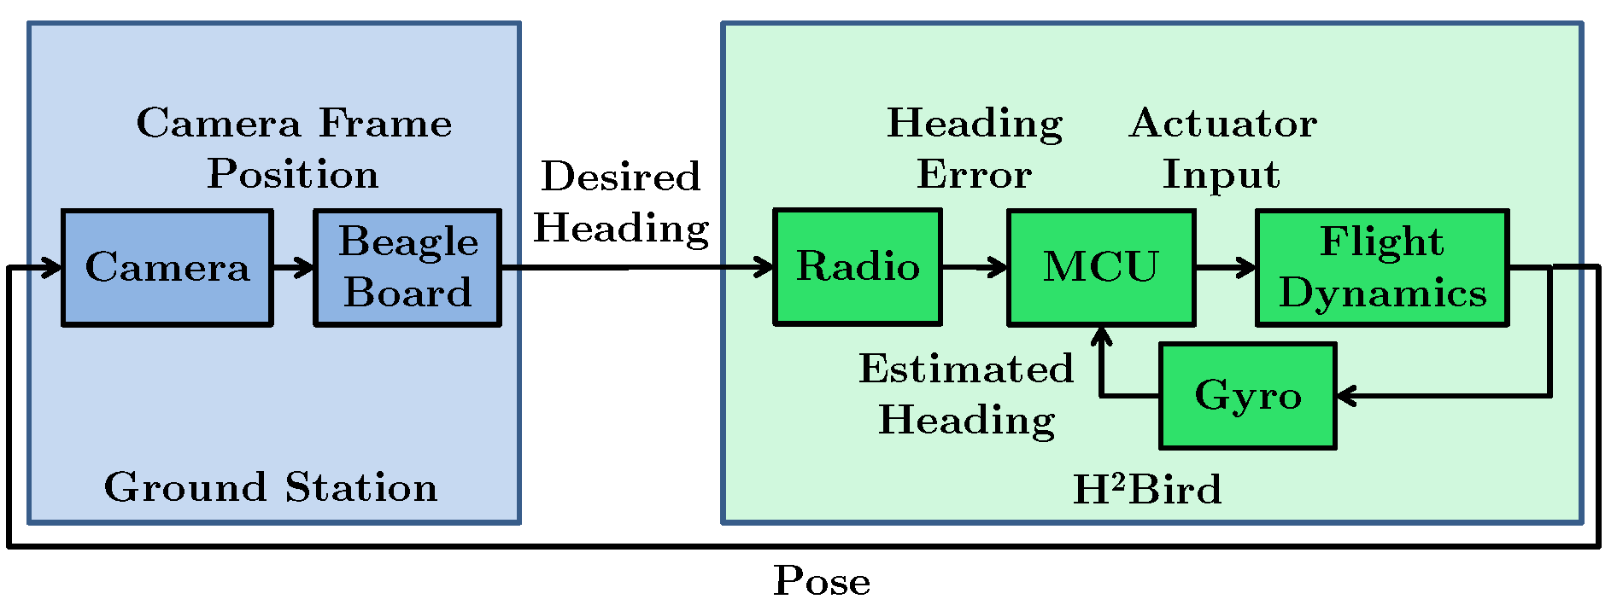
Top Level Hardware Interaction

Slide 12
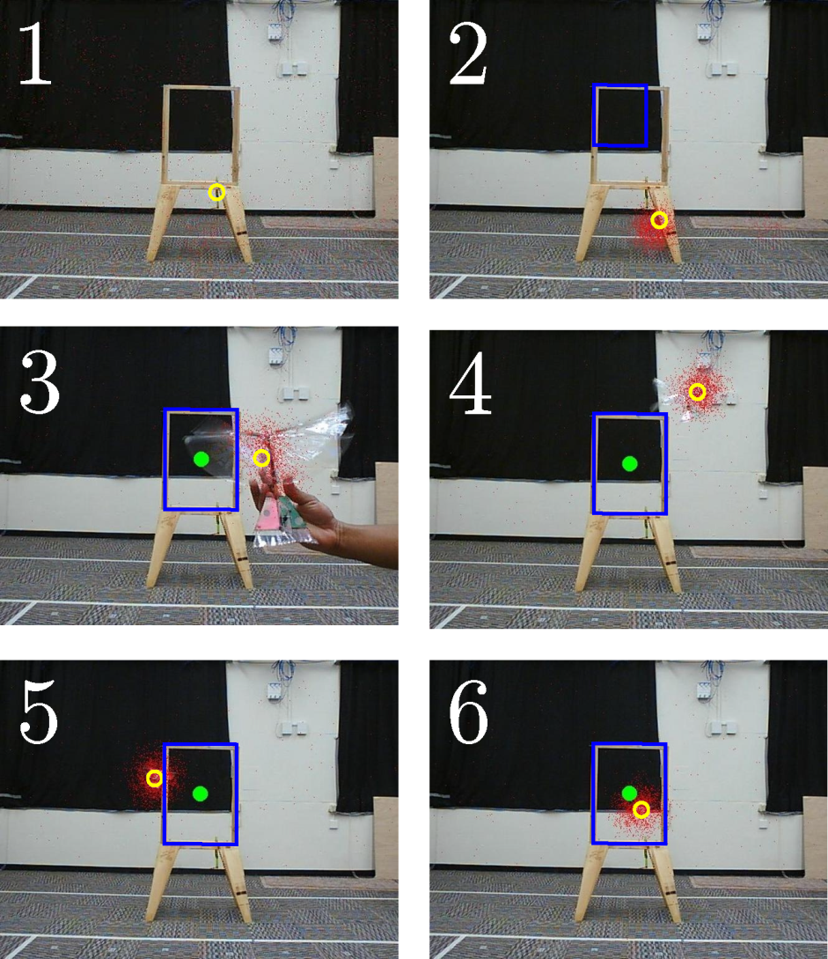
Tracking

Slide 13
Outline
Motivation
Hardware
Cooperative System
System Identification
Model Verification
Simulation result
Experimental verification
Future Applications

Slide 14
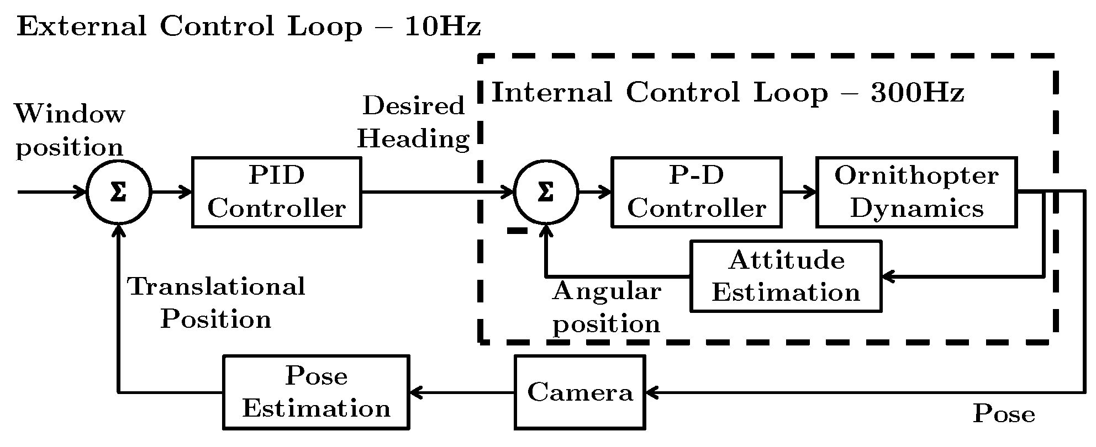
Software Control Loop

Slide 15
System Model

Slide 16
Outline
Motivation
Hardware
Cooperative System
System Identification
Model Verification
Simulation result
Experimental verification
Future Applications

Slide 17
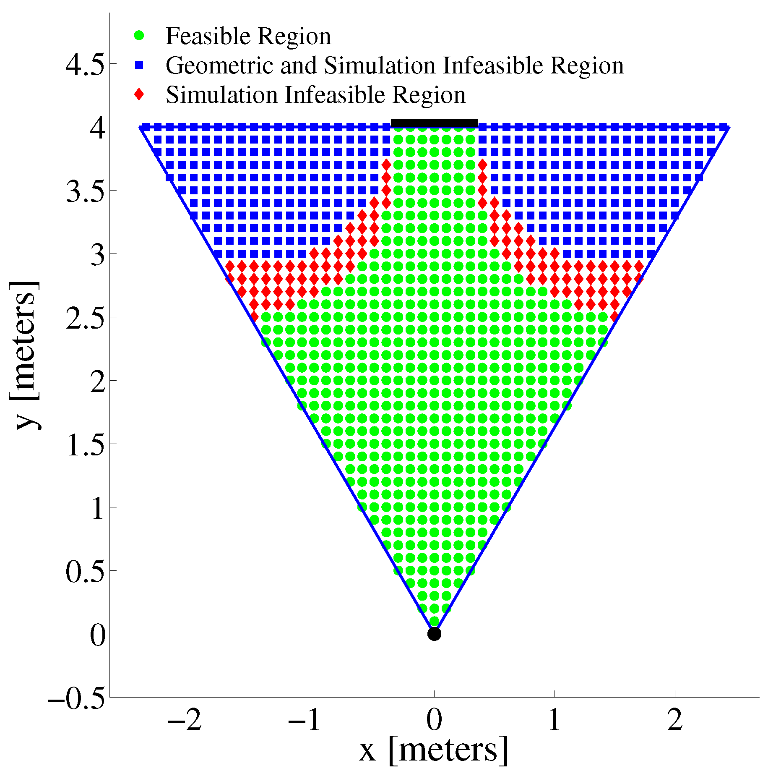
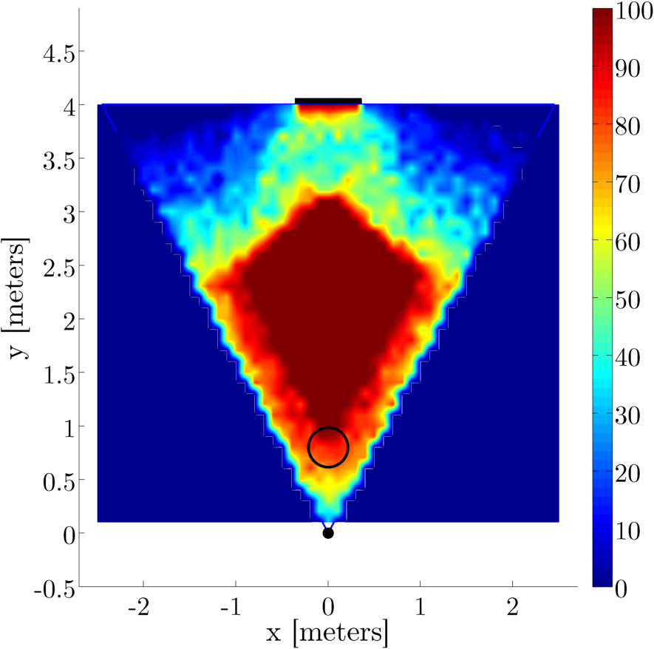
Model Predicted Feasible Regions

Slide 18
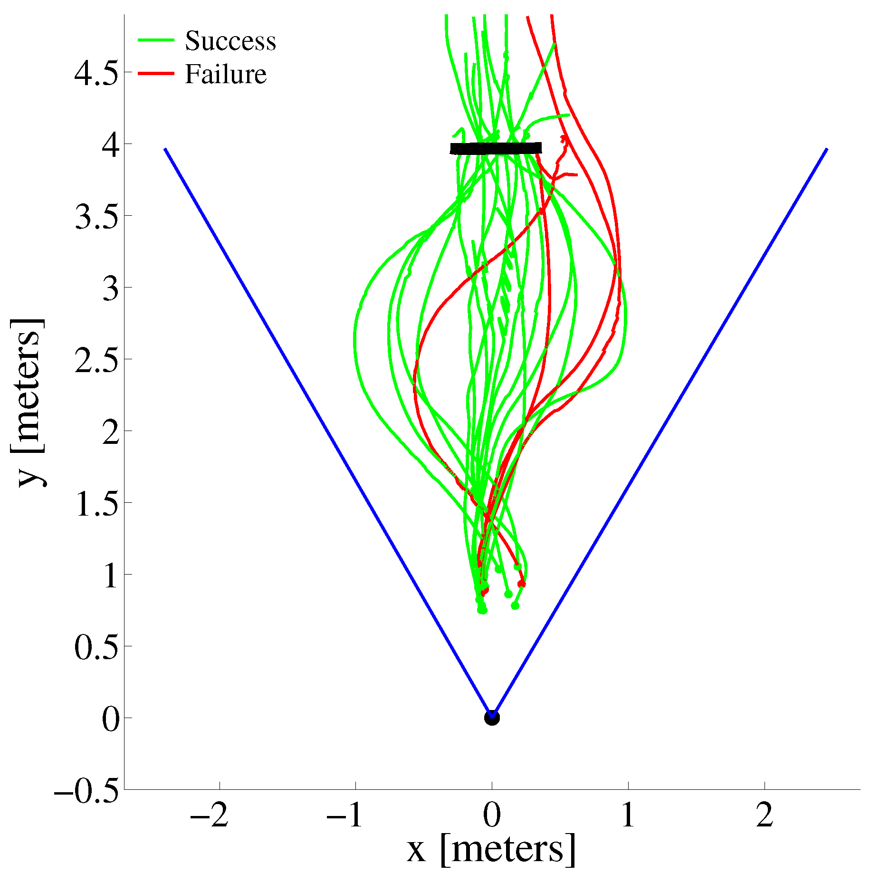
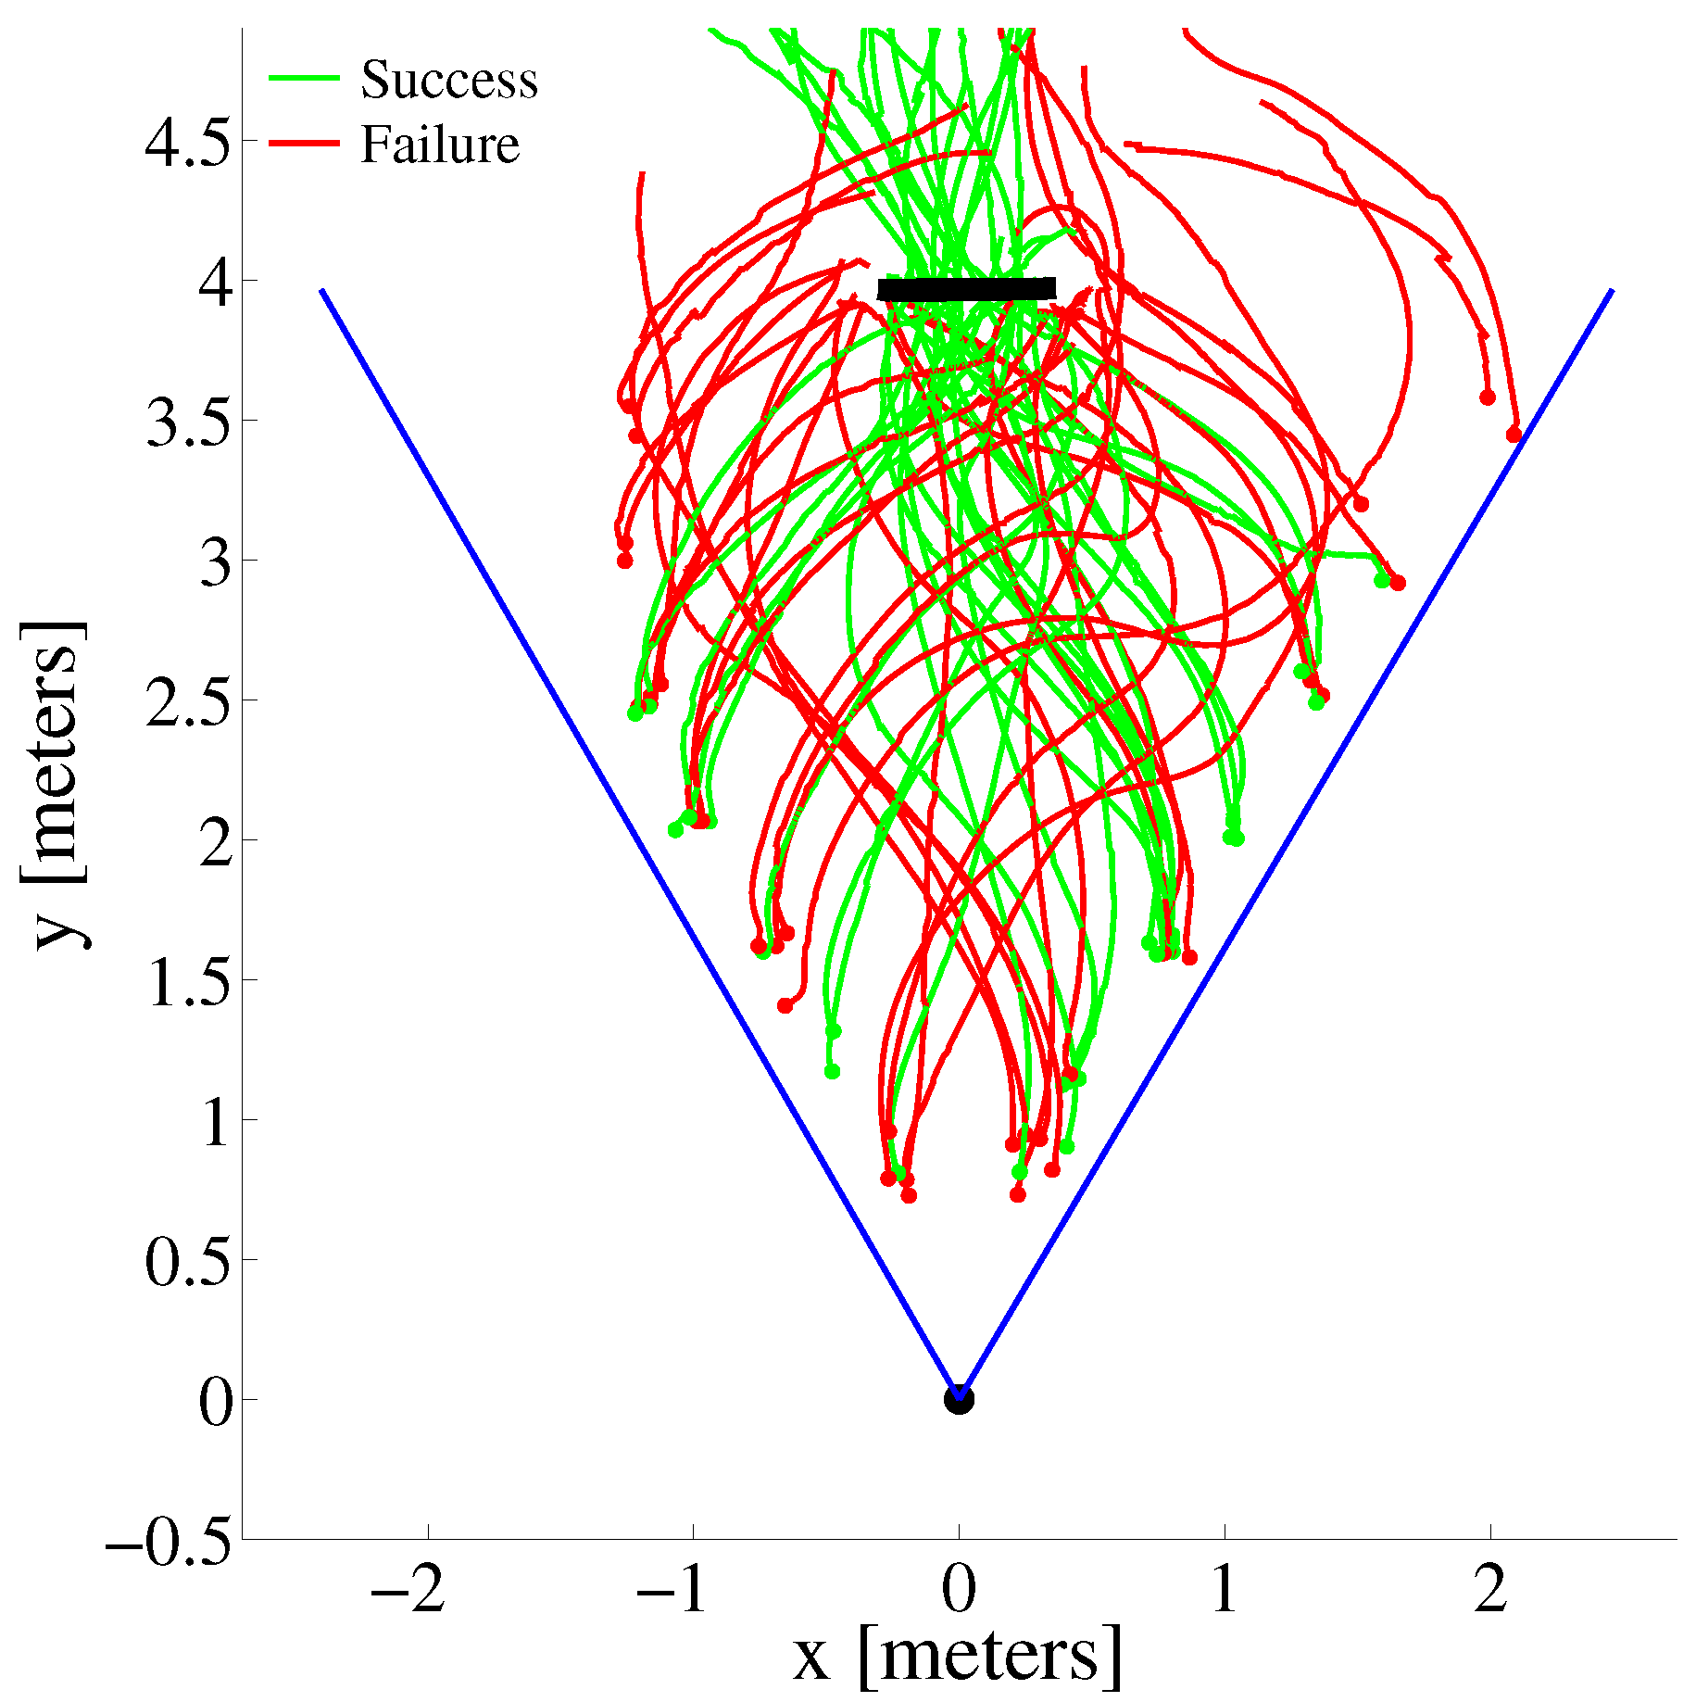
Experimental Results

Slide 19
Conclusions

Slide 20
Outline
Motivation
Hardware
Cooperative System
System Identification
Model Verification
Simulation result
Experimental verification
Future Applications

Slide 21
Discussion of limitations of current implementation
Talk about VLR and multi-view localization method

Slide 22
Acknowledgements

Slide 23
References

