Slide 1
Efficient Parallel Algorithm for Computing the Closeness Centrality in Social Networks
By Ryan Wenham

Slide 2
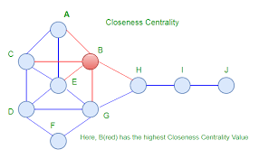
What is Closeness Centrality ?
Closeness Centrality is the metric use for large scale analysis across social networks like Facebook. and determining the distance between different nodes (users).

Slide 3
What is the Paper About ?
In this paper the authors create a new algorithm that executes this Closeness Centrality using a Breadth first search method and executing it in parallel with global queues and maps for all the threads.
They compare the normal methods NetworKit and Teex versus their algorithm called Big Graph.

Slide 4
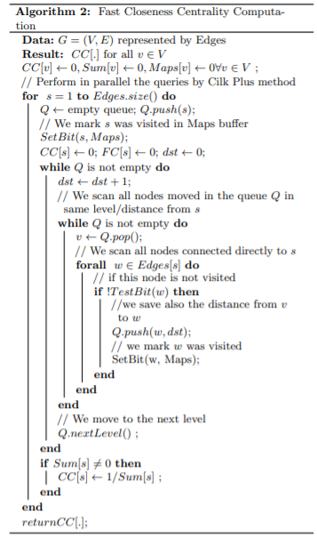
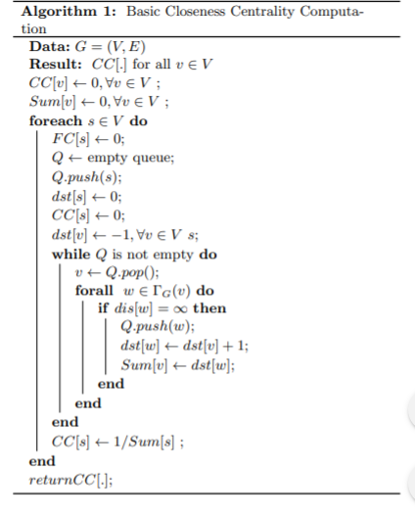
Comparison of the Two Algorithms: NetworKit / Teex Big Graph

Slide 5
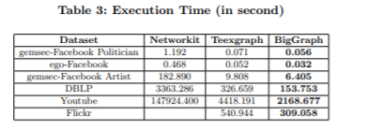
Test and Results
. To test and validity they ran five datasets of all different size, type of data, and what network. To analyze the speed, they ran with different number of parallel threads, varied from 1 to 36 threads. They did this ten times for each data set. From the test they collected the BigGraph execution time and speed up, and when compared toTeex it was 1.27-2.21 times faster and 14.78-68.21 faster than NetworKit.

Slide 6
How does this effect ?
From the report the data it showed the new idea clearly ran faster every single time but there was no report on how it effects the memory compared to the others which does leave questions on is it better. The paper showed that this algorithm could have an impact on our social networks, with the social media giants being able to compare and find data a lot faster that could benefit us.
Citation
Du, Phuong Hanh, et al. “An Efficient Parallel Algorithm for Computing the Closeness Centrality in Social Networks.” Proceedings of the Ninth International Symposium on Information and Communication Technology - SoICT 2018, 6 Dec. 2018, pp. 456–462., doi:10.1145/3287921.3287981.

