Slide 1

Impact of AI on Everyday Life
Ryan Zurich

Slide 2

Introduction
Artificial Intelligence was once the product of Science Fiction in movies. Now, it permeates everyday life through facets of communication, entertainment, transportation, and healthcare. AI shapes our routines and decisions behind the scenes. Artificial intelligence has brought about numerous benefits, including greater efficiency, convenience, and personalization. However, AI simultaneously raises concerns about privacy, fairness, and the power of automated decision-making. As the reach of AI expands, it becomes more important to consider both sides: the positives and negatives. The goal: maximize benefits to daily life and keep risks minimal

Slide 3
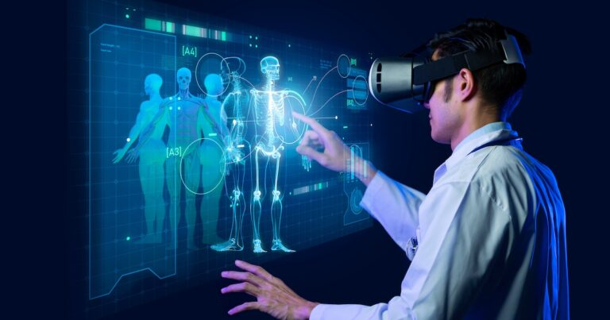
AI in Healthcare

Slide 4
How has AI Impacted Modern Healthcare?
Healthcare is rapidly changing due to AI. Algorithms analyze medical images, sometimes identifying concerns faster and more accurately than humans. Wearables collect health data and alert users and providers to issues, while chatbots facilitate symptom checks and patient intake. Despite these benefits, the use of AI in healthcare is not without risk. If AI systems are
trained on data that does not represent all populations, certain groups may receive less accurate diagnoses or lower-quality care. Additionally, while improving diagnostics, the collection and use of sensitive health information raise significant privacy and data security concerns.

Slide 5
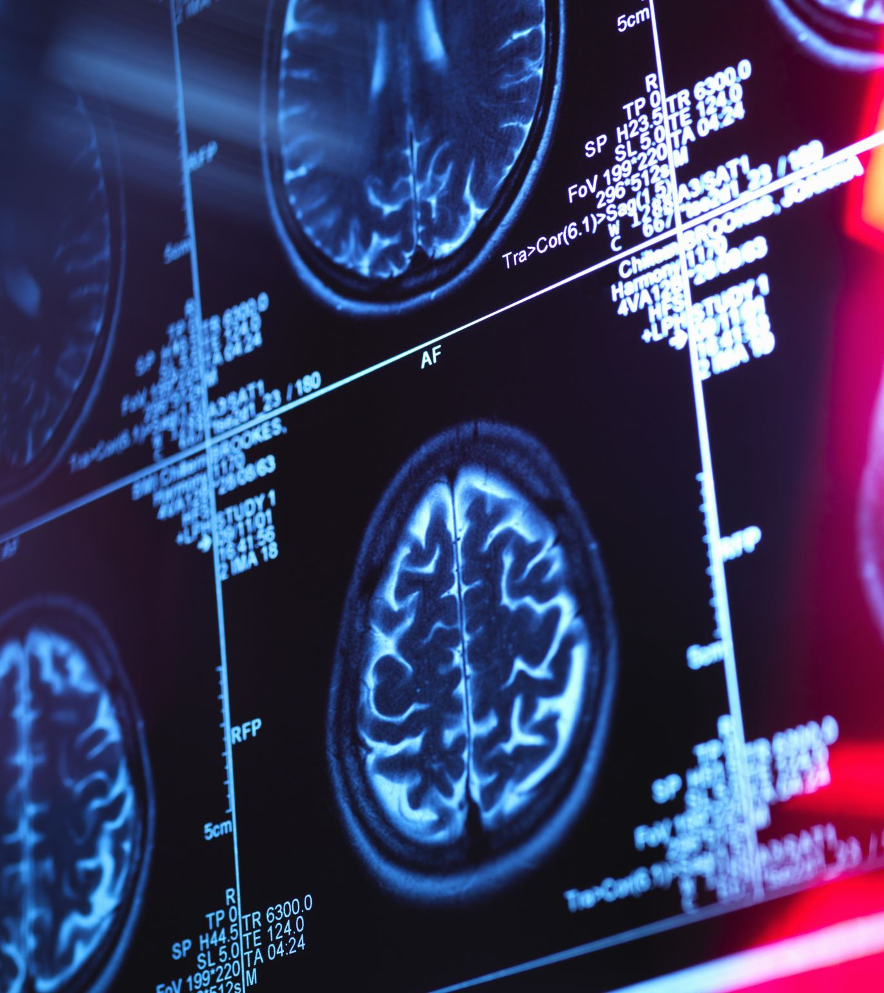
How has AI Impacted Modern Healthcare?
AI automates administrative and diagnostic tasks, reducing repetitive work for healthcare staff. This shift affects employment and healthcare roles.
Walk into a modern hospital, and chances are, AI is working in the background. X-rays and MRIs get scanned by computers looking for trouble spots faster than most doctors can. Wrist health trackers send warnings if something seems off. Even chatbots help people describe symptoms and decide whether it’s time to see a real doctor

Slide 6
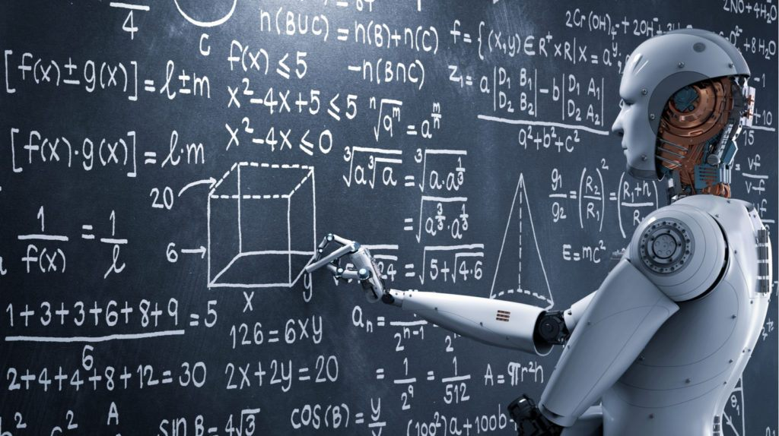
AI in Education

Slide 7
How has AI changed how we educate?
In modern society, AI has allowed for higher levels of personalized learning, adaptive assessment, and intelligent tutoring. But has AI truly improved how students learn in schools? Tools such as AI tutors and automated feedback systems can serve as tools for research to help our students improve upon their studies. However, there also lies the risk of students relying on Chatbots far too much in the modern world. Future research must find ways to address these potential flaws with AI in our educational system. However, there are quite a number of ways AI has been infinitely beneficial within our education system.

Slide 8
How has AI changed how we Educate?
Physics-STAR, an AI tutoring framework that provides step-by-step guidance for newer physics learners. In recent years, a study has shown proof of a controlled pilot showing improvement in his comprehension and efficiency when compared with generic instruction through lecture. Through using this AI program, this student was more proficient in his studies than a normal class lecture would have allowed him to be. Physics-STAR concentrates on fostering deep understanding through guided questioning and reflective-based tasks rather than only providing answers. Physic-STAR is especially unique because it presents a system of AI that has improved the ability of numerous pilots, which is likely only the tip of the iceberg regarding how AI will impact education in the coming years. These instructional tools could very well change how we learn in all facets of life in the near future. We will begin to see more tutoring software such as these within the next ten years in all schools.

Slide 9
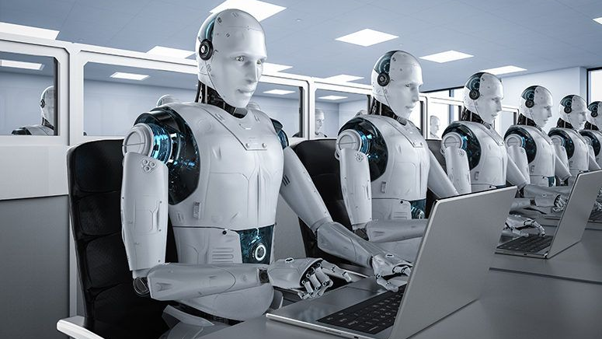
AI in the Work Force

Slide 10
How has AI Impacted Modern Employment?
In the modern day, there are many concerns regarding how Artificial Intelligence will impact our workforce and leave people out of jobs. However, there are many studies proving that while certain occupations are potentially at risk due to AI automation, the collective labor market has shown resilience thus far. AI's effects appear to be uneven: some workers gain wage premiums through the skills they attain through AI usage while others face potential job loss. In other words, many workers are actually positively impacted by the introduction of Artificial Intelligence in their field of work. Simultaneously, studies have shown that AI must be implemented into the work force strategically to ensure the benefits of AI in the work force are inclusive in order for individuals to keep their jobs. AI should benefit us, not take us out of a job. While this is a general fear of many, AI has currently not cause the US job market to suffer significant damage.

Slide 11
How has AI Impacted Modern Employment
A study from Brookings Institution explains recent research that shows how generative AI has not, to date, cost the US jobs in any significant manner. While AI is actively changing how many occupations operate, the evidence points to a gradual transformation of these occupations rather than them simply disappearing. The conclusion this article ultimately comes to is that how the job market is impacted by AI will depend on how it's integrated, who is investing in development, and government policy. Brookings provides a resource here that calms the winds cautioning against alarmist predictions regarding AI that lack long-term data. In other words, fear of job loss due to AI is just that, fear. There is currently a lack of data to fuel that fear.

Slide 12
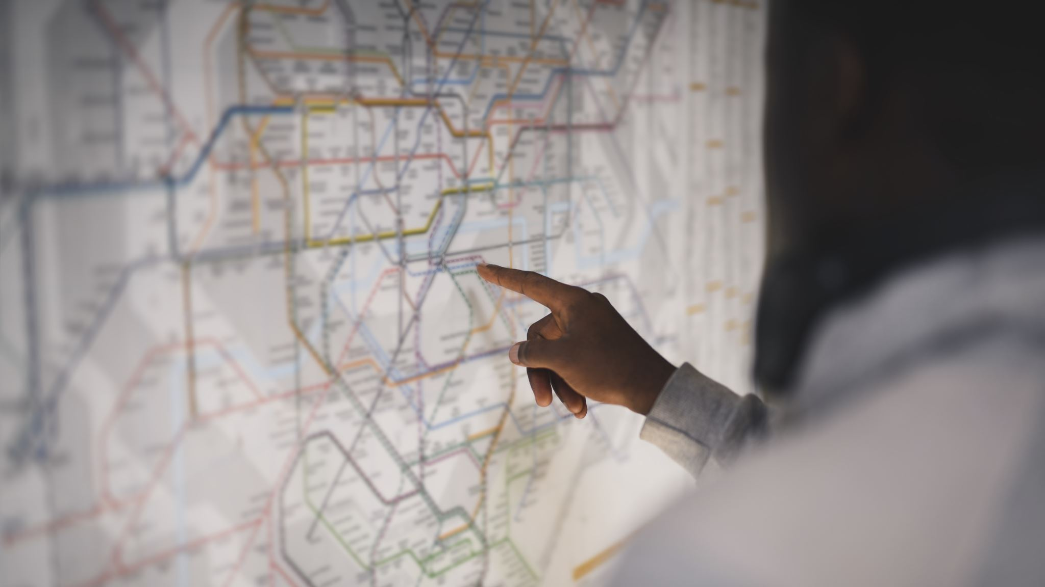
AI and Traveling

Slide 13

How has AI Impacted Modern Travel?
AI is often used in navigation apps, such as Google Maps and Waze, to analyze traffic data in real time. These solutions maximize mobility in crowded regions and enhance commuter experience.
One of the most advanced uses of AI in the modern world is in self-driving cars. These systems traverse roadways with minimal human assistance and use data about roadways to navigate crowded areas. Although fully driverless cars aren't yet common, safety features such as lane-keep assist bring cars to a semi-autonomous state.
Hypothetically, self-driving cars would create quite a dilemma. Who will be accountable if these vehicles are involved in collisions? As of now, the answer is unclear.

Slide 14
How has AI Impacted Modern Travel?
Beyond just transportation, AI helps refine city infrastructure in numerous ways. AI has the potential to manage garbage disposal, forecast public transportation demand, coordinate emergency responses, and optimize traffic signals. Machine learning systems enhance the quality of life and sustainability of urban communities.
Emergency response teams now use AI tools to analyze 911 call patterns, traffic data, and location information so they can send help faster and more effectively. In traffic management, machine-learning systems look at road conditions, signal timing, and the behavior of drivers. These datasets are collected to improve traffic flow, cut commute times, and lower emissions. These technologies help make city life better and more sustainable by making daily services quicker, more efficient, and more responsive to what residents need.

Slide 15
Sources
Artificial intelligence, job quality and inclusiveness: OECD Employment Outlook 2023. (2023). OECD. https://www.oecd.org/en/publications/2023/07/oecd-employment-outlook-2023_904bcef3/full-report/artificial-intelligence-job-quality-and-inclusiveness_a713d0ad.html ‌ Kinder, M. (2025, October). New data show no AI jobs apocalypse—for now. Brookings. https://www.brookings.edu/articles/new-data-show-no-ai-jobs-apocalypse-for-now/ ‌ Wang, S., Wang, F., Zhu, Z., Wang, J., Tran, T., & Du, Z. (2024). Artificial intelligence in education: A systematic literature review. Expert Systems with Applications, 252, 124167–124167. https://doi.org/10.1016/j.eswa.2024.124167 ‌ Jiang, Z., & Jiang, M. (2024). Beyond Answers: Large Language Model-Powered Tutoring System in Physics Education for Deep Learning and Precise Understanding. ArXiv.org. https://arxiv.org/abs/2406.10934 ‌ Ratwani, R. M., Sutton, K., & Galarraga, J. E. (2024). Addressing AI Algorithmic Bias in Health Care. JAMA, 332(13), 1051–1051. https://doi.org/10.1001/jama.2024.13486 ‌ Angus, D. C., Khera, R., Lieu, T., Liu, V., Ahmad, F. S., Anderson, B., Bhavani, S. V., Bindman, A., Brennan, T., Celi, L. A., Chen, F., Cohen, I. G., Denniston, A., Desai, S., Embí, P., Faisal, A., Ferryman, K., Gerhart, J., Gross, M., & Hernandez-Boussard, T. (2025). AI, Health, and Health Care Today and Tomorrow. JAMA, 334(18), 1650. https://doi.org/10.1001/jama.2025.18490 ‌ New. (2019). Tech, AI Transforming the Workplace. New Jersey Business Magazine. https://njbmagazine.com/monthly-articles/tech-ai-transforming-the-workplace/ Johnson, A. (2019, February 6). 5 Ways AI Is Changing The Education Industry. ELearning Industry. https://elearningindustry.com/ai-is-changing-the-education-industry-5-ways ‌ Singh, A. (2023, March 22). How AI Is Transforming Day-To-Day Healthcare. Successive Cloud. https://successive.cloud/artificial-intelligence-in-healthcare/ Veljko Dubljevic, List, G., Milojevich, J., Ajmeri, N., Bauer, W. A., Singh, M. P., Bardaka, E., Birkland, T. A., Charles, Mayer, R. C., Muntean, I., Powers, T. M., Rakha, H. A., Ricks, V. A., & M. Shoaib Samandar. (2021). Toward a rational and ethical sociotechnical system of autonomous vehicles: A novel application of multi-criteria decision analysis. PLoS ONE, 16(8), e0256224–e0256224. https://doi.org/10.1371/journal.pone.0256224 ‌ ‌

