Slide 1
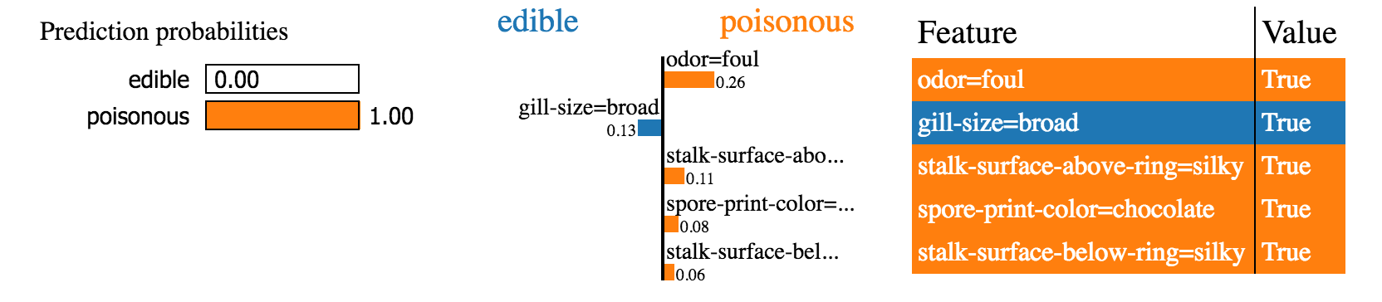
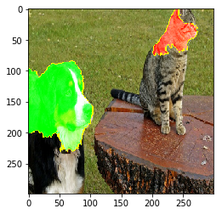
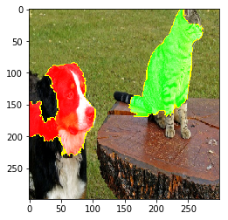
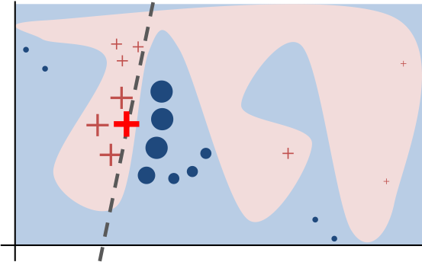
ENHANCING TRUST IN MACHINE LEARNING: INTERPRETING MACHINE LEARNING MODELS USING PYTHON'S LIME PACKAGE
Ryan Nazareth | ryankarlos@gmail.com | @rkn08
INTRODUCTION
Machine learning models are widely recognised as 'black boxes' and interpretation of the results is becoming an increasingly important consideration to build trust in model outputs especially in the era of General Data Protection Regulation (GDPR). In addition, in certain applications like cancer detection, a single incorrect prediction can have a significant impact and being able to ‘verify’ the model is critical before deploying a model or carrying out an action based on a prediction. End users are more likely to trust the outputs of the 'black box' model predictions if they understand the reason why the predictions were made. Locally Interpretable Model-Agnostic Explanations (LIME) is a Python package that can explain the predictions of any classifier or regressor in a faithful way, by approximating it locally with an interpretable model. This poster will show how the steps for using the LIME package in Python to make a machine learning model more interpretable using a number of classifiers (e.g. Support Vector Machine, xgboost, Neural Network) for a classification task on a tabular and imaging dataset.
IMAGE DATA
INTUITION BEHIND LIME
The key intuition behind LIME is that it is much easier to approximate a black-box model by a simple model locally (in the neighborhood of the prediction we want to explain), as opposed to trying to approximate a model globally. In order to figure out what parts of the interpretable input are contributing to the prediction, we perturb the input around its neighborhood and see how the model's predictions behave. We then weight these perturbed data points by their proximity to the original example, and learn an interpretable model on those and the associated predictions. An illustration of this process is given below.
The top “pros” (positive coefficients) and cons (negative coefficients) for classifying this image as a dog or cat.
The original model's decision function is represented by the blue/pink background, and is clearly nonlinear. The bright red cross is the instance being explained (let's call it X). We sample perturbed instances around X, and weight them according to their proximity to X (weight here is represented by size). We get original model's prediction on these perturbed instances, and then learn a linear model (dashed line) that approximates the model well in the vicinity of X. Note that the explanation in this case is not faithful globally, but it is faithful locally around X.
CONCLUSIONS
Trust is crucial for effective human interaction with machine learning systems, and we think explaining individual predictions is an effective way of assessing trust. LIME is an efficient tool to facilitate such trust for machine learning practitioners by providing an intuition into the inner workings of machine learning algorithms and the features that are being used to arrive at a prediction. By building such trust, powerful methods can be deployed in a business context achieving the twin benefits of higher accuracy and interpretability.
TABULAR DATA
First, an example from a tabular financial dataset where the goal is to predict whether or not a client will subscribe a term deposit during marketing campaigns of a Portuguese Banking Institution. The marketing campaigns were based on phone calls. Often, more than one contact to the same client was required, in order to access if the product (bank term deposit) would be ('yes') or not ('no') subscribed. Training a xgboost (xxx parameters), Neural Network (xxx parameters) and support vector machine (xxx parameters) we get a test set accuracy of 92.4%, which is surprisingly high. If accuracy was our only measure of trust, we would definitely trust this classifier. However, let’s look at an explanation in Figure 5 for an arbitrary instance in the test set.
REFERENCES
Marco Tulio Ribeiro, Sameer Singh, Carlos Guestrin. “Why Should I Trust You?” Explaining the Predictions of Any Classifier. Proceedings of the 22nd ACM SIGKDD International Conference on Knowledge Discovery and Data Mining

