Slide 1


Good Eats vs Popular Eats
By: Albert Lee Ryan Chang David Wu Anjali Vardhan

Slide 2
Introduction
For our project, our team decided to work on a topic that is dear to our hearts/stomachs.....food. This lead to a discussion on which restaurants we liked and hated. This discussion was what sparked the idea for our project.
For many of us, we pick a restaurant based on word of mouth or on positive review online. Earlier this year, Yelp, a popular restaurant review site, added a restaurants’ health inspection score/grade to the restaurant’s review page.
With this new information now readily available, we wanted to see if this would have an impact on restaurant's popularity.

Slide 3


Questions
What is the correlation between restaurant inspection grades and popularity of the restaurant (number of Yelp reviews)?
Is there a correlation between inspection grading and Yelp $ signs?
What is the most common grade?
What type of food typically gets the highest grade?

Slide 4

Hypothesis
The health score rating of a restaurant has a direct correlation to its popularity.
As the price point of a restaurant goes up, the health score rating will also go up.
The most common health score grade is a “B”
The most cleanliest type of restaurant serve French food.

Slide 5

The mission of the Los Angeles County Public Health department is to protect and improve the health of Los Angeles County residents.
One of their duty is to conduct health inspections on all restaurants.
Restaurants are inspected anywhere from 1 to 3 times a year
Los Angeles County Environmental Health is responsible for inspections and enforcement activities for all unincorporated areas and 85 of the 88 cities in the County. This dataset does not include Pasadena, Long Beach or Vernon (each has its own city health department).
Results are updated and published on the department’s website
https://data.lacounty.gov/Health/LOS-ANGELES-COUNTY-RESTAURANT-AND-MARKET-INSPECTIO/6ni6-h5kp

Slide 6
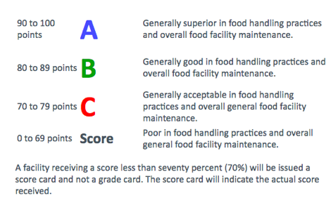

Do You Know Your ABC’s?
Notes:
Health Inspection Criteria

Slide 7
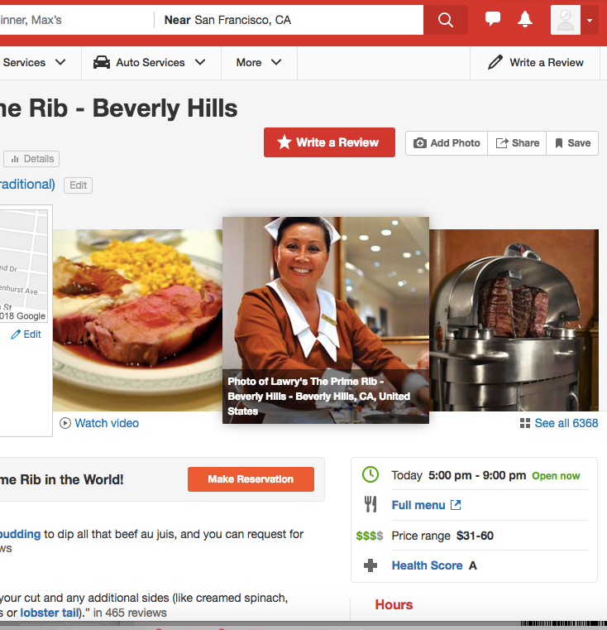

Yelp is a social networking site that is also serves as a business search engine. Yelp provides users with not only information about a business, but also allows users to post reviews and rate businesses.
Users rate business on scale of stars with 5 being the best and 1 being the worst.
Users can share their positive or negative reviews for anyone to read
www.yelp.com

Slide 8
Data Set
Original Data Set
Rows: 200,000
Columns: 20
Cleaning Criteria
Using only the latest activity date
Dropped 155,369
Using only “Active” status
Dropped 8,107
Using only business categorized as “Restaurants”
Dropped 9,949
Dropped restaurants designated as “Fast Food”
Dropped 4,004
Dropped restaurants designate as “N/A”
Dropped 9
Random Sample Set
5000
Further Cleaning
Dropped those that are under the 25th percentile
Dropped 1,267
Final data set
3,733 restaurants

Slide 9
Assumptions and Limitations
Not all “Fast Food” restaurants were dropped.
Only restaurants with “#” in name were dropped and categorized by us as “Fast Food”.
A restaurant’s total review count is symbolic of its popularity.
The dataset is limited to only 5000 restaurants due to Yelp’s API limitations.
Good or bad, it still shows that the reviewer patroned the restaurant.
Our conclusions is an extrapolation from our data.

Slide 10

Analysis
Average health grade
A
Average number of reviews per restaurant
415
Cleanliest restaurant type
Brazilian (95.5%)
Most common restaurant type
Mexican

Slide 11
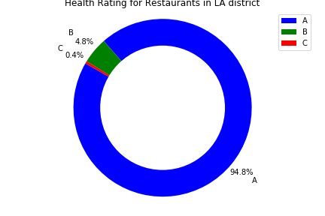
Grade Breakdown

Slide 12
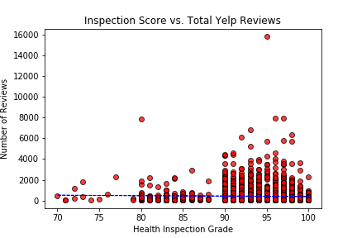


Reviews vs Grade

Slide 13
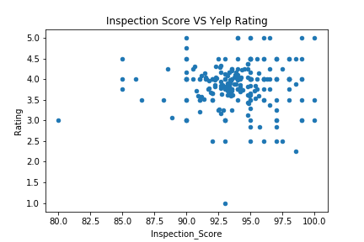
Health Score vs Yelp Score
No correlation between health score and ratings.

Slide 14
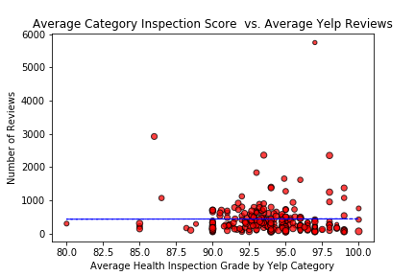
Restaurant Type vs Number of Reviews

Slide 15
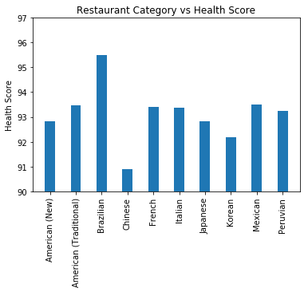
Restaurant Type vs Health Score

Slide 16
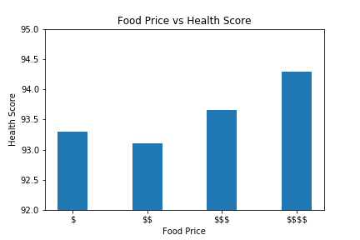
Price vs Score
As price increase so does the health score

Slide 17


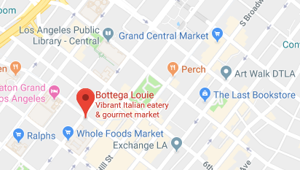
Conclusion
Most popular with high health grade:
Bottega Louie
The average restaurant in LA county has an “A” health grade.
Health grade has no impact on a restaurants popularity
If the food is good, people will come.
Price makes a difference on a restaurants health score
Higher priced restaurant more likely to have a higher health score

Slide 18


Slide 19


