Slide 1
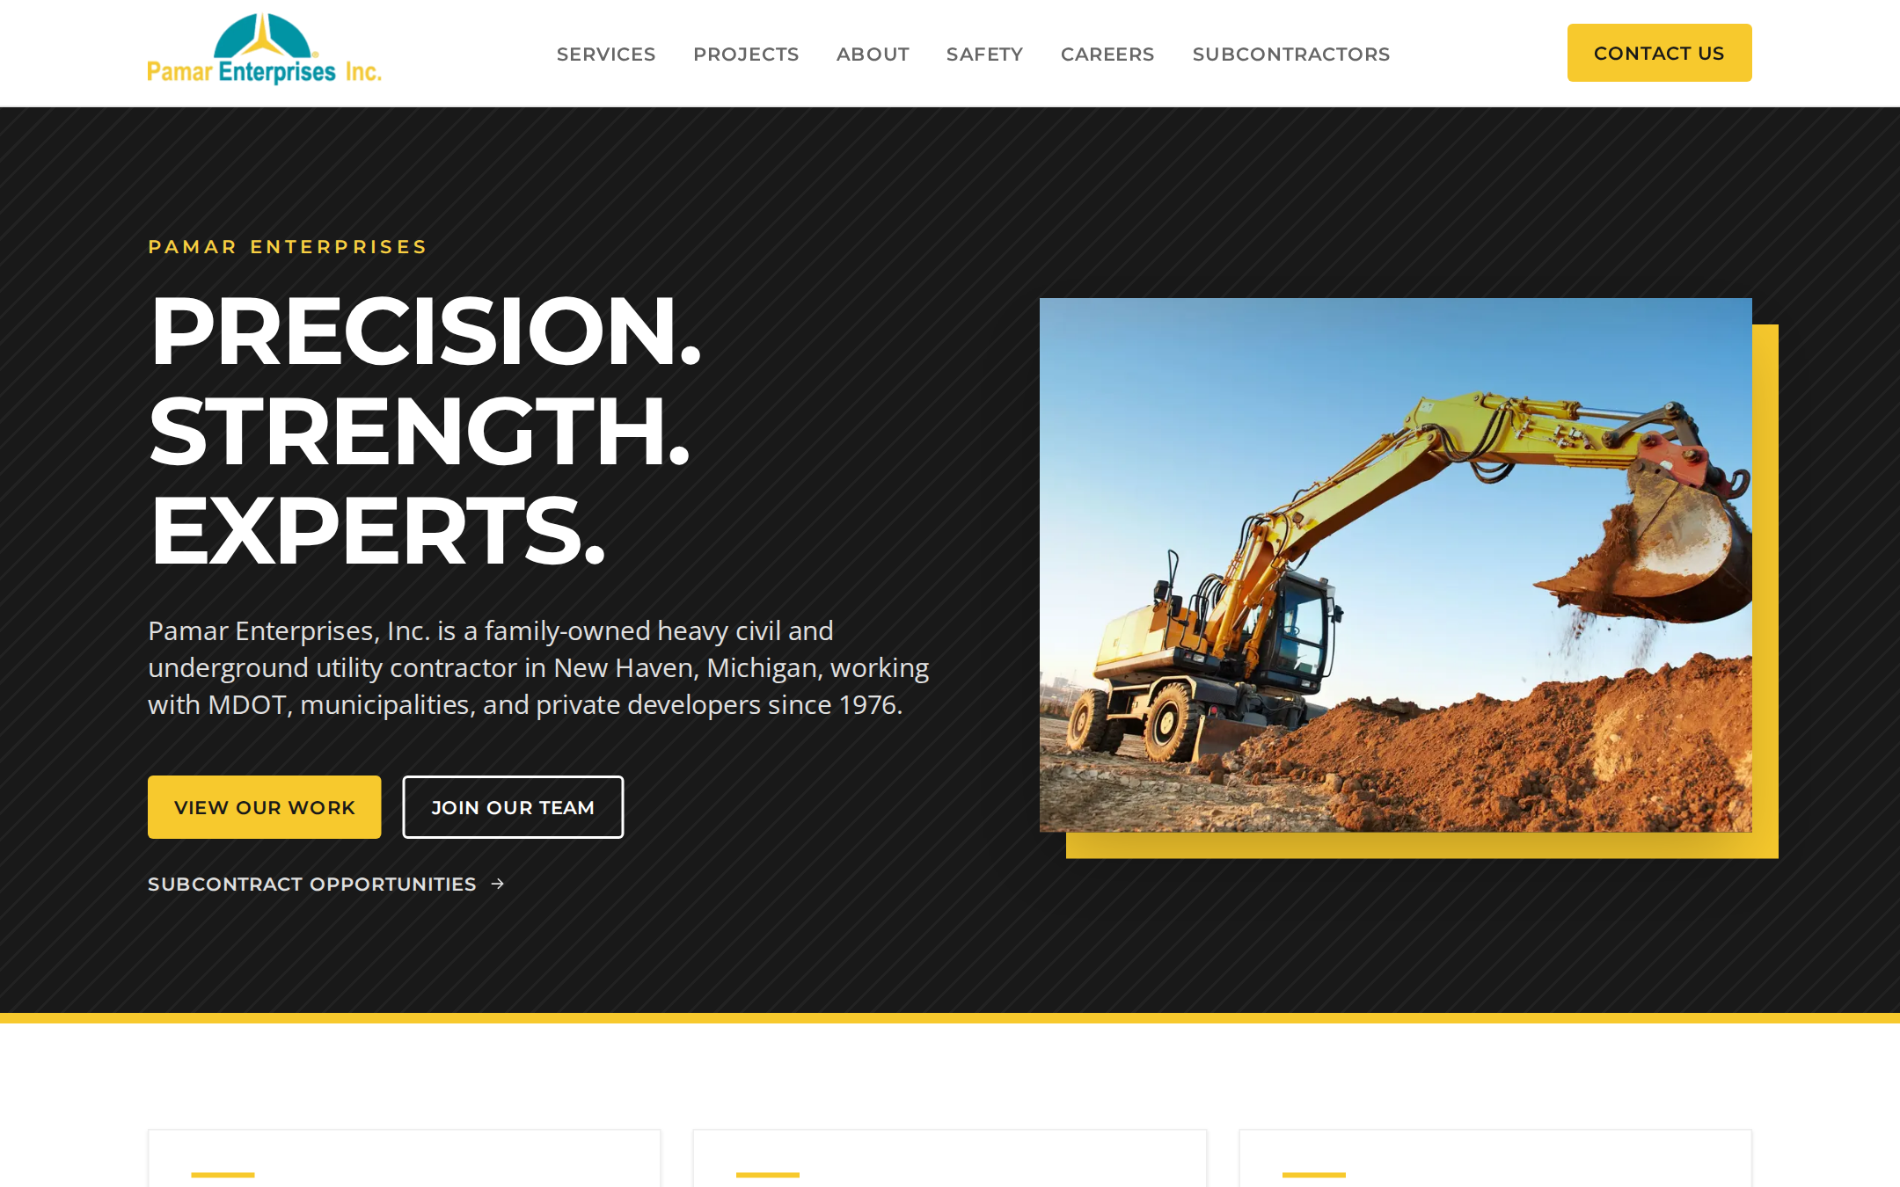
OVERVIEW · SEPTEMBER 2026
A website that works as hard as your crews
Website revamp for Pamar Enterprises: project showcase, careers funnel, and subcontractor bid portal.
Prepared by Summit

Slide 2



WHAT WE HEARD
Three jobs for the new website
Showcase the work
Recruit the crew
Win the right subs
Show the full range of capabilities and completed projects so owners, engineers, and agencies see what Pamar can deliver.
Give operators, laborers, foremen, and managers an easy way to find openings and apply, right from their phone.
Post subcontract packages on awarded contracts and collect interest, bids, and prequalification in one place.
Design direction informed by leading contractor sites: Kokosing, FNF, and Dan’s Excavating.
Summit · Pamar Enterprises website overview
2

Slide 3

THE SOLUTION
One site, three audiences
Home
Owners & engineers
Job seekers
Subcontractors
Services (per capability)
Project portfolio
Project detail pages
About & Safety
Contact
Careers & benefits
Open positions (filterable)
Job detail pages
Mobile application
Confirmation + email
How to work with us
Bid opportunities board
Package pages + bid form
Registration / prequal
Confirmation + email
Summit · Pamar Enterprises website overview
3

Slide 4
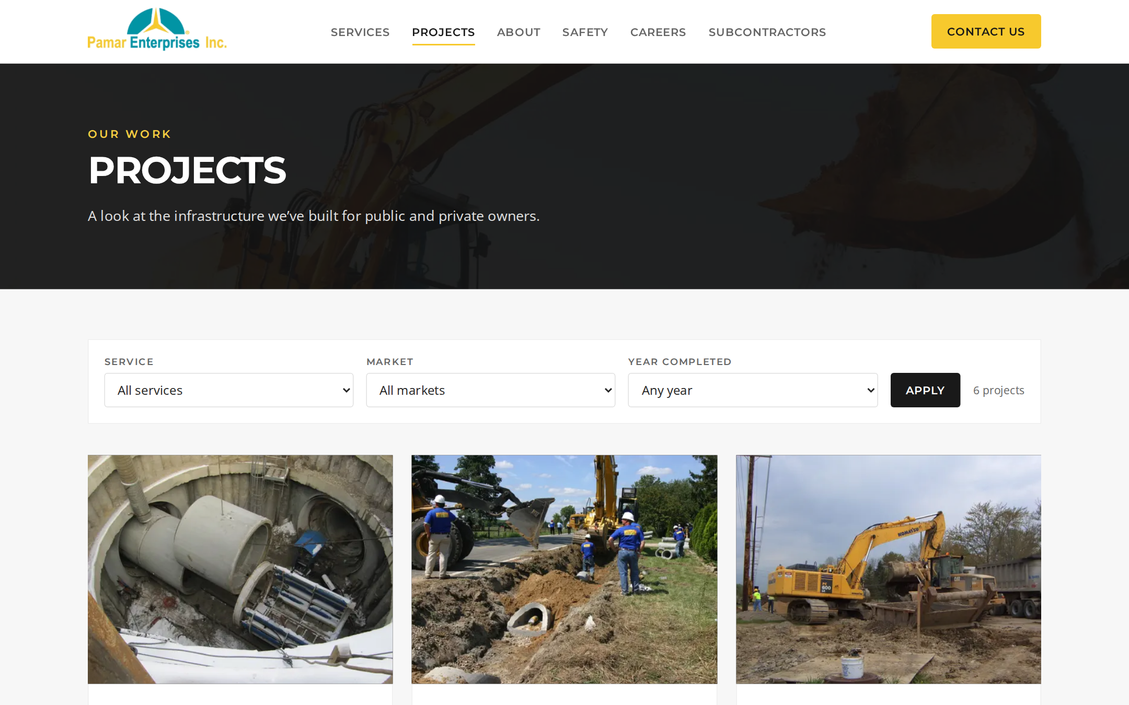



SHOWCASE OF WORK
Let the projects sell the company
Filterable portfolio
Browse by service, market, and year. Filtered views are shareable links.
Project stories
Scope, challenge, result, key facts, and a photo gallery for every job.
Capabilities pages
Each service line links to the projects that prove it.
Staff-managed
Marketing adds new projects in the CMS, with no developer needed.
Summit · Pamar Enterprises website overview
4

Slide 5
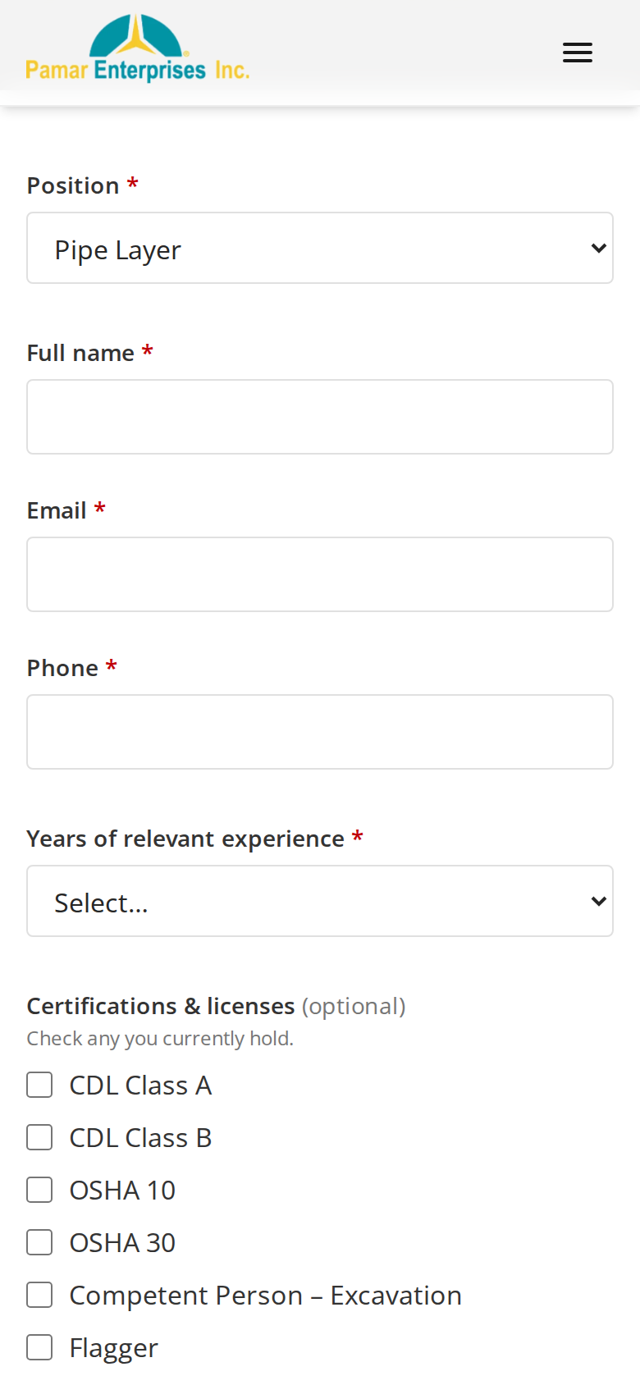
CAREERS FUNNEL
From job post to applicant in minutes
1
Find the right opening
Filter by department, location, and full-time or seasonal.
< 3 min
2
Apply from a phone
Short form with certifications (CDL, OSHA) and resume upload.
to apply on a phone, including a resume
3
HR gets it instantly
Email with the resume attached; the applicant gets a confirmation.
4
Every application counted
GA4 conversion tracking shows which jobs and channels work.
Summit · Pamar Enterprises website overview
5

Slide 6
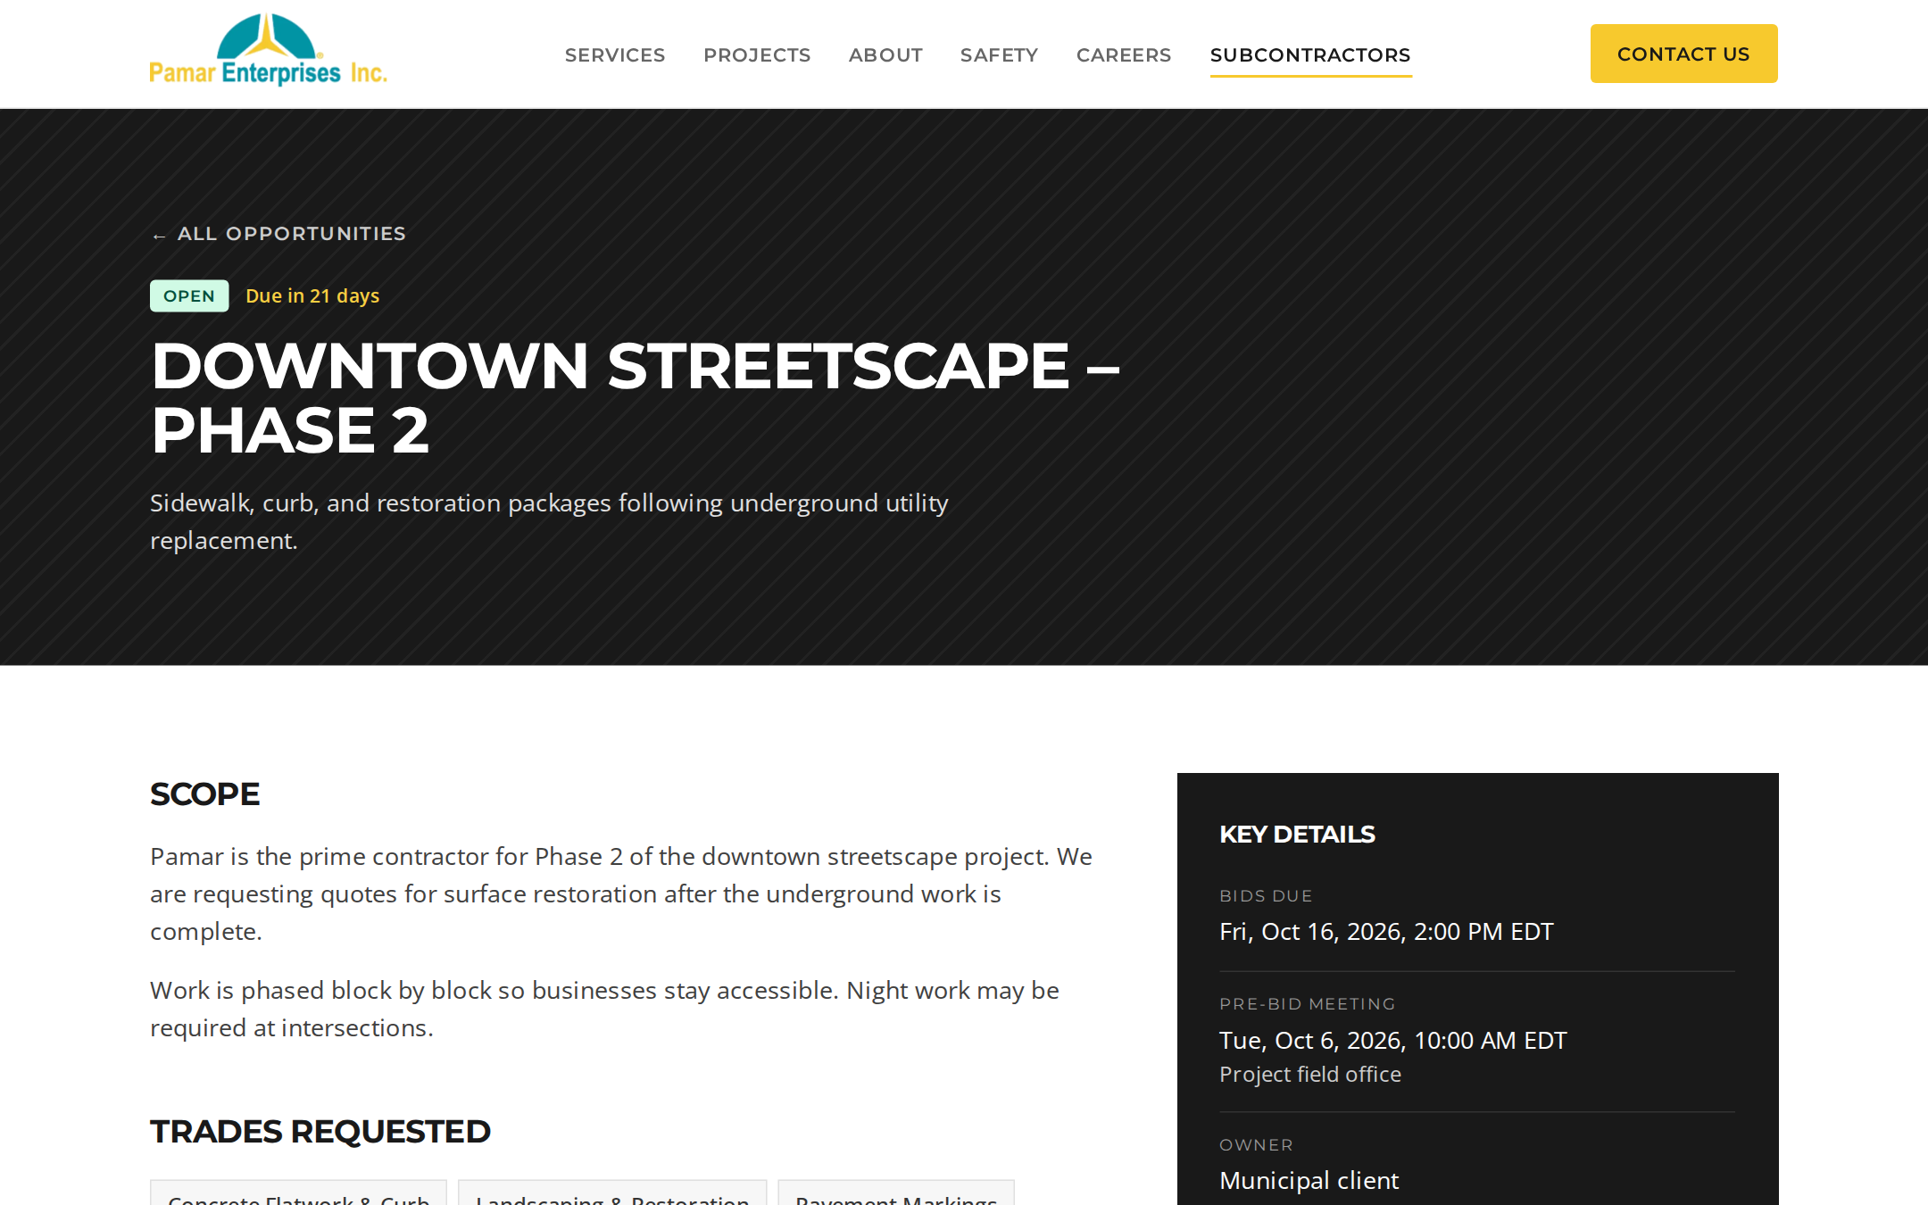





SUBCONTRACTOR PORTAL
Post packages. Collect bids. Hit your goals.
Live bid board
Open packages listed first, soonest due date on top.
Deadlines enforced
Packages close automatically at the due time; late bids are rejected.
Intent to bid or full bid
Subs send a price and bid PDF straight to estimating.
Prequalification
Trades, service area, bonding, insurance, COI and W-9 on file.
DBE / MBE / WBE outreach
Certifications captured to support participation goals.
Summit · Pamar Enterprises website overview
6

Slide 7






UNDER THE HOOD
Built to be found, fast, and easy to run
Easy for staff
Mobile-first & fast
Found on Google
HR, estimating, and marketing update jobs, packages, and projects themselves.
Designed for the field. Targets Lighthouse 90+ on mobile.
Sitemap, structured data, and job listings eligible for Google for Jobs.
Measured
Secure forms
Accessible
GA4 conversions for applications, registrations, bids, and inquiries.
Spam protection plus server-side file checks on every upload.
Built to WCAG 2.1 AA: keyboard, screen reader, and contrast friendly.
Summit · Pamar Enterprises website overview
7

Slide 8


SEO + AEO
Be the answer when they search
OWNERS & ENGINEERS
JOB SEEKERS
SUBCONTRACTORS
underground utility contractor near me
equipment operator jobs near me
sewer project subcontract bids
What they find
What they find
What they find
Your services, projects, and safety record in Google results, Maps, and AI answers.
Your openings in Google’s job listings, with a one-tap mobile application.
Your open packages, due dates, and bidder registration.
More searches now end with an AI answer, not a list of links. Google AI Overviews, ChatGPT, Perplexity, and Copilot summarize the sources they trust. The goal is for Pamar to be the source they name.
Summit · Pamar Enterprises website overview
8

Slide 9

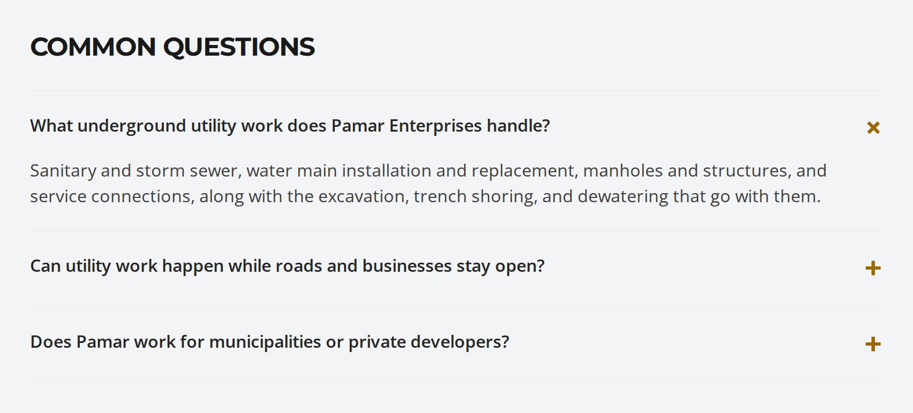

TWO WAYS TO GET FOUND
Rank in search. Get cited in answers.
ALREADY BUILT INTO THE NEW SITE
SEO: search engines
AEO: answer engines
Rank in Google search, Maps, and Google’s job listings.
Get named and quoted by AI assistants and AI Overviews.
Fast, mobile-first pages
Clean URLs and a sitemap
Local listings and Google Business Profile
Job posting markup
Direct answers to real questions
Structured data machines can read
An llms.txt summary for AI tools
Consistent facts everywhere Pamar appears
Direct answers on every service page, marked up so search engines and AI tools can quote them.
Structured data on every key page
Google job listing markup
FAQ answers + llms.txt
Sitemap, fast mobile pages
Summit · Pamar Enterprises website overview
9

Slide 10




AFTER LAUNCH
Your online presence, managed
Google Business Profile
Reviews
Reported monthly
Accurate hours, services, photos, and posts.
A simple process to request and respond to reviews.
Calls and contact-form leads
Job applications
Subcontractor registrations and bids
Search rankings and visibility
Mentions in AI answers
Project stories
Jobs & bid packages
New projects published as case studies.
Openings and packages posted and kept current.
Local listings
AI answer monitoring
Consistent name, address, and phone everywhere.
Checking what AI assistants say about Pamar, and fixing gaps.
Search and AI visibility build over months. No one can guarantee rankings or citations; we make Pamar the clearest, most credible answer and track the results.
Summit · Pamar Enterprises website overview
10

Slide 11
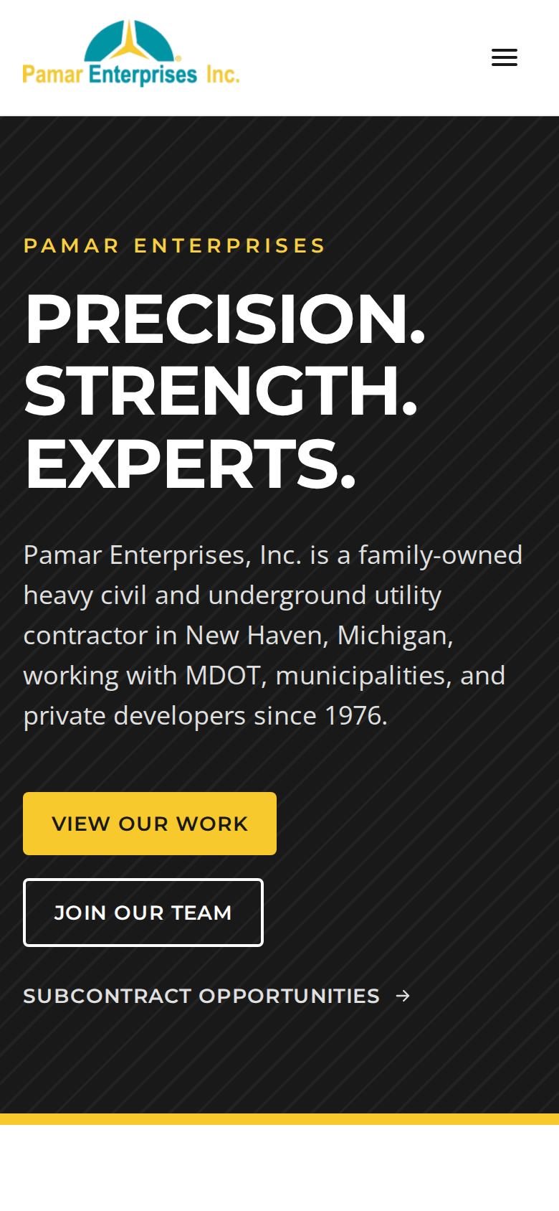
A HEAD START
This isn’t a mockup. It’s already working.
6
37
4
106
real Pamar projects
pages live in the preview
working forms
automated tests
Core pages, the careers funnel, and the bid portal already run end to end, in Pamar’s brand with real projects and company history. The build phases add the CMS, staff tools, and launch.
Lower risk · Faster launch · Decisions based on something you can click
Summit · Pamar Enterprises website overview
11

Slide 12
TIMELINE
Live in about 12 weeks
W1
W2
W3
W4
W5
W6
W7
W8
W9
W10
W11
W12
Discovery & Design
Core Site & Showcase
Careers Funnel
Subcontractor Portal
CMS & Staff Admin
SEO, Content & Launch
Design approved
Staging review
Launch
Assumes content and feedback from Pamar within 3 business days. Phases overlap to shorten the schedule.
Summit · Pamar Enterprises website overview
12

Slide 13
INVESTMENT
Choose the scope that fits
1
Essentials
2
Standard
3
Complete
Showcase and careers
Add the subcontractor portal
The full platform
Showcase site: services, projects, About, Safety, Contact
Careers funnel with mobile applications
SEO, analytics, and launch
Subcontracting stays on email for now
Everything in Essentials
Bid board and subcontractor registration
Intent-to-bid and bid submission
CMS so staff update jobs, packages, and projects
Everything in Standard
Subcontractor accounts
Restricted plan and spec downloads
Trade-matched bid alerts by email
Every package is a fixed price, sized to your budget and priorities. Add-ons are available: copywriting, project map, applicant-tracking integration, bid dashboard, photography.
Summit · Pamar Enterprises website overview
13

Slide 14
AFTER LAUNCH
Support plans that keep the site working for you
Essential
Growth
RECOMMENDED
Partner
Secure & running
Hands-on help
Part of your team
5 hours of maintenance and changes included
11 hours of maintenance and changes included
24 hours of maintenance and changes included
Hosting, SSL & monthly security updates
Uptime monitoring & daily backups
Small content help
2-business-day response
Quarterly analytics report
Everything in Essential
Staff help posting jobs, bids & projects
Small new features
1-business-day response
Monthly analytics + quarterly SEO check
Everything in Growth
Roadmap feature sprints
Weekly updates, monthly SEO
Same-day response (critical: 4 hrs)
Quarterly strategy review
Every build includes a 30-day post-launch warranty. Extra work beyond a plan is billed at the standard rate.
Summit · Pamar Enterprises website overview
14

Slide 15
NEXT STEPS
Let’s shape it together
1
2
3
4
Walk through the prototype
Share budget & priorities
Get a fixed-price proposal
Kickoff & discovery workshop
A live demo of the working site with your team.
Your budget range, timeline, and must-haves.
Sized to your budget, within 2 business days.
Goals, reference-site review, content and photo plan.
Summit
Thank you. We’re ready when you are.

