Slide 1
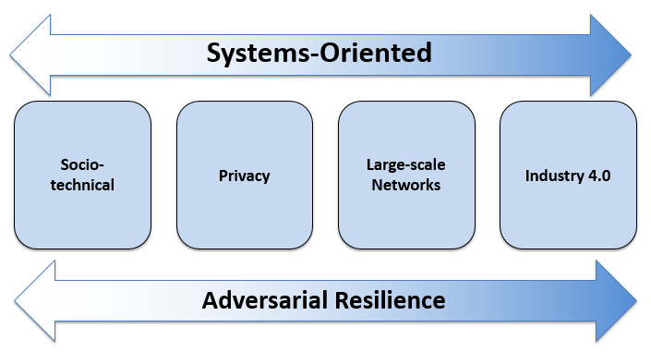







Strathclyde Cybersecurity Group
https://www.strath.ac.uk/research/strathclydesecurityresearchgroup/
About Us
Key Projects
Industry and Academic Links
The cybersecurity group spans across a range of disciplines, including:
Computer and Information Sciences
Governance and Public Policy
Statistics
Engineering
Management Science
Law
Sociology
The group is internationally recognised for its systems focus that bridges systems security, behavioural and legal aspects of cybersecurity research.
The permanent members of staff in the group are supported by 5 postdoctoral research associates, and a thriving PhD programme consisting of 23 students in the areas of technical and socio-technical security, and cyber law.
An MSc in Cybersecurity is in its planning stages
Following our key areas of research, and coinciding with the group’s strategy and vision, they key projects undertaken within the security group include:
Cyber-Physical Systems Security UKERI-DST – £220,000 2019 to 2021
Cybersecurity iCASE Studentships EPSRC-NPL – £180,000 2019 to 2023
5G RuralFirst Testbed
DCMS – £450,000 – 2018 to 2019
Robustness-as-evolvability
EPSRC – £790,000 – 2015 to 2019
SFC Interface Programme
£104,799 – 2015 to 2018
MoE Cybersecurity Research Studentships Award
University of Strathclyde – £673,000 2014 to 2022
Standardised Security Evaluation Testbed
GCHQ – £210,000 – 2014 to 2016
Data Provenance Solutions for IoT
KTP – £136,782 – 2014 to 2016
Secure High Availability Avionics Wireless Networks (SHAWN)
Technology Strategy Board £162,724 – 2014 to 2016
Social Networks
DSTL – £100,000 - 2012
Botnet Detection via Structured Graph Analysis
DARPA – $155,000 – 2010 to 2012
Resource Static Analysis
EPSRC – £101,255 – 2009 to 2010
Mobile VCE Flexible Networks Programme
EPSRC – £207,542 – 2009
Botnet Detection and Mitigation
DARPA-I3P – $150,000 2018 to 2019
Our research group is connected with a wide variety of industry, government and academic links, including:
Industry – IBM, Google, Microsoft, Samsung, VMWare, Thales, Airbus, Brocade, Juniper and Keysight
Government – NPL, Police Scotland, SIPR (MoD, DSTL, Interpol, FBI, Department of Homeland Security, Cabinet Office)
We have received £3.88M in research grants in the last ten years, funded by EPSRC, ESRC, EC, DSTL, CPNI and MoD.
Our partnerships and connections with major (international) academic links include:
University of Illinois, Urbana-Champaign, USA
Simon Fraser University, Canada
OTH-AMS
Indian Institute of Science, Bangalore, India
Strategy and Vision
Our vision is to provide world-class multi-disciplinary research, that provides the evidence based on which we jointly seek to improve the security of today’s society. Our strategy is as follows:
Cybersecurity research spanning science, engineering, business and the social sciences
Intersectorality drawing on leading academics across faculties, industry and third sector organisations (e.g. health providers, local government, armed forces, etc.)
The scale of its intended impact is based upon 75 companies who are already part of the Strathclyde Knowledge Exchange ecosystem
Focus on delivering end-to-end solutions, including a strong focus on the legal, ethical and regulatory frameworks governing the use of cybersecurity
Provide world-class training for all security specialists who will, in turn, be able to address security from a holistic perspective, drawing on a range of disciplinary insights
Facilities
Our research group consists of a multitude of exceptional research facilities, including:
MSc Lab (Teaching)
SDN Testbed – Experimental Network ArChitectures Testbed (ENACT)
Malware Testbed – Ransom Architectures for Network and System Opportunistic Malware (RANSOM)
Electricity Grid Testbed – Power Network Demonstration Centre (PNDC) Testbed
General Networking Labs
HPC Facilities
Shishir Nagaraja
Reader
Sotirios Terzis
Lecturer
George Weir
Lecturer
James Irvine
Reader
Robert Atkinson
Senior Lecturer
Daniel Thomas
Lecturer
Edited by R K Shah and S Nagaraja

