Slide 1
Sentinel Prime: Final Project
AI-Powered Emergency Vehicle Identification
Presenter: Ryan Kukreti
Taranjot Singh
Trinabh Thakur

Slide 2
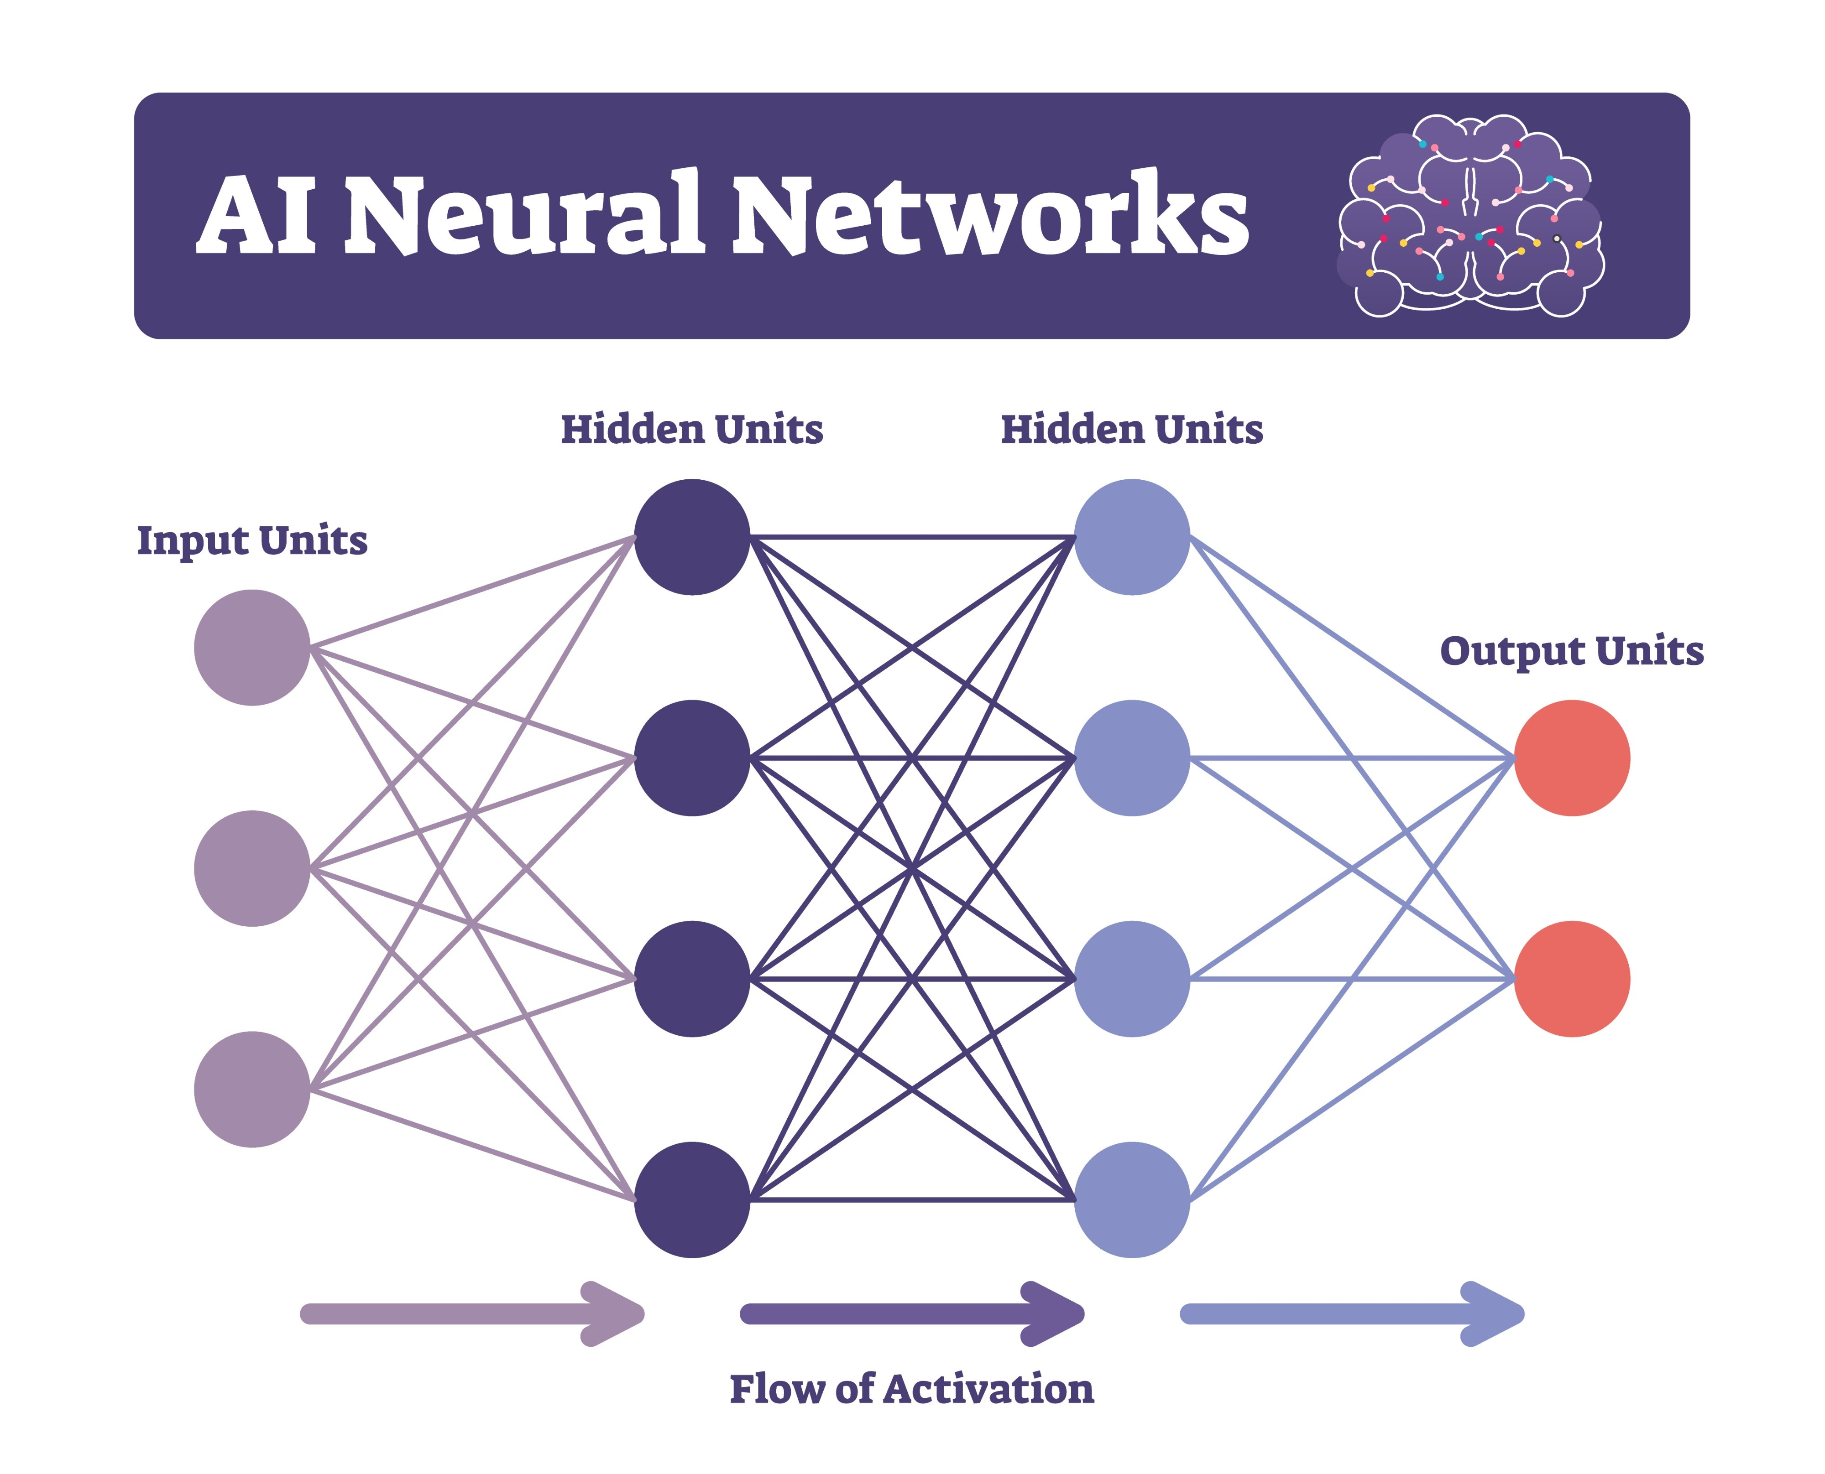
Basics of Deep Learning & ANNs
Deep Learning uses multi-layered neural networks to extract features.
Architecture: Input Layer -> Hidden Layers -> Output Layer.

Slide 3

Forward Propagation & Activations
Forward Pass: Calculates weighted sums using Weights and Biases.
Activation Functions (ReLU, Sigmoid) introduce non-linearity.

Slide 4
Learning via Backpropagation
Loss Functions (MSE, Cross-Entropy) measure the network's error.
Optimizers (Adam) use Gradient Descent to adjust weights backward.

Slide 5
Convolutional Neural Networks (CNN)
Standard ANNs flatten images and lose spatial layout.
CNNs use sliding Kernels (filters) to detect edges and shapes.
Pooling layers reduce computational size.

Slide 6
RNNs & Object Detection
RNNs handle sequential data like video frames.
YOLO (You Only Look Once) revolutionized computer vision by processing whole images in a single fast pass.

Slide 7
DL Applications in Smart Cities
Automated license plate recognition and pedestrian tracking.
Our App: Real-time emergency vehicle identification to clear intersections.

Slide 8
Problem Statement
Intersections cause critical delays for emergency responders.
Traditional acoustic and strobe sensors are flawed and expensive.
Goal: A scalable, vision-based CCTV system to preempt traffic lights.

Slide 9
Literature Review
Past Methods: RF emitters cost $2,000+ per vehicle to install.
Our Approach: Edge-AI shifts intelligence to the camera.
Requires zero additional hardware on the emergency vehicles.

Slide 10
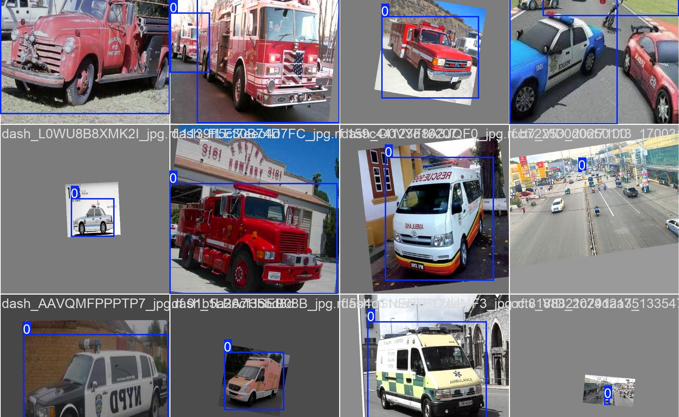
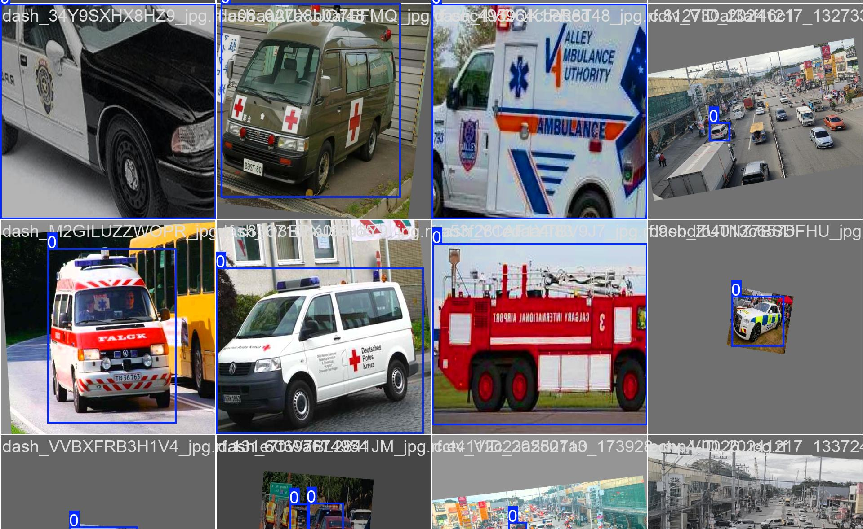
Dataset Used
Gathered ~4,500 images of ambulances, fire trucks, and police cars.
Fixed 'Ghost Class IDs' and purged corrupted files.
Applied Mosaic augmentation for robust feature learning.

Slide 11
Methodology
1. Edge Detection: YOLOv8 analyzes video locally.
2. Logic Gate: Filters out visual noise.
3. API Bridge: Threaded HTTP POST to backend.
4. Command Center: React UI visually alerts operators.

Slide 12

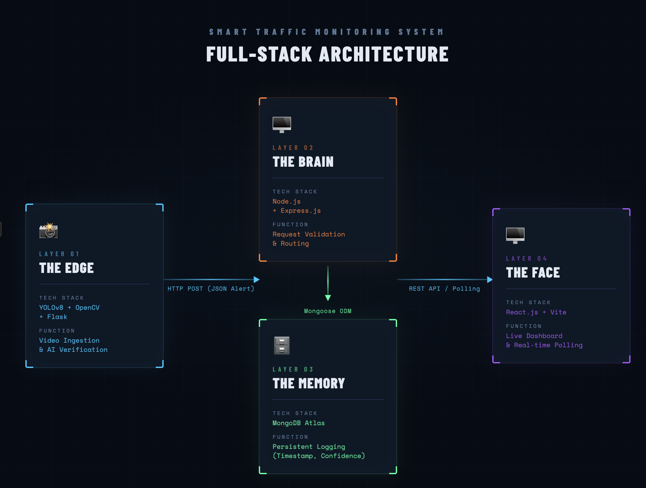
Model Architecture & System Design
Python Edge Node -> REST API -> MongoDB -> React Dashboard.
Strict separation of heavy AI processing and lightweight web backend.

Slide 13
Tools & Technologies Used
AI/Vision: Python, YOLOv8, OpenCV, ByteTrack.
Backend: Node.js, Express.js (REST API).
Database: MongoDB Atlas (Cloud NoSQL).
Frontend: React, Vite, Axios, Custom CSS.

Slide 14
Work Completed So Far
Curated dataset and trained custom YOLOv8 model.
Engineered the Anti-Flicker persistence logic script.
Deployed the Node.js + MongoDB backend.
Developed the live React video-streaming UI.

Slide 15
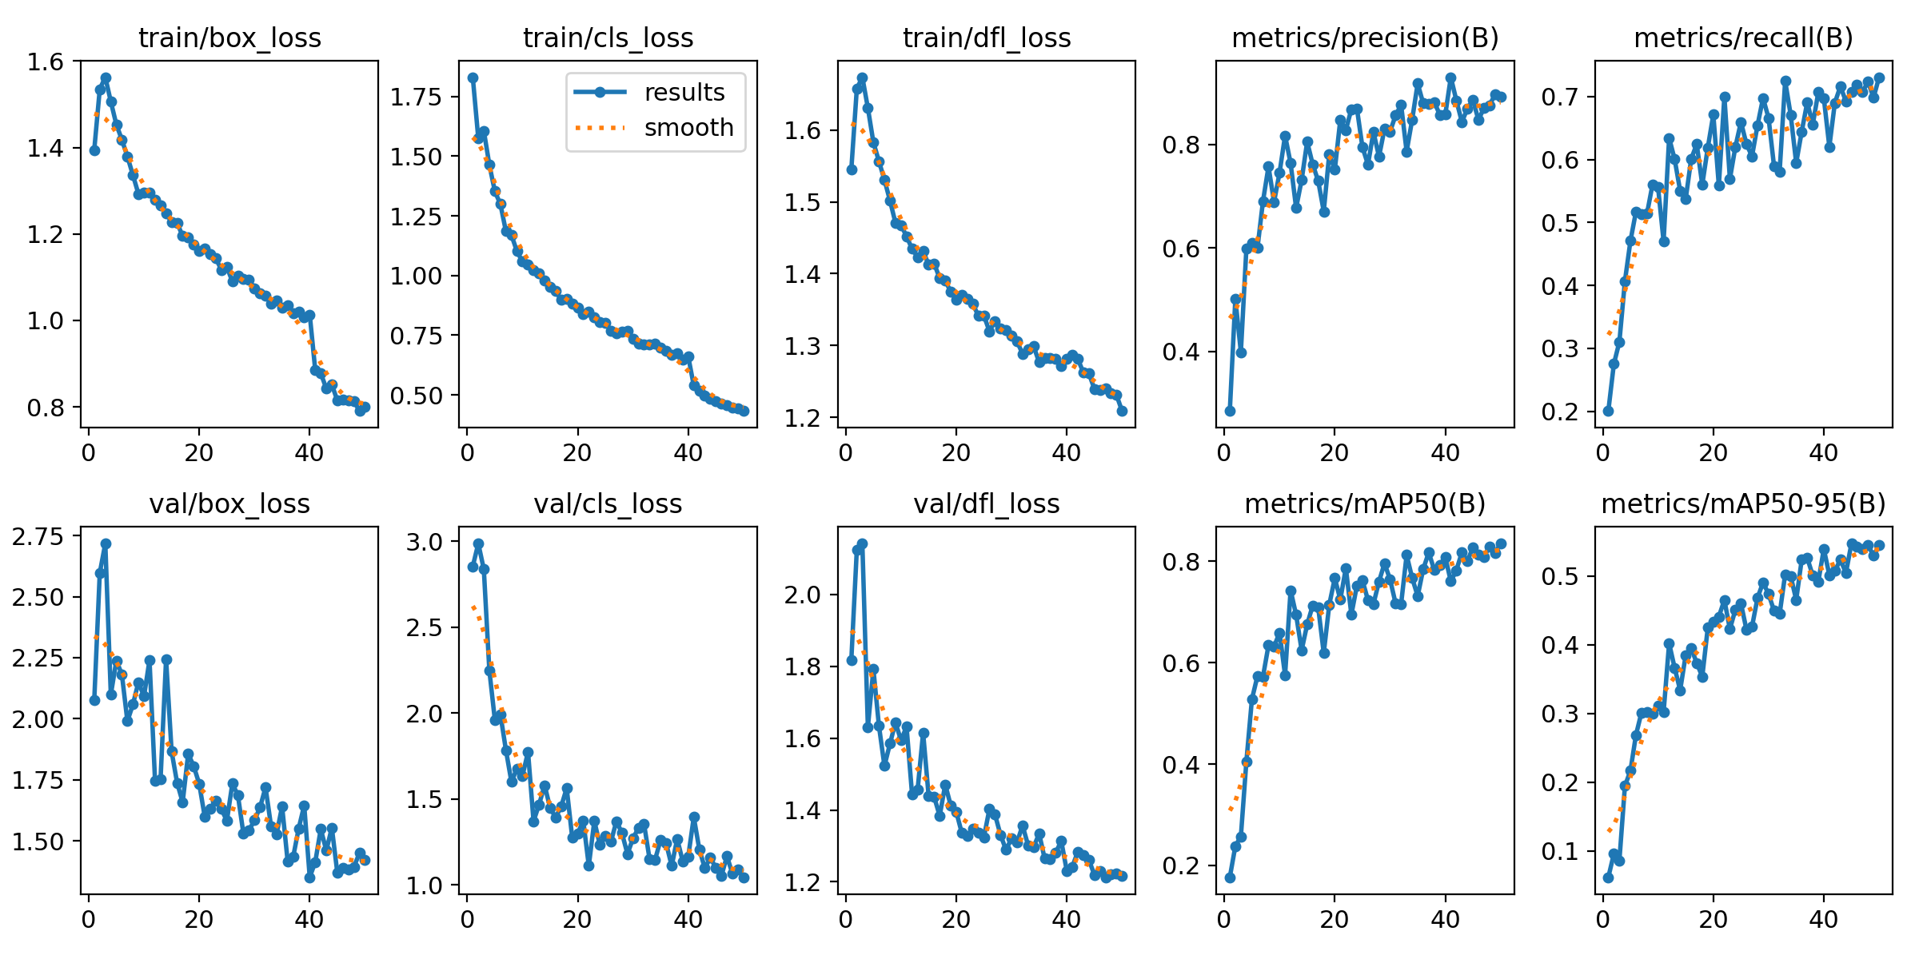
Results & Performance
Achieved strong mAP50 score indicating reliable recognition.
Zero False-Positives due to the strict Time-Gate requirement.

Slide 16
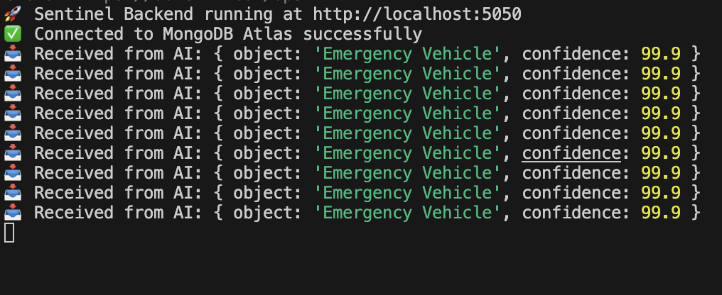
Deep Dive: Anti-Flicker Logic
Raw AI models 'flicker' on similar objects (like delivery vans).
Solution: Target must be detected with >65% confidence for 15 frames.
One missed frame hard-resets the counter to zero.

Slide 17
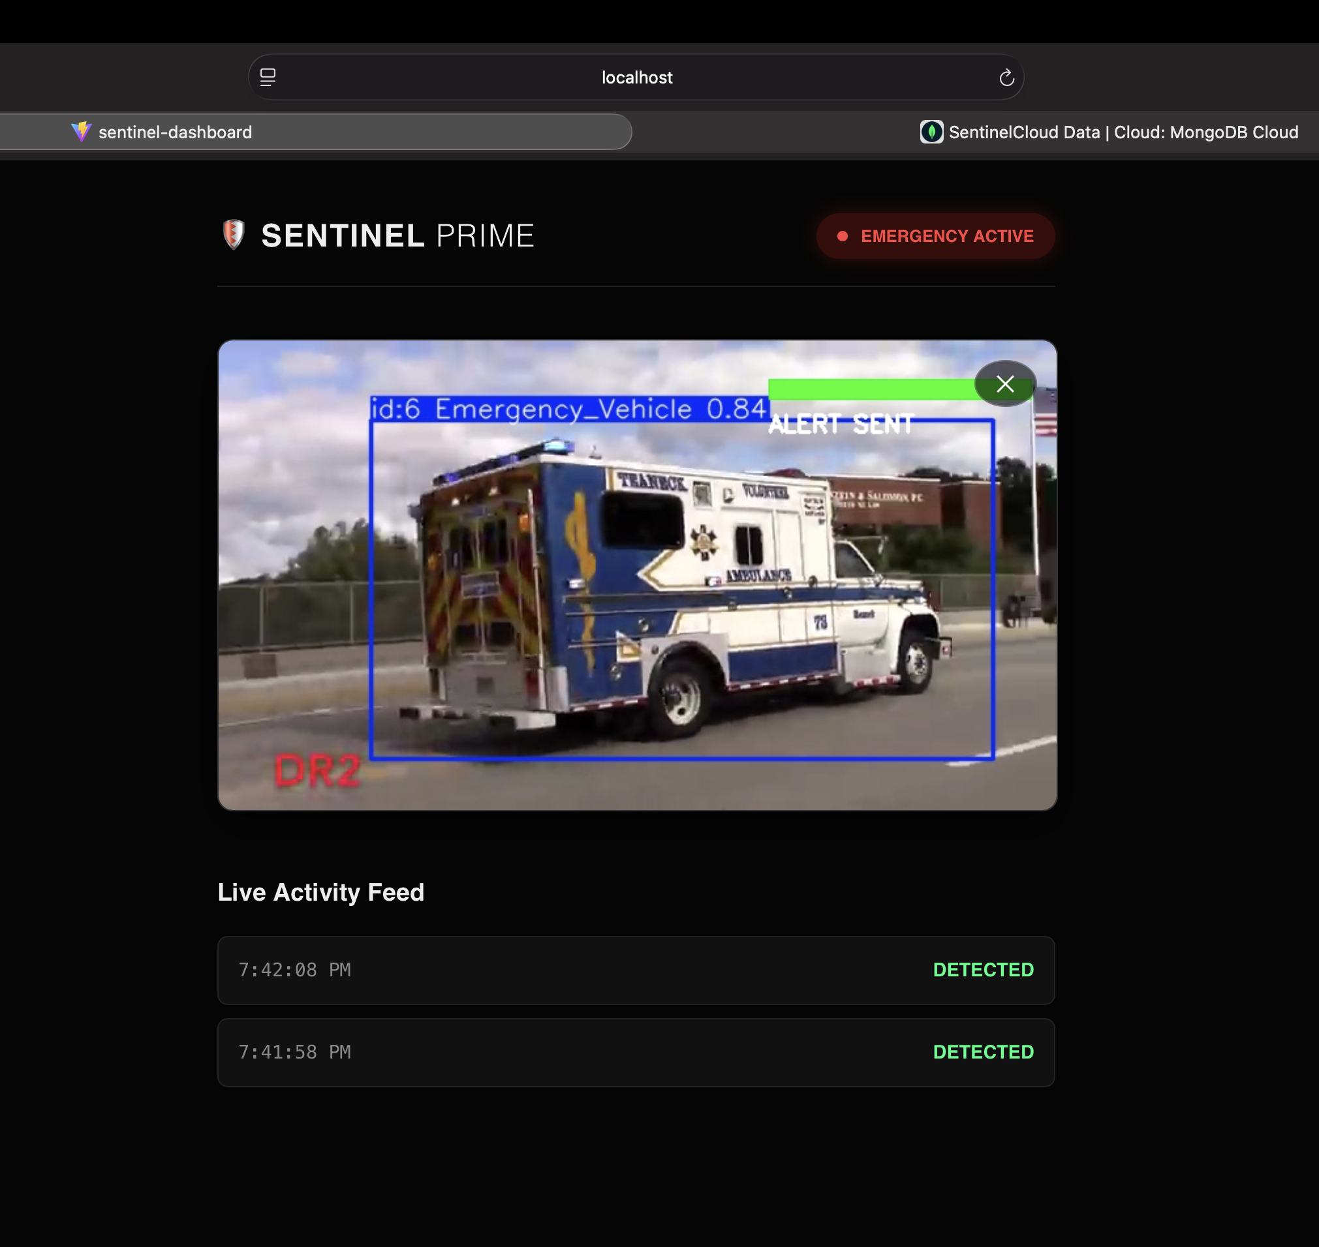
The Command Center (Frontend UI)
React dashboard dynamically fetches new data every second.
Users upload local traffic footage directly into the browser.
Flask microservice streams AI-processed video back in real-time.

Slide 18

Challenges Faced
Corrupted Datasets: Debugging indexing errors during training.
Hardware Constraints: Mapping PyTorch to Apple Silicon MPS GPU.
Async Blocking: Overcame video freezes using Python threading.

Slide 19

Next Plan of Action
Port the Python edge-script to a Jetson Nano or Raspberry Pi.
Integrate physical GPIO pins to control a miniature hardware traffic light.

Slide 20
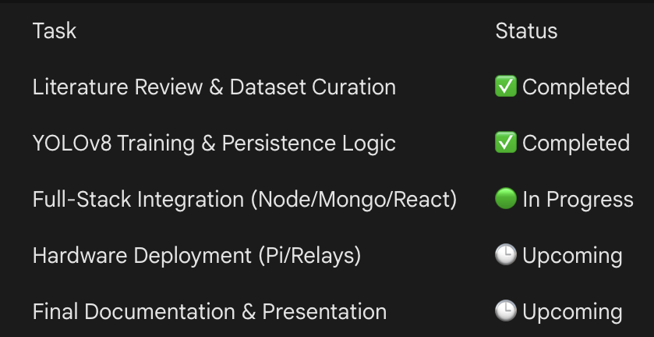
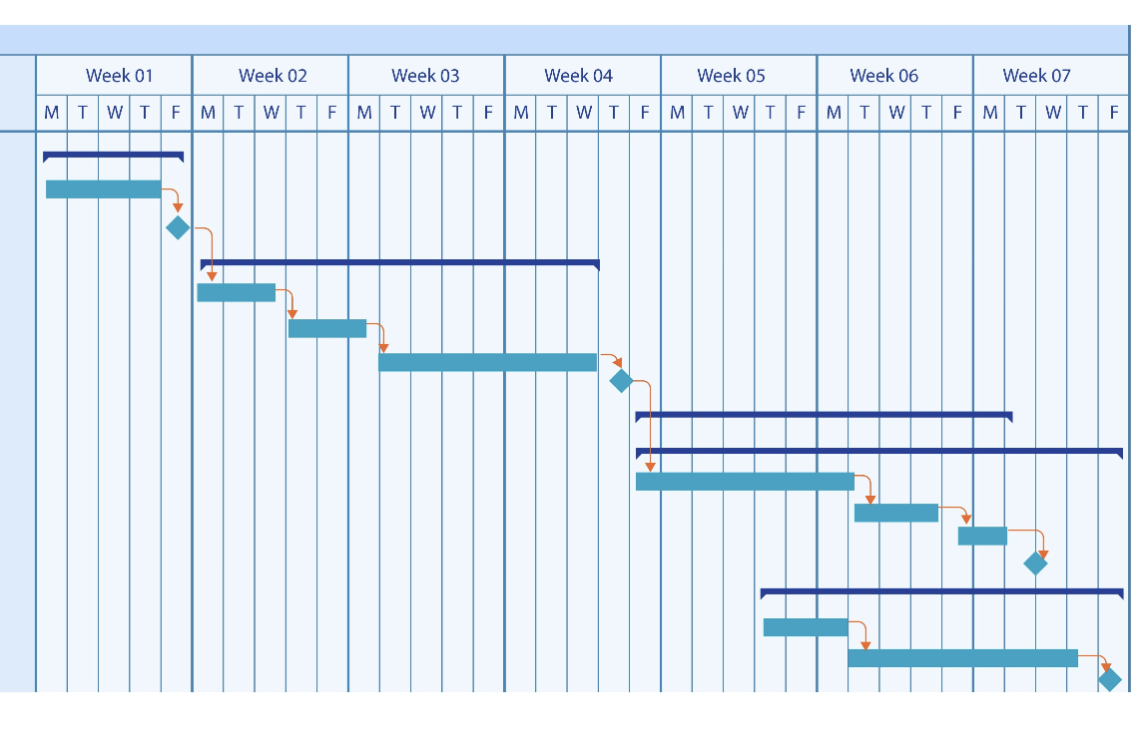
Project Timeline (Gantt Chart)
Completed: Dataset, Training, Backend Setup, Full-Stack UI.
Upcoming: Hardware Integration, Final Testing, Report Writing.

