Slide 1
Surface of a Cone
Ryan Jhon Lee N. Lajola

Slide 2
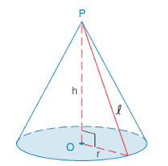
Introduction
Recall now that the lateral area for a regular pyramid is given by $L=\frac{1}{2}lP$. For a right circular cone, consider an inscribed regular pyramid as in Figure 9.32. As the number of sides of the inscribed polygon’s base grows larger, the perimeter of the inscribed polygon approaches the circumference of the circle as a limit. In addition, the slant height of the congruent triangular faces approaches that of the slant height of the cone. Thus, the lateral area of the right circular cone can be compared to $L=\frac{1}{2}lP$ ; for the cone, we have $L=\frac{1}{2}lC$.

Slide 3
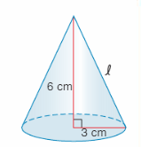
in which C is the circumference of the base. The fact that $C=2πr$ leads to
$$L=\frac{1}{2}l\left(2πr\right)$$
$$L=πl$$

Slide 4
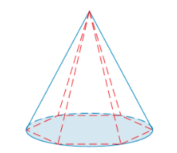
Theorem 9.3.4
The lateral area L of a right circular cone with slant height of length l and circumference C of the base is given by $L=\frac{1}{2}lC$. Alternative Form: Where r is the length of the radius of the base, $L=πrl$
The following theorem follows easily from Theorem 9.3.4 and is given without proof.
Theorem 9.3.5
The total area T of a circular cone with base are B and lateral are L is given by $T=B+L$ Alternative Form: Where r is the length of the radius of the base and $l$ is the length of the slant height, $T=π^{2}+πrl$
Example:
For the circular cone in which $r=3cm$ and $h=6cm$, find the
exact and approximate lateral area $L$
exact and approximate total are $T$

Slide 5
SOLUTION:
We need the length of the slant height $l$ for each problem part, so we apply the Pythagorean Theorem:
$l^{2}=r^{2}+h^{2}$
$l^{2}=3^{2}+6^{2}$
$l^{2}=9+36=45$
Then, $l=\sqrt{4}5=\sqrt{9}*5$
$l=\sqrt{9}*\sqrt{5}=3\sqrt{5}$
Using $L=πrl$, we have
$L=π\left(3\right)3\sqrt{5}$
$L=9π\sqrt{5}cm^{2}≈63.22cm^{2}$
We also have,
$T=B+L$
$T=πr^{2}+πrl$
$T=π\left(3^{2}\right)+9π\sqrt{5}$
$T=\left(9π+9π\sqrt{5}\right)cm^{2}≈91.50cm^{2}$

