Slide 1
AngularJS
For the .NET MVC Developer

Slide 2




































Platinum Sponsors
Gold Sponsors
Silver Sponsors

Slide 3
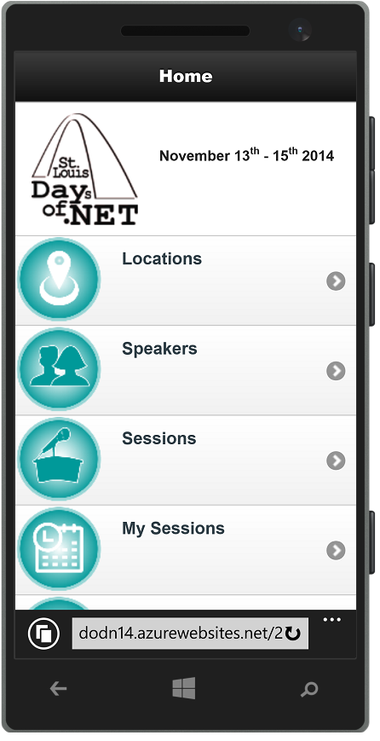
Conference Mobile App
dodn14.azurewebsites.net
Quick access to conference info
Build your custom agenda
Anonymously rate the sessions you attended
Share with the Twitter-verse

Slide 4


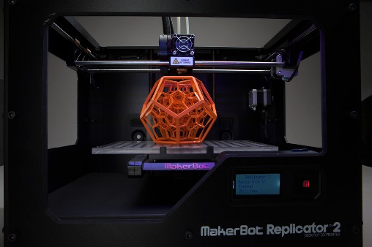

Fun Stuff Downstairs

Slide 5

Ryan Langton @rlangton76

Slide 6
My Recent History
3-4 years C# MVC development
Consulting Firms – varied projects
jQuery – mostly UI team
Late 2013 – AngularJS
Shift from jQuery to AngularJS
Applications
Teacher/student course notes
Industrial equipment quoting tool
Payroll processing application
Running Club registrations
2014
Joined UMB – HSA team

Slide 7
Session Overview
What we will cover
Why AngularJS w/ ASP .NET?
Tips/Tricks for Integration w/ ASP.NET.
Templating
Data loading
Routing
In Practice
Demo Site (Products)
https://github.com/ryanlangton/angularjs-mvc
Not included
AngularJS 101 ($scope, ng directives, controllers, services)
AngularJS in-depth
Custom directives or filters

Slide 8
State of the Web
Users expect well behaved applications.
Fast page loads.
Async is the norm.
No UI thread locking
Client-side code increasing.
We need tools to manage it.
Pragmatic decisions are necessary
Server vs Client code.
Data management (when? how?)
There is no Silver Bullet.
AngularJS can help us solve these problems.
Notes:
The Browser should NEVER have to wait.
AngularJS makes putting code in the client easy while still following the same best practices we follow with our .NET Code (IoC, Testing, Single Responsibility)

Slide 9
Layered Architecture (Top-Down)
UI
Business
Data
Layers reference down.
NEVER reference up.
Loosely coupled.
Well defined API
Maintainable.
Changes to a higher level never break layers below.

Slide 10
Example technology Stacks
Razor Views
ASP.NET MVC Controllers
Entity Framework
Business Logic (C#)
Razor Views/Templates
ASP.NET MVC/API Controllers
Entity Framework
AngularJS
Business Logic (C#)
jQuery
jQuery:
$(‘#btnFoo’).click(…);
AngularJS: <button ng-click=“doSomething()” />
Notes:
Our client-side code should be written in a framework that supports “top-down” layering.

Slide 11
Why AngularJS?
Framework for writing structured, top-down client-side code.
Two way data-binding.
Easy async communication ($http, $resource, $q)
Custom directives/libraries.
AngularUI (http://angular-ui.github.io/)
Testable client side code (IoC built in)
Write clean, organized code.
DRY (services and directives)
Single Responsibility

Slide 12
The AngularJS Way
Never manipulate the DOM directly.
Only manipulate your $scope
Write testable code – inject dependencies.
Share using AngularJS services.
Server calls.
Business Logic.
State.
Organize client-side code into components.
Template
Controller
One or more services
Avoid jQuery – but not at all costs.
Notes:
If you think you need jQuery, consider how to do it the AngularJS way first.
If you still need jQuery, isolate the code to a small service or directive.

Slide 13
Server Technologies
What backend framework do you use with your AngularJS Apps?
Linked in discussion (http://tinyurl.com/lnb2b3j)
700+ comments.
Some choices:
ASP.NET
NodeJS
MEAN Stack
Play
Go
Symphony
Django
Rails
Grails with Groovy
ASP.NET WebForms
Classic ASP

Slide 14
Why ASP.NET?
Best of Class Server Side technology.
Great Enterprise Solution.
Evolving technology with a high level of support.
Excellent security.
Secure out of the box (particularly VS 2012+)
Highly configurable (web.config, machine.config)
ASP.NET Security Secrets revealed – Troy Hunt, pluralsite.com
Web API – easy way to build RESTful API’s.
Power of 3rd party libraries (ORM’s, IoC, Testing, etc) – Nuget
.NET Shop
Where does ASP.NET MVC fit in?
Notes:
Large scale projects with a long lifespan, ASP.NET is a great choice.
Small scale projects with a short lifespan, may be quicker/easier solutions.

Slide 15
Mini SPA – single MVC page
Choose a single page for AngularJS (Products Detail)
Add a module - <div ng-app=“myModule” />
Add a controller - <div ng-controller=“myController” />
Server Model -> Client Model as JSON
In AngularJS Controller
In AngularJS Service

Slide 16
Code Demo
Product-MVC
Products Index (MVC-Razor)
Products Detail (MVC-Razor)
Dynamic Image Selection – jQuery.ajax()
Secure using ASP.NET [Authorize]
Product-AngularJS
Products Index (MVC-Razor)
Products Detail (AngularJS)
Dynamic Image Selection – AngularJS 2-way model binding
Secure using ASP.NET [Authorize]
Notes:
Introduce the site (out of the box MVC)
Demo [Authorize]
Log in as User – ProductMVC controller
ProductMvcController – Index and Detail
ProductMvc Views (Index and Detail)
Index.cshtml
@Html helpers (DisplayNameFor, ActionLink, DisplayFor)
Detail.cshtml
@if (@Model.InStock)
@if (@Model.Options.Any)
@Html.DropDownList
jQuery image selection
Switch to AngularJS
Add $scope.product = @Model
Demo JS Error (MiniSPA not found)
Change MVC controller to return string (Json.net)
Change Razor model to string
Demo JS error (&quote not valid)
Use @Html.Raw
Compare jQuery vs 2-way binding
Load data using angularjs controller
Load data using angularjs service
Inject productDataSvc
$scope.product = productDataSvc.product

Slide 17
Razor vs AngularJS Templating
Razor
HTML generated on page load.
Model and View are “dead” to the client after initial load.
Manipulate the DOM to update HTML (jQuery)
Razor and JavaScript code mixed concern (both change the HTML).
Does a lot of “magic” to create HMTL.
AngularJS
HTML generated on page load.
Model “lives” in client ($scope).
Modify values on $scope (HTML updates client-side)
Always working with the $scope for building/modifying HTML.
It’s just HTML, with ng- decorations.

Slide 18
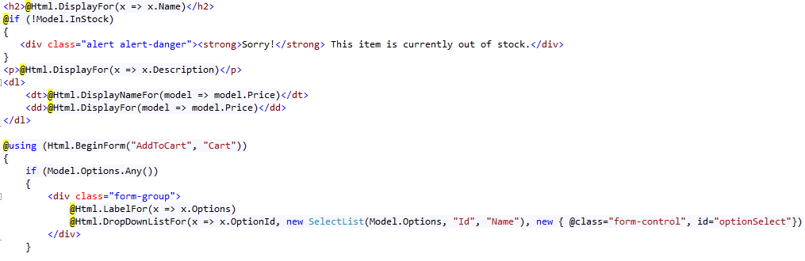
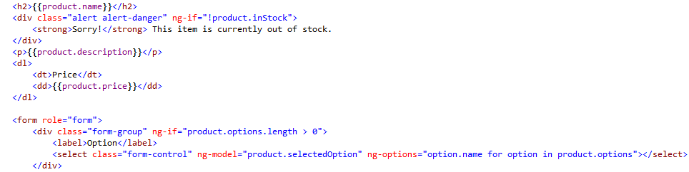
Razor
AngularJS

Slide 19
Conclusion - Templating
Where to use Razor Templating
To transfer Razor model to AngularJS model
Only if loading data via MVC Controller
Bundling and minification
Where to use AngularJS Templating
For model binding
ng-model or {{ }}
Don’t Mix Razor and AngularJS
Any other dynamic behavior.
Questions?

Slide 20
ASP.NET MVC Application
Client Issues an HTTP GET (\Product)
MVC Controller
Receives Request
Data Retrieval and Processing
Combined with Razor View
Client Renders HTML
MVC Controller
Receives HTTP GET, Returns HMTL

Slide 21
ASP.NET MVC Application
Client Issues an HTTP GET (\Product)
MVC Controller
Receives Request
Data Retrieval (SLOW, error prone)
Combined with Razor View
Client Renders HTML
MVC Controller
Receives HTTP GET, Returns HMTL

Slide 22
Loading Data using WebAPI
1. Synchronous Page Load
2. Asynchronous Data Load
Client Issues an HTTP GET (\Product)
MVC Controller
Receives Request
MVC Controller Returns HTML only (FAST, no errors)
Client Renders HTML
AngularJS Issues an HTTP GET - (\Api\Product\1)
API Controller
Receives Request
API Controller
Retrieves Data (SLOW, error prone)
AngularJS Updates HTML

Slide 23
Async server calls w/ AngularJS
$http
.get(), .post(), .put(), .delete()
.success(function(data))
.error(function(data))
.then(function(data), function()) // success, error
Must use a callback function.
$resource
Include: angular-resource.js
Inject module: ngResource
.get(), .query() , .save(), .delete()
Can use callback function.
Can assign directly to object
$scope.product = $resource(‘/api/product’).get(1);

Slide 24
Products-REST
CODE DEMO
Products List & Detail – AngularJS (separate modules)
Load HTML via MVC controller
Load Data via WebAPI
Notes:
Demo ProductRestController
No longer does anything other than authorization
Demo WebAPI ProductController
Show url results - /api/product and /api/product/1
Global JsonFormatter - WebApiConfig
Demo Index.cshtml
$http – load data
Switch to use $resource
$scope.products = $resource(‘/api/product’).query();
Add angular-resource.js
Include ‘ngResource’
Switch to use shared productRepository
$scope.products = productRepository.query();
Add productModule.js
Include ‘productModule’
Demo Detail.cshtml
Still tied to Razor
Get id from URL using $location (add ngRoute)
Remove id from controller
Add delay at repository
Demo Product-Angular behavior
Demo Product-REST behavior
Add spinner (add angularSpinner module)

Slide 25
Conclusion – Loading Data
Use MVC Controllers
Only to return the initial View (NO logic)
Use WebAPI
All CRUD operations
Any server-side business logic.
Pages load very fast
Data loading and other server calls are ALWAYS async.
Don’t make blank pages with a spinner.
Questions?

Slide 26
Mini SPA – single MVC page
Advantages
Low risk.
Isolated to a small area.
Easy to implement.
Works great on legacy applications (any tech).
Disadvantages
Each page will need it’s own ng-app.
Passing data from one module to another.
Getting parameters from a URL.

Slide 27
Routing – MVC and AngularJS
MVC routing for dividing your Web app into distinct “Modules”.
Each module requires it’s own ng-app
Secure using [Authorize]
AngularJS routing within each Module.
List/Details. (/Product#/1)
Multistep wizard (/Register#/Step1)
Any time you want a shareable URL (/Product#/Category/HomeGoods)

Slide 28
Routing – MVC and AngularJS
CODE DEMO
Notes:
Demo ProductRoutingController (MVC)
Demo Index.cshtml
ng-app
ng-view
ng-controller handled by routing
Demo product-index.html
Demo product-detail.html
$routeParams.id for detail
Add @Scripts.Render("~/bundles/productModule")

Slide 29
Conclusion – Routing
Use MVC Routing
For different sections (modules) of your web app (Mini-SPA)
Or remove entirely (Full-SPA)
Use AngularJS routing
For routing within each module (Mini-SPA)
Parent/child – list/detail.
Multi-step process.
Preserving state.
Or for the entire site (Full-SPA)
Don’t forget to use it!
Questions?

Slide 30
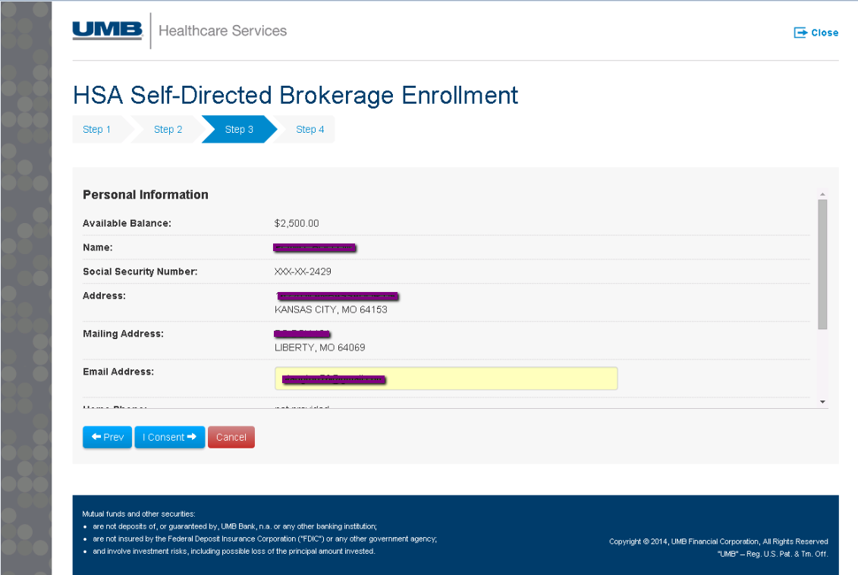

Slide 31
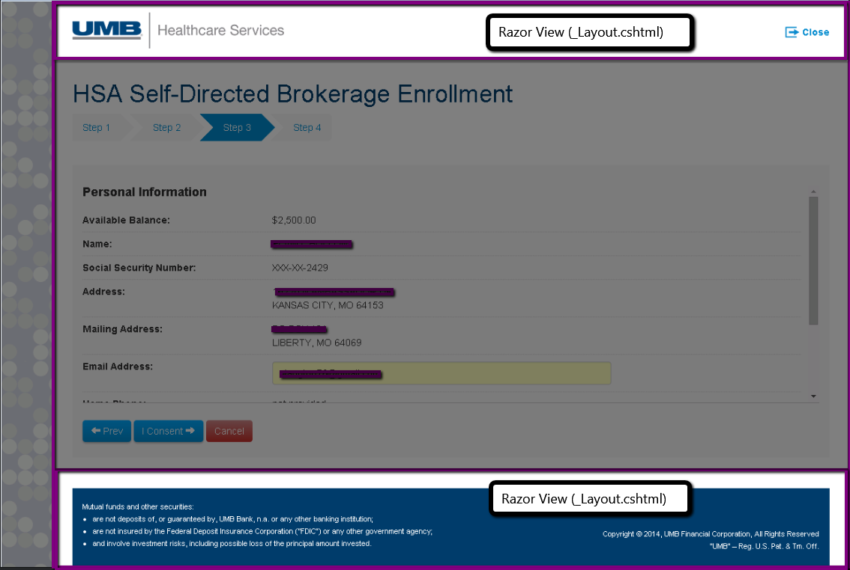

Slide 32
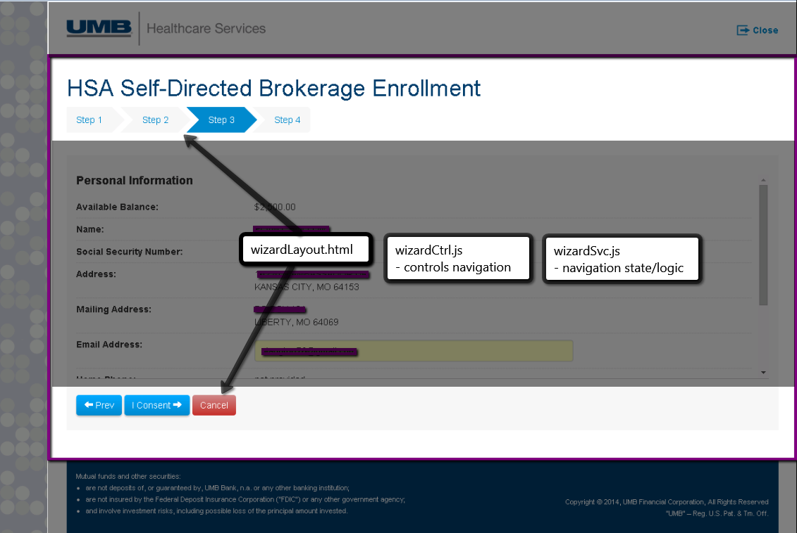

Slide 33
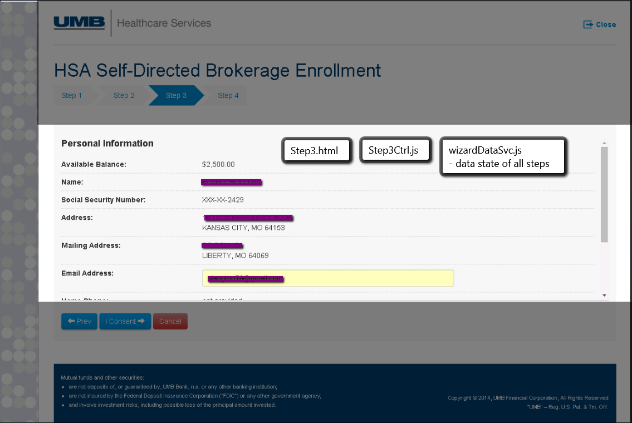

Slide 34
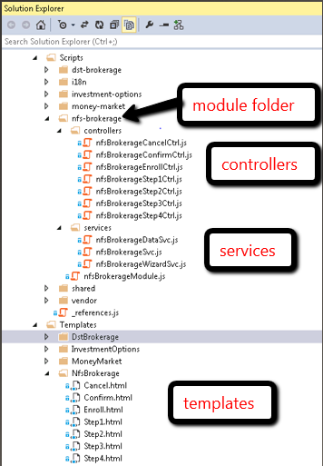
In Practice– Solution Layout

Slide 35
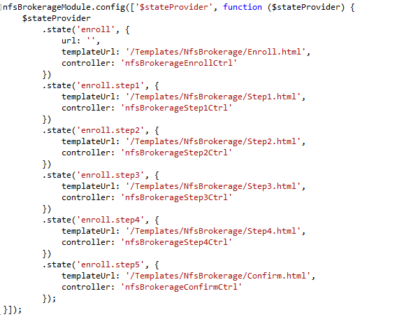
In Practice – Routing

Slide 36
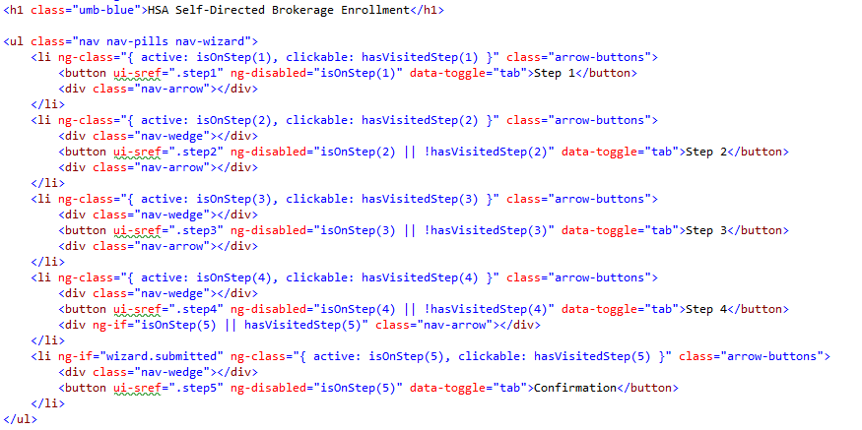
In Practice – Wizard Nav Template

Slide 37
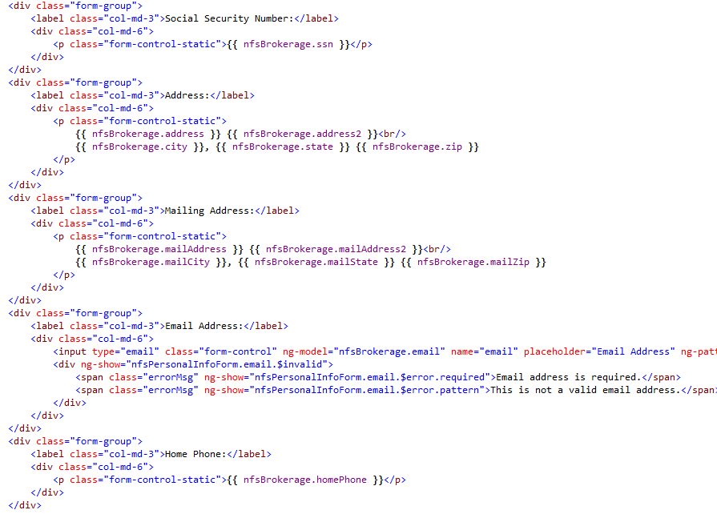
In Practice – Step 3 Template

Slide 38
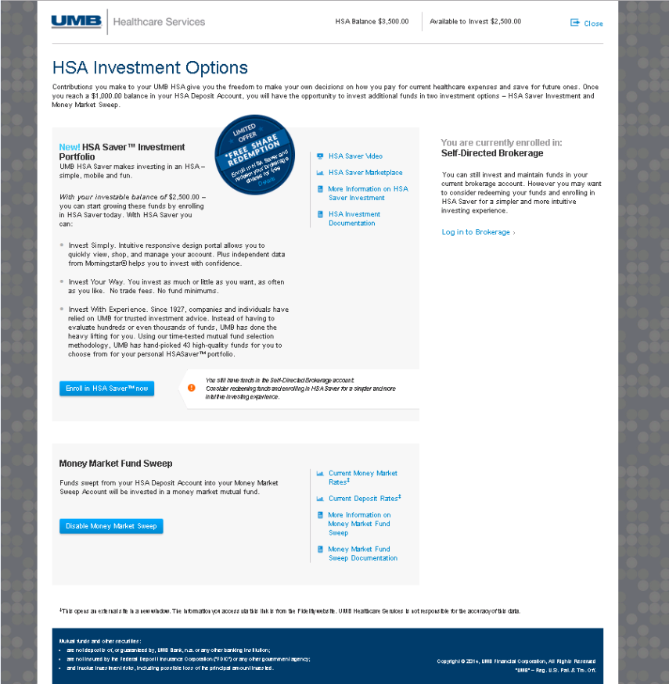

Slide 39
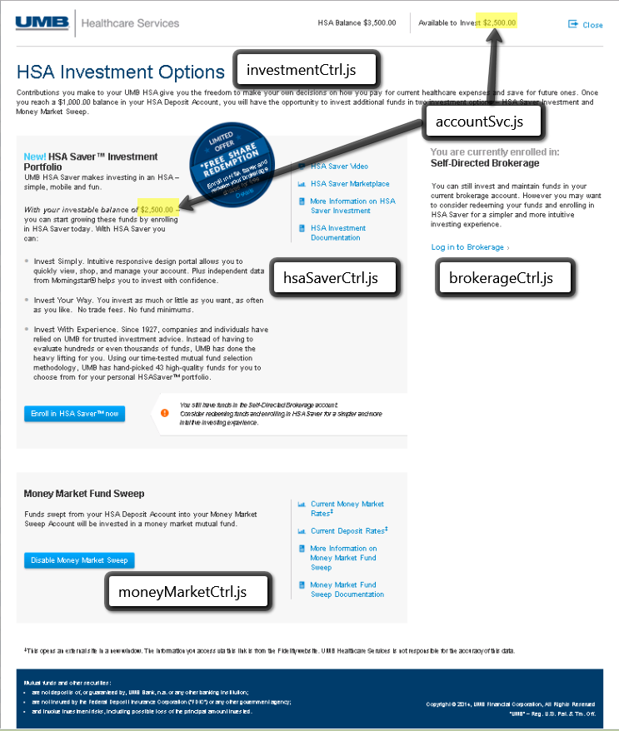

Slide 40
Constructing Sites – The Big Picture
Modules
Site Mini-SPA’s.
Sharing considerations.
Controllers (AngularJS)
Page components (sections on a page)
Nest with ng-include
Or with ui-router parent/child
Services
Server interaction (REST)
Business logic
State shared between more than one controller
Directives
When html and ng doesn’t what you want it to do.

Slide 41
If your Web Application were a house…
ASP.NET MVC
Modern House – Locking doors, nice furniture.
No appliances or adjustable furniture – Futon? Forget about it!
ASP.NET MVC w/ jQuery
Modern House – Locking doors, nice furniture.
Hi-tech appliances
That break often and require a manual.
NodeJS w/ AngularJS
Beach cabana – easy to set up. Cool place.
Hi-tech appliances – 65” Ultra HD TV
ASP.NET w/ AngularJS
Modern House – Locking doors, nice furniture.
Hi-tech appliances – 65” Ultra HD TV
Where do you want to be?

Slide 42
AngularJS – When/how to start?
Right now
Starting a new project.
Mid-project.
Legacy project.
Not all or nothing.
Decisions
How much? 1 page? 1 section? Entire site?
Views
Where to use Razor (if at all)
Data
Bootstrapped through MVC
Retrieved via WebAPI (preferred)
Routing
Where to use C# MVC routing
Where to use AngularJS routing
Client side code
jQuery/AngularJS/Other/Mix

Slide 43
QA

