Slide 1
AngularJS
For the .NET MVC Developer

Slide 2

Ryan Langton @rlangton76

Slide 3
Session Overview
What we will cover
Why AngularJS w/ ASP .NET?
Tips/Tricks for Integration w/ ASP.NET.
Templating
Data loading
Routing
Big Picture
Demo Site (Products)
https://github.com/ryanlangton/angularjs-mvc
Not included
AngularJS 101 ($scope, ng directives, controllers, services)
AngularJS in-depth
Custom directives or filters

Slide 4
State of the Web
Users expect well behaved applications.
Fast page loads.
Async is the norm.
No UI thread locking
Client-side code increasing.
We need tools to manage it.
Pragmatic decisions are necessary
Server vs Client code.
Data management (when? how?)
There is no Silver Bullet.
AngularJS can help us solve these problems.
Notes:
The Browser should NEVER have to wait.
AngularJS makes putting code in the client easy while still following the same best practices we follow with our .NET Code (IoC, Testing, Single Responsibility)

Slide 5
Layered Architecture (Top-Down)
UI
Business
Data
Layers reference down.
NEVER reference up.
Loosely coupled.
Well defined API
Maintainable.
Changes to a higher level never break layers below.

Slide 6
Example technology Stacks
Razor Views
ASP.NET Controllers
Entity Framework
Business Logic (C#)
Razor Views/Templates
ASP.NET Controllers
Entity Framework
AngularJS
Business Logic (C#)
jQuery
jQuery:
$(‘#frmRegister’).submit();
AngularJS: <button ng-click=“submit()” />
Notes:
Our client-side code should be written in a framework that supports “top-down” layering.

Slide 7
Why AngularJS?
Framework for writing structured, top-down client-side code.
Two way data-binding.
Easy async communication ($http, $resource, $q)
Custom directives/libraries.
AngularUI (http://angular-ui.github.io/)
Testable client side code (IoC built in)
Write clean, organized code.
DRY (services and directives)
Single Responsibility

Slide 8
The AngularJS Way
Never manipulate the DOM directly.
Only manipulate your $scope
Write testable code by using services.
Maintain state in AngularJS services.
Organize client-side code into components
Template
Controller
Services
Avoid jQuery – but not at all costs.
Notes:
If you think you need jQuery, consider how to do it the AngularJS way first.
If you still need jQuery, isolate the code to a small service or directive.

Slide 9
Server Technologies
What back-end technology do you use with AngularJS?
Linked in discussion (http://tinyurl.com/lnb2b3j)
700+ replies.
Some choices:
ASP.NET
NodeJS
MEAN Stack
Play
Go
Symphony
Django
Rails
Grails with Groovy
ASP.NET WebForms
Classic ASP

Slide 10
Why ASP.NET?
Best of Class Server Side technology.
Great Enterprise Solution.
Evolving technology with a high level of support.
Excellent security.
Secure out of the box (particularly VS 2012+)
Highly configurable (web.config, machine.config)
ASP.NET Security Secrets revealed – Troy Hunt, pluralsite.com
Web API – easy way to build RESTful API’s.
Power of 3rd party libraries (ORM’s, IoC, Testing, etc) – Nuget
.NET Shop
Where does ASP.NET MVC fit in?
Notes:
Large scale projects with a long lifespan, ASP.NET is a great choice.
Small scale projects with a short lifespan, may be quicker/easier solutions.

Slide 11
Code Demo – Product-MVC
Products Index
Products Detail
No dynamic behavior
Secure using ASP.NET
Accounts – user, admin
Notes:
Introduce the site
Create a User and Admin account
Demo [Authorize]
ProductMvcController – Index and Detail
ProductMvc Views (Index and Detail)
Index.cshtml
@Html helpers (DisplayNameFor, ActionLink, DisplayFor)
Detail.cshtml
@if (@Model.InStock)
@if (@Model.Options.Any)
@Html.DropDownList

Slide 12
Mini SPA – single MVC page
Choose a single page for AngularJS (Products Detail)
Add a module - <div ng-app=“myModule” />
Add a controller - <div ng-controller=“myController” />
Server Model -> Client Model as JSON
In AngularJS Controller
In AngularJS Service

Slide 13
Code Demo – Product-AngularJS
Products List - MVC
Products Detail – MVC -> AngularJS
Dynamic image selection – option selected
Notes:
Controller differences – returns json string instead of C# object
Not using typed @model
Json serializer added to controller
Most razor syntax removed
Inject to angularjs using @Html.Raw(Model))
@Html.Raw avoids HTML encoding
AngularJS syntax added
ng-app – initialize module
ng-controller
{{ }}
ng-model
ng-if
ng-options
Demonstrate 2-way binding
Load data using angularjs controller
Load data using angularjs service
Inject productDataSvc
$scope.product = productDataSvc.product

Slide 14
Razor vs AngularJS Templating
Razor
HTML generated on page load.
Model and View are “dead” to the client after initial load.
Manipulate the DOM to update HTML (jQuery)
Razor and JavaScript code mixed concern (both change the HTML).
Does a lot of “magic” to create HMTL.
AngularJS
HTML generated on page load.
Model “lives” in client ($scope).
Modify values on $scope (HTML updates client-side)
Always working with the $scope for building/modifying HTML.
It’s just HTML, with ng- decorations.

Slide 15
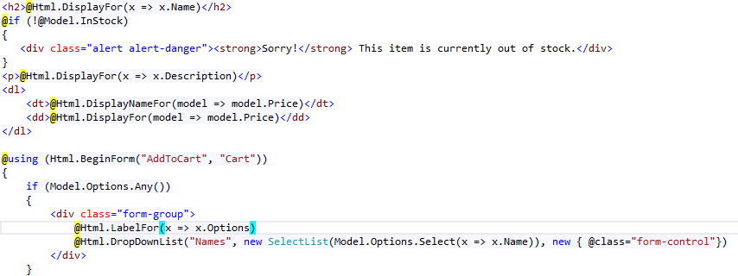
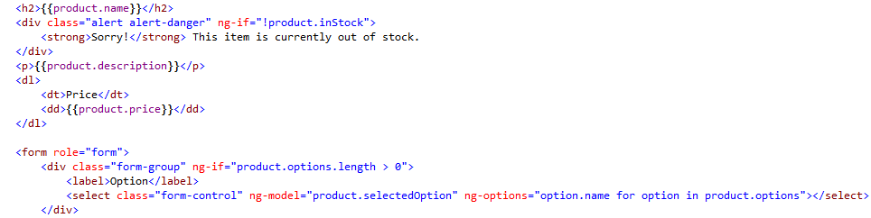
Razor
AngularJS

Slide 16
Conclusion - Templating
Where to use Razor Templating
Sparingly if at all – never for model binding (@Html.EditorFor, etc)
Transfer Razor model to AngularJS model
Only if loading data via MVC Controller
Bundling and minification
Where to use AngularJS Templating
For everything else
Don’t
Mix Razor and AngularJS
Questions?

Slide 17
ASP.NET MVC Application
Client Issues an HTTP GET (\Product)
MVC Controller
Receives Request
Data Retrieval and Processing
Combined with Razor View
Client Renders HTML
MVC Controller
Receives HTTP GET, Returns HMTL

Slide 18
ASP.NET MVC Application
Client Issues an HTTP GET (\Product)
MVC Controller
Receives Request
Data Retrieval (SLOW, error prone)
Combined with Razor View
Client Renders HTML
MVC Controller
Receives HTTP GET, Returns HMTL

Slide 19
Loading Data using WebAPI
1. Synchronous Page Load
2. Asynchronous Data Load
Client Issues an HTTP GET (\Product)
MVC Controller
Receives Request
MVC Controller Returns HTML only (FAST, no errors)
Client Renders HTML
AngularJS Issues an HTTP GET - (\Api\Product\1)
API Controller
Receives Request
API Controller
Retrieves Data (SLOW, error prone)
AngularJS Updates HTML

Slide 20
Products-REST
CODE DEMO
Products List & Detail – AngularJS (separate modules)
Load HTML via MVC controller
Load Data via WebAPI
Notes:
Demo WebAPI ProductController
Show url results - /api/product and /api/product/1
Global JsonFormatter - WebApiConfig
Demo ProductRestController
No longer does anything other than authorization
2 MVC routes = 2 modules
Demo Index.cshtml
$http
No Razor code
Demo Detail.cshtml
Still tied to Razor
Get id from URL using $location (add ngRoute)
Remove id from controller
Add delay at repository
Demo Product-Angular behavior
Demo Product-REST behavior
Add spinner (add angularSpinner module)

Slide 21
Conclusion – Loading Data
Use MVC Controllers
Only to return the initial View
Use WebAPI
All data loading
Pages load very fast
Data loading and other server calls are ALWAYS async.
Don’t
Make every page a blank page with a spinner.
Questions?

Slide 22
Mini SPA – single MVC page
Advantages
Low risk.
Isolated to a small area.
Easy to implement (no routing considerations)
Works great on legacy applications (any tech).
Disadvantages
Each page will need it’s own ng-app.
Passing data from one module to another.
Getting parameters from a URL.
Sections of the page outside of ng-app?

Slide 23
Routing – MVC and AngularJS
MVC routing for dividing your Web app into distinct “Modules”.
Each module requires it’s own ng-app
Secure using [Authorize]
AngularJS routing within each Module.
List/Details. (/Product#/1)
Multistep wizard (/Register#/Step1)
Any time you want a shareable URL (/Product#/Category/HomeGoods)

Slide 24
Routing – MVC and AngularJS
CODE DEMO
Notes:
Demo ProductRoutingController (MVC)
Demo Index.cshtml
ng-app
ng-view
ng-controller handled by routing
Demo product-index.html
Demo product-detail.html
$routeParams.id for detail
Add @Scripts.Render("~/bundles/productModule")

Slide 25
Conclusion – Routing
Use MVC Routing
For different sections (modules) of your web app.
Or not at all.
Use AngularJS routing
For routing within each module
Parent/child – list/detail.
Multi-step process.
Preserving state.
Or for the entire site.
Don’t
Make a large SPA or mini-SPA with no routing.
Questions?

Slide 26
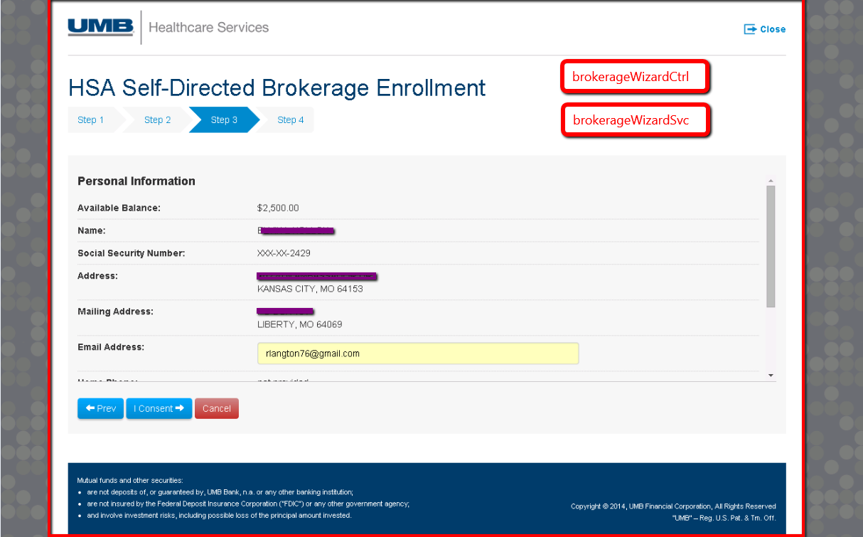

Slide 27
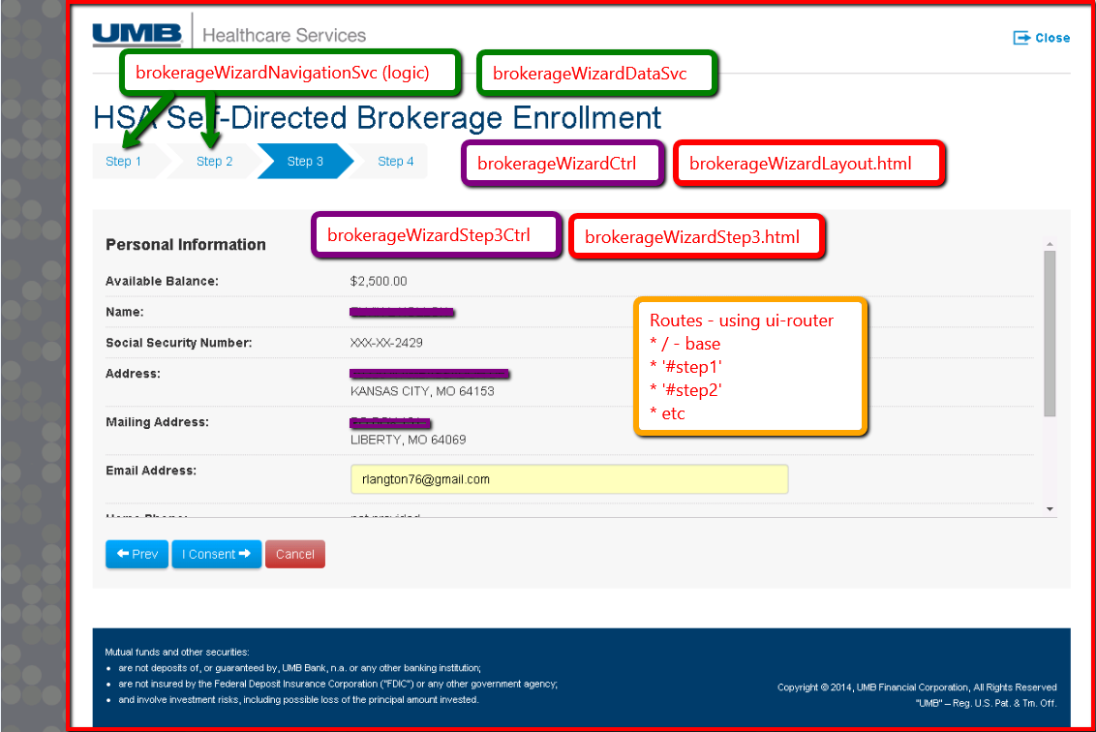

Slide 28
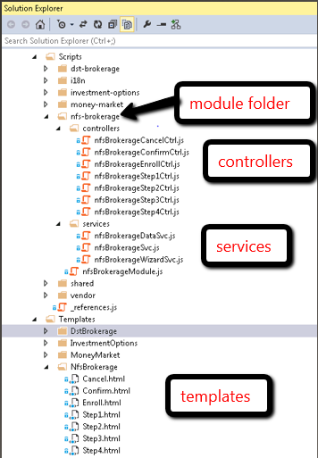
Real World – Solution Layout

Slide 29
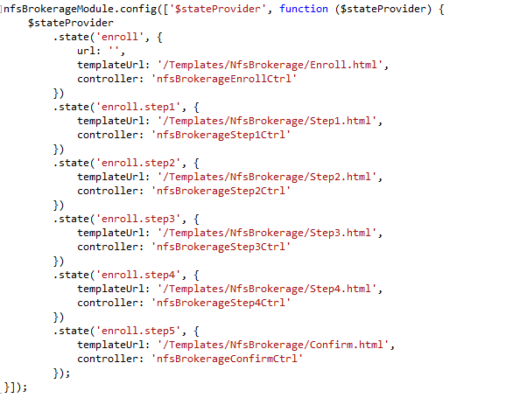
Real World – Routing

Slide 30
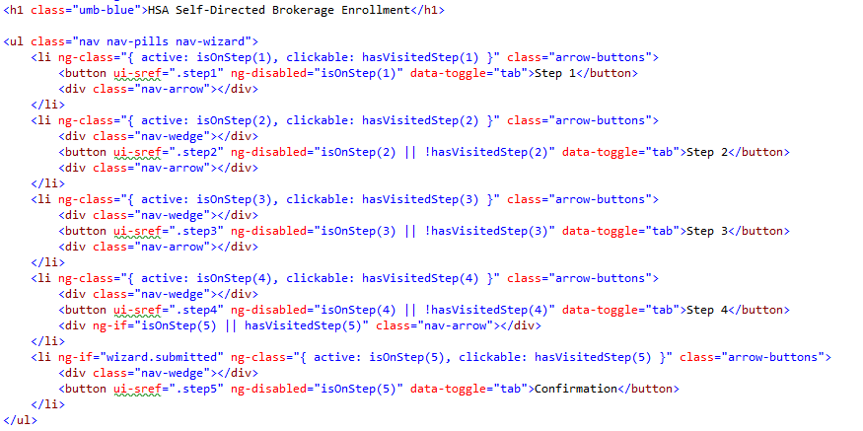
Real World – Enroll.html

Slide 31
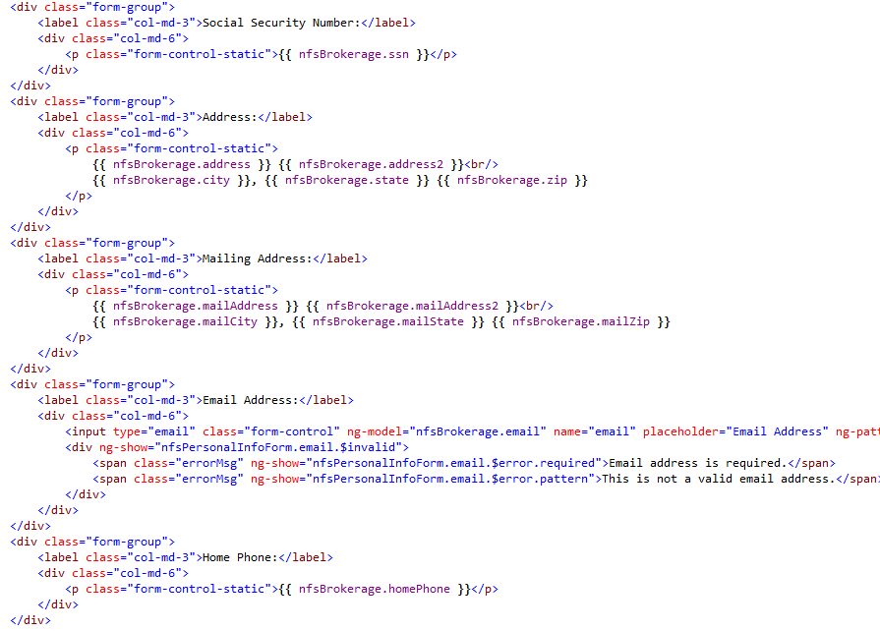
Real World – Step3.html

Slide 32
Constructing Sites – The Big Picture
Modules
Site Mini-SPA’s.
Package functionality for sharing.
Controllers
Handle routes (base page controllers).
Page components (sections on a page)
Nest with ng-include
Or with ui-router parent/child
Services
Server interaction (REST)
Business logic
State shared between more than one controller
Directives
When html and ng doesn’t what you want it to do.

Slide 33
If your Web Application were a house…
ASP.NET MVC
Modern House – Locking doors, nice furniture.
No appliances or adjustable furniture – Futon? Forget about it!
ASP.NET MVC w/ jQuery
Modern House – Locking doors, nice furniture.
Lots of hi-tech appliances
That break often and require a manual.
NodeJS w/ AngularJS
Beach cabana – easy to set up. Cool place.
Lots of hi-tech appliances – 65” Ultra HD TV
ASP.NET w/ AngularJS
Modern House – Locking doors, nice furniture.
Lots of hi-tech appliances – 65” Ultra HD TV

Slide 34
AngularJS – When/how to start?
Right now
Starting a new project.
Mid-project.
Legacy project.
Not all or nothing.
Pragmatic decisions
How much? 1 page? 1 section? Entire site?
Views
Where to use Razor (if at all)
Data
Bootstrapped through MVC
Retrieved via WebAPI (preferred)
Routing
Where to use C# MVC routing
Where to use AngularJS routing
Client side code
jQuery/AngularJS/Other/Mix

Slide 35
The Big Picture - Conclusion
Construct your site into bite size “components” that makes sense to you.
Questions?

