Slide 1
AngularJS
For the .NET MVC Developer

Slide 2

Ryan Langton @rlangton76

Slide 3
Session Overview
What we will cover
Why AngularJS w/ ASP .NET?
Tips/Tricks for Integration w/ ASP.NET.
Demo Site (Products)
https://github.com/ryanlangton/angularjs-mvc
Where to “Draw the Line” (points of confusion)
Razor Views or HTML Templates?
Routing?
Not included
AngularJS 101 ($scope, built-in directives, controllers, services)
AngularJS in-depth
Custom directives or filters

Slide 4
State of the Web
Users expect well behaved applications.
Fast page loads.
Async is the norm.
No UI thread locking.
Client-side code increasing.
Pragmatic decisions are necessary
There is no Silver Bullet.
Server vs Client code.
Data management (when? how?)

Slide 5
Layered Architecture (Top-Down)
UI
Business
Data
Layers reference down.
NEVER reference up.
Loosely coupled.
Maintainable.

Slide 6
Example technology Stacks
Razor Views
ASP.NET Controllers
Entity Framework
Business Logic (C#)
Razor Views/Templates
ASP.NET Controllers
Entity Framework
AngularJS
Business Logic (C#)
jQuery
jQuery:
$(‘#frmRegister’).submit();
AngularJS: <button ng-click=“submit()” />

Slide 7
Why AngularJS?
Framework for writing structured, top-down client-side code.
Two way data-binding.
Easy async server communication.
Custom directives/libraries.
AngularUI (http://angular-ui.github.io/)
Testable client side code (IoC built in)
You can now write Clean Code (client side)!

Slide 8
Why ASP.NET?
Best of Class Server Side technology.
Excellent security.
Secure by default (particularly VS 2012+)
Highly configurable (web.config, machine.config)
ASP.NET Security Secrets revealed – Troy Hunt, pluralsite.com
Web API – easy way to build RESTful API’s.
Power of 3rd party libraries (ORM’s, IoC, Testing, etc) – Nuget
.NET Shop
Where does ASP.NET MVC fit in?

Slide 9
Products-MVC
CODE DEMO
MVC Products List and Detail
No dynamic behavior
Users
Consumer – Role: User
Admin – Role: Admin
Notes:
Introduce the site
ProductMvcController
Demo [Authorize]
ProductMvc Views (Index and Detail)

Slide 10
The AngularJS Way
Never manipulate the DOM directly.
Only manipulate your $scope
Write testable code by using services.
Maintain state in AngularJS services.
Organize client-side code into components.

Slide 11
Server vs Client Model
Server Model (ASP.NET MVC w/ Razor)
Model (C#) and View (Razor) are processed to create HTML
Model and View are “dead” to the client after initial load.
Manipulate the DOM to update HTML (jQuery)
jQuery.ajax() for async server communications.
Razor and JavaScript code mixed concern (both change the HTML).
Client Model (ASP.NET MVC w/ AngularJS)
Server Model (C#) transferred to Client Model (JavaScript).
Model “lives” in client ($scope).
Modify values on $scope (HTML updates client-side)
$http (or $resource) for async server communications.
Always working with the $scope for building/modifying HTML.

Slide 12
Mini SPA – single MVC page
Choose a single page for AngularJS (Products Detail)
Add a module - <div ng-app=“myModule” />
Add a controller - <div ng-controller=“myController” />
ASP.NET MVC renders the HTML w/ AngularJS syntax.
Server Model -> Client Model, using @Html.Raw(Model)
Using ng-init.
In AngularJS Controller
In AngularJS Service

Slide 13
Products-AngularJS
CODE DEMO
Products List - MVC
Products Detail – AngularJS
Dynamic image selection

Slide 14
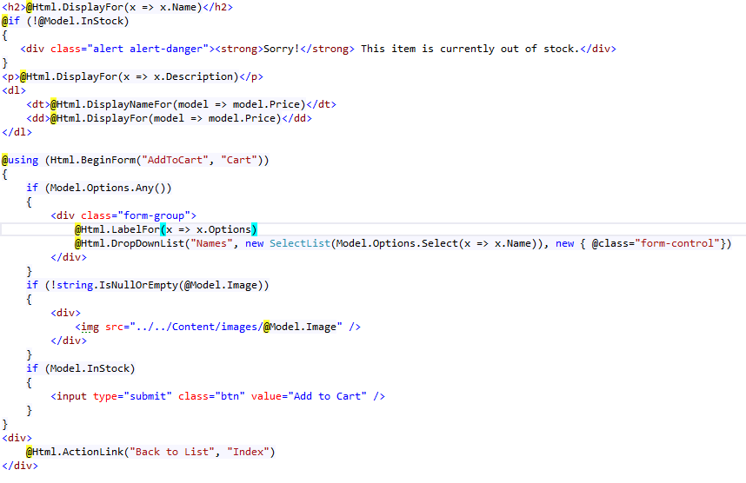
Razor

Slide 15
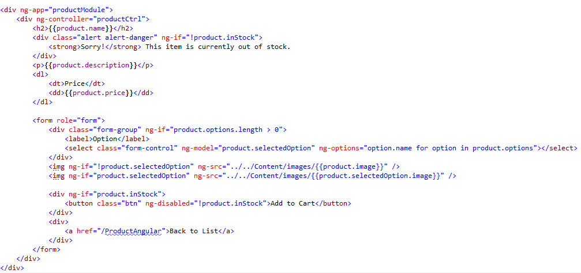
AngularJS

Slide 16
Razor vs AngularJS syntax
Razor
Binds to the Server model.
Only used on initial Page Load.
Does a lot of “magic” to create HTML.
AngularJS
Binds to the Client model.
Lives in the client (if $scope changes, so does your HTML)
It’s just HTML
Easy team handoff.

Slide 17
Mini SPA – single MVC page
Advantages
Low risk.
Isolated to a small area.
Easy to implement (no routing considerations)
Works great on legacy applications (any tech).
Disadvantages
Each page will need it’s own ng-app.
Shared functionality considerations.
Sections of the page outside of ng-app?

Slide 18
Products-Adding a Cart
CODE DEMO

Slide 19
ASP.NET MVC Application
Client Issues an HTTP GET (\Product)
MVC Controller
Receives Request
Data Retrieval (SLOW, error prone)
Combined with Razor View
Client Renders HTML
MVC Controller
Receives HTTP GET, Returns HMTL

Slide 20
Loading Data using WebAPI
1. Synchronous Page Load
2. Asynchronous Data Load
Client Issues an HTTP GET (\Product)
MVC Controller
Receives Request
MVC Controller Returns HTML only (FAST, no errors)
Client Renders HTML
AngularJS Issues an HTTP GET - (\Api\Product\1)
API Controller
Receives Request
API Controller
Retrieves Data (SLOW, error prone)
AngularJS Updates HTML

Slide 21
Products-REST
CODE DEMO
Products List - MVC
Products Detail – AngularJS
Load HTML via MVC controller
Load Data via WebAPI
Dynamic image selection

Slide 22
Routing – MVC and AngularJS
MVC routing for Segmenting your Web app.
Each segment requires it’s own module <div ng-app>
Secure using [Authorize]
AngularJS routing within each Segment.
List/Details. (/Product#/1)
Multistep wizard (/Register#/Step1)
Any time you want a shareable URL (/Product#/Category/HomeGoods)

Slide 23
Routing – MVC and AngularJS
CODE DEMO

Slide 24
Routing – SEO Friendly URLs
Doesn’t work in IE 9 or earlier
Install URL rewrite
http://www.microsoft.com/web/gallery/install.aspx?appid=urlrewrite2
$locationProvider.html5mode(true)
Create MVC catchall routes.

Slide 25
If your Web Application were a house…
ASP.NET MVC
Modern House – Locking doors, nice furniture.
No appliances or adjustable furniture – Futon? Forget about it!
ASP.NET MVC w/ jQuery
Modern House – Locking doors, nice furniture.
Lots of cool appliances
That break often and require a manual.
NodeJS w/ AngularJS
Beach cabana.
Lots of cool, reliable appliances – 65” HD TV
ASP.NET w/ AngularJS
Modern House – Locking doors, nice furniture.
Lots of cool, reliable appliances – 65” HD TV

Slide 26
AngularJS – When/how to start?
Right now
Starting a new project.
Mid-project.
Legacy project.
Not all or nothing.
Pragmatic decisions
How much? 1 page? 1 section? Entire site?
Routing
Where to use C# MVC routing
Where to use AngularJS routing
Data
Bootstrapped in MVC
Retrieved via WebAPI
Views
Razor views or Html templates
Client side code
jQuery/AngularJS/Other/Mix

Slide 27
Q&A

