Slide 1
CLOAKED
Game Design Project

Slide 2
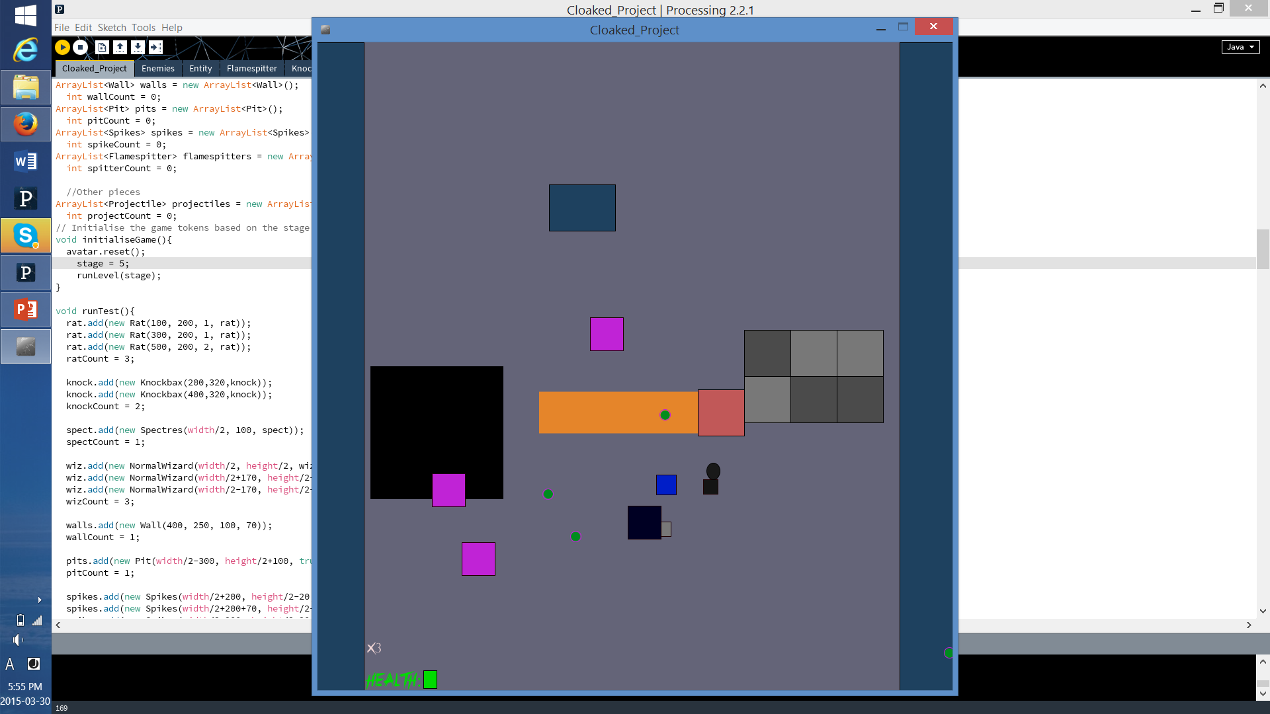
Nice Shapes but what are we looking at?
Game takes place in a dungeon like arena
Imagine yourself, a cloaked figure, who can’t even remember their own name let alone appearance, trapped in a linear dungeon, with no place to go but forward: not even certain if you are escaping or diving deeper.
Original game concept inspired by the theme of claustrophobia.
Why is this relevant you may ask?

Slide 3
Goals: the Player
The player realizes early on that the implicit goal is survival.
The player does not know exactly what lies ahead, but the game seems to suggest going forward is the best option.
Originally, the game’s goal was to be story driven, and so expected to provide a reward of illumination as the levels progressed.

Slide 4
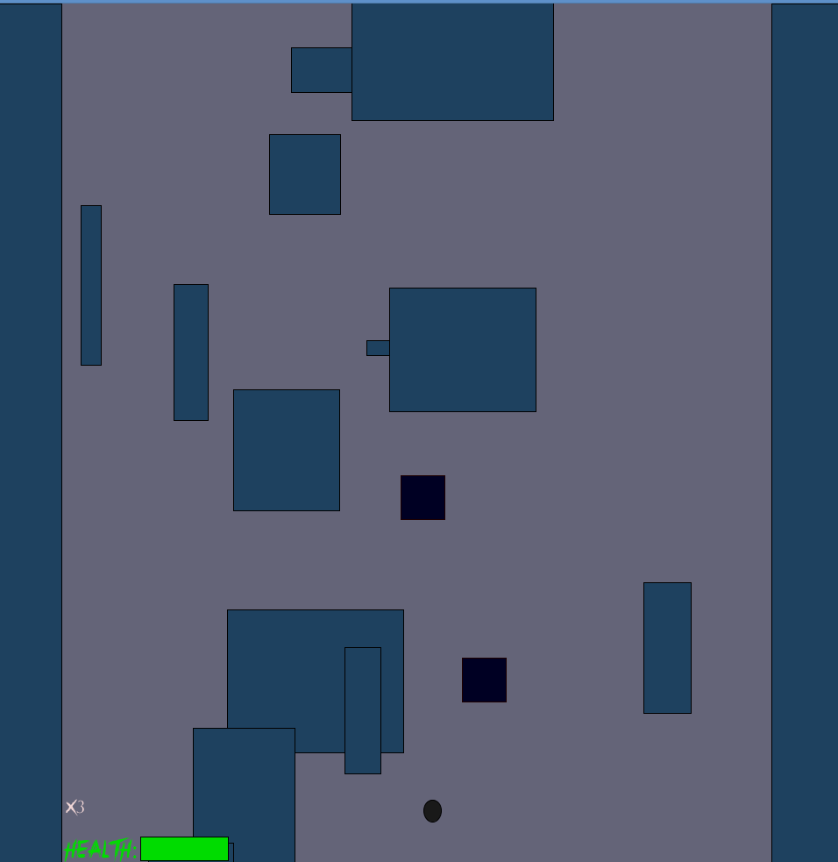
Flexibly Design for Easy Implementation
Pieces based approach
All the pieces interact with one another and behaves independently using the global AI structure.
Result: easy implementation
Opens up many venues for creative level design ideas using automation.
Example: Demo Level 4
Limitations? Game loop events.
Solution? Easy.

Slide 5
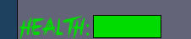
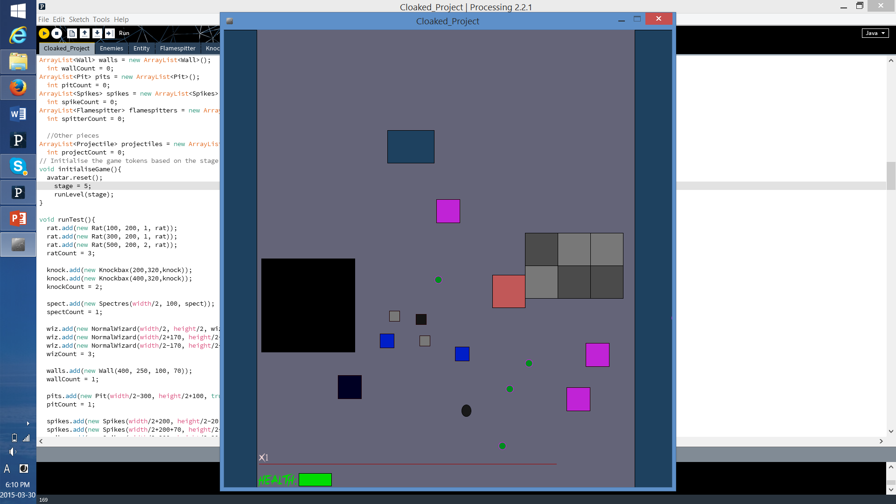
Resource for the player
Health
While the value itself is hidden, the player receives clear information about the state of the characters health.
What about the non-performative?
Cooldown based offense system

Slide 6
Entity Identity
Various traps: spikes, pits, flamethrowers. More potentially to come in later implementations.
Various enemies: Standard dungeon lurkers, from bats to rats and beyond to wizards and spooky Spectres.
Lack of resources currently hinder clarity with regard to these enemies and traps.
This said, the player is quickly made aware that each of these pieces have a unique “identity”.

Slide 7
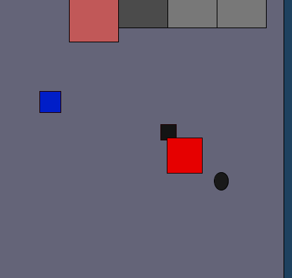
Imperfect but Unfinished
Many design ideas yet to be implemented
More Pieces, more variety
AI Structure: improve on the existing pieces
Balancing and improving overall pace
Aforementioned: walls closing in
The story narrative would also help solve some clarity issues
But first: bug fixes
Major bugs already fixed from: remaining known bug, “enraged spectre” currently left without a fix. It is relatively infrequent and it has been decided that for the purposes of this demo other bugs were a priority.

