Slide 1
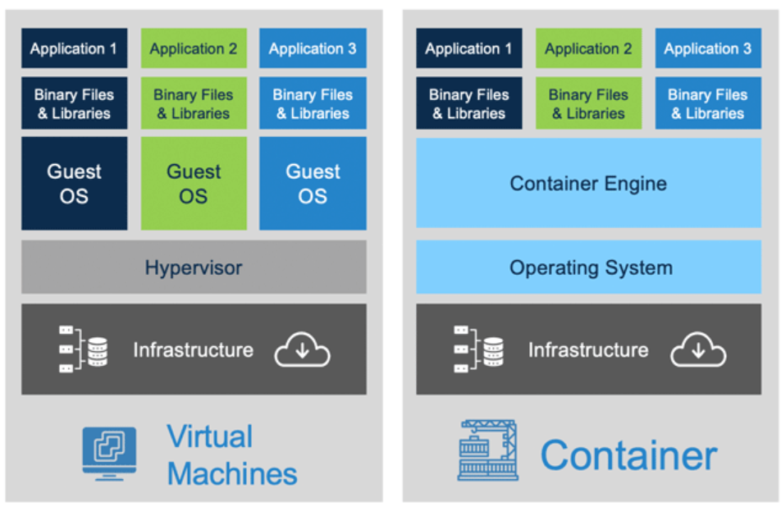
https://i2.wp.com/www.docker.com/blog/wp-content/uploads/Blog.-Are-containers-..VM-Image-1.png?fit=1600%2C680&ssl=1

Slide 2
MySQL (container) Linux
Apache (container)
Linux
MS SQL (container) Windows
Apache (container)
Linux
Linux
MySQL (container) Linux
Docker Linux
Docker Desktop for Window
Linux
Windows 10

Slide 3
internet
Org
Windows
My_cli
ubuntu
DOCKER MySQL
13306<->13306
3306<->13306

