Slide 1
RCS pt pain metric selection
Last updated by Ryan 10/28/22

Slide 2
Determine most behaviorally meaningful binarization of pain metrics
Histograms
Noticed high prevalence of VAS 50s (per patient all VASs equaled 50 in ranging from 0-23% of surveys)
Indicates that patient did not likely move slider
Even if they did, survey does not represent a high or low pain state
Pearson correlations, and histograms w/o ”all VAS 50s” surveys
Unless mentioned otherwise, subsequent analyses exclude these ”all VAS 50s” surveys
See information redundancy between pain metrics
For 1 or 2 metrics, pick extrema of distributions as high and low pain states

Slide 3
RCS02, hereafter

Slide 4
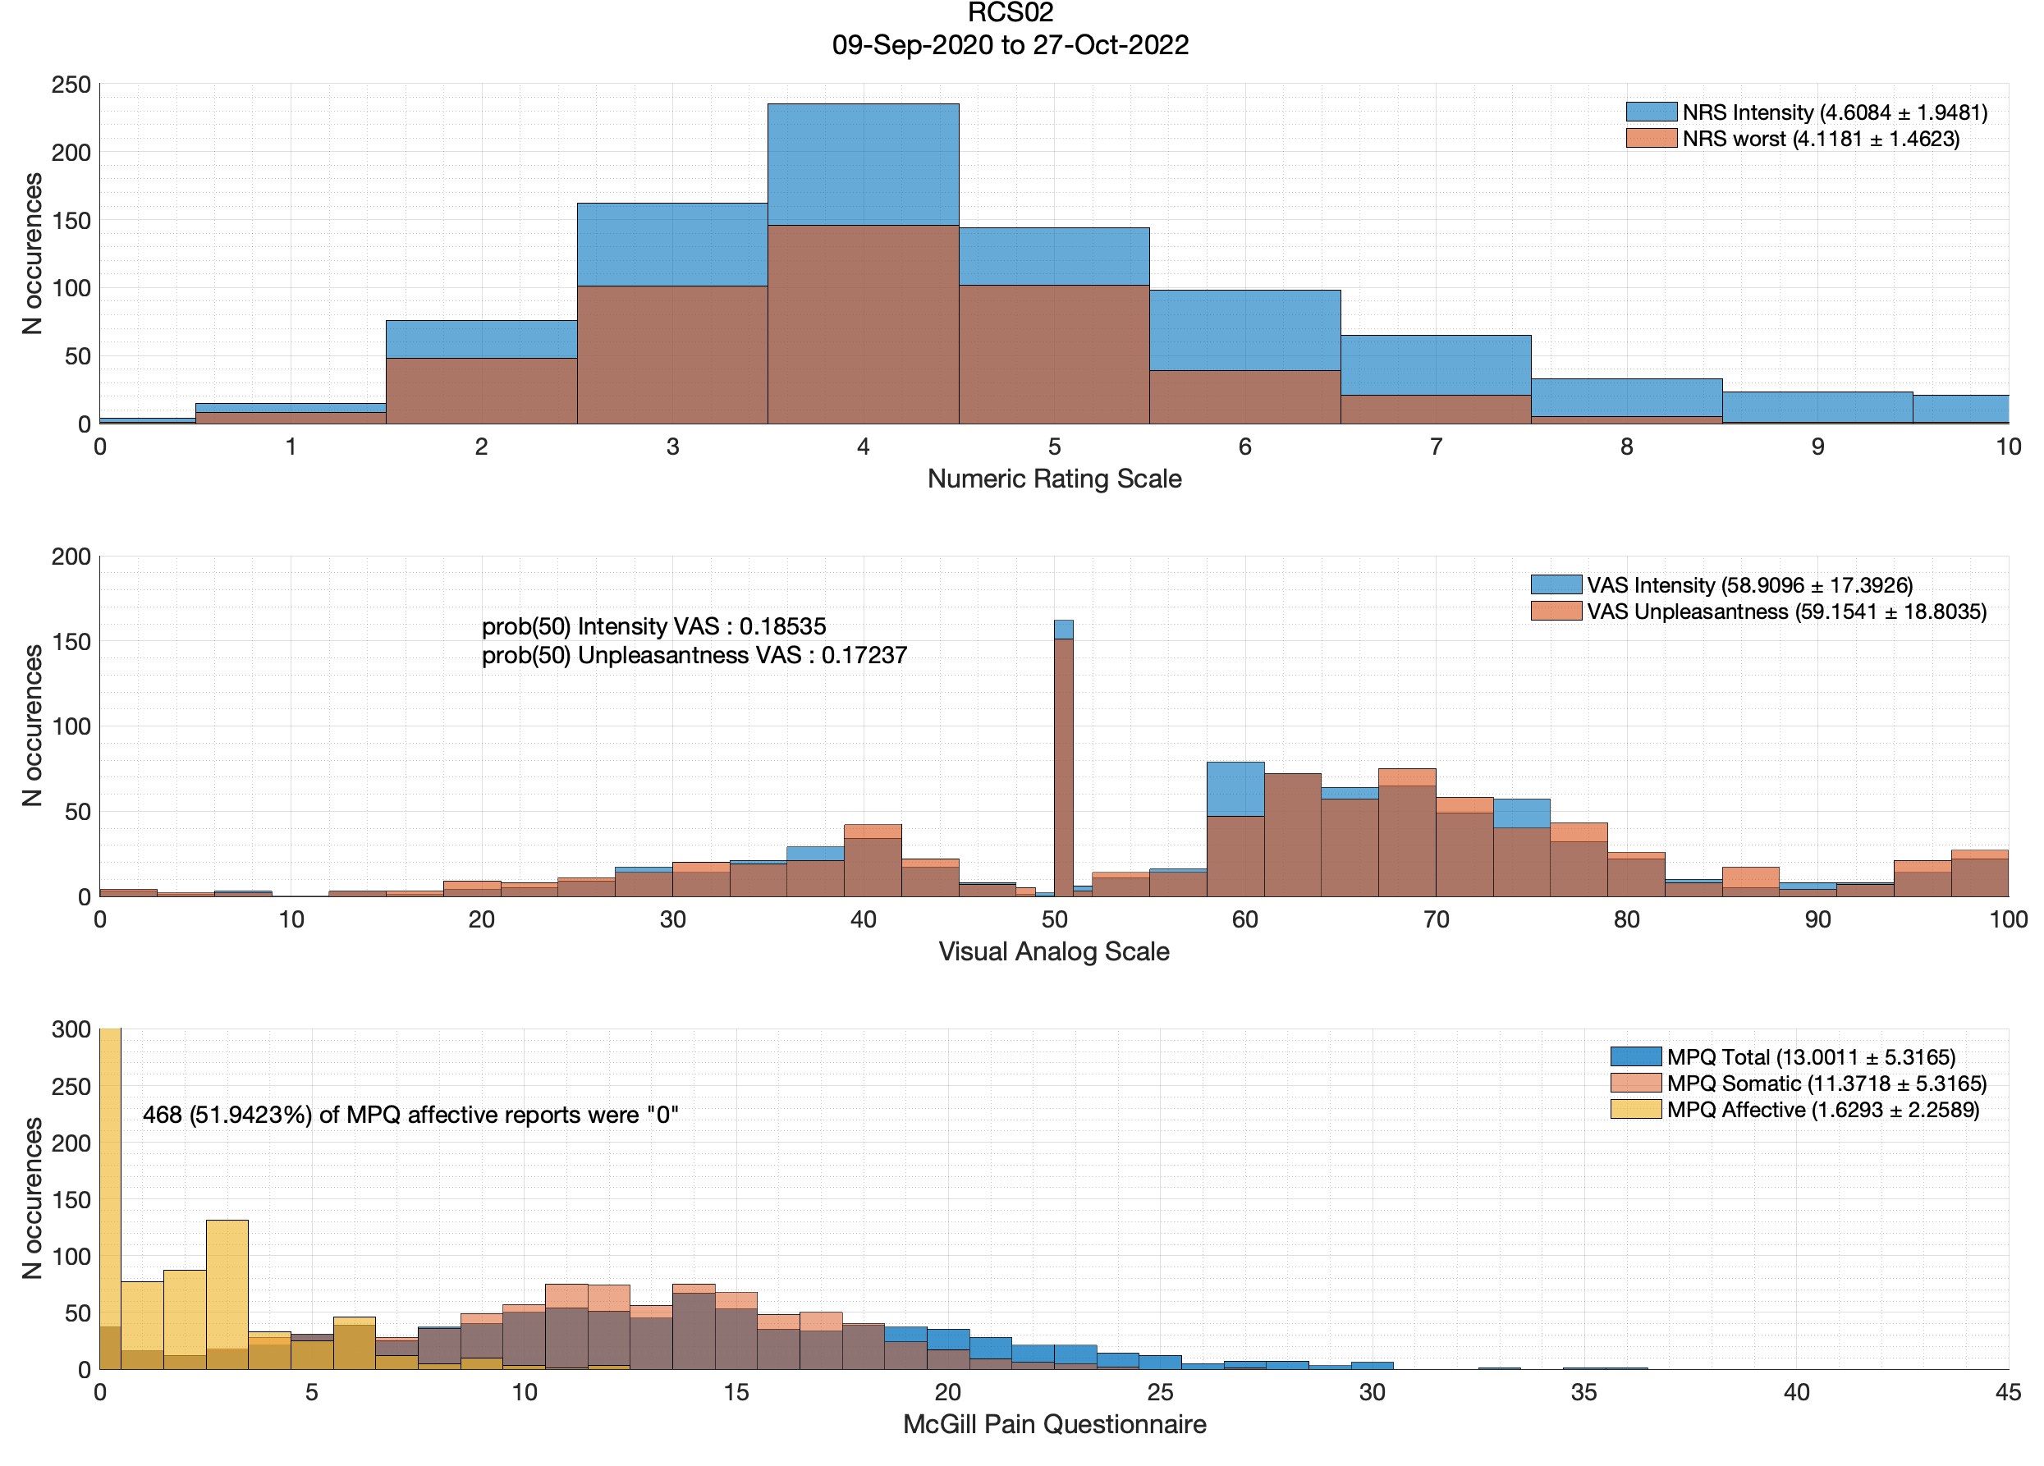
Worst NRS is lower than NRS b/c worst NRS started to be collected later w/n the study

Slide 5
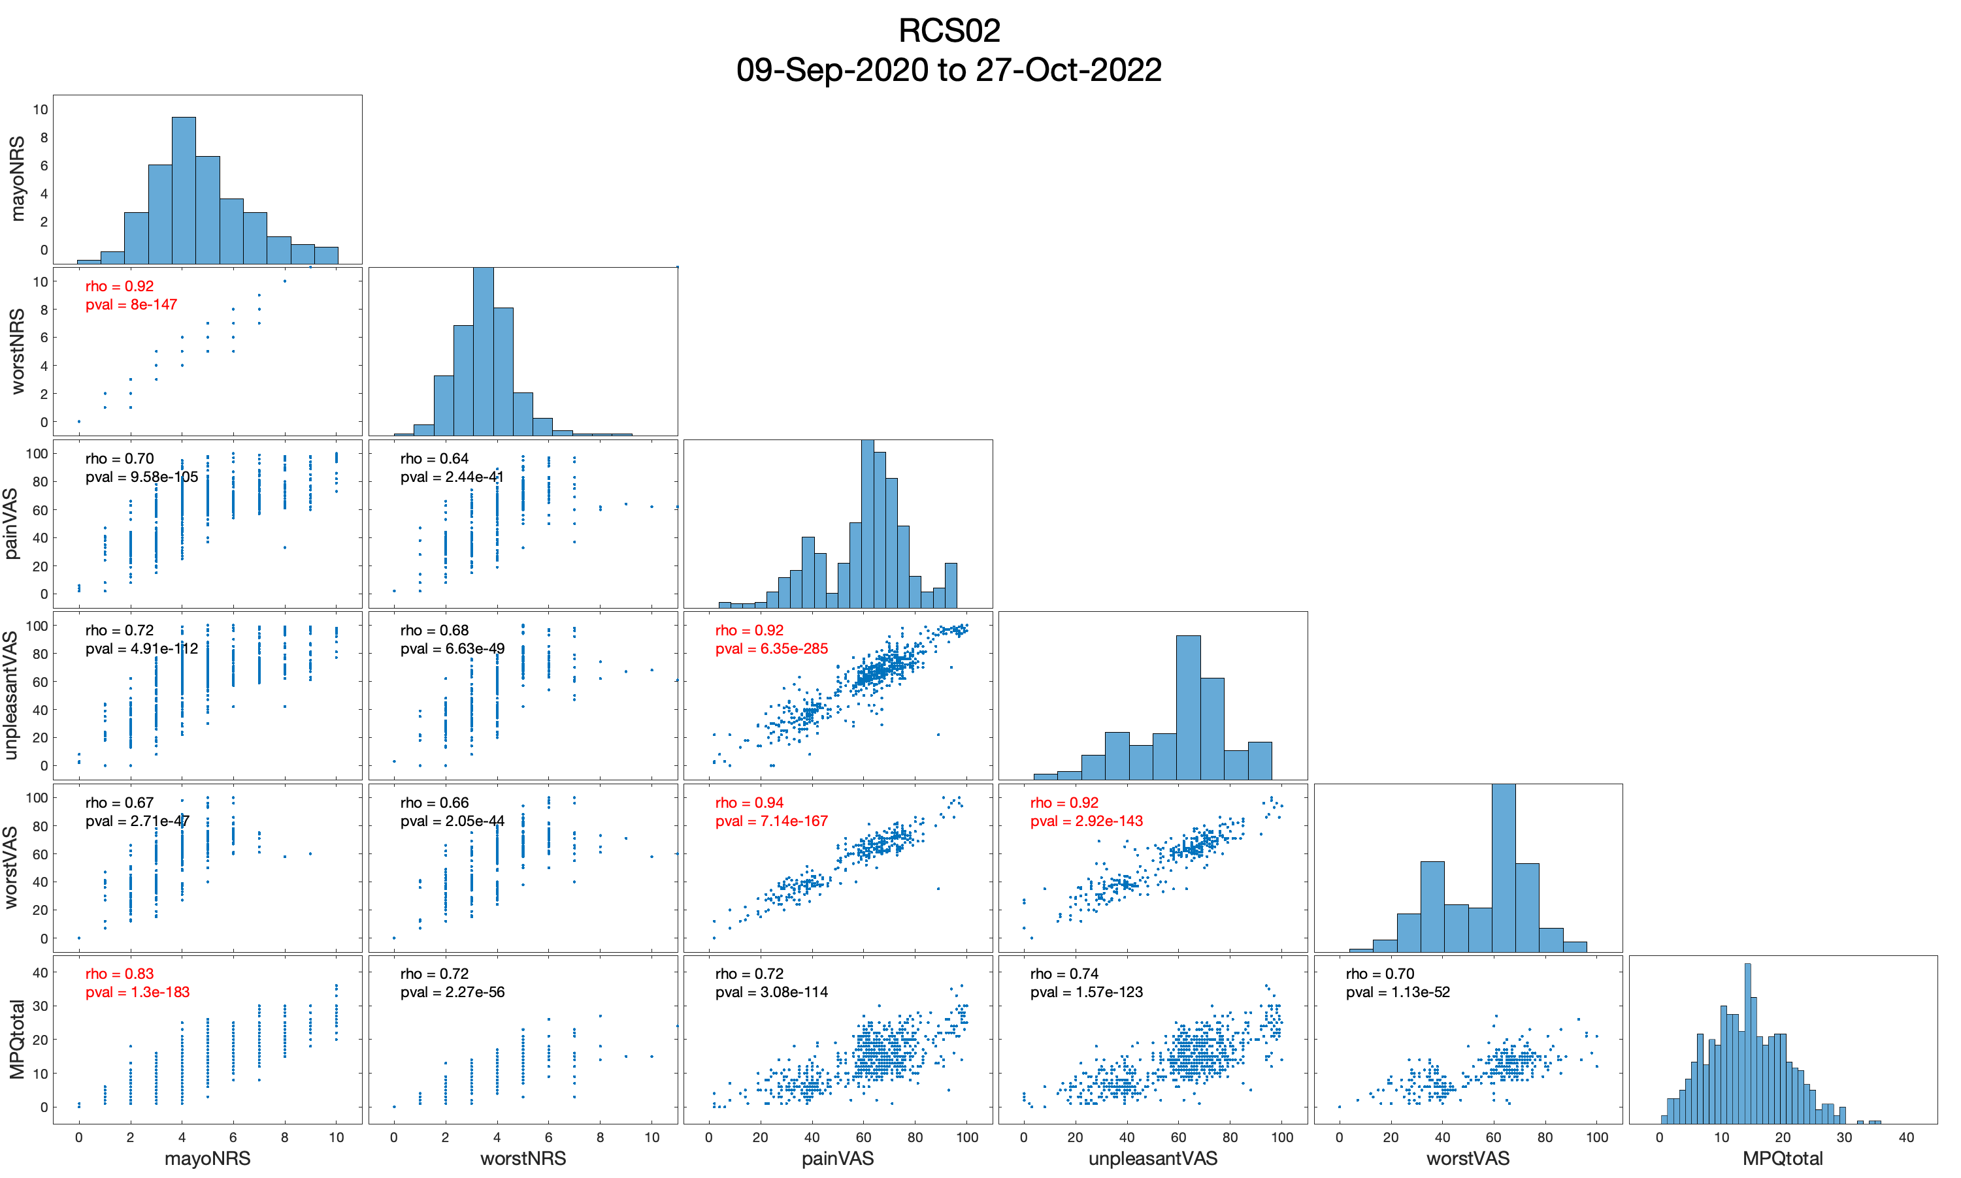
painVAS, unpleasantVAS, and worstVAS provide the same information
mayoNRS (the overall NRS) and worstNRS provide the same information
PS:
worstVAS—most bimodal
MPQ—could be bimodal if 15-17 peak was removed

Slide 6
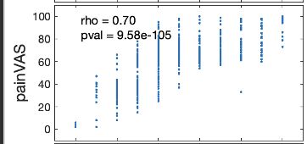

RCS02: VAS and NRS construct validity
Enlarged painVAS versus mayoNRS
Note that NRS ranges from 0-10 and VAS from 0-100.
Look at range of VASs given per each NRS!
NRS of 3 has VASs of 15-70
NRS of 4 has VASs of 20-90
NRS of 5 has VASs of 30-90
Since VAS spans over half of its range per given NRS, this shows poor construct validity compared to other pts.
Similar for unpleasantVAS and worstVAS since the VASs are highly correlated (r >0.9—see last slide)
Perhaps survey reporting overtime can help explain

Slide 7
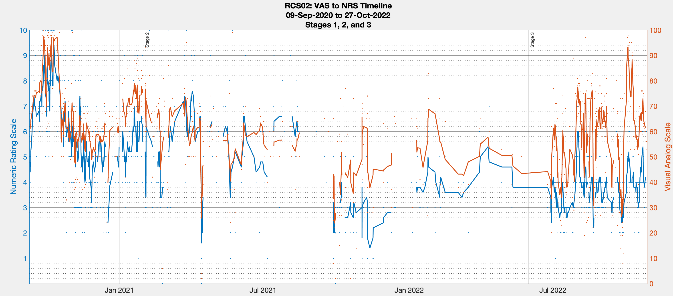
Big question: Is RCS02 in the same amount of pain during a washout in Stage 3 as she was throughout Stage 1?
The VAS shows washout pain to be like Stage 1 pain—look at orange peaks being above 70. While NRS shows washout pain to increase, but not as high as Stage 1—see blue peaks staying below 6.

Slide 8
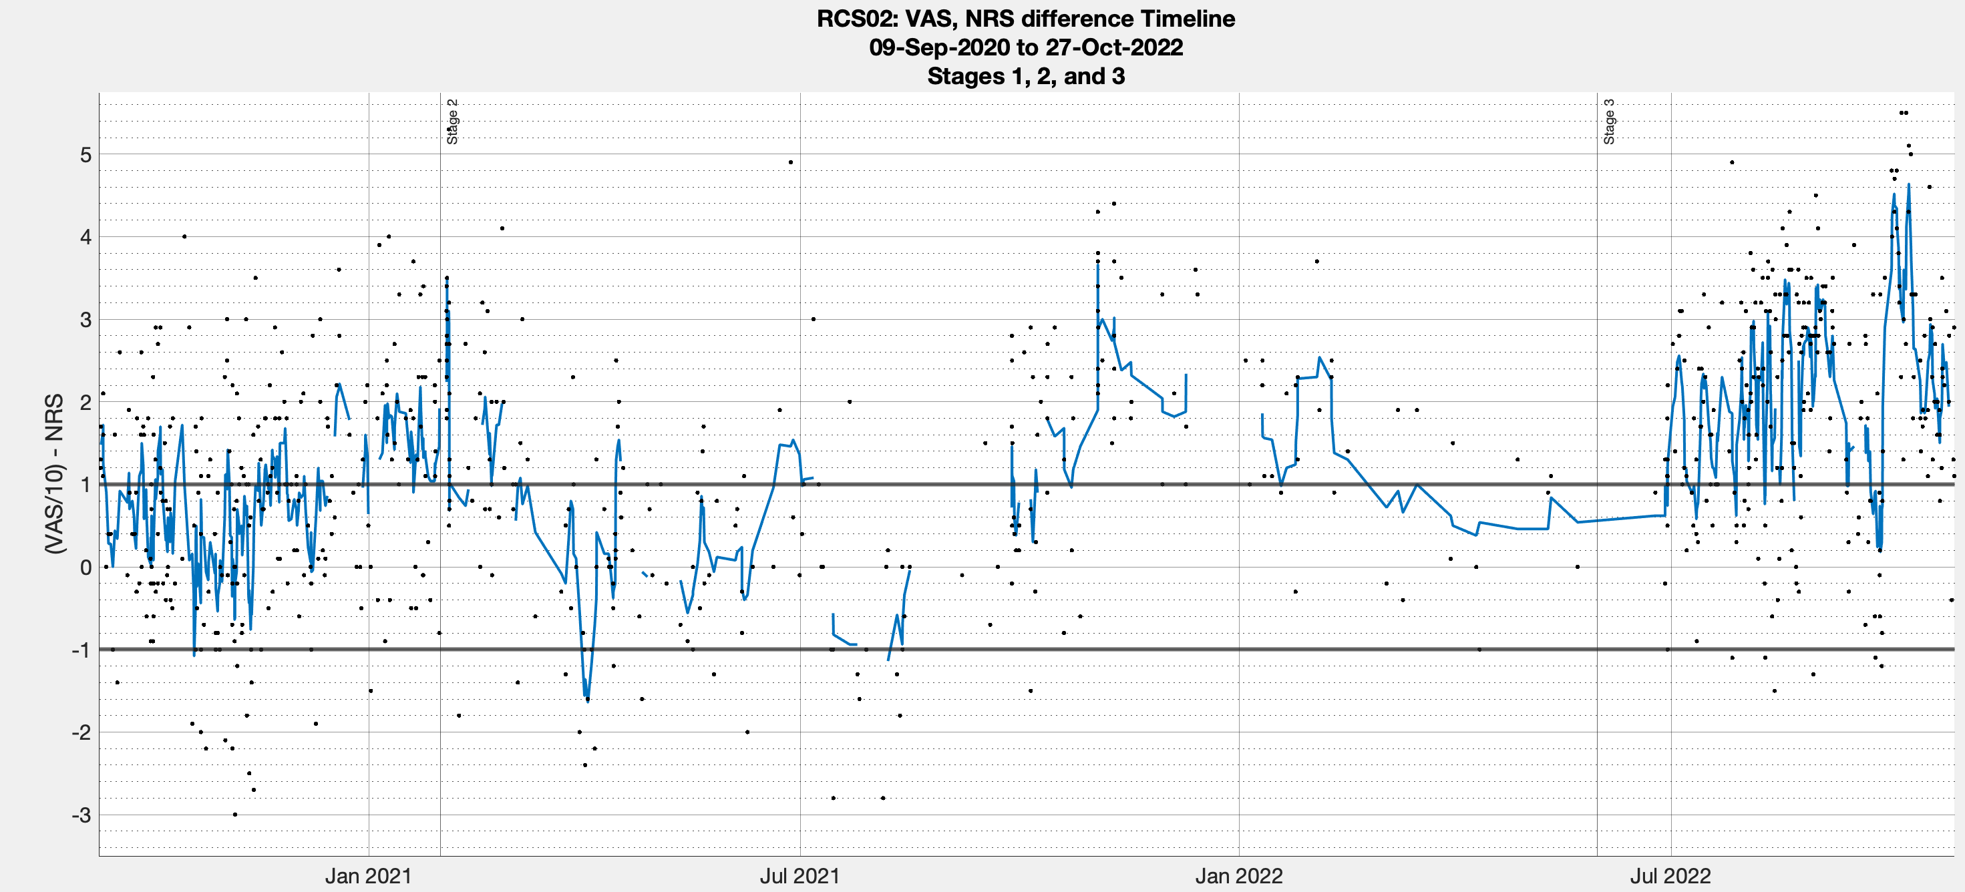
To assess validity, calculate (VAS/10) minus NRS. Division is needed to have VAS go from 0-100 scale to 0-10 scale. The blue line is a five-point moving average centered on the given survey. The black lines at -1 and 1 are numerically where the difference “should” be.
Greater difference between VAS and NRS in Stage 3 than Stage 1—note considerable variation throughout Stages.

Slide 9
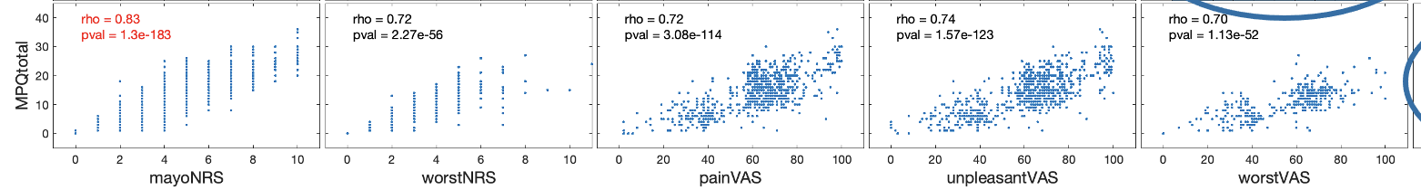
RCS02 pain metric recommendations
The VAS and NRS inconsistencies likely adds noise to our identification of “high pain” and “low pain” states via top/bottom third split of VAS intensity. Given that the MPQ has a stronger relationship with the NRS than VAS—meaning converging evidence from different pain scales—I’d recommend trying a MPQ and NRS split.

Slide 10
RCS04, hereafter

Slide 11
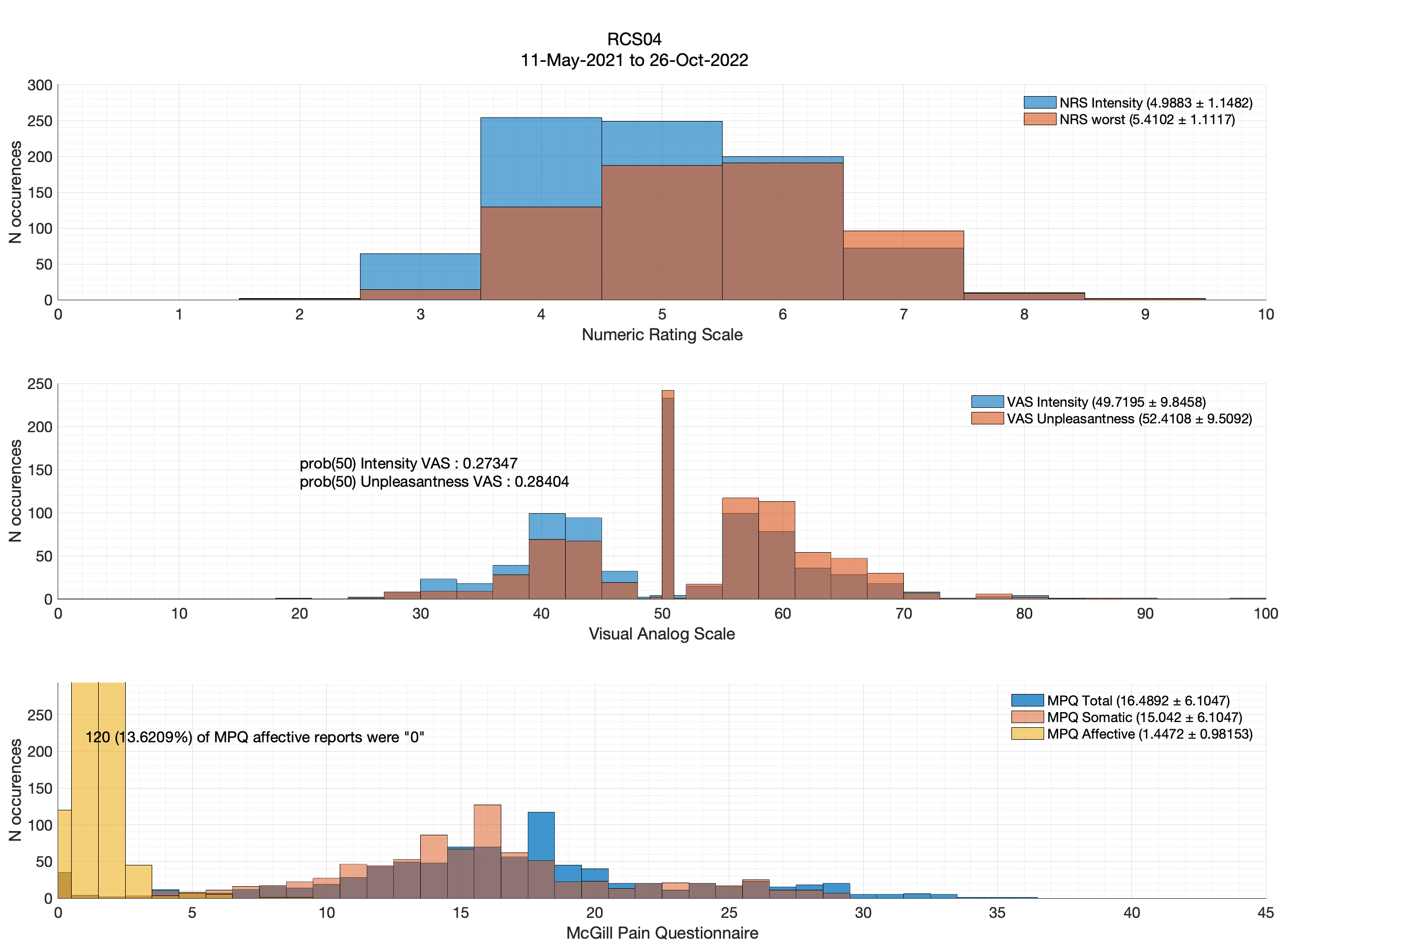
Nearly a third of surveys w/ VAS 50s ☹

Slide 12
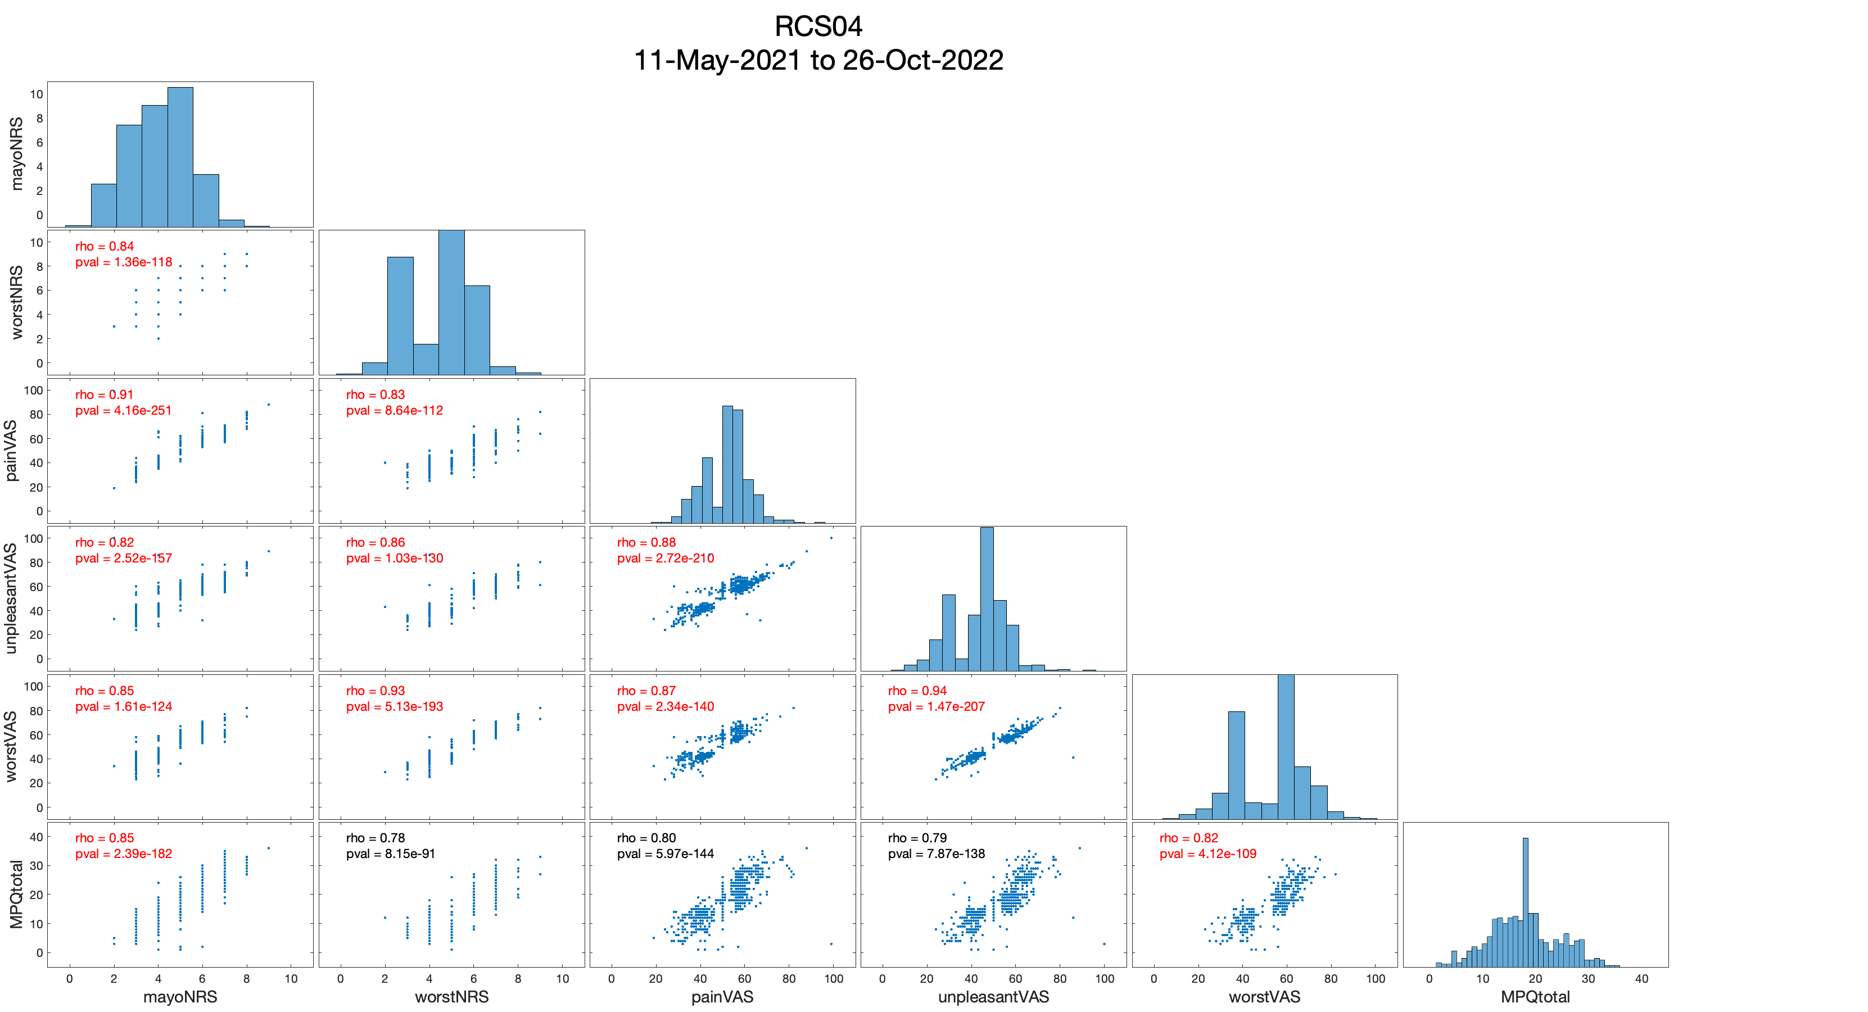
Since NRSs and VASs provide similar information, I recommend VAS pain intensity for simplicity.

Slide 13
RCS05, hereafter

Slide 14
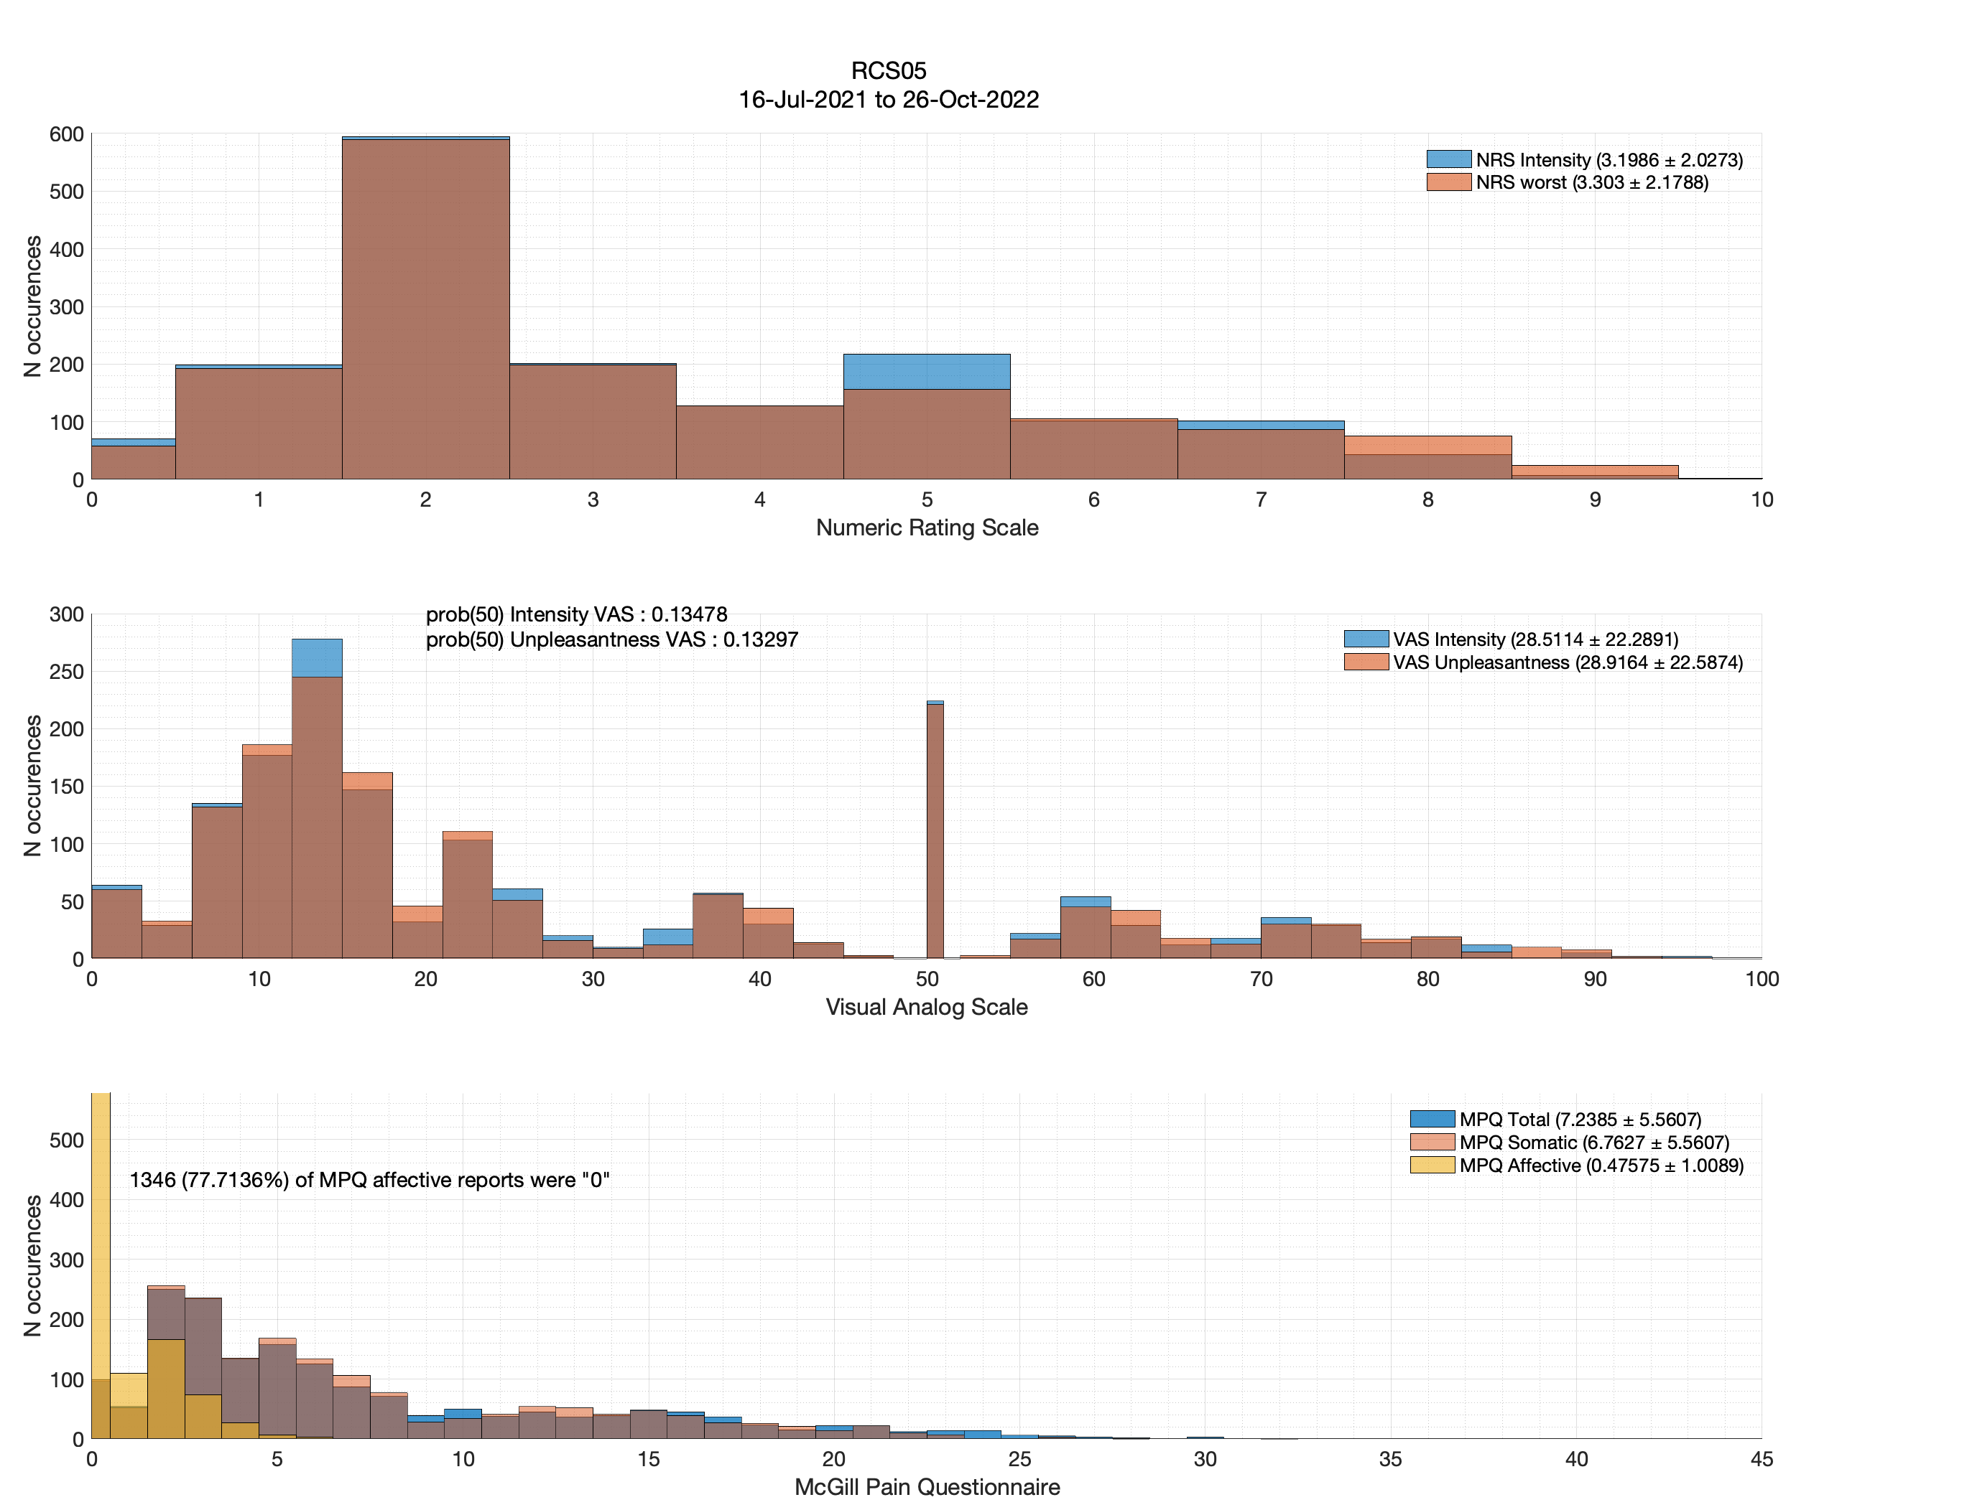
Very few VAS 50s!

Slide 15
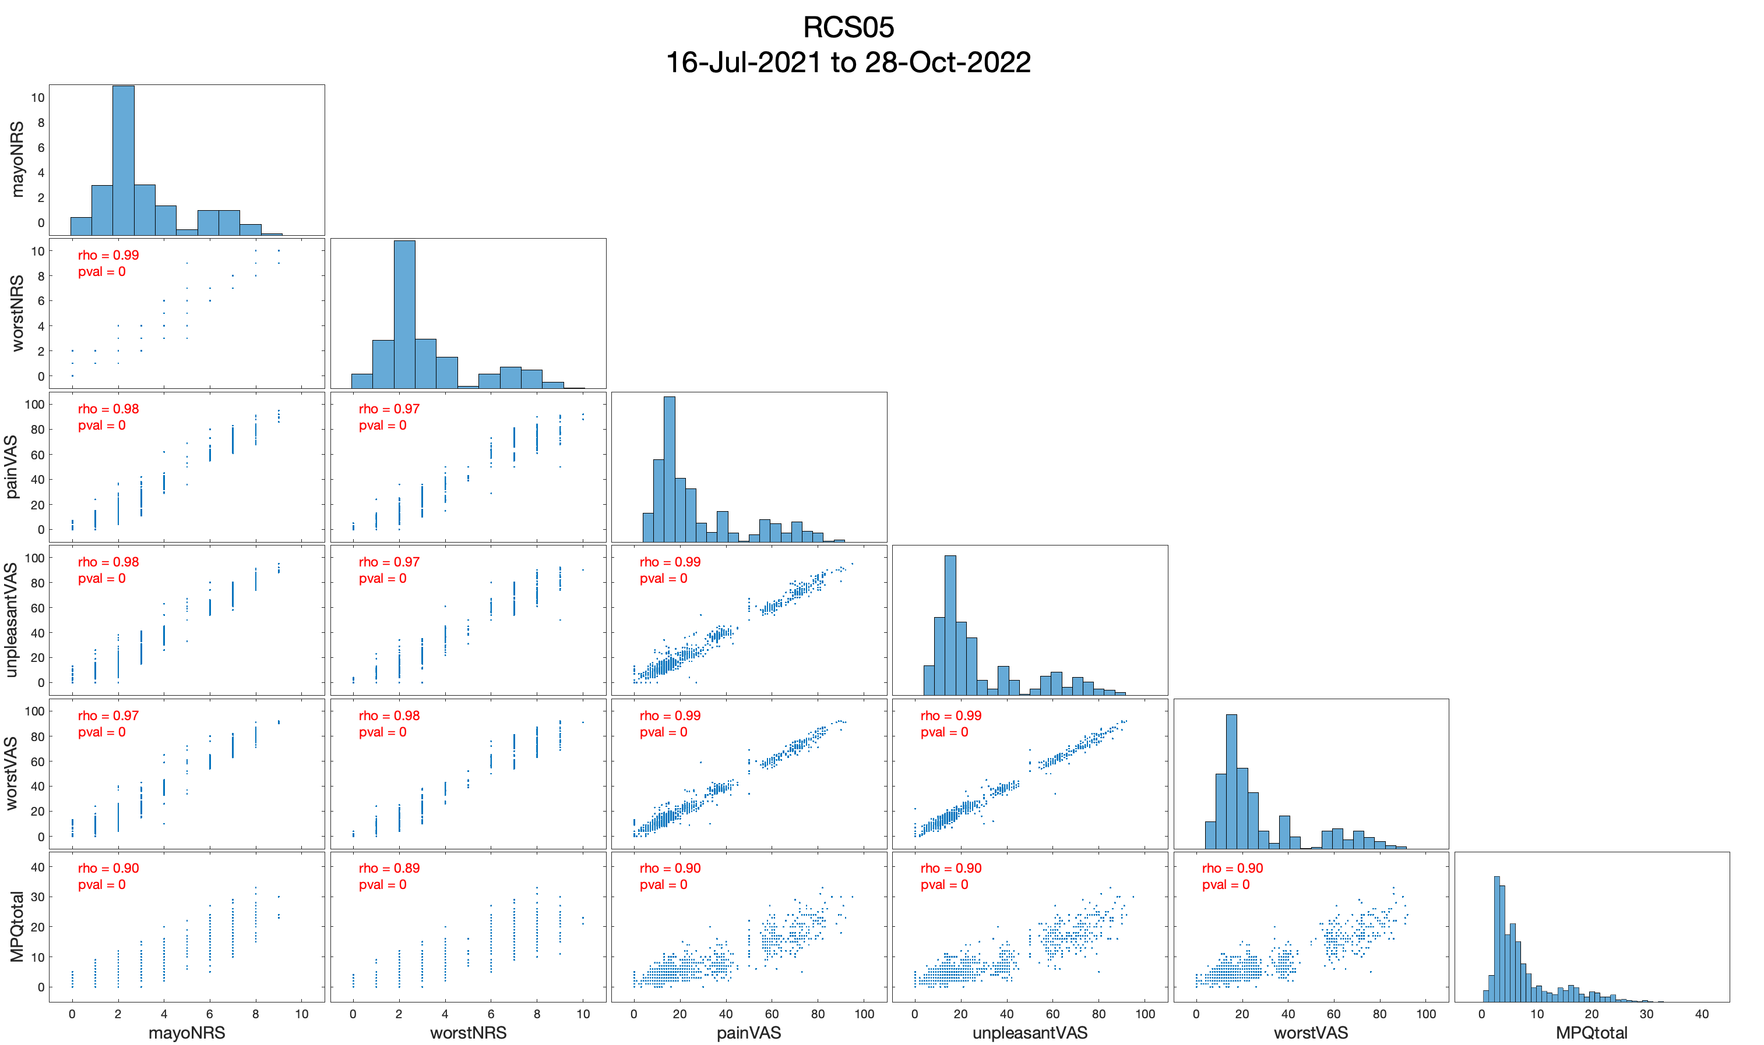
Wow. Every metric contains very similar information.
Use VAS pain intensity for simplicity

Slide 16
RCS06, hereafter

Slide 17
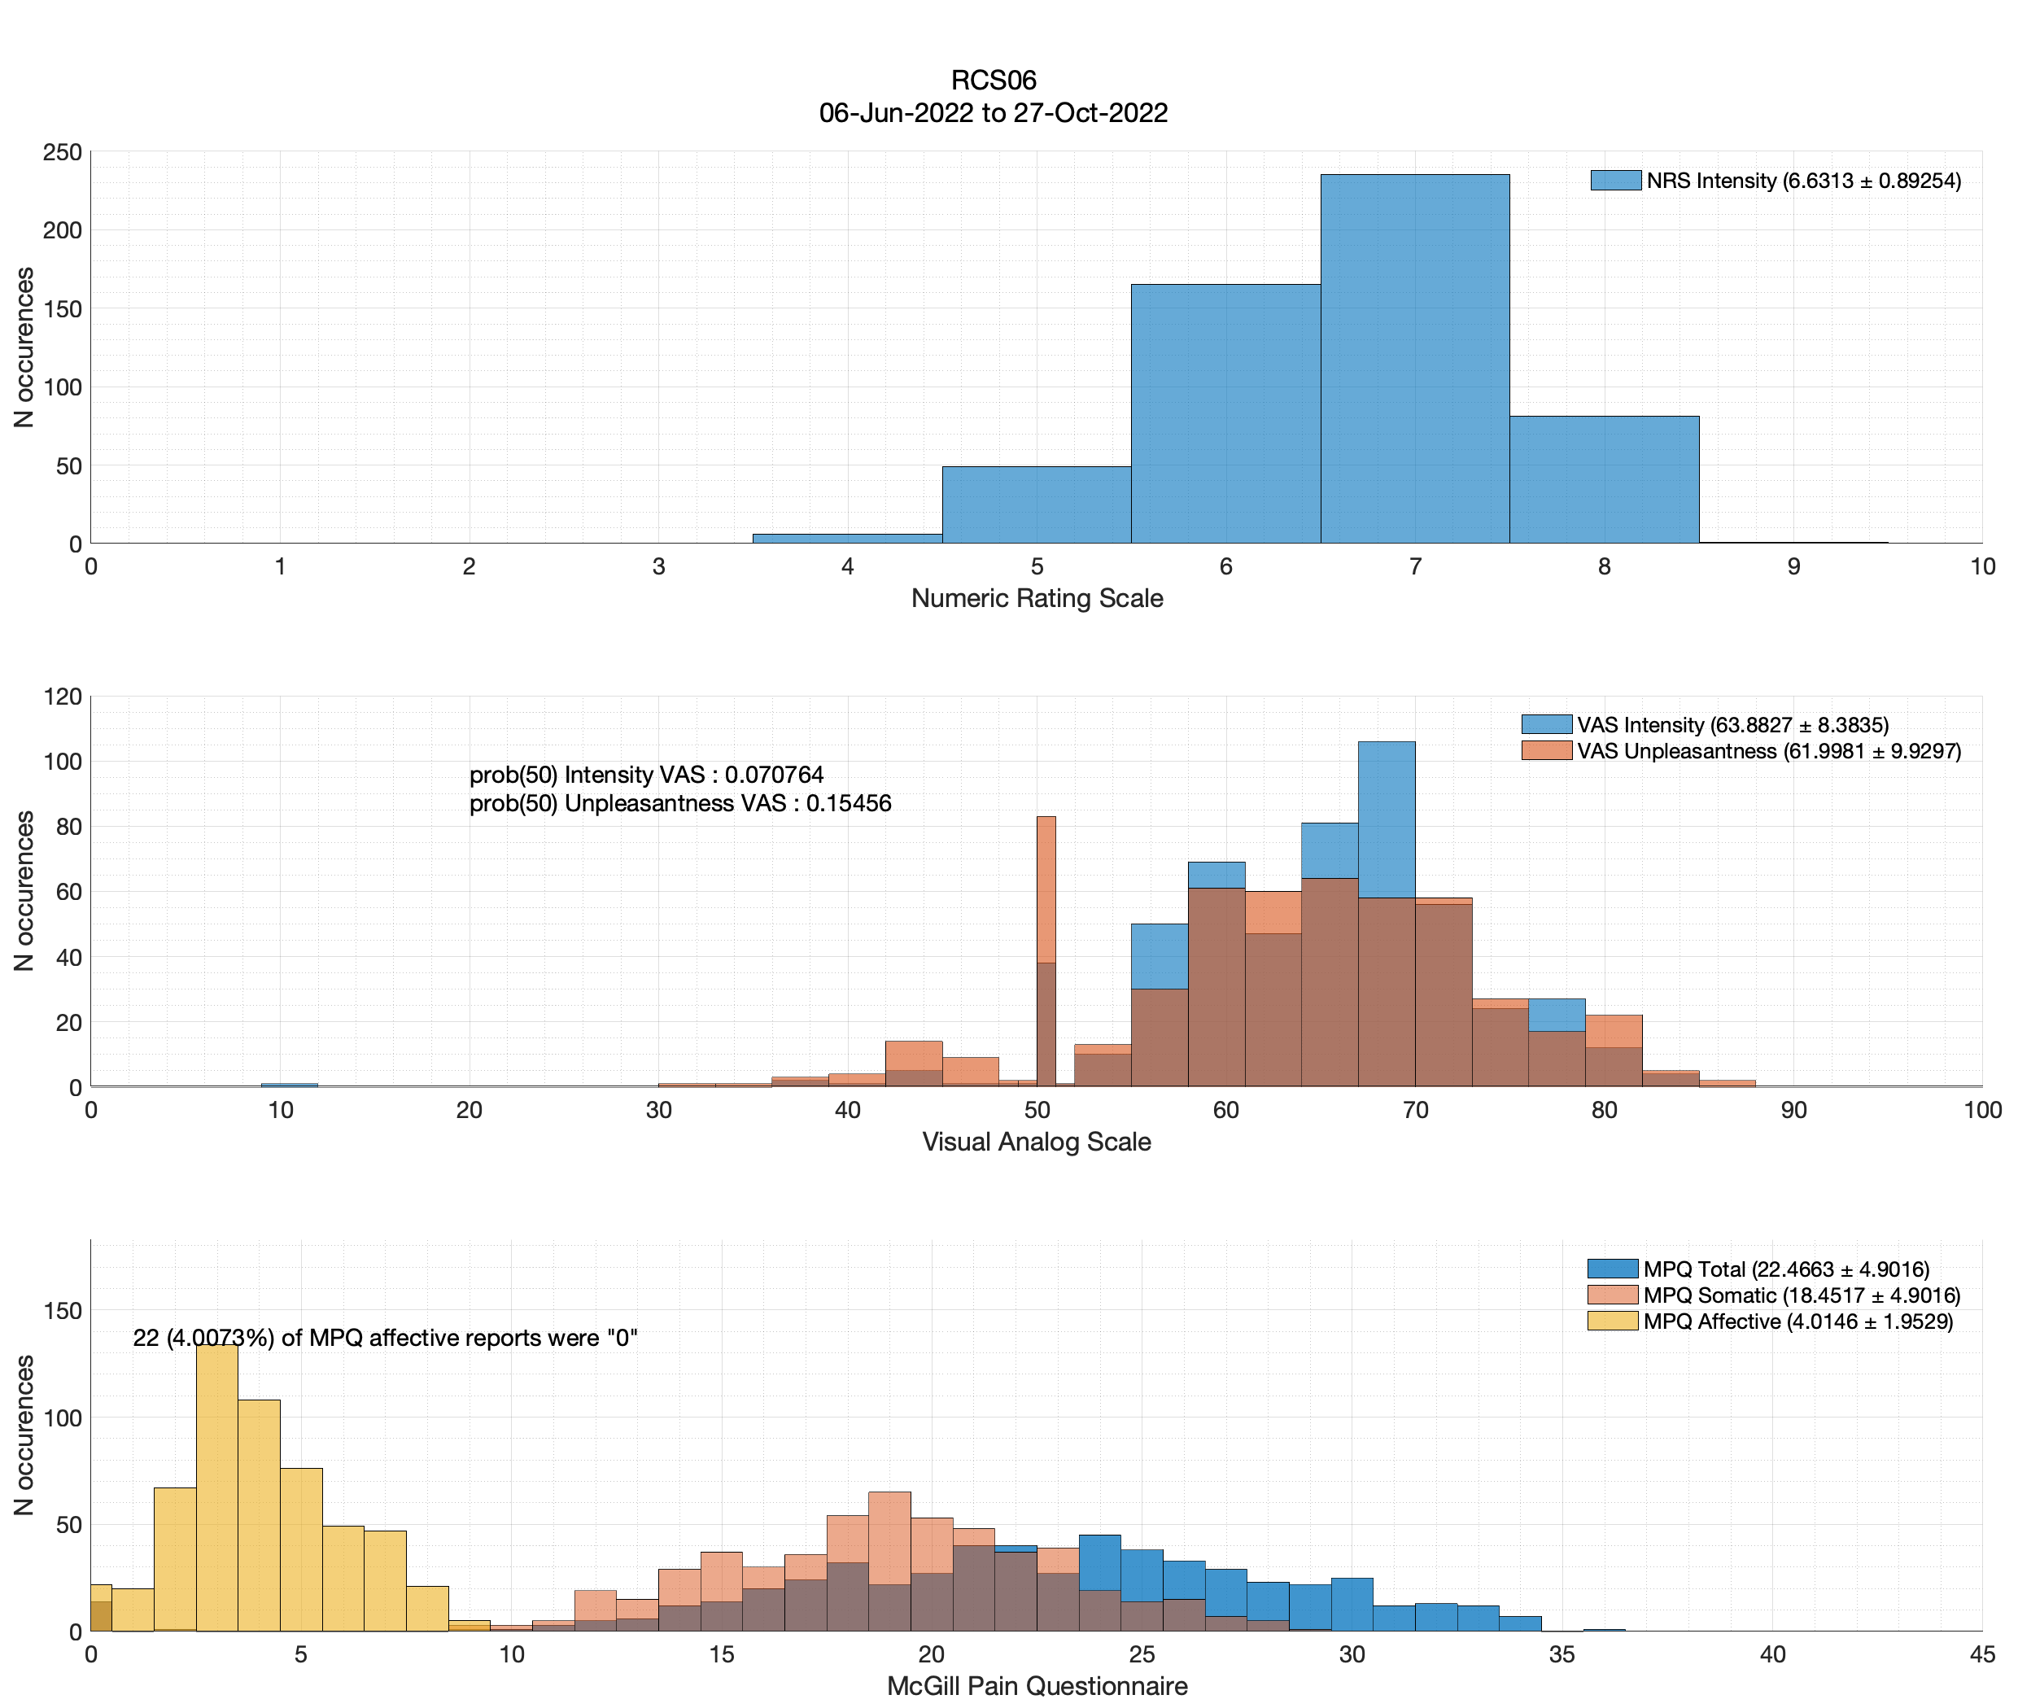

Slide 18
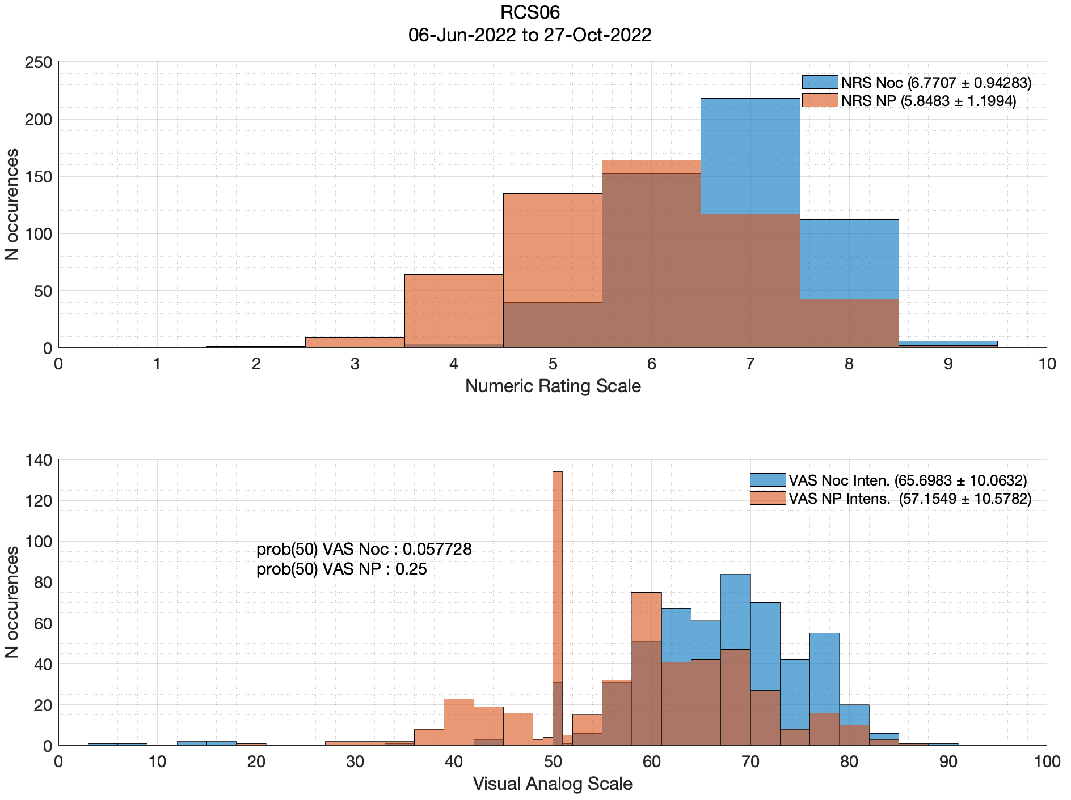
Good to see VAS/NRS showing
neuropathic pain < nociceptive pain

Slide 19
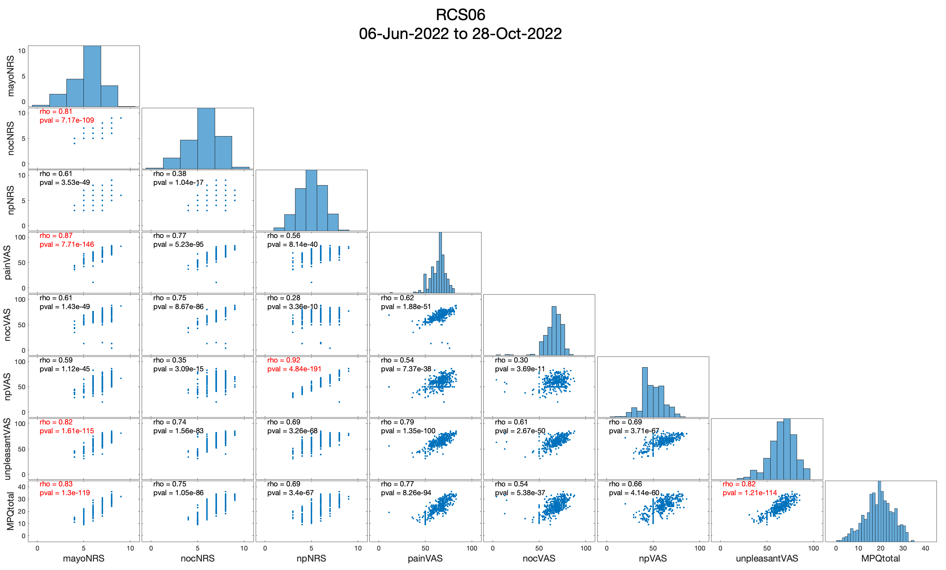
MPQ since it spans the greatest number of values—especially at the lower end

